Slide 1

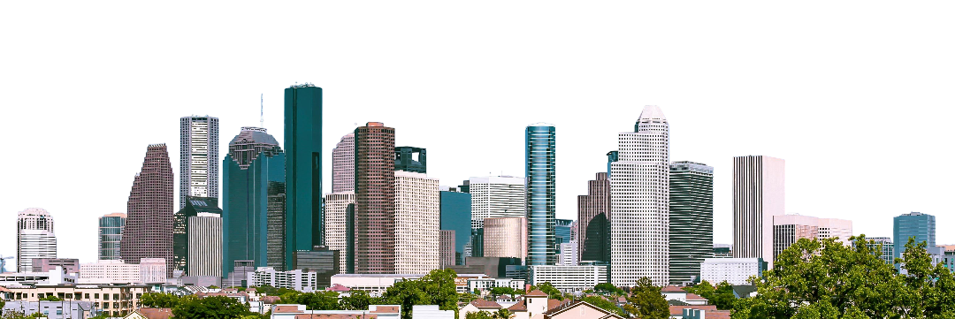
Garay LLC
Houston Law Firm by Alexis Garay
Source: Jason Villanueva

Slide 2
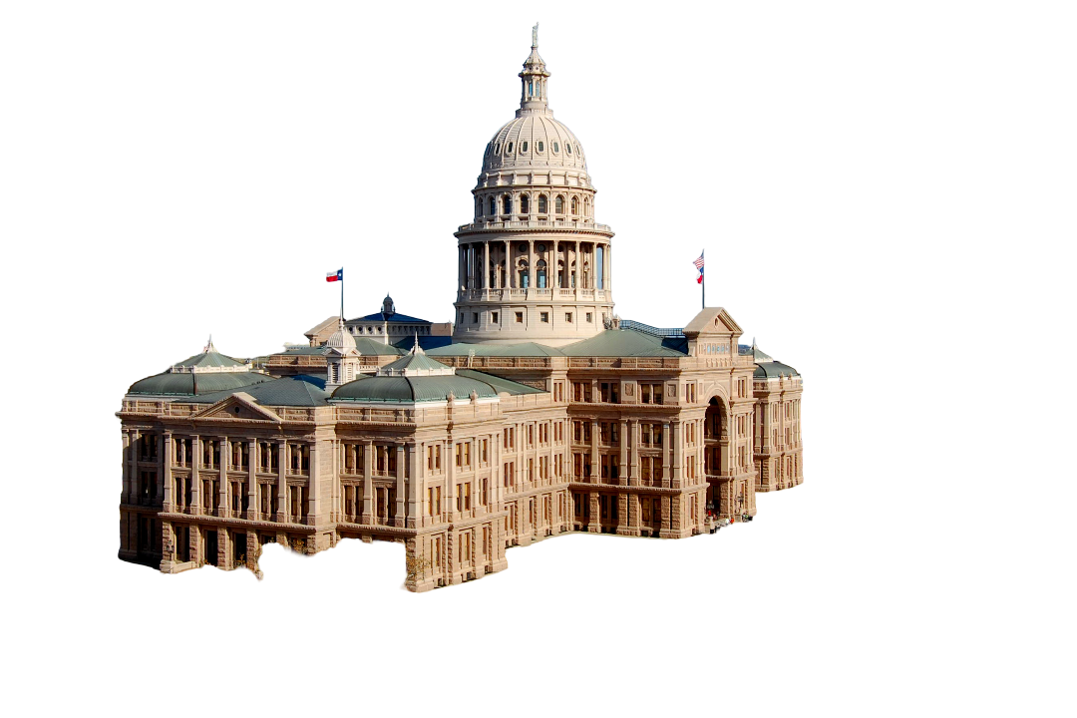
Texas Senate Bill - 2025
“An Act relating to the Texas moving image industry incentive program and the establishment and funding of the Texas moving image industry incentive fund.”
A grant program for production companies that produce movies in Texas
Incentivizes filming in Texas
Source: LoneStarMike

Slide 3
What is Garay LLC?
Law firm located in Houston, Texas
Specializes in Intellectual Property for Creatives
  Examples being:
    Illustrators
      Artists
      Painters
    Performers
      Actors
      Professional Wrestlers
      Musicians
    Directors
      Film and Video
      Social Media Influencers

Slide 4
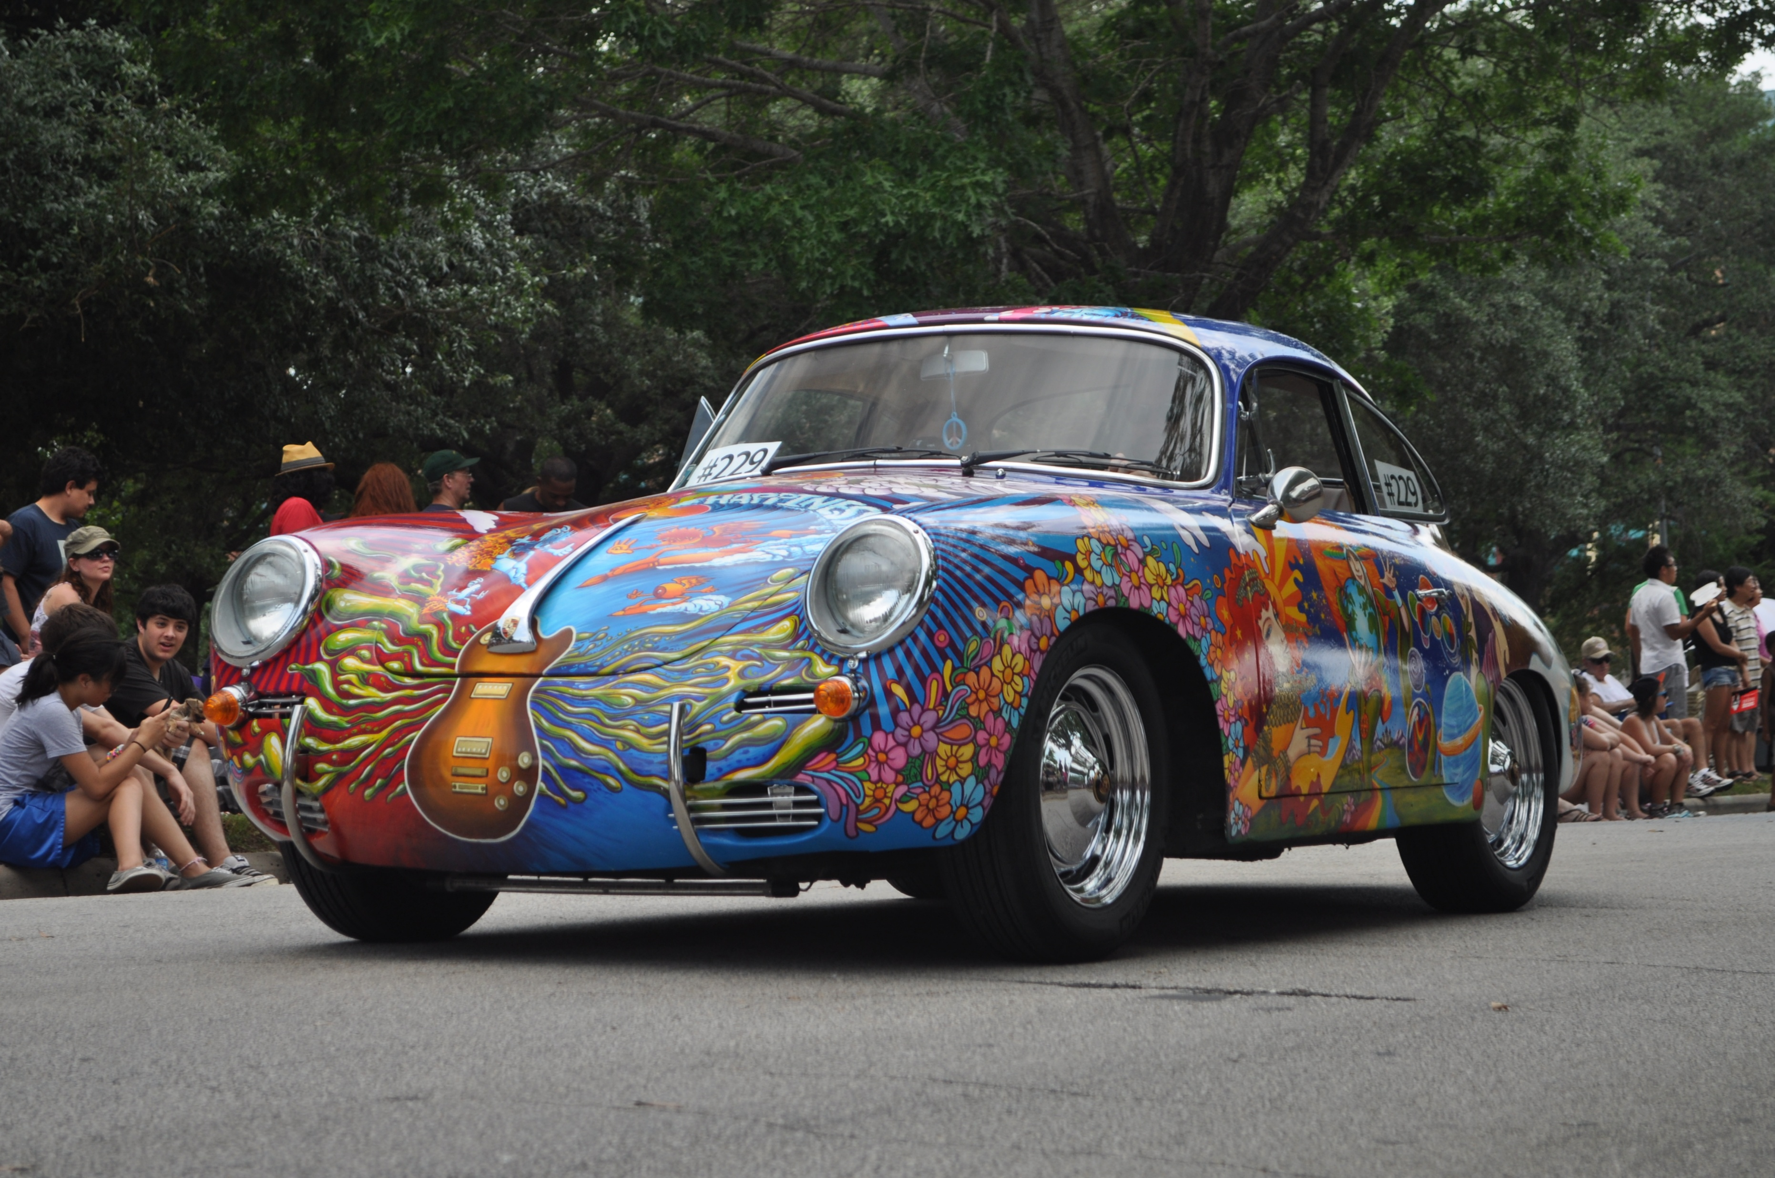
Why Houston?
Population of 2.3 million, 7.8 million when accounting for Greater Houston
Most racially and ethically diverse city in the US
Presence of events such as:
  Houston Livestock Show and Rodeo
  Houston Gay Pride Parade
  Houston Art Car Parade
Locations with strong heritage such as:
  Montrose
  Bellaire
Source: Alex Brogan

Slide 5
Business Model: B2C
Pay-as-you-go:
  Appointments for legal advice
  Civil cases
Advertising:
  Free Seminars and Webinars to inform clients, regardless of career
  Promoting the prospect of having an IP lawyer
  Non-Specific law advice
Potential for B2B as Garay LLC upscales

Slide 6
Framework
Asset-based community development (ABCD)
Can help identify and strengthen the assets already found in Houston, such as diversity
Create partnerships throughout the community to strengthen creatives, through alliances with organizations
Develop resilience from outside variables
Comes from a desire to support and uplift the community of Greater Houston

Slide 7
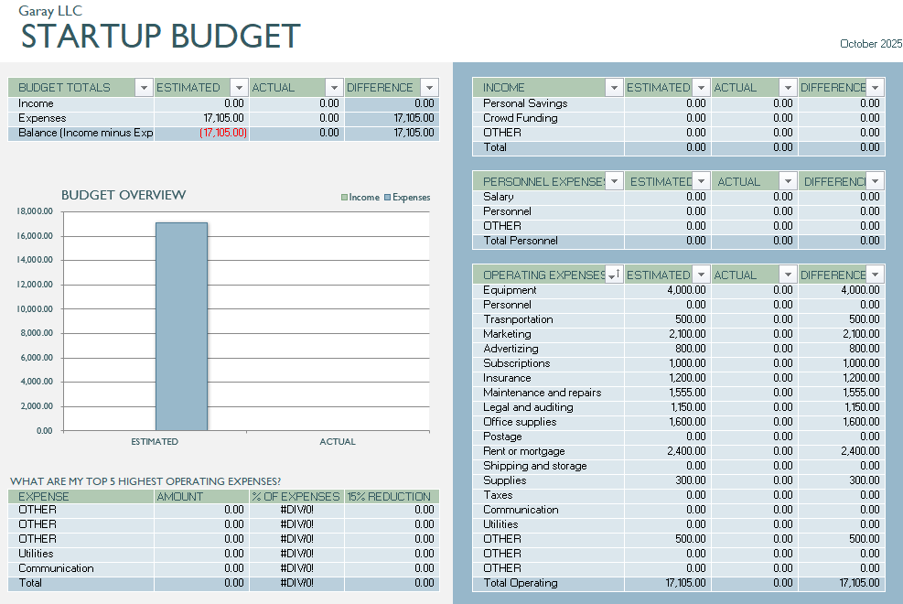
Estimated Budget to Start: $17,105
Notes:
Would require Business Loans and Credit

Slide 8
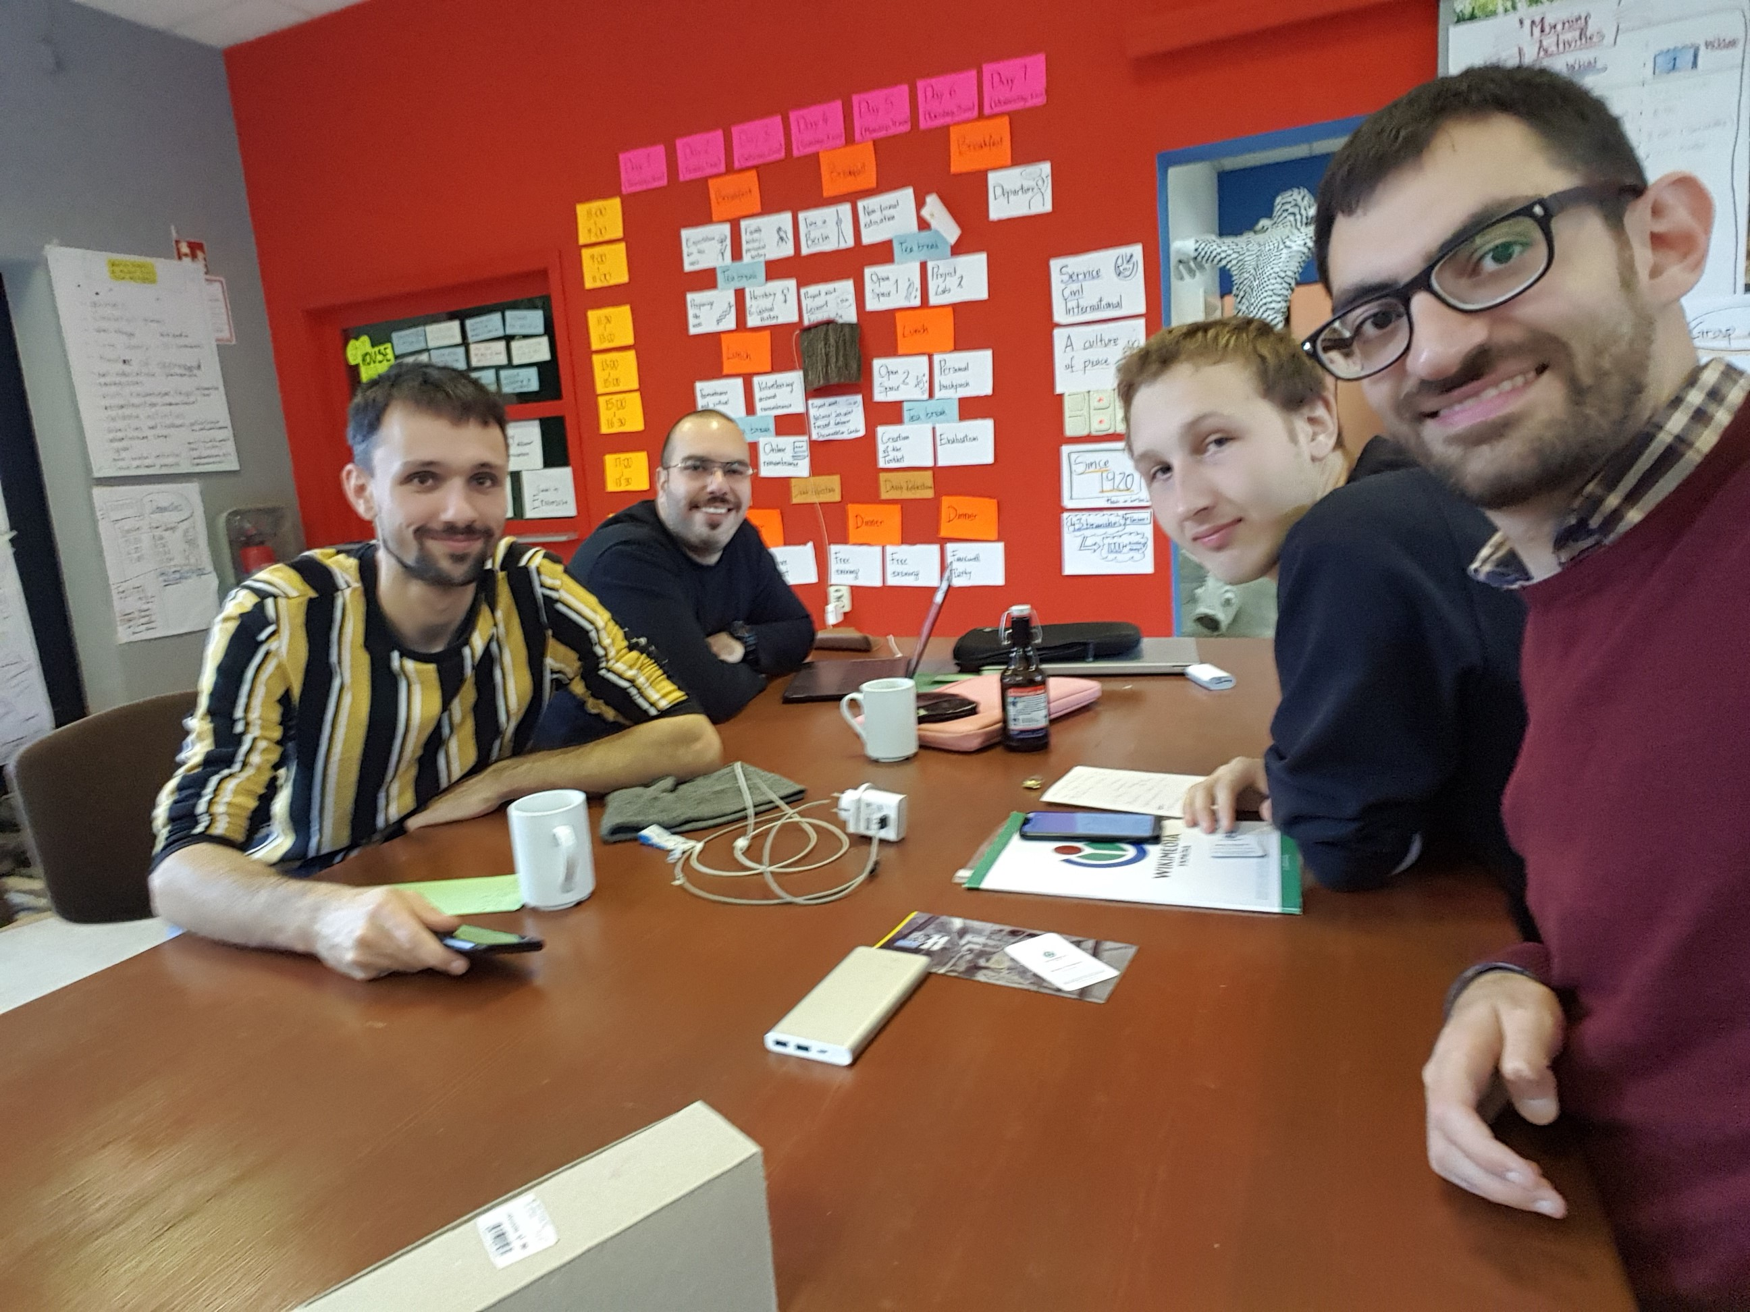
Promotional Activity
Show Up to Creative Events
  Going to Greater Houston Conventions, Art Fairs, Film Festivals, and promoting Garay LLC’s services.
  Begins with a “Garay Everywhere” campaign where I make myself available in as many creative social events in Houston during the beginnings of Garay LLC
Billboards
  Once a steady income is accomplished, begin spending for highway billboards
Free Seminars/Webinars
  The glue of Garay LLC, will be the primary way to gain and maintain clients, can be set anywhere
Source: XenonX88

Slide 9

“Garay Everywhere”
(Based on the concept of Majima Everywhere System from Yakuza Kiwami)
Show up in community events & third places:
  Monthly Art Festivals,
  Conventions
  Comic Book stores
  Libraries
Wear a Business Professional suit, and hand out flyers featuring information about Garay LLC
Many flyers placed in the community centers and third places of various Greater Houston locations, such as:
  The Woodlands
  Humble
  Uptown Houston
  Downtown Houston
  Memorial City
  Katy
  Sugar Land
Source: Ryu Ga Gotoku Studio

Slide 10
Socials
Website: https://sites.google.com/view/garay-llc/home
  The Home Base for Garay LLC. A work in progress.
Twitter (X): https://x.com/TheGarayLLC
  Twitter has a high install base and is one of the most used websites for artists.
Medium: https://medium.com/@thegarayllc
  Medium is a blogging website, and those interested in blogging and writing are a prime audience for an IP lawyer.
Substack: https://garayllc.substack.com/
  Substack has the infrastructure to provide subscription-based content and can be used to provide notifications to Garay LLC followers.

Slide 11


Potential Collaborators
  Houston Intellectual Property Law Association (HIPLA)
    HIPLA “promotes the development and understanding of intellectual property law”, and can assist the development Garay LLC.
    https://hipla.org/
  Institute for Intellectual Property & Information Law (IPIL)
    IPIL is the institute within the University of Houston that teaches Intellectual property & Information Law and is a lynchpin of information for Garay LLC.
    https://www.law.uh.edu/ipil/

Slide 12
Upscaling
As Garay LLC grows, potential room for expansion throughout Texas:
  Austin
  Dallas & Fort Worth
  San Antonio
  Lubbock
And beyond:
  California & Georgia
  More generally, the South, such as New Mexico, Louisiana, Mississippi, Tennessee

Slide 13

Any Questions?

Slide 14
Thank you.

