Slide 1

Data pipeline
Astrafy

Slide 2
Exigences technologiques
Context
Proposition
Sitography

Slide 3


Context
Google Cloud as hosting platform
Open-source technologies as much as possible
High focus on GitOps and DataOps

Slide 4
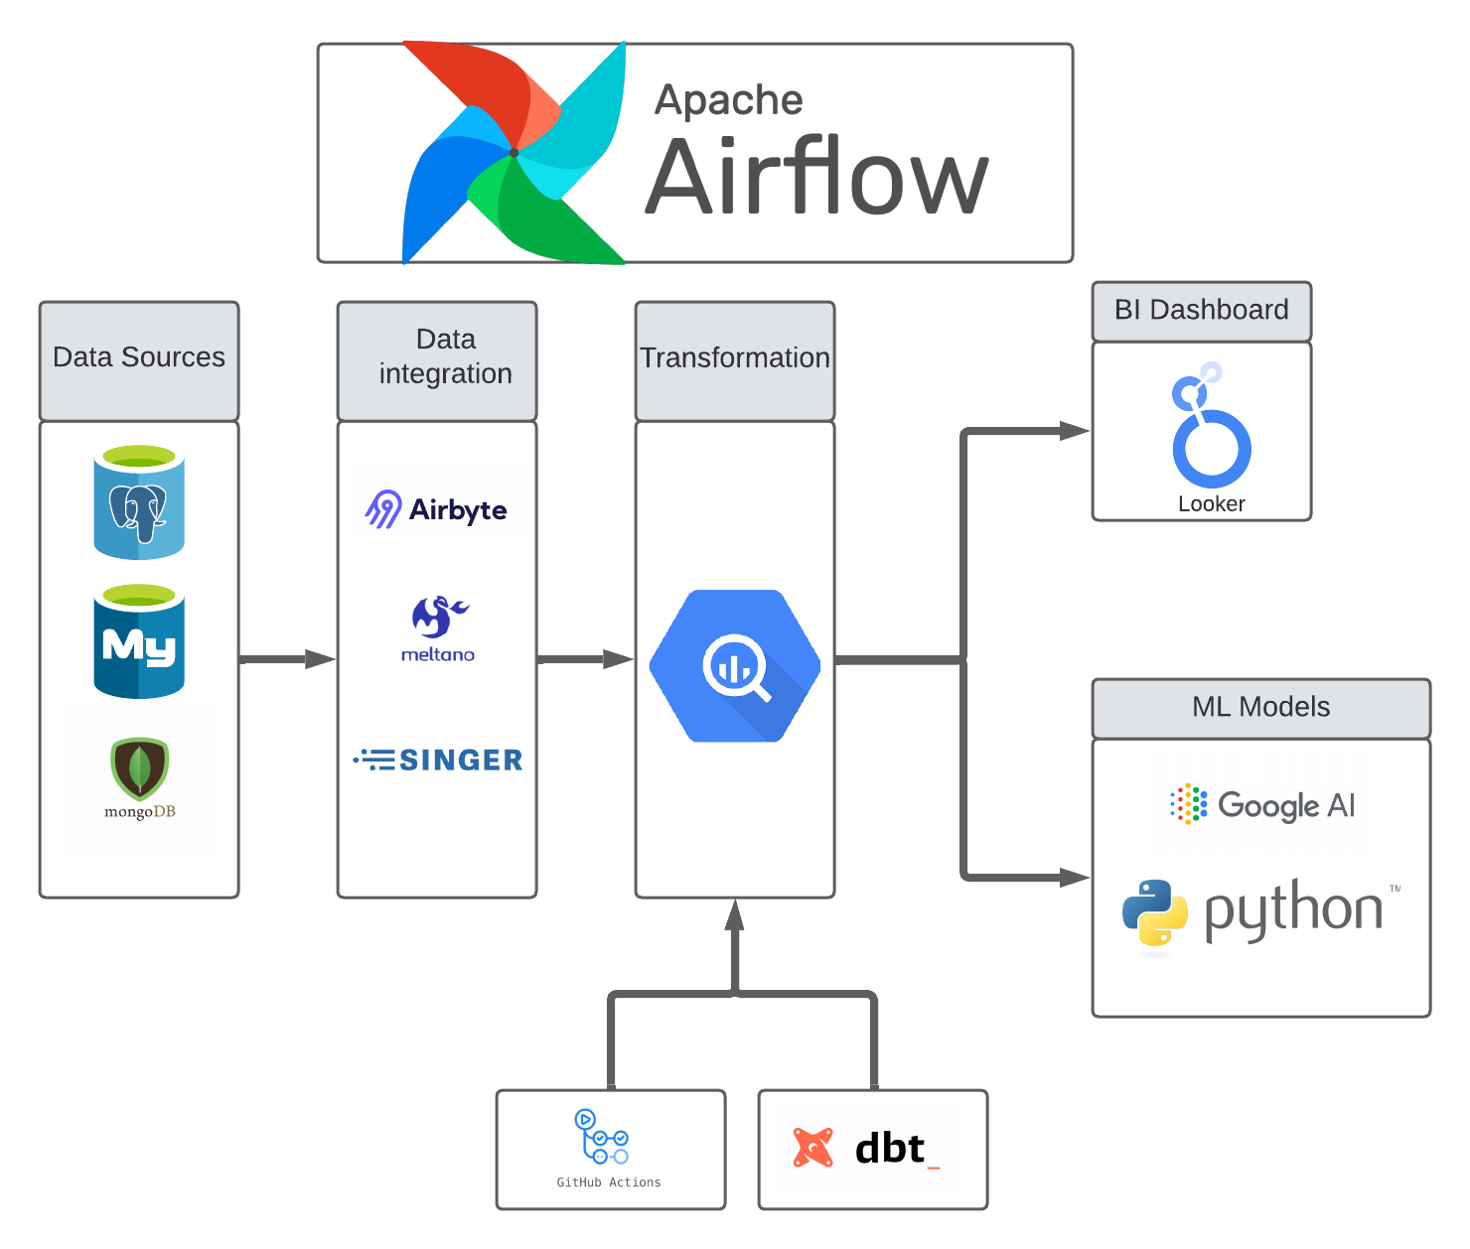
proposition
Data Sources :
PostGreSQL
MySQL
MongoDB
Start of the pipeline
“garbage in, garbage out”

Slide 5
proposition
Data Integration :
AirByte
Meltano
Singer
Ingestion tools open-sources
Exact copy of data sources

Slide 6
Transformation
Transformation :
BigQuery
DBT Cloud
Github Actions
Landing zone → Staging Area
Data Warehouse →Data Marts
Use of Github Actions for continuous integration

Slide 7
Transformation
BI Dashboard / ML models :
Looker
Google AI
Python
Visualization Analyze & build AI models

Slide 8
Sitography
https://airbyte.com/etl-tools-comparison
https://medium.com/astrafy/
https://www.analytics8.com/blog/best-in-breed-data-stack-platform-bigquery-dbt-and-looker/
https://lucid.app/

Slide 9

Merci
Alexis.guillotin1@hotmail.com

