Slide 1

Welcome to
Experience the role of a Software Engineer helping companies, like Google and Amazon, solve their issues

Slide 2

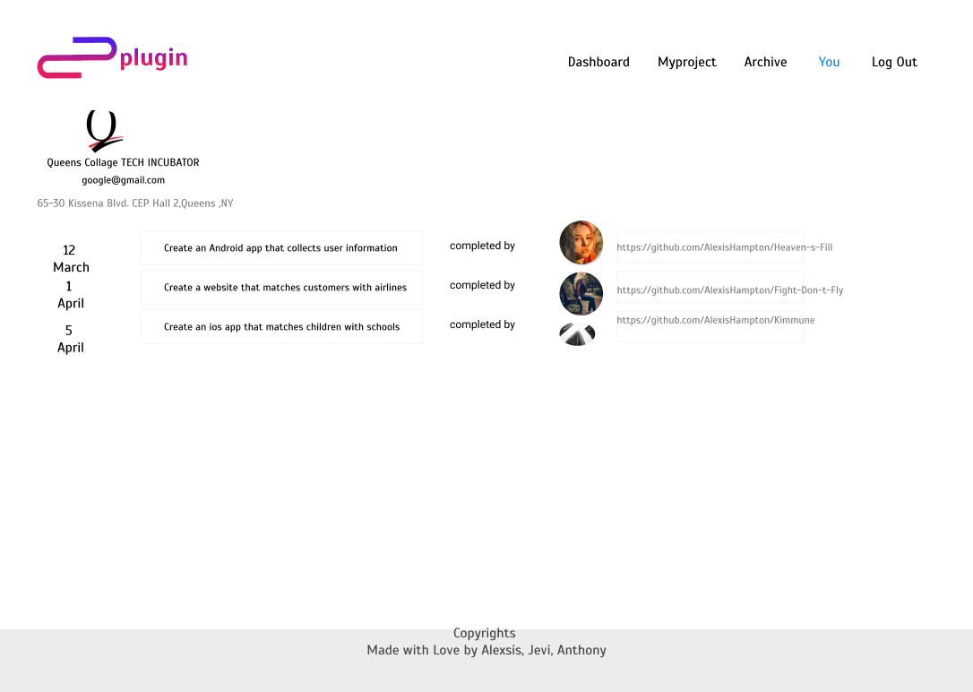
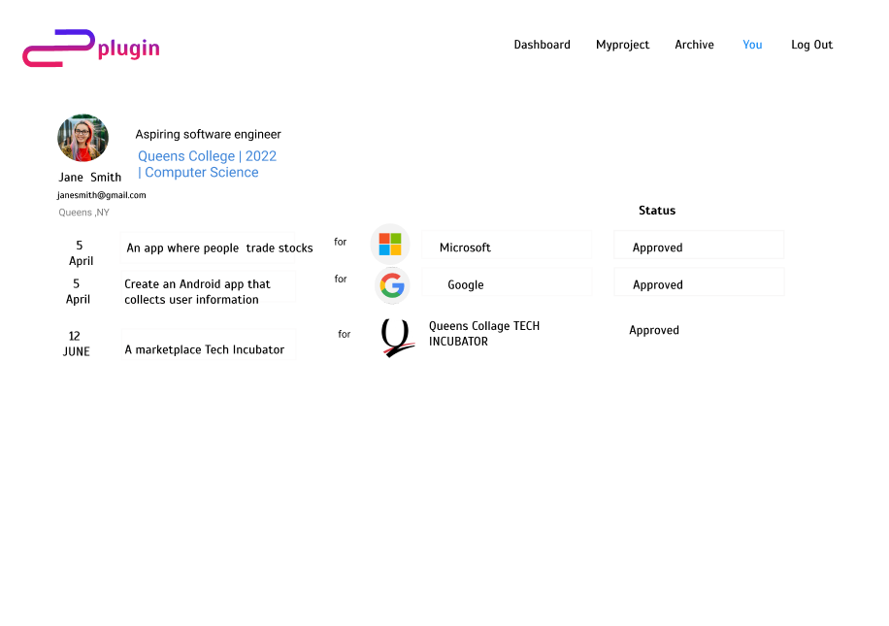
Product
Search
Complete
Experience

Slide 3
Problem
Opportunities is an important element that is missing for students and aspiring software engineers
Innovation from an outside audience is a constant missing element that would benefit company success
There’s no easy way to earn SWE experience as expectations for positions are very high

Slide 4
Solution
A web platform that solves problems for both engineers and companies by:
Assigning Tasks
To fresh-minded Engineers
Gain
Experience
As an aspiring Engineer
Gain
Revenue
For the company’s success

