Slide 1
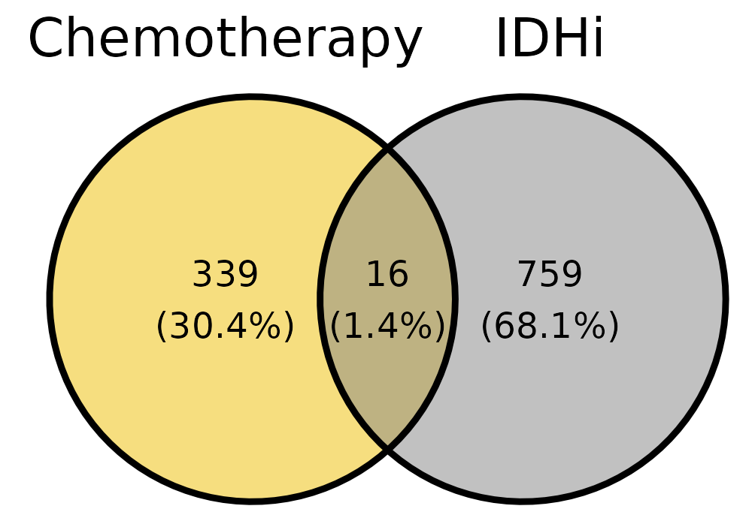
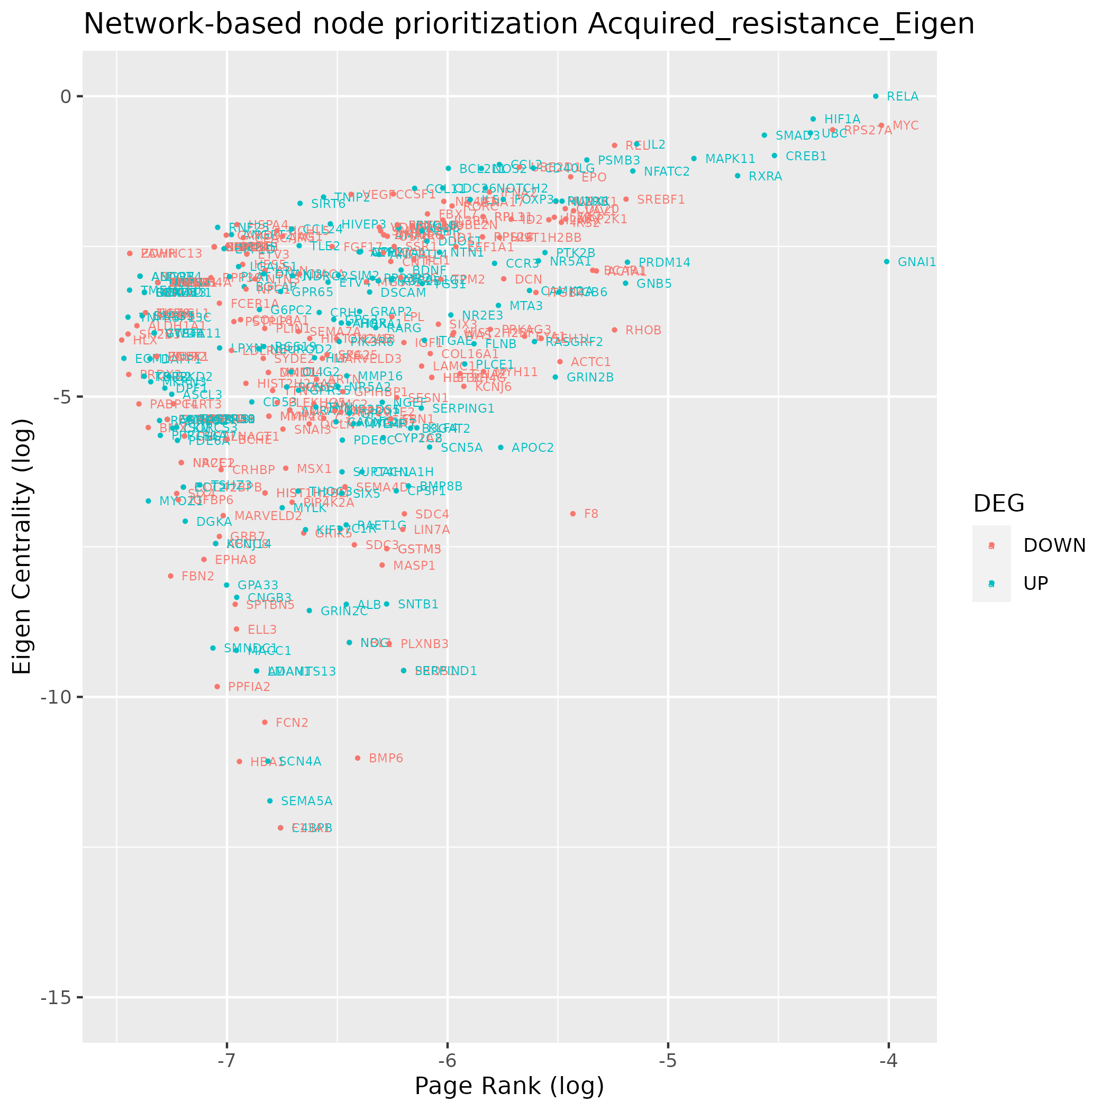
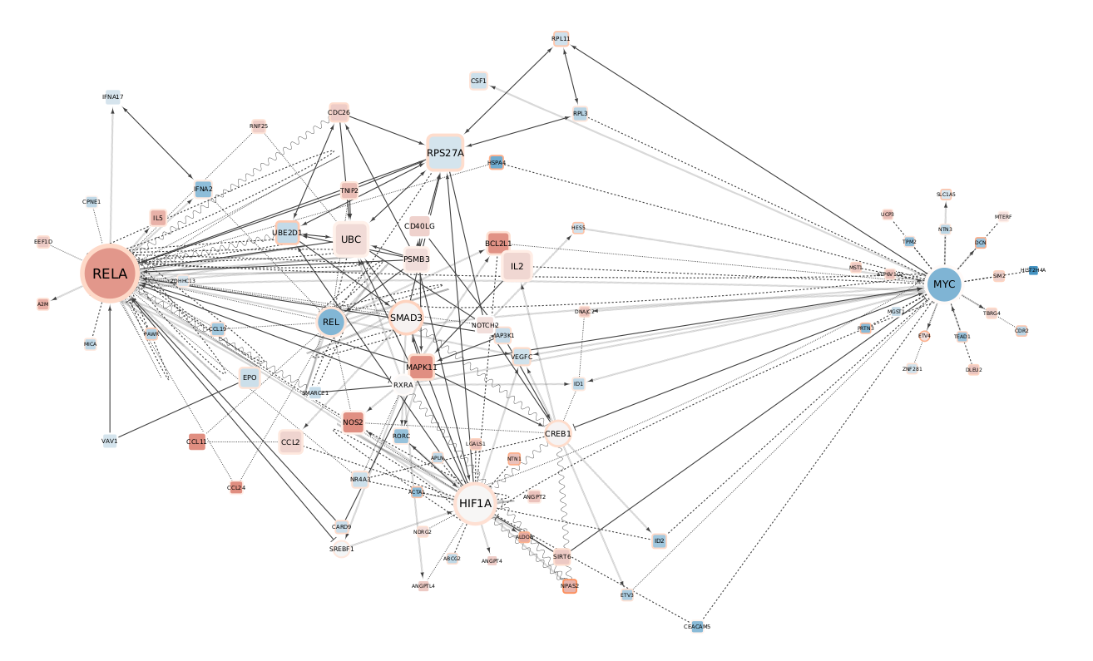
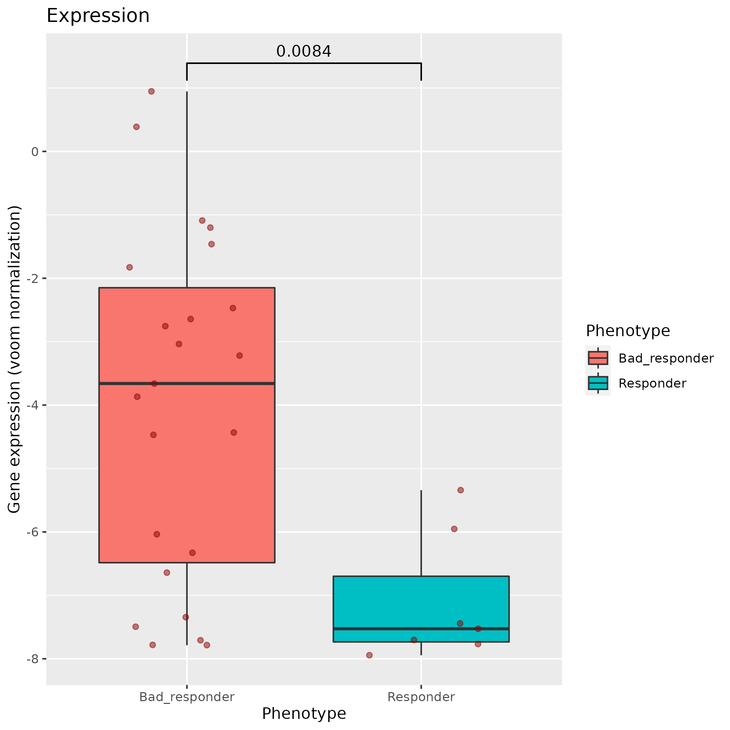
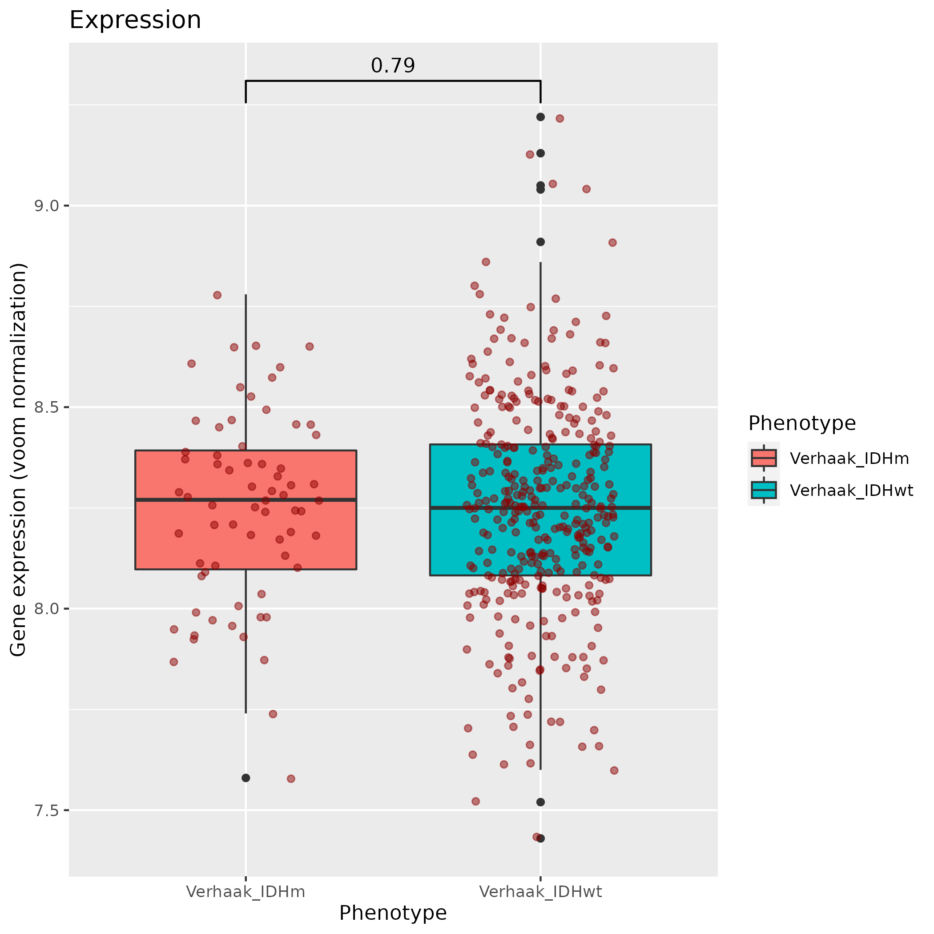
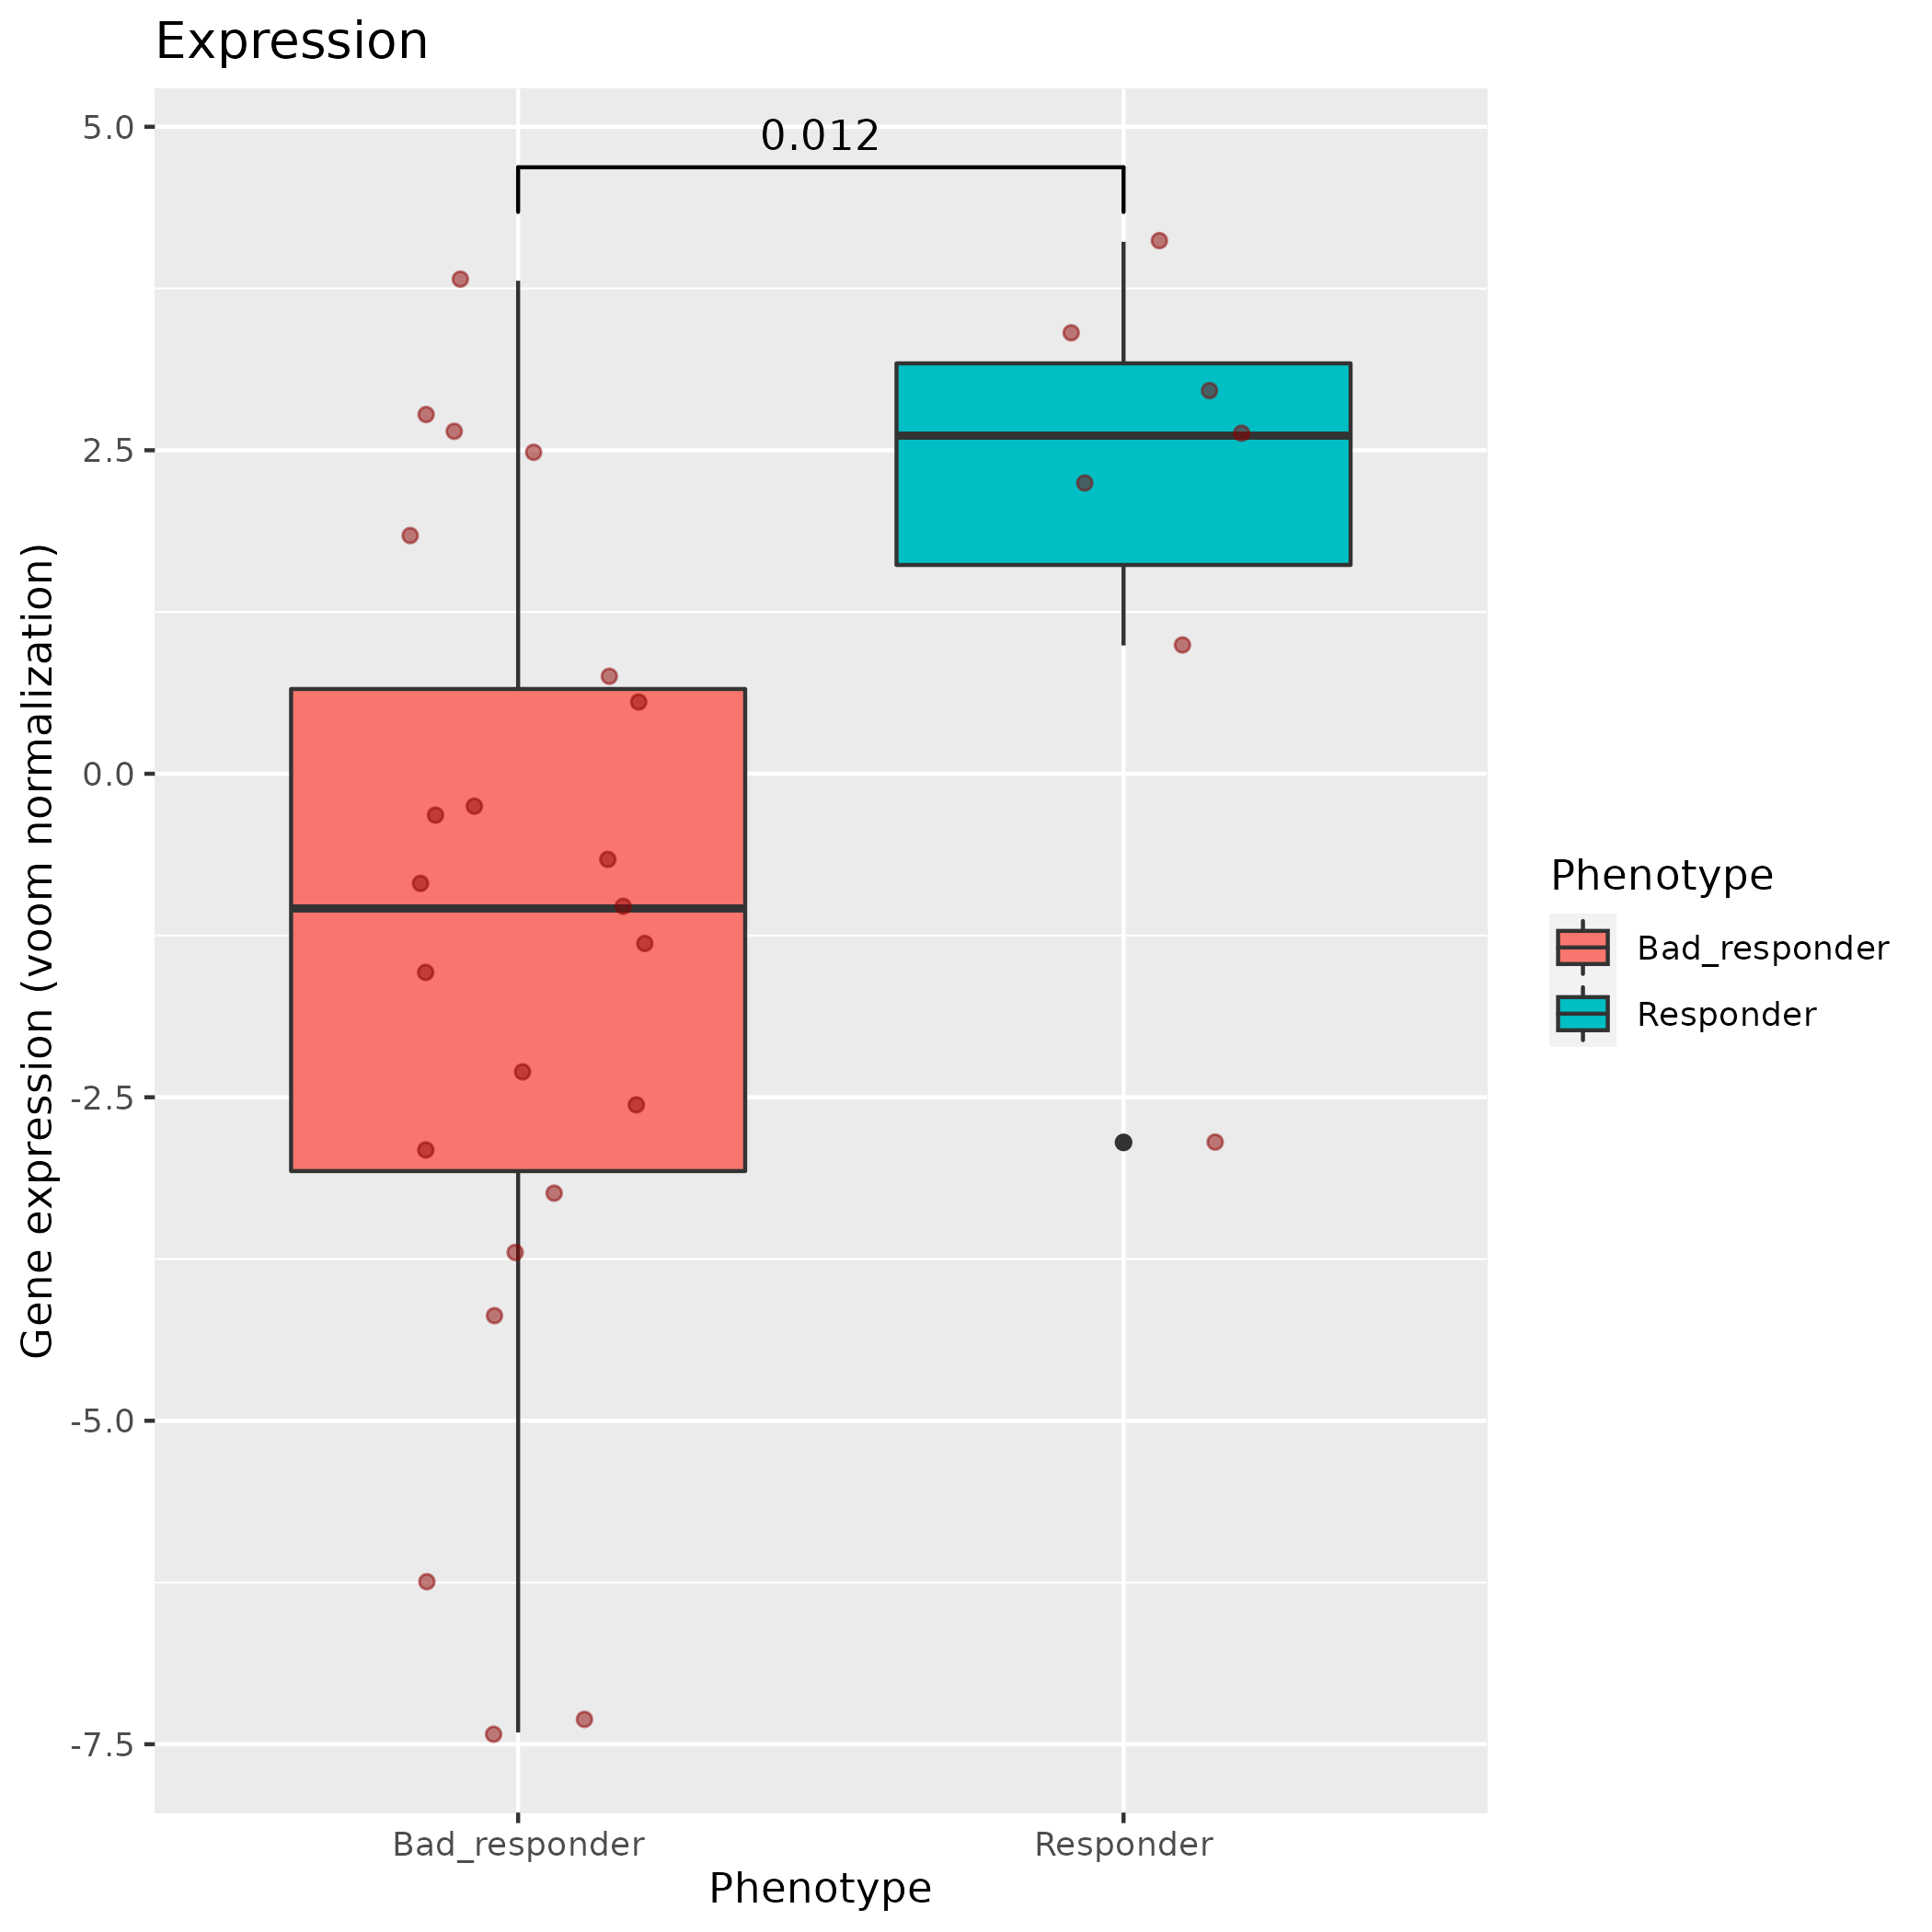
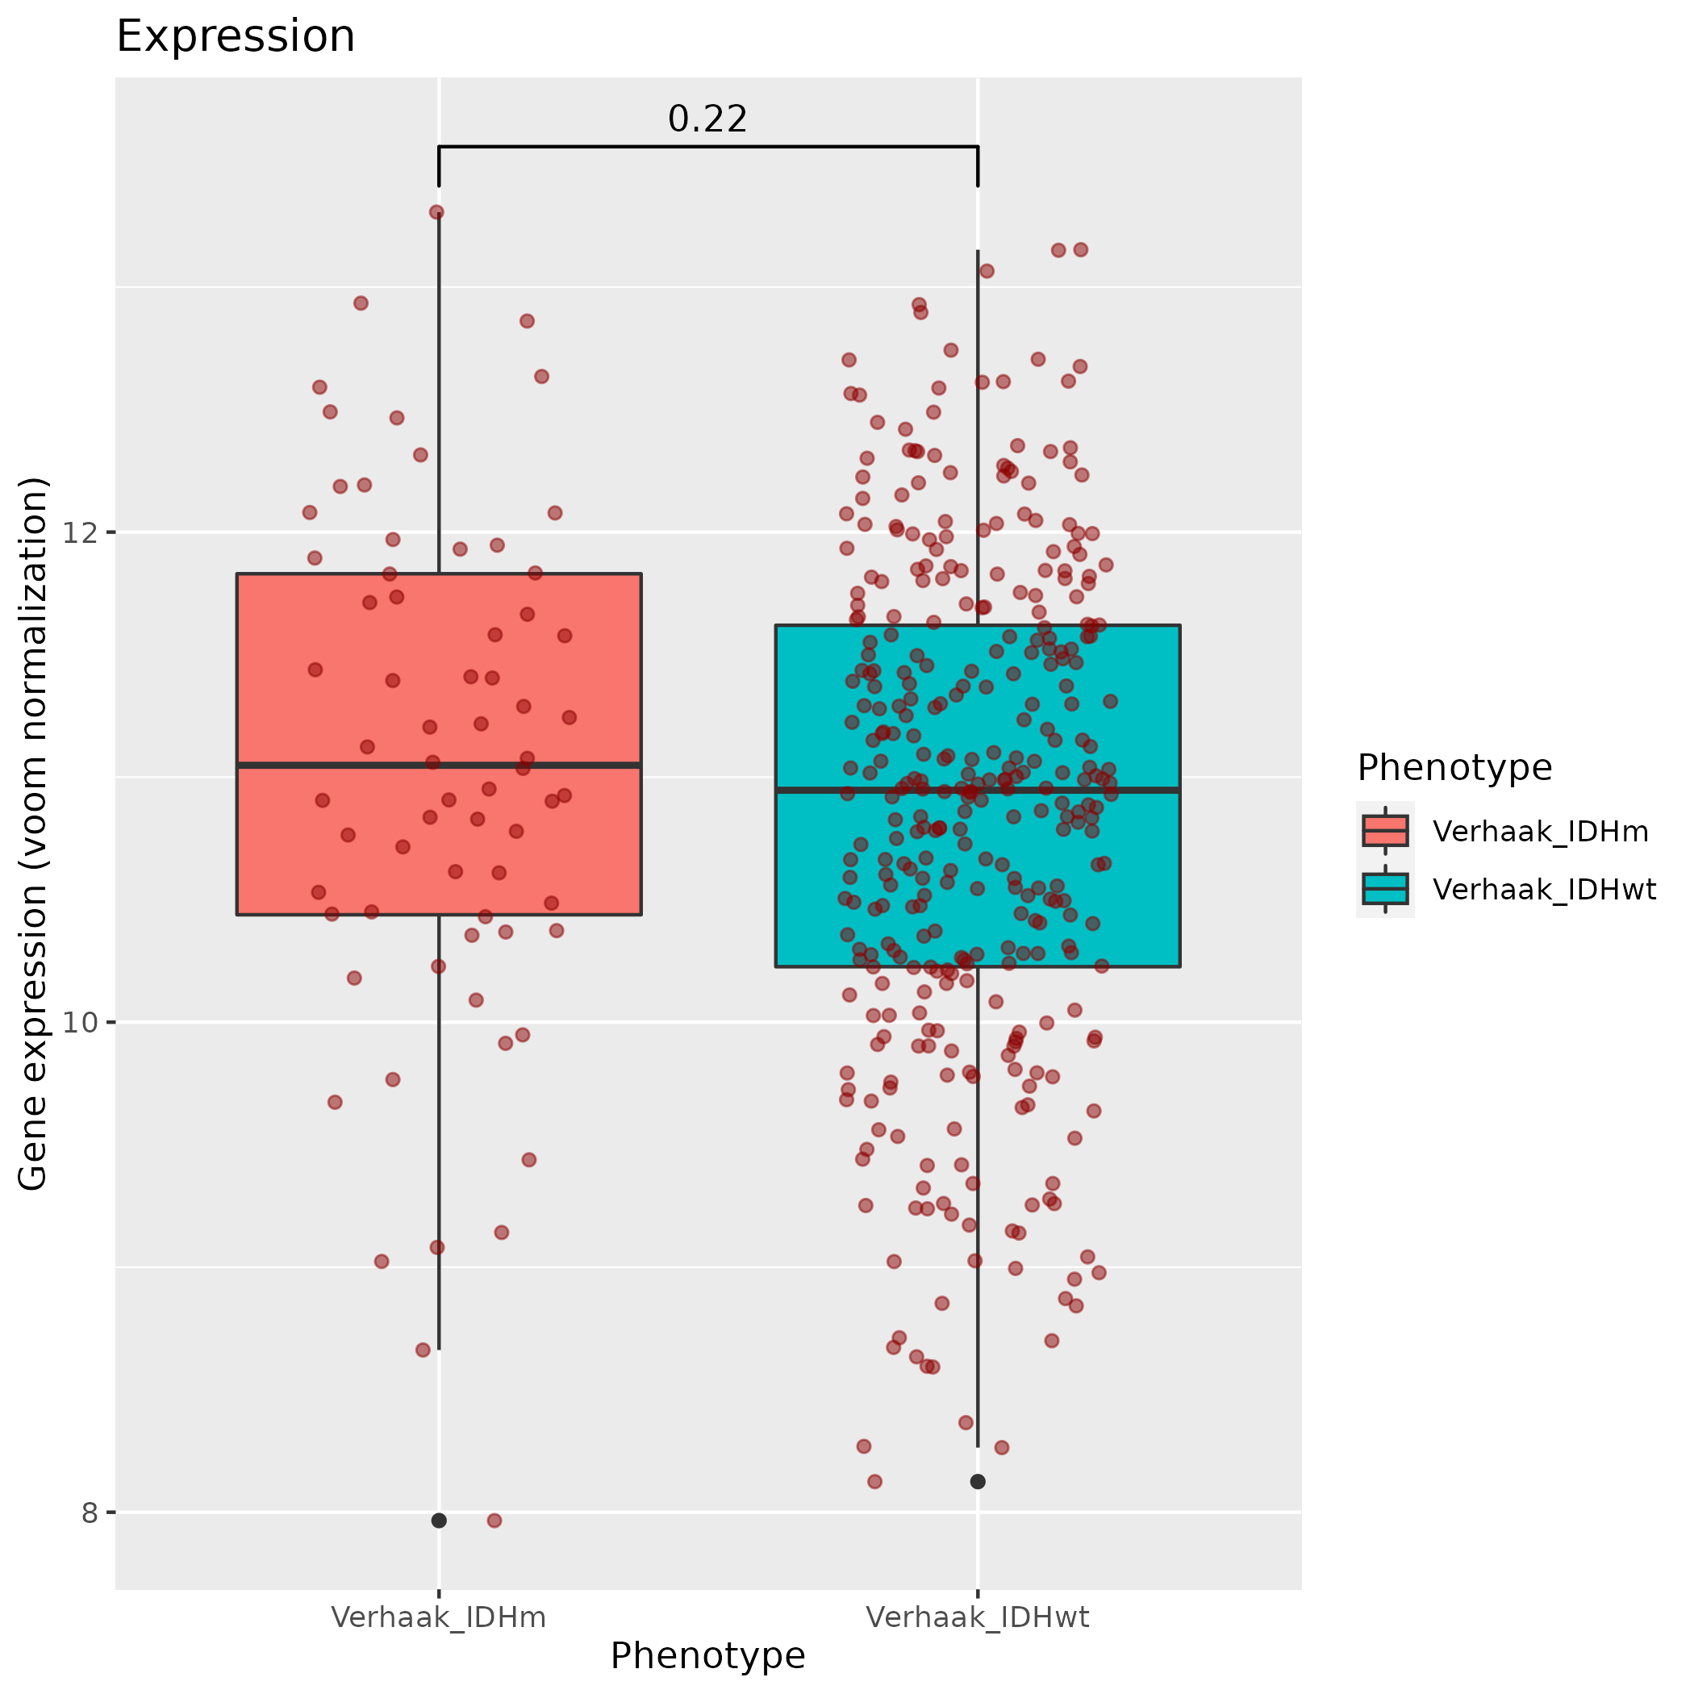
A
B
Figure to explain how I built
the networks.
Two schematic networks for
PPI and TF-target into
one big network
A list of DEG and Tfs that will
Filter the big network
(for IDHi → 759 genes)
C
D
A schema to explain briefly
Page rank and Eigen centrality
Calcul and analysis
E
F
G
MYC

