Slide 1
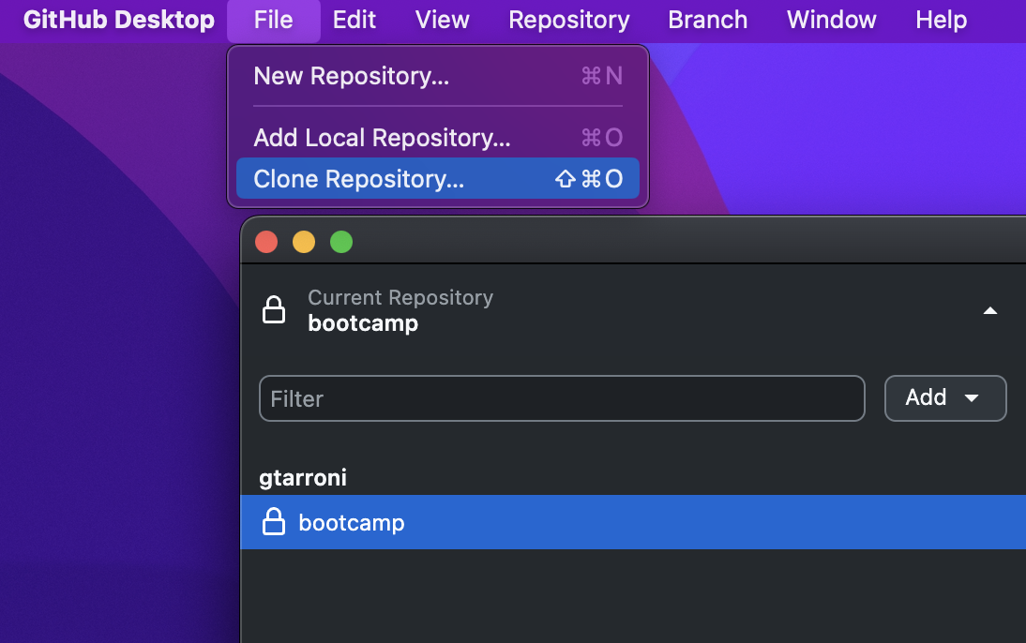
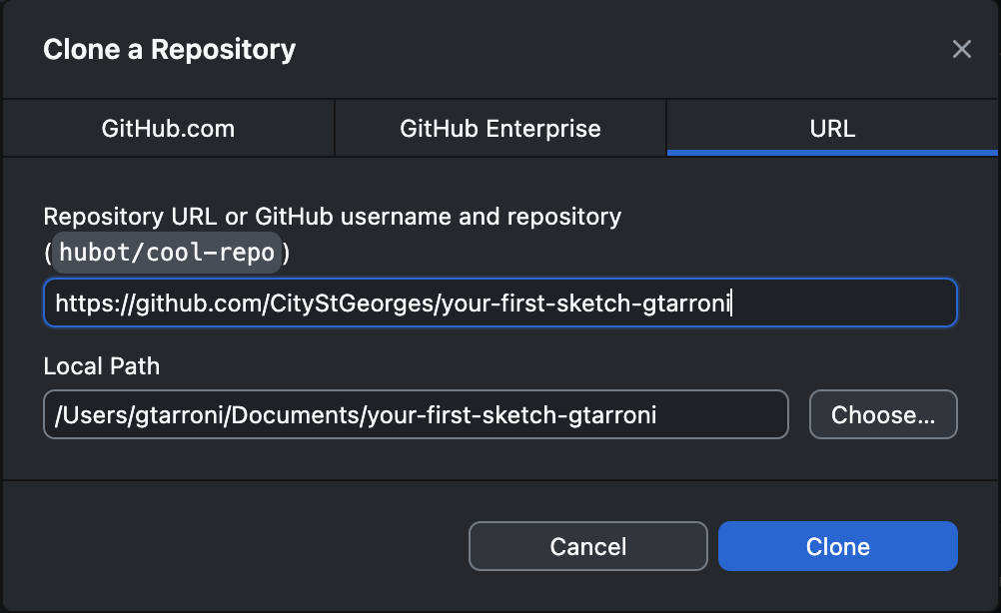
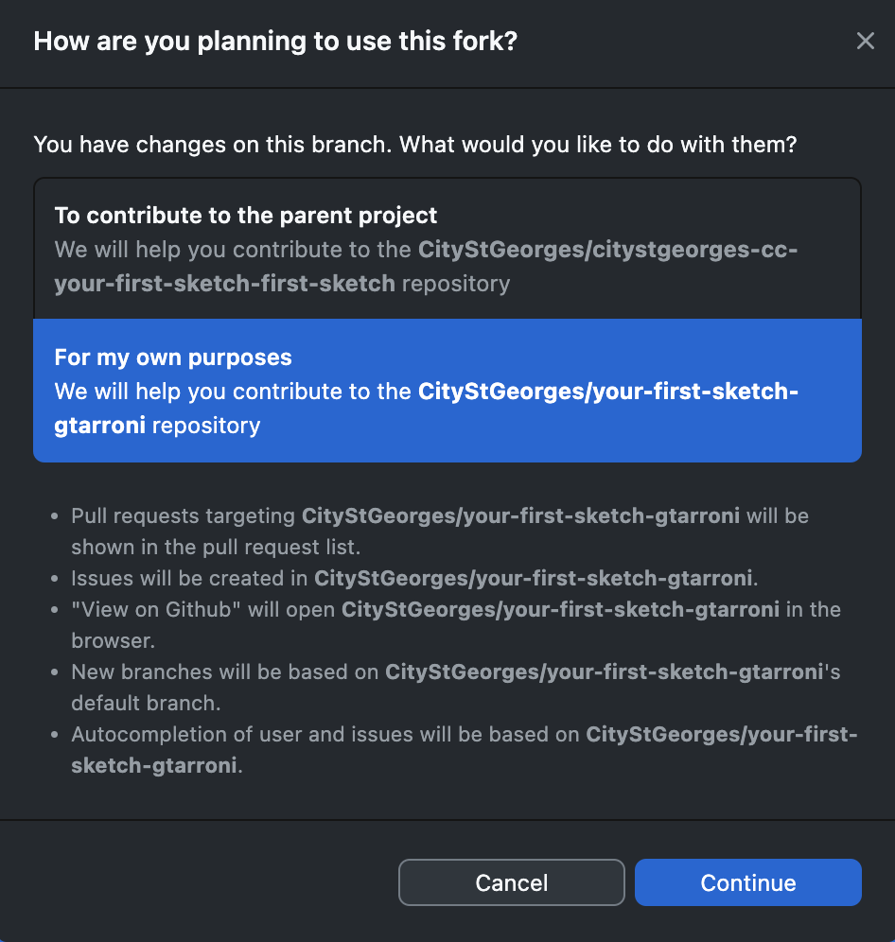
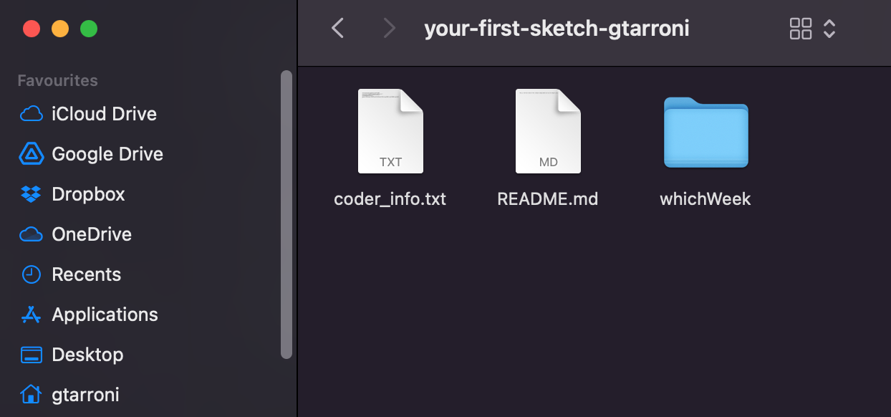
Paste repo link from previous step
Choose parent folder
Check that the repo is on your computer now

Slide 2
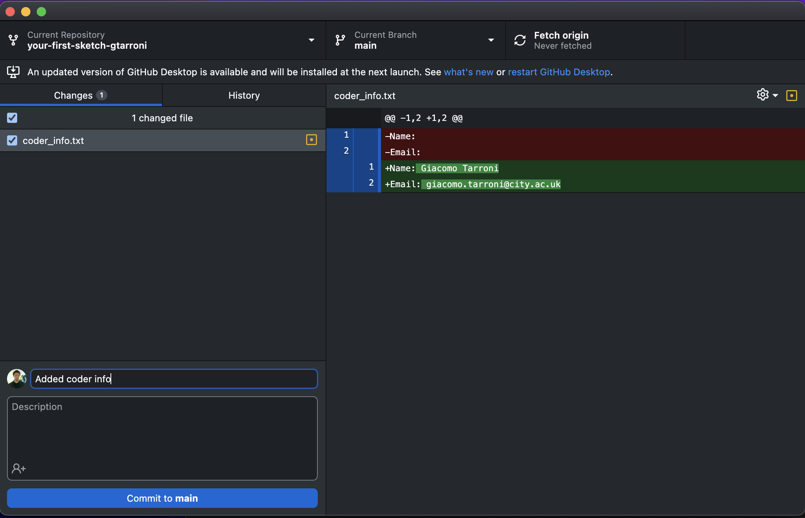
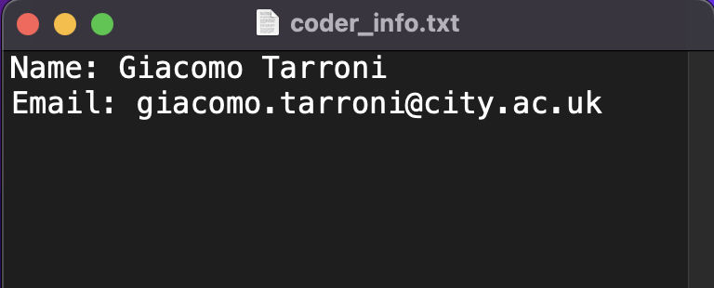
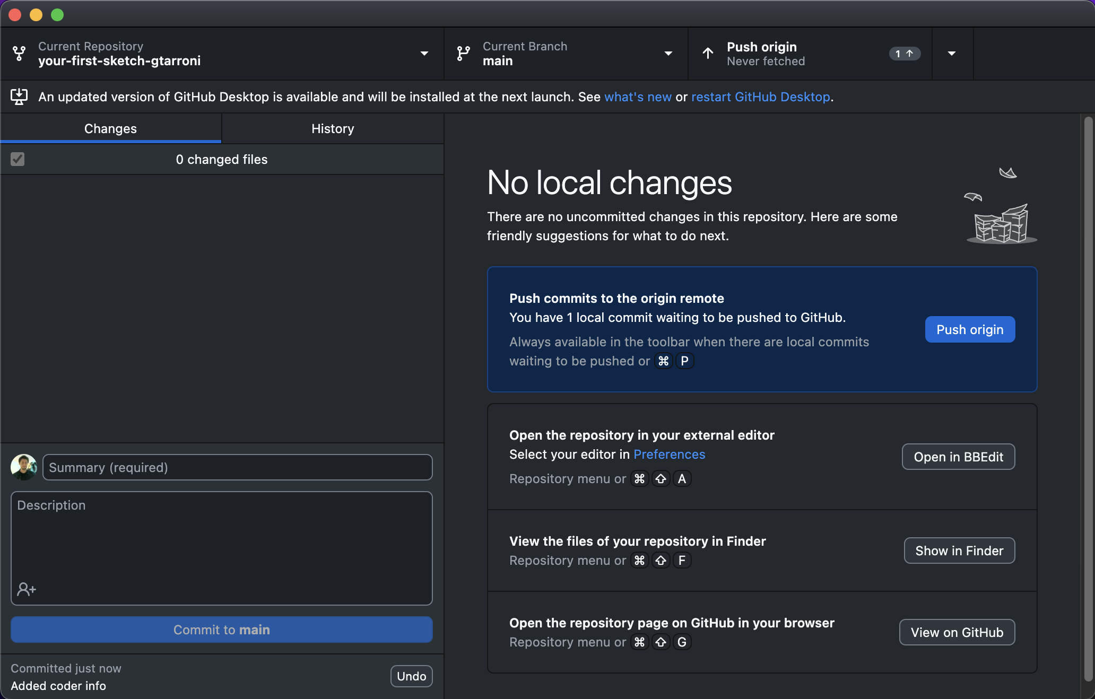
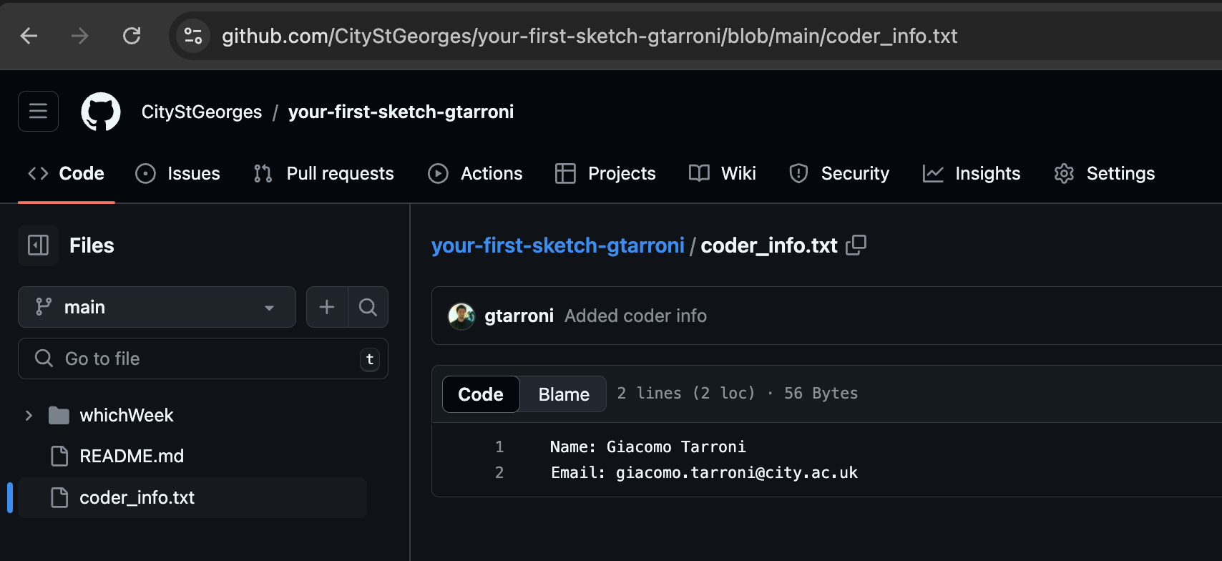
GitHub keeps track of changes to coder_info.txt!
Add a note about the changes you have made and hit “commit”
Notice how changes have disappeared: that’s because you have ‘saved’/committed them
Click “push origin” to push to online repo on GitHub
Notice how the online repo has changed accordingly!

