Slide 1












Regular-expression (regex)
a language to find patterns

Slide 2
What is a ‘regex’?
Code to manipulate tekst
find
validate
replace
split
Notes:
Typically, these patterns (which can be horrifyingly intricate and precise) are used for four main tasks: to find text within a larger body of text; to validate that a string conforms to a desired format; to replace text (or insert text at matched positions, which is the same process); and to split strings.

Slide 3
Where is it used?
Search engines
Google
User-input validation
passwords
email

Slide 4
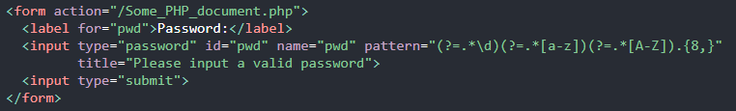
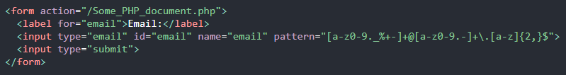
Practical Examples
First example:
Second example:
Password 8+char. “1aA”
Email validation

Slide 5
Break it down
(?=.*\d)
(?=.*[a-z])
(?=.*[A-Z])
.{8,}
Look ahead for numbers
Look ahead for a-z
Look ahead for A-Z
Match 8 or more characters

Slide 6
Rebuild
(?=.*\d)
(?=.*[a-z])
(?=.*[A-Z])
.{8,}
Thispasswordisnotok
Th15p455w0rd150k

Slide 7
Break it down
[a-z0-9._%+-]
+
@
[a-z0-9.-]+
\.
[a-z]{2,}$
Find a-z & 0-9 etc.
Match previous ∞ times
Match @
Find & Match a-z & 0-9 .-
Match .
Match a-z twice or more

Slide 8
Rebuild
[a-z0-9._%+-]
+
@
[a-z0-9.-]+
\.
[a-z]{2,}$
Characters_+-%.@e-mail.com
Characters_+-%.@e-mail.co.uk

Slide 9

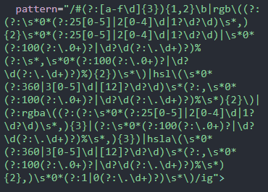
Monster code
This block matches colour-codes

Slide 10
Resources
https://regexr.com/
Cheatsheet
Trial and error

Slide 12
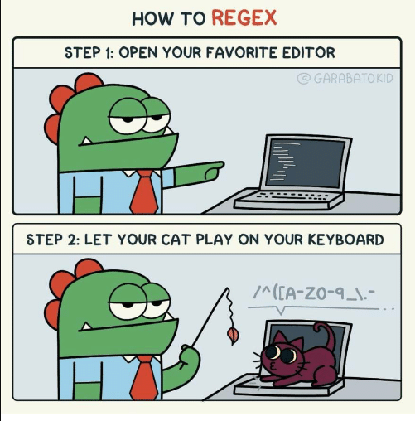
Q&A

