Slide 1

Folding@home

Slide 2
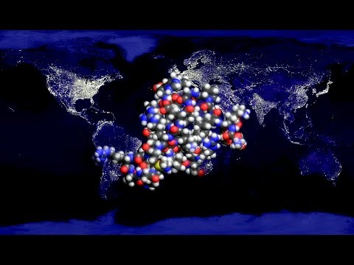
What is it?
Distributed computing project
Goal:
Help scientists find new
cures for diseases
How?
By simulating protein
dynamics on your computers!
Why?
To use “all” processors on the
world to speed up research

Slide 3
F@H
Why? How?
Research - Diseases
Technical part

Slide 4
The research part
Why protein and protein dynamics?
What is folding?
How the simulation works?

Slide 5
Why is protein research in this case so important?
Proteins = an essential component to many biological functions and processes within human cells.
Bones, Muscles, Blood vessels
Structural elements
Hair, Skin
Proteins are
Recognize invading elements
Antibodies
Allow the immune system to get rid of the invaders

Slide 6
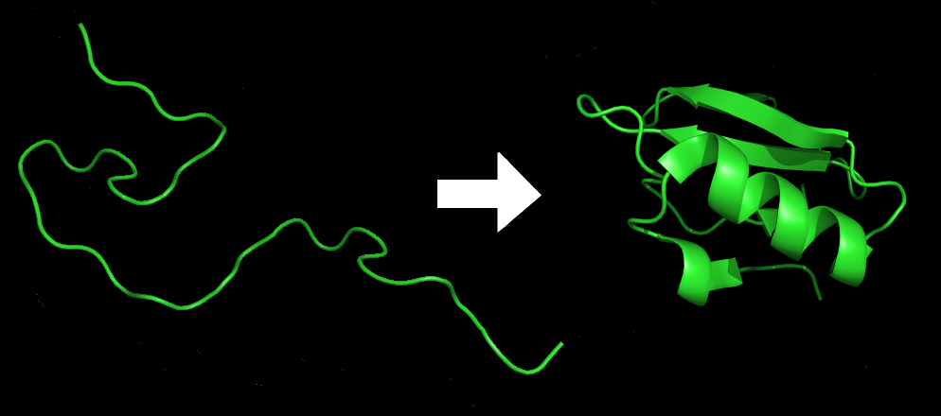
Folding vs. misfolding
Before proteins do their work, they assemble themselves, that is called “folding”
Thus, protein has to fold in order to work correctly
- If something goes wrong in our body protein can not fold, in that case we call it “misfolding”
Thus, protein misfolding can result in a variety of diseases
A protein before and after folding.

Slide 7
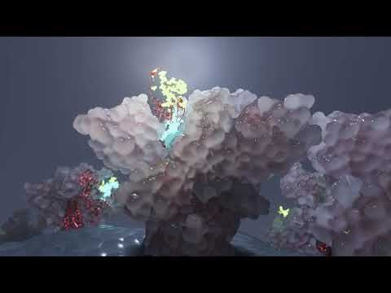
About simulation
Markov State Models (MSMs) = the “core” of the whole simulation
gathers data + basic algorithms of protein behaviour.
Why to use it?
To observe the factors
that influence folding,
which is especially important
if the protein misfolds.

Slide 8
The technical part
How does the system works?
Which devices can contribute?
How does the software looks?

Slide 9
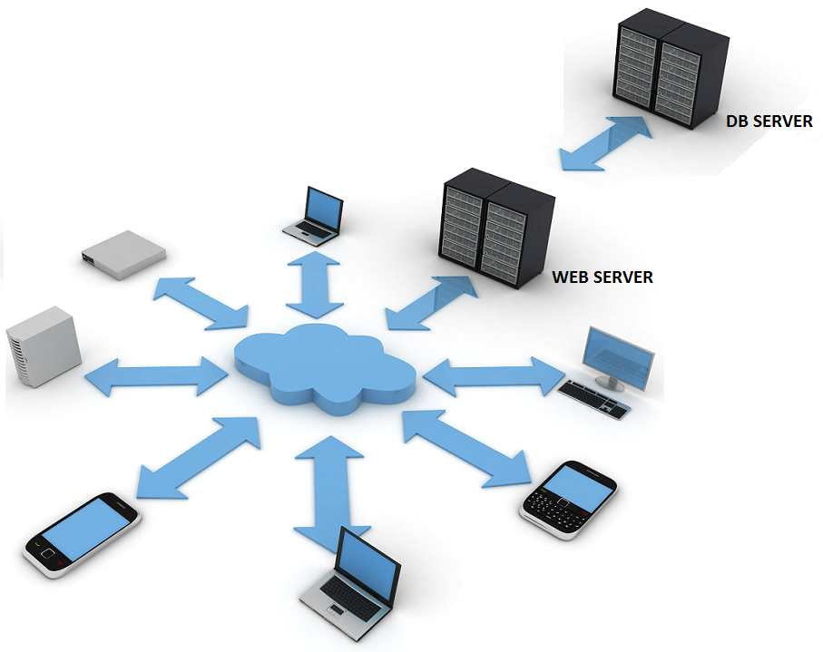
How does it work in practice?
The volunteer installs F@H software on their device
Each device receives pieces of a simulation (work units)
They run it and complete them
Returns them to the project's
database servers
Here, the units are compiled into an overall simulation
distributed system
=
supercomputer

Slide 10
More CPUs = More speed = Faster results
- processors (CPUs)
- graphics processing units (GPUs)
What devices can be used?
-”almost” all computers can contribute
-computers (<5 old) need a pentium 4 in order to be fast enough to finish deadlines
- some Sony Xperia smartphones

Slide 11
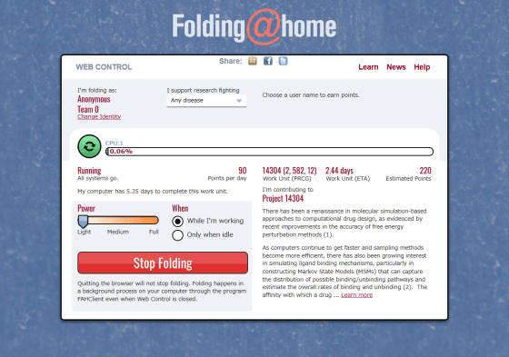
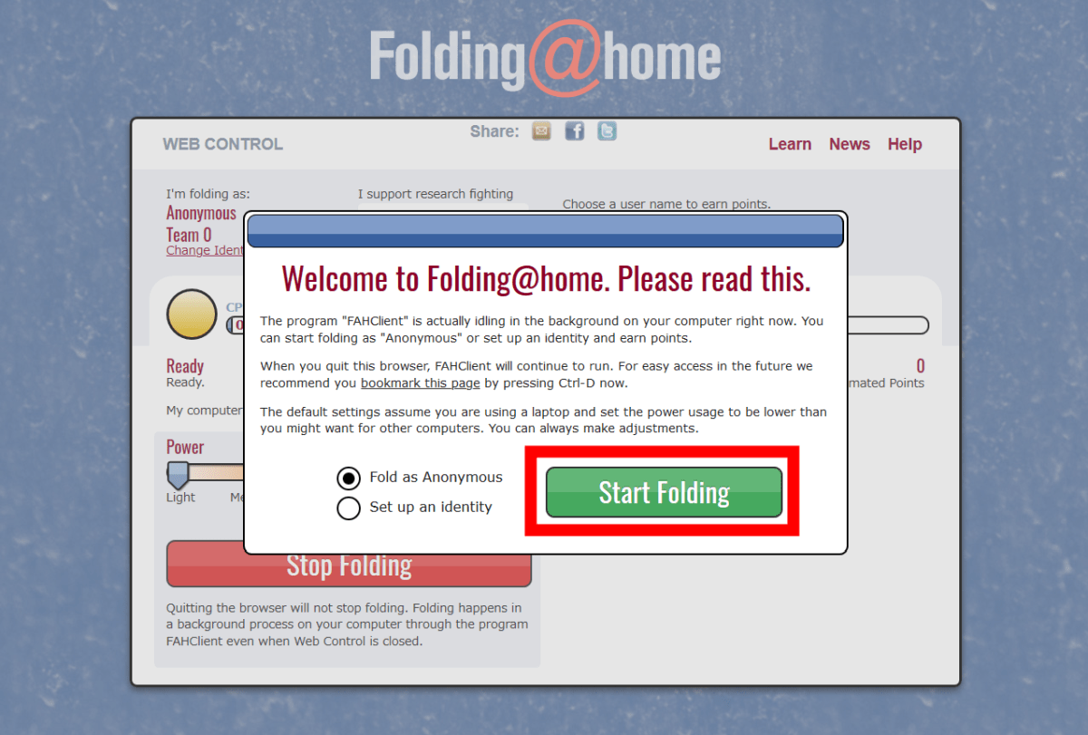
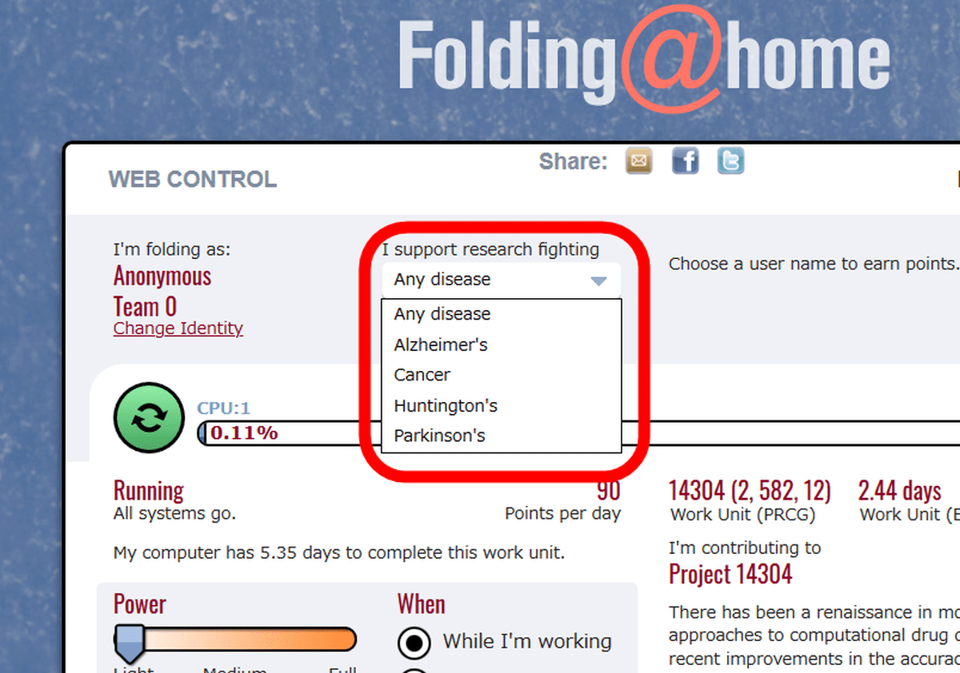
Software

Slide 12
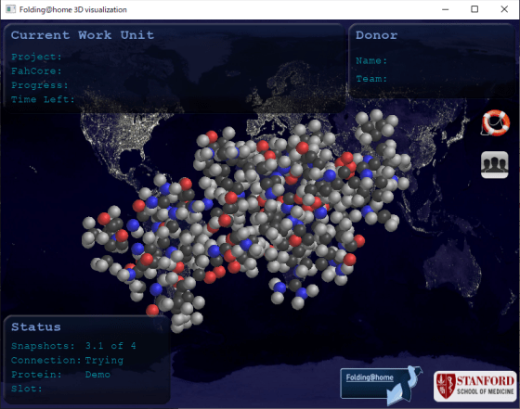
3D visualization

Slide 13
Why to be part of it?
It does not limit you or your computer
New skills by experiencing the process
Contribute also as a web developer with programming plugins
Help to solve pandemy COVID-19 faster

Slide 14
-Cancers (breast cancer, kidney cancer…)
-Infectious diseases (Ebola, COVID-19…)
-Neurological diseases (Alzheimer, Parkinson..)
What projects can you contribute on?

Slide 15

Interesting Fact!
COVID-19 pandemy = >increased interest in the project
System achieved double speed in 1 month!!!
late March 2020 = 1.22 exaflops
April 12, 2020 = 2.43 exaflops
(a measure of computer performance 1exa=1mil tera)
That makes F@H one of the
world's fastest computing system

Slide 16













Contributors
Sources:
https://foldingathome.org/
https://en.wikipedia.org/wiki/Folding@home
https://www.youtube.com/watch?v=jiMZYJ--cT8
https://www.youtube.com/watch?v=gFcp2Xpd29I
https://www.youtube.com/watch?v=M0hxyNT11jI&feature=youtu.be

Slide 17

“Together, we are powerful”

Slide 18
Thank you!
Q&A

