Slide 1
LOGIC BUILDING IN PRGRAMMING
Ways to enchance

Slide 2
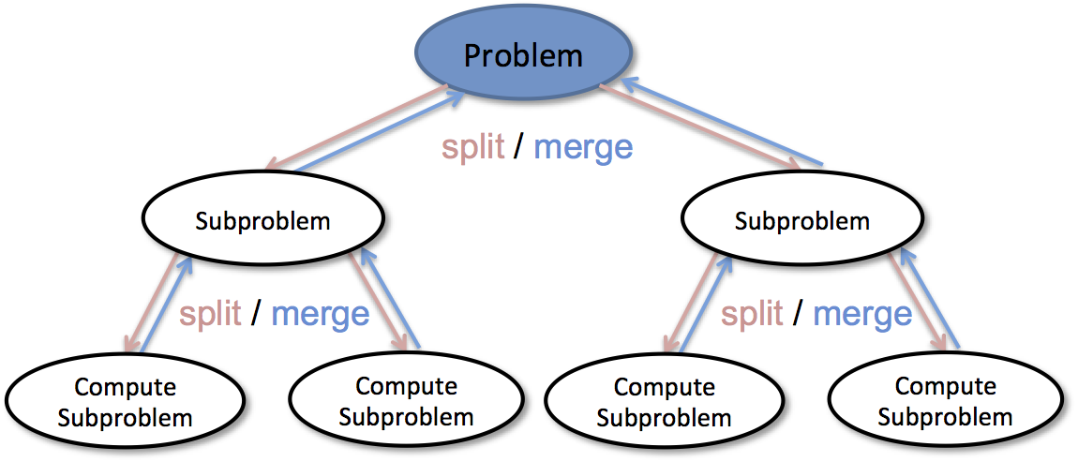
Divide and Conquer
Divide big problem into smaller problems.
Find the solution of the smallest problem.
Merge solutions

Slide 3
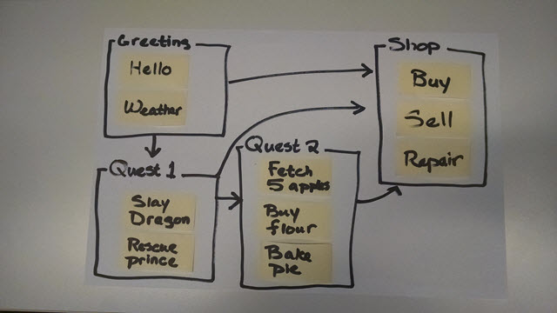
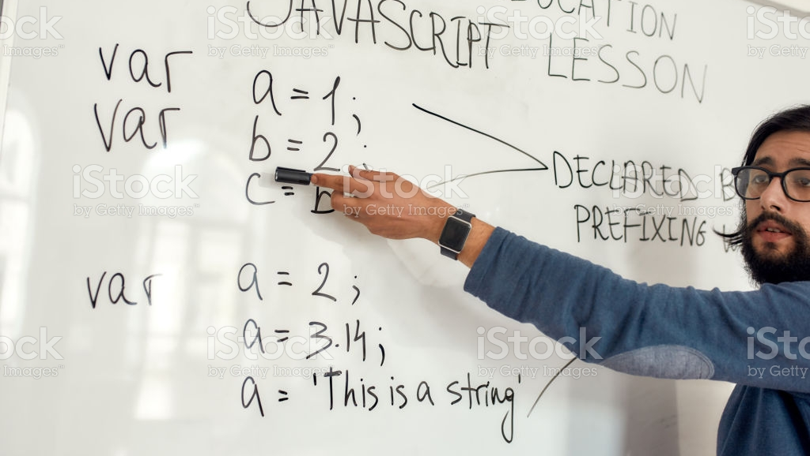
Writing on Paper and white board
Visualise problem.
Brain storming.
Think effeciently.

Slide 4
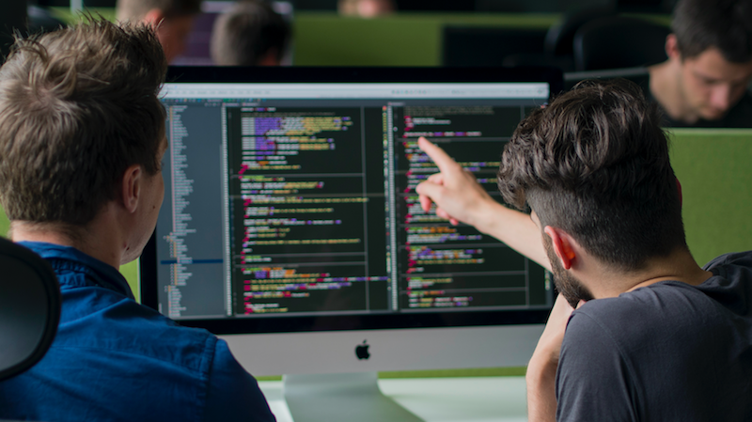
PAIR PROGRAMMING
Two brains focus on the same problem.
Critic on eachother’s ideas.
Refine logic.

Slide 5
LEARN FROM OTHER’S CODE
Opensource, GitHub, etc.
Codes are written by one the best programmers.
Learn from them.

Slide 6
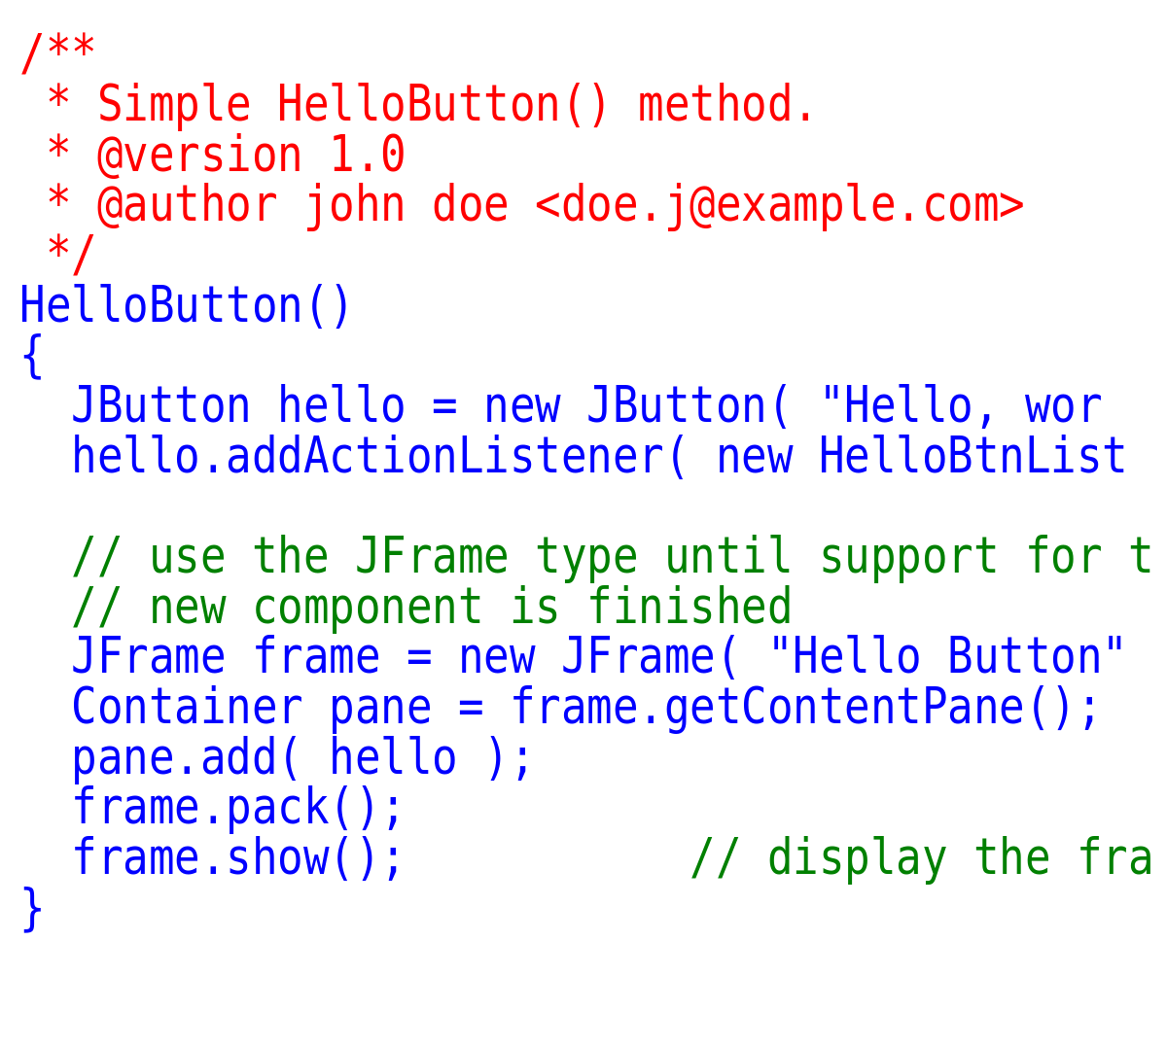
Comment your code
A good practice.
What your code is supposed to accomplish.
Good for other programmers.

Slide 7
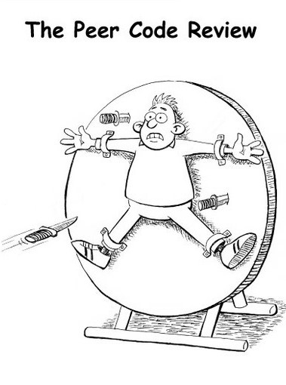
Code reviews
Review the codes of others.
Ask others to review your codes.
Either way you learn.

Slide 8
Competitive programming
leetcode, geeksforgeeks, etc,
Adding weapons to your arsenal,

Slide 9
The Two P Rule
1- Patience
2- Practice

Slide 10
revision
Divide and Conquer
Use paper and white-board
Pair programming
Learn from other’s code
Use Comment
Code Reviews
Competitive Programming
The two P rule

Slide 11
Feel Free to add any other tip

Slide 12


