Slide 1
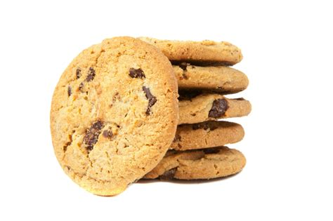
Cookies
A bite sized introduction

Slide 2
What are cookies
How are they used
Cookies and privacy
Improving privacy online

Slide 3
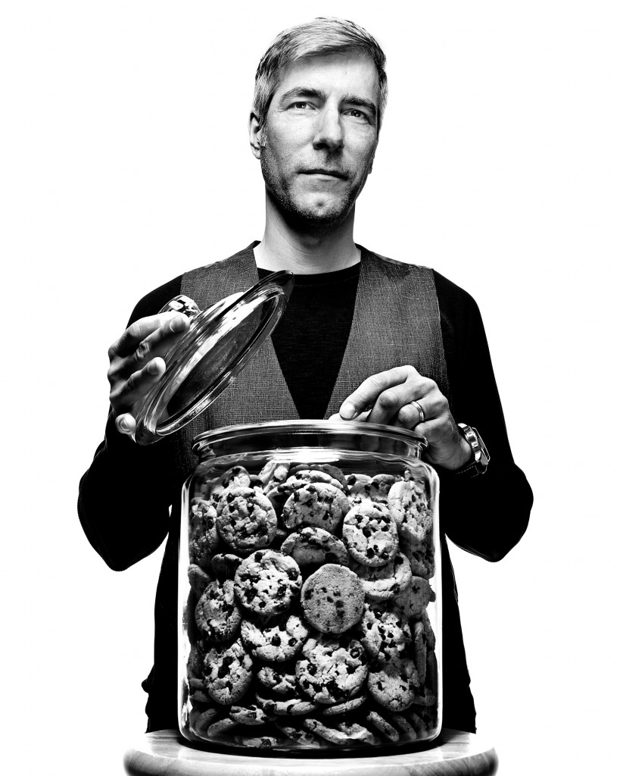
Origin of cookies
Lou Montulli 1994
Netscape
Internet Explorer 1995
Public awareness 1996

Slide 4
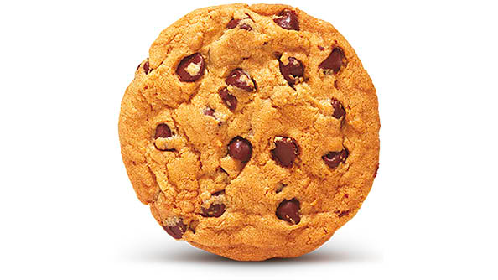
What are cookies?
Name
Value
Attributes

Slide 5
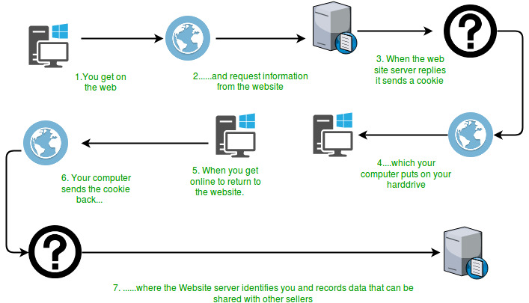
What are cookies?

Slide 6
How are they used?
Session management
Preferences
Tracking

Slide 7
How are they used?
First party
- domain created
- enhance site experience
Third party
- non domain created
- advertising

Slide 8
Cookies and privacy
GDPR & CCPA legislation
Browser tools
Google commitment (2022)

Slide 9



Improving privacy online
Don’t simply accept
Privacy settings
Browser extentions
...

Slide 10
Q&A

