Slide 1
Gestalt & Webdesign

Slide 2


Slide 3
Gestalt Psychology
Perception of visual elements
Early 20th century
Wertheimer, Köhler, Koffka
Reaction against structuralism
Legacy:
Perceptual illusions
Website & user interface design

Slide 4
4 Principles of Gestalt
Emergence
Multistability
Reification
Invariance
Laws of Prägnanz
Figure/Ground organisation

Slide 5


Slide 6
Emergence
Complexity to simplicity
Whole before the parts
Overall appearance > details

Slide 7
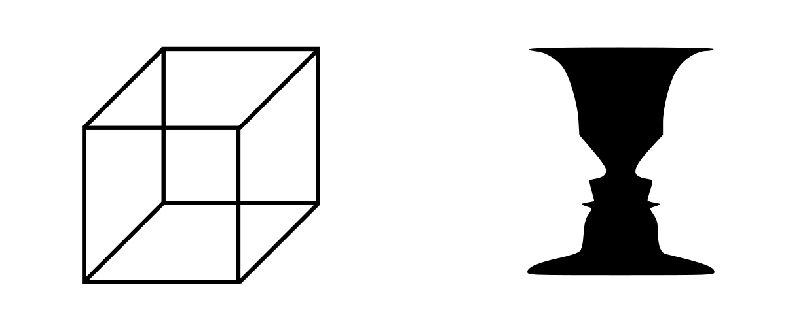

Slide 8
Multistability
Occurs with multiple interpretations
Alternates stable-unstable
Avoid ambiguity in design

Slide 9
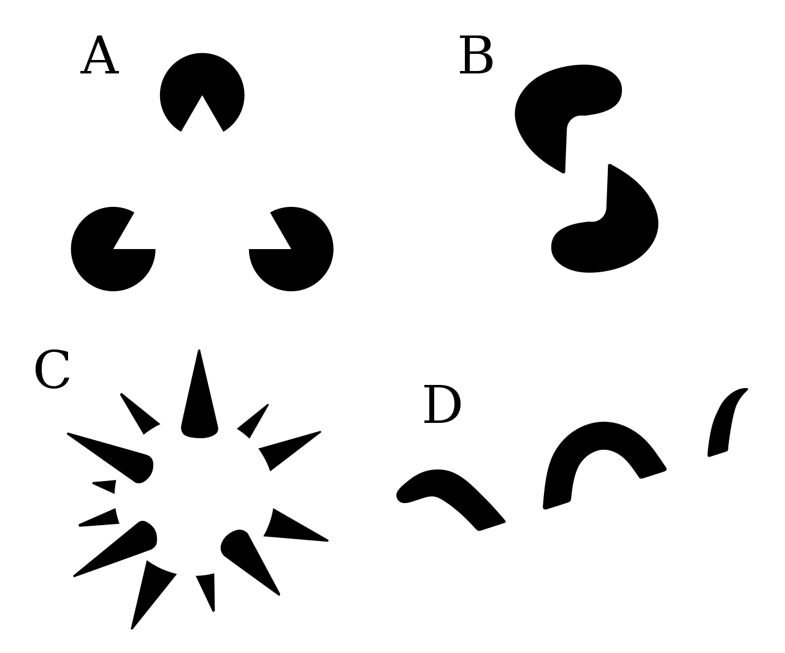

Slide 10
Reification
Constructive - generative
Different from sum of it’s parts
Whitespace and simplicity

Slide 11
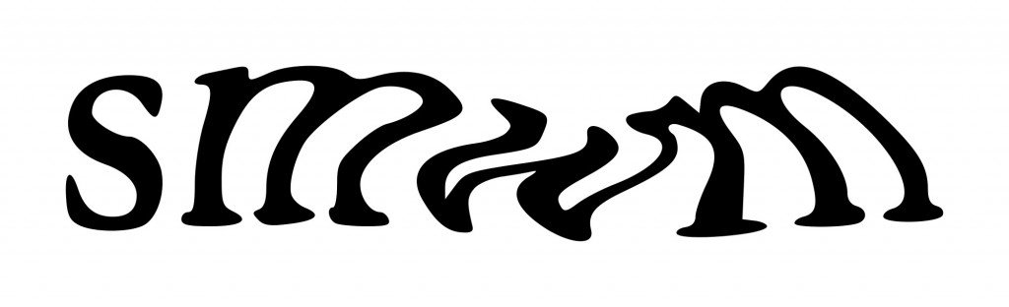
Invariance
Object recognition:
Rotation
Scale
Translation
Elasticity
CAPTCHA

Slide 12
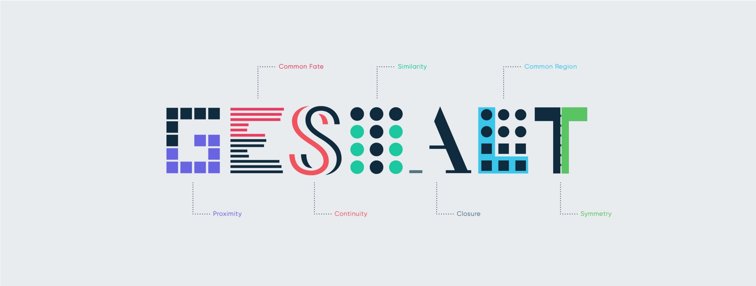
Laws of prägnanz

Slide 13
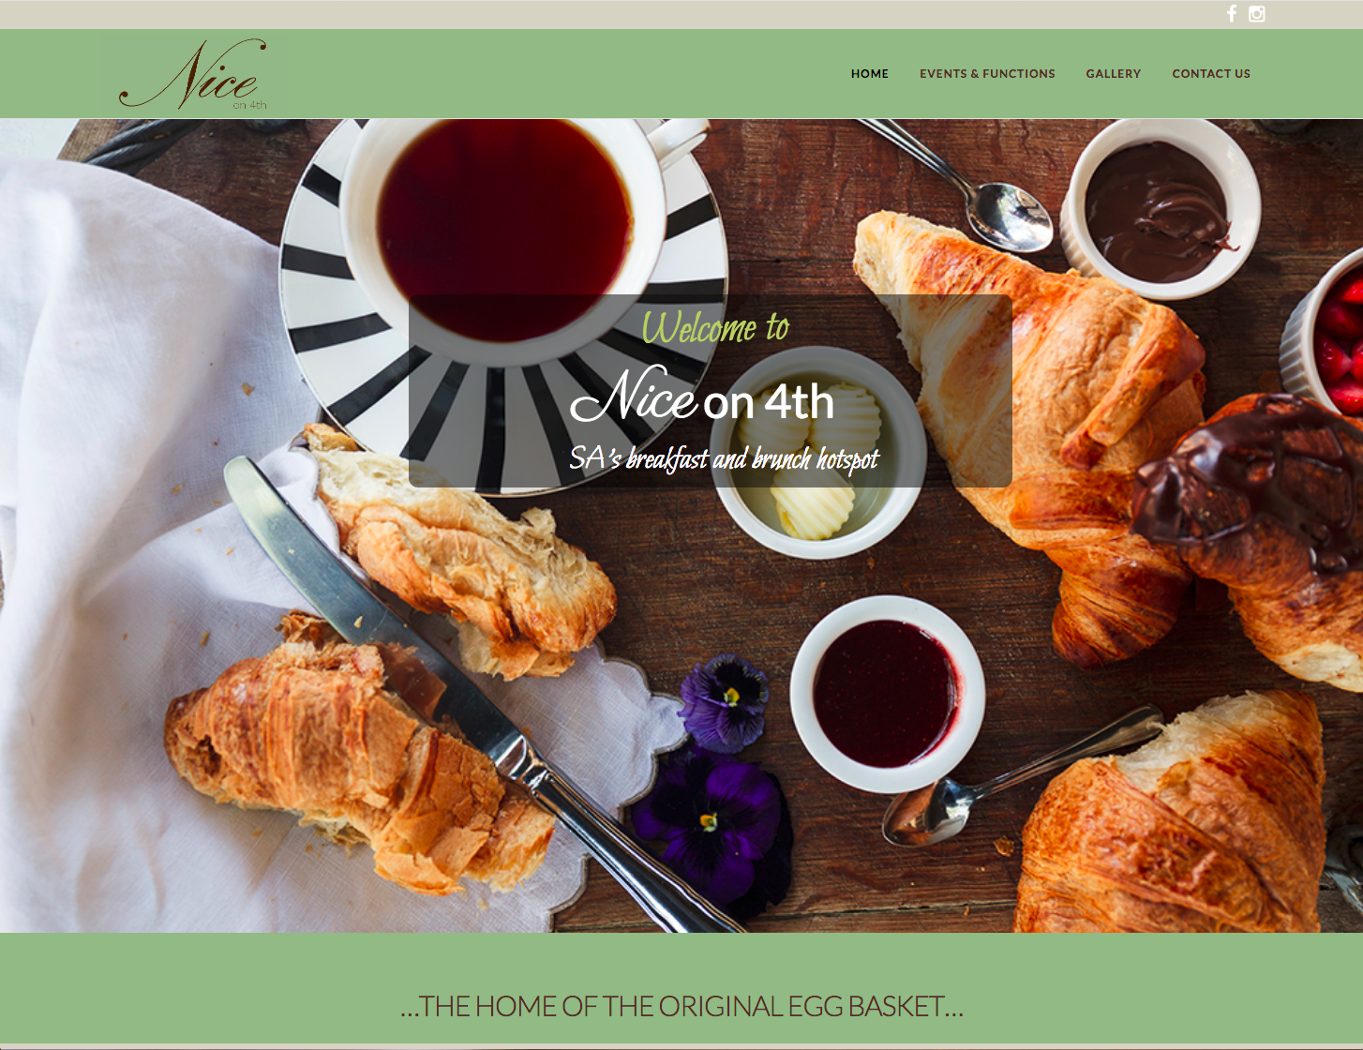
Figure/Ground organisation

Slide 14
A glorious mess
https://www.lingscars.com/

Slide 15
Q&A

