Slide 1
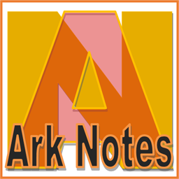
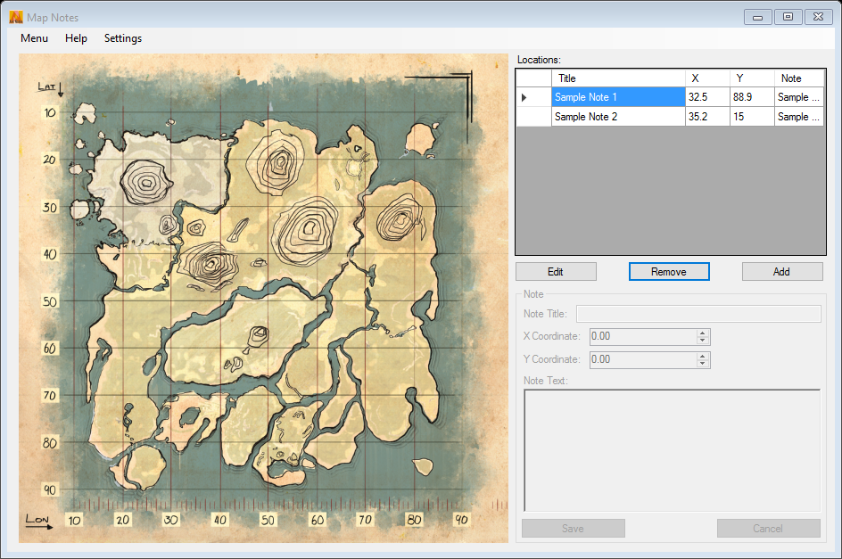
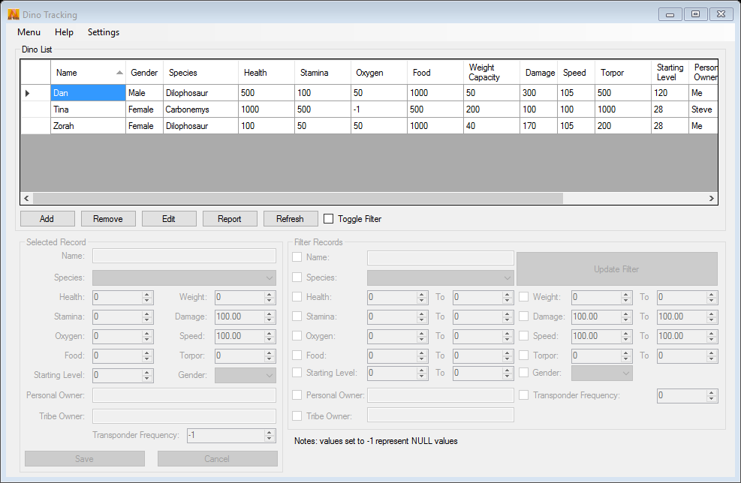
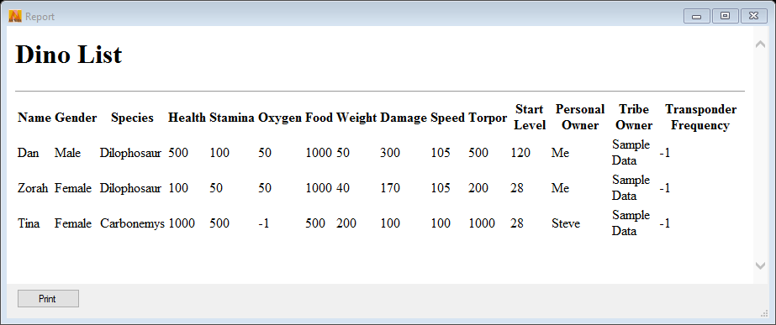

Ark Notes
: a Companion app for ARK: Survival Evolved
Features:
Dino/Creature Tracking Including
Ability to Create Search Filters
Printable Reports
GPS Notes
Easy to use interface
Embedded Help Files

