Slide 1

Verifi2: A layman’s introduction
Alex Lisboa-Wright

Slide 2
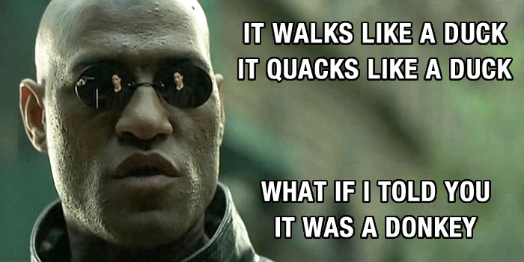
Motivation
Social media misinformation has become increasingly important in recent years
One example: Twitter “news” service accounts
Look and sound like a news provider, but actually peddling lies/distortions
https://bennadel-cdn.com/resources/uploads/2015/what-if-i-told-you-it-was-a-donkey.jpg

Slide 3

The challenge
People behind misinformation
want others to believe it
Misinformation often plays
on readers’ experiences &
prejudices – fits
into an existing pattern
Many different forms – content
language, images
https://img.buzzfeed.com/buzzfeed-static/static/2020-03/23/15/asset/5cd789360b4d/sub-buzz-278-1584977747-6.jpg

Slide 4

VERIFi2 - the data
Taken from Twitter via public Twitter Streaming API
Sources: 285 Twitter accounts - 166 real news org accounts, 119 suspicious ones
All extensively cross-checked by 3rd parties & used in previous research

Slide 5
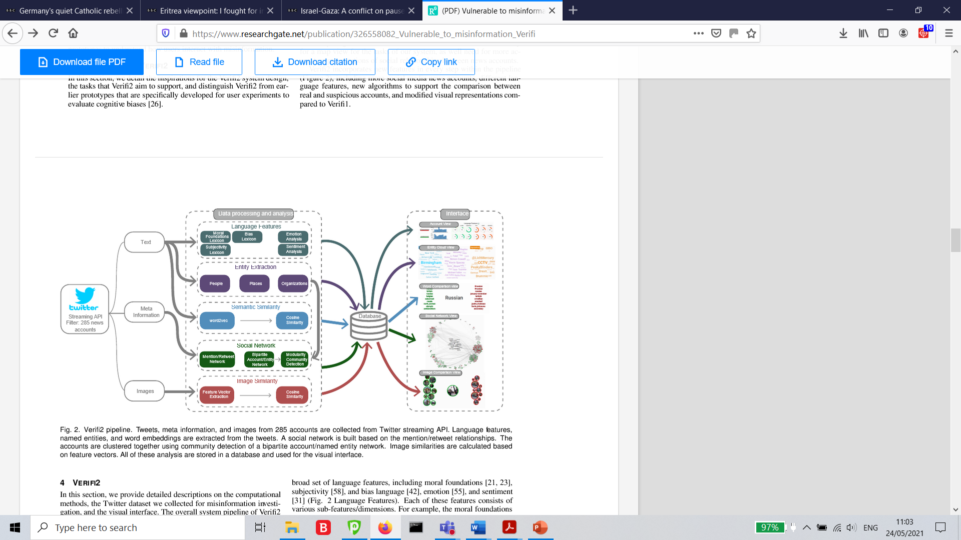
verifi2 pipeline

