Slide 1
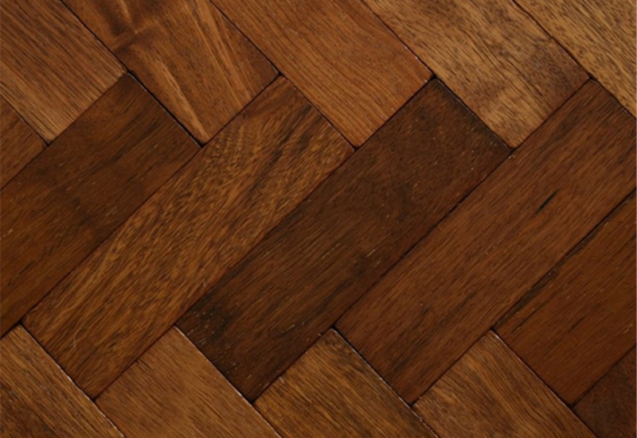
Parquet

Slide 2
Definition
A columnar storage format available to any project in the Hadoop ecosystem, regardless of the choice of data processing framework, data model or programming language

Slide 3
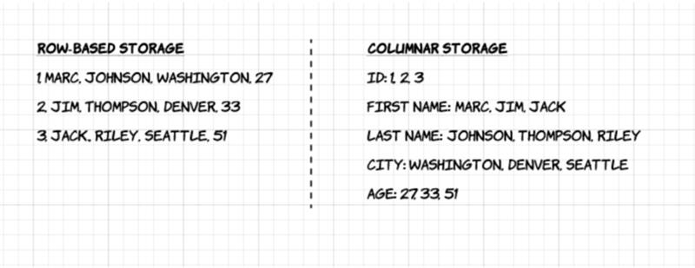
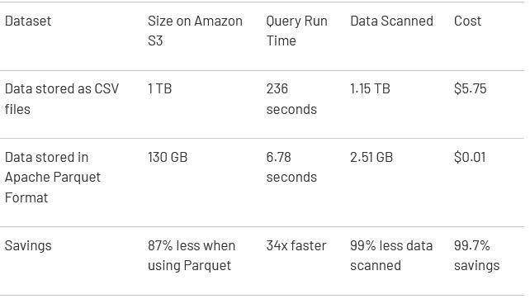
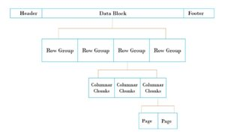
Example

Slide 4
Explanation
Column-wise compression is efficient and saves storage space
Compression techniques specific to a type can be applied as the column values tend to be of the same type
Queries that fetch specific column values need not read the entire row data thus improving performance
Different encoding techniques can be applied to different columns

Slide 5
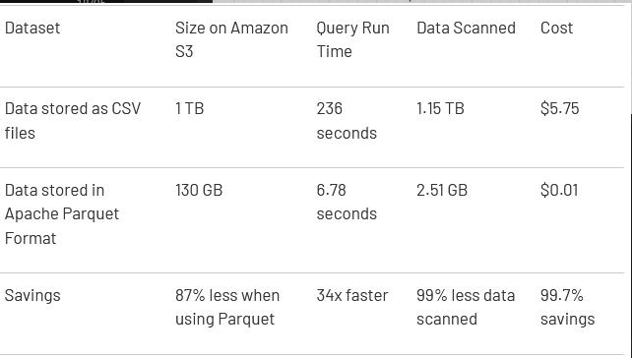
Advantages
Columnar storage is designed to bring efficiency compared to row-based files like csv.
Columnar storage can skip over non-relevant data quickly.
Makes aggregation queries less time consuming
Reduces cost when using cloud storages.
By their very nature, column-oriented data stores are optimized for read-heavy analytical workloads
Quick to read from

Slide 6
Disadvantages
Columnar is not as efficient for writing to human users, e.g. airline tickets, where it's far more relevant to have info for different columns grouped together for a single purchase -> row-wise like AVRO
If you need to access all data fields, prefer row-wise over columnar.
Slow to write files

Slide 7
Compressible data types:
BOOLEAN: 1 bit Boolean
INT32: 32 bit signed ints
INT64: 64 bit signed ints
INT96: 96 bit signed ints
FLOAT: IEEE 32-bit floating point values
DOUBLE: IEEE 64-bit floating point values
BYTE_ARRAY: arbitrarily long byte arrays.

Slide 8
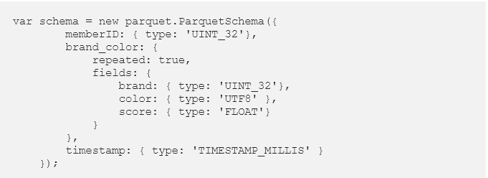
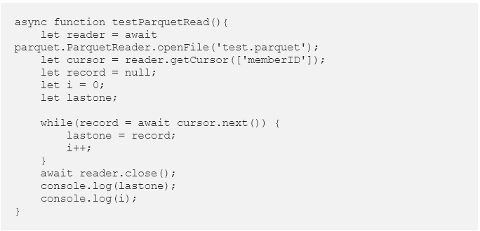
Reading the ‘memberID’ of the parquet file
Schema of a parquet file

Slide 9
Thanks for listening!
Questions?

