Slide 1
Best Practices for Creating
Functions
By Alex, Andrei, Arcan, Edward and Kieran
Notes:
Hello Everyone, today our presentation on best practices for creating functions will be presented by Ed, Alex, Arcan, Andrei, and myself.

Slide 2

When to use functions
Kieran
When projects begin to get more complex, you may find yourself repeating yourself.
This does not follow the DRY philosophy
Errors when repeating
Visual clutter
Increased storage
Increased effort in management
Using the same code pattern more than twice

Slide 3
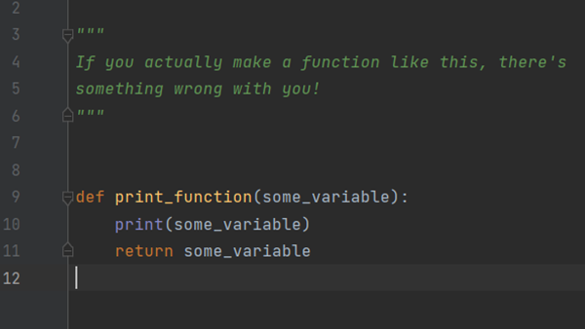
Ed
Useless Function

Slide 4
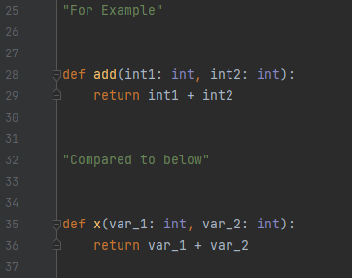
Name Function Appropriately
Ed
When naming your function, make sure you include something that relates to what the function is doing

Slide 5
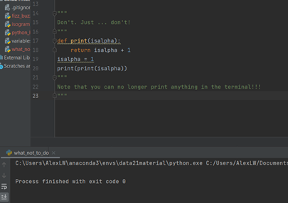
Don’t use keywords as function names
Alex
You do not want to name a function that is already in Python, otherwise when you reference it later Python will not know which function you are referring to.

Slide 6
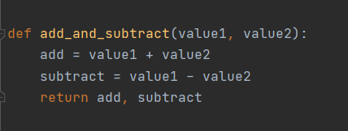
Single Responsibility Principle
Arcan
Don’t create a code that carries out more than one task.
Reduces the need change the function down the line to only carry out one task.
This will also help with naming conventions.
This function adds the values and also subtracts the values.
Notes:
Hello Everyone,

Slide 7
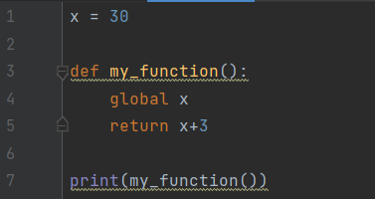
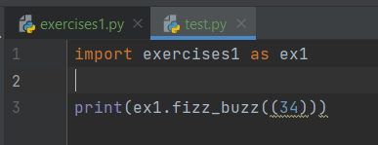
Organizing Function
Andrei
Order Matters in Python:
Global Variables should be added before functions.
Importing libraries should be done before functions.
Functions before remaining scripts.
Functions to be used inside other functions First.
Creating Module
Creating a separate .py file for your functions.

