Slide 1

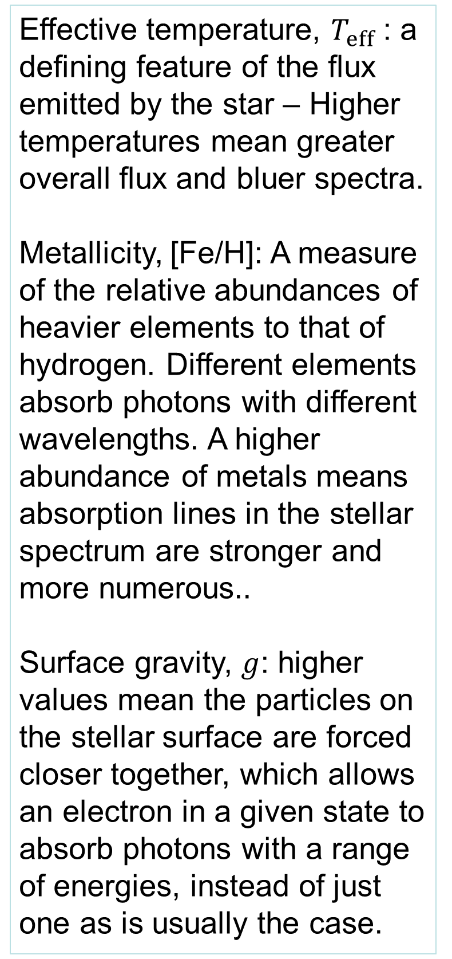
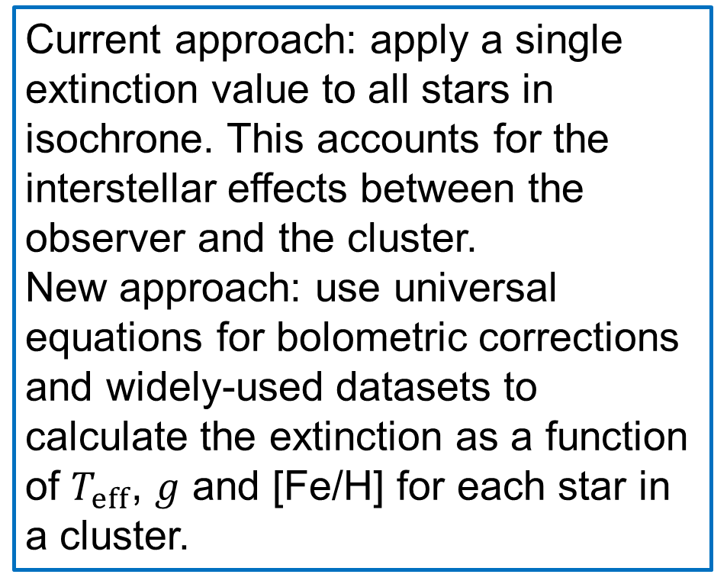
Modelling extinction in stellar populations
Alex Lisboa-Wright & Maurizio Salaris
Astrophysics Research Institute, Liverpool John Moores University
Byrom Street, Liverpool, L3 3AF, UK
Abstract
To determine the age of a cluster of stars, a series of stellar isochrones is fitted to the observed colour-magnitude diagram (CMD) of the cluster, with the age of the best-fitting isochrone taken as the cluster age. However, to link observations to theory, the interstellar extinction of light must first be accounted for.
In this project, the variations of extinction between individual stars, relative to a known reference filter extinction, A_{V}, are calculated, using synthetic stellar atmospheres for multiple wide-field filters in the Gaia observatory and Hubble Space Telescope, with wavelengths ranging from the ultraviolet (UV) to the infrared (IR).
These variations are then modelled empirically in each filter, using analytic functions of stellar effective temperature, surface gravity and metallicity. The function in each filter is able to accurately describe the variations in the data.
The functions will then be applied to a series of isochrones, together with differing values A_{V} to simulate different distances to clusters. A constant extinction value for each filter will also be applied to the isochrones for comparison. The difference between the results of these two methods is significant, particularly for observations made by Gaia, with the function-based approach providing best-fit isochrones with ages younger than found using the current approach.
Effective temperature, $T_{eff}$: a defining feature of the flux emitted by the star – Higher temperatures mean greater overall flux and bluer spectra.
Metallicity, [Fe/H]: A measure of the relative abundances of heavier elements to that of hydrogen. Different elements absorb photons with different wavelengths. A higher abundance of metals means absorption lines in the stellar spectrum are stronger and more numerous..
Surface gravity, $g$: higher values mean the particles on the stellar surface are forced closer together, which allows an electron in a given state to absorb photons with a range of energies, instead of just one as is usually the case.
Extinction refers to the difference, after accounting for distance and instrumental effects, between the flux a light source should emit and the flux actually detected by an observer.
A stellar population of a single age is known as an isochrone. To determine the isochrone age, extinction for the relevant filters is applied and the resulting colour-magnitude diagram (CMD) is used to determine the age of the theoretical isochrone with the best-fitting main-sequence turn-off (MSTO) point.
Aim: to improve extinction models for for stellar populations, with the specific objective aim of determining any changes in estimated cluster ages from those found using the current approach.
Results and discussion
The Hubble telescope wide-field filters are robust against significant differences in isochrone age between the two approaches. The Gaia filters, however, experience a significant difference in both the position and shape of the isochrone between the current and new approaches, as shown in Figure 1.
In Figure 2, the calculated age of the open cluster NGC 6793 is 600 Myr and the calculated extinction Av is 0.84 (from Gaia Collaboration et al., 2018) for the current approach. For the best fit using the new approach, the calculated parameters are 500 Myr and Av = 1.1. All curves assume the cluster to have solar metallicity.
It is clear that the new function-based approach is capable of reproducing the accuracy of the current approach but that the best-fit age is always lower and the best-fit Av is always higher. Also, the isochrone position for post-MSTO evolution is altered significantly.
Current approach: apply a single extinction value to all stars in isochrone. This accounts for the interstellar effects between the observer and the cluster.
New approach: use universal equations for bolometric corrections and widely-used datasets to calculate the extinction as a function of $T_{eff}$, $g$ and [Fe/H] for each star in a cluster.
References
Gaia Collaboration et al., 2018, A&A, 616, A10
Cardelli J. A., Clayton G. C., Mathis J. S., 1989, ApJ, 345, 245
Salaris M., Cassisi S., 2005, Evolution of Stars and Stellar Populations
Casagrande L., VandenBerg D. A., 2014, MNRAS, 444, 392
Casagrande L., VandenBerg D. A., 2018b, MNRAS, 479, L102
Kurucz R., 1993, ATLAS9 Stellar Atmosphere Programs and 2 km/s grid. Kurucz CDROM No. 13
Figure 1: The effect of the current (green, blue & red lines represent ages of 400, 500 & 600 Myr, respectively) and new (orange line) approaches to modelling extinction for a 500 Myr-old cluster with solar metallicity. The purple line is the 500 Myr isochrone with no extinction.
Figure 2: The result of both the current (red and green dashed lines) and new (solid blue line) approaches to extinction.

