Slide 1

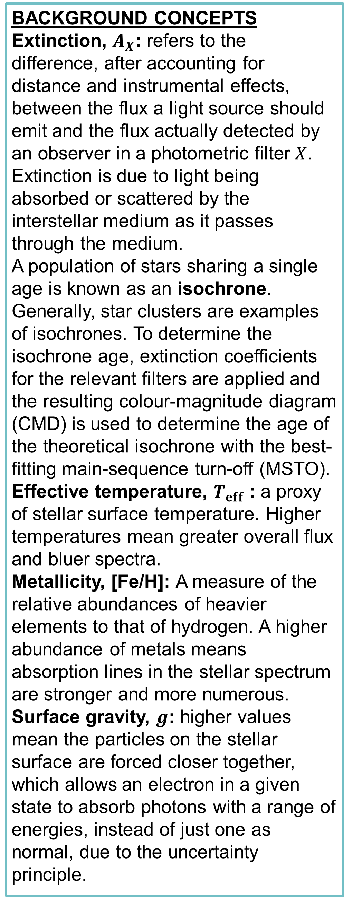
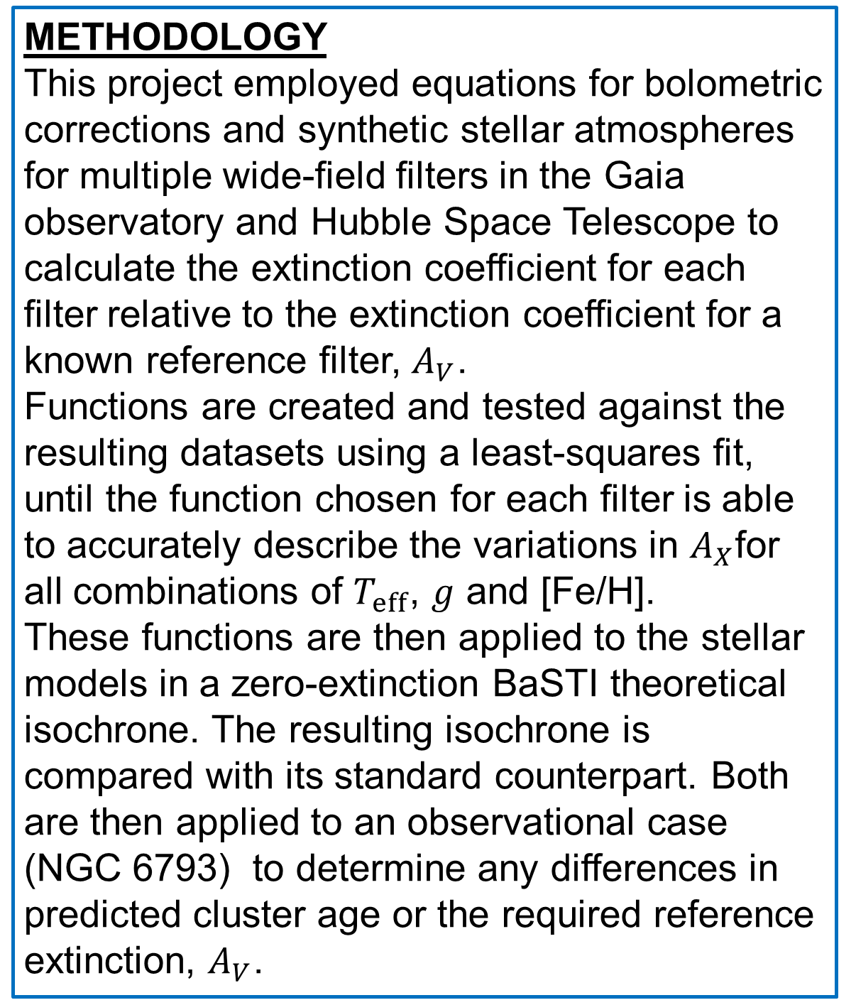
Modelling extinction in stellar populations
Alex Lisboa-Wright & Maurizio Salaris
Astrophysics Research Institute, Liverpool John Moores University
Byrom Street, Liverpool, L3 3AF, UK
When determining the age of a star cluster, the interstellar extinction of light must first be accounted for to link observations to stellar evolution theory. The current widely-used approach applies a fixed value of the extinction coefficient to all stars in a given cluster for each filter, ignoring variations in extinction values within filters. In this project, for wide-field filters in the Hubble and Gaia telescopes, these variations are modelled as functions of fundamental stellar parameters and applied to a series of isochrones. A constant extinction value for each filter, as per the standard approach, will also be applied for comparison. The difference between the results of these two methods is significant for observations made by Gaia, with the new approach providing best-fit isochrones with ages younger than found using the standard approach.
Background concepts
Extinction, $A_{X}$: refers to the difference, after accounting for distance and instrumental effects, between the flux a light source should emit and the flux actually detected by an observer in a photometric filter $X$. Extinction is due to light being absorbed or scattered by the interstellar medium as it passes through the medium.
A population of stars sharing a single age is known as an isochrone. Generally, star clusters are examples of isochrones. To determine the isochrone age, extinction coefficients for the relevant filters are applied and the resulting colour-magnitude diagram (CMD) is used to determine the age of the theoretical isochrone with the best-fitting main-sequence turn-off (MSTO).
Effective temperature, $T_{eff}$: a proxy of stellar surface temperature. Higher temperatures mean greater overall flux and bluer spectra.
Metallicity, [Fe/H]: A measure of the relative abundances of heavier elements to that of hydrogen. A higher abundance of metals means absorption lines in the stellar spectrum are stronger and more numerous.
Surface gravity, $g$: higher values mean the particles on the stellar surface are forced closer together, which allows an electron in a given state to absorb photons with a range of energies, instead of just one as normal, due to the uncertainty principle.
Results and discussion
The Hubble telescope filters are robust against significant differences in isochrone age between the two approaches. The Gaia filters, however, experience a significant difference in both the position and shape of the isochrone between the current and new approaches, as shown in Figure 1.
In Figure 2, the calculated age of the open cluster NGC 6793 is 600 Myr and the calculated extinction Av is 0.84 (from Gaia Collaboration et al., 2018) for the standard approach. For the best fit using the new approach, the calculated parameters are 500 Myr and Av = 1.1. All curves assume the cluster to have solar metallicity.
It is clear that the new function-based approach is capable of reproducing the accuracy of the standard approach but that the best-fit age is always lower and the best-fit Av is always higher. The new approach has the added benefit of accounting for variations in extinction arising from well-studied and accepted data.
Figure 1: Effect of the standard (green, blue & red lines represent ages of 400, 500 & 600 Myr, respectively) and new (orange line) approaches to modelling extinction for a 500 Myr-old cluster with solar metallicity in the Gaia CMD. The purple line is the 500 Myr isochrone with zero extinction.
METHODOLOGY
This project employed equations for bolometric corrections and synthetic stellar atmospheres for multiple wide-field filters in the Gaia observatory and Hubble Space Telescope to calculate the extinction coefficient for each filter relative to the extinction coefficient for a known reference filter, $A_{V}$.
Functions are created and tested against the resulting datasets using a least-squares fit, until the function chosen for each filter is able to accurately describe the variations in $A_{X}$for all combinations of $T_{eff}$, $g$ and [Fe/H].
These functions are then applied to the stellar models in a zero-extinction BaSTI theoretical isochrone. The resulting isochrone is compared with its standard counterpart. Both are then applied to an observational case (NGC 6793) to determine any differences in predicted cluster age or the required reference extinction, $A_{V}$.
MSTO
References
- Gaia Collaboration et al., 2018, A&A, 616, A10
- Cardelli J. A., Clayton G. C., Mathis J. S., 1989, ApJ, 345, 245
- Salaris M., Cassisi S., 2005, Evolution of Stars and Stellar Populations
- Hidalgo S. L., et al., 2018, ApJ, 856, 125
- Kurucz R., 1993, ATLAS9 Stellar Atmosphere Programs and 2 km/s grid.
Figure 2: Result of both current (red and green dashed lines) and new (solid blue line) approaches to extinction in the distance-corrected Gaia CMD for NGC 6793.

