Slide 1
CS673 · ITERATION 2
SAFEDROP
Inventory Management & Checkout Service
Team 3 · Iteration 2 Review · October 2026
Alexa Stein
Amber Rastella
Alex Picard
Mateus Silva
Orelmis Toribio
Team Lead
Security Lead
Configuration Lead
Requirements Lead
QA Lead
Presented by Alexa, Alex and Amber · Demo recorded by Orelmis and Mateus
github.com/BUMETCS673/CS673OLF26P3
Notes:
ALEXA:
Hi everyone, we're Team 3, and this is our Iteration 2 review of SafeDrop.
I'm Alexa Stein, the team lead. Alex Picard, our configuration lead, and Amber Rastella, our security lead, are presenting with me today. Mateus Silva and Orelmis Toribio recorded the live demo you'll see in the middle.
[Next slide.]

Slide 2
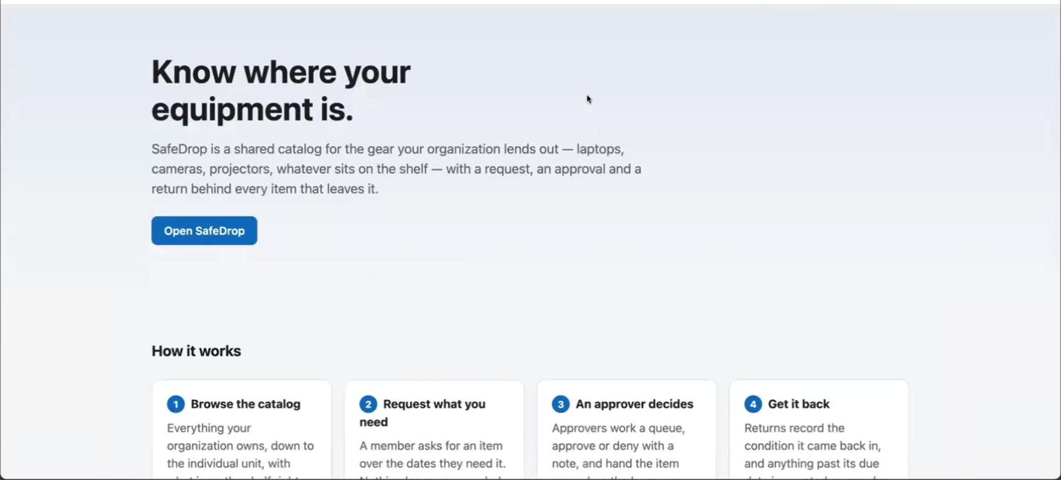
Know Where Your Equipment Is
Alexa
The problem
Organizations lend laptops, cameras, projectors and drones, and track them in spreadsheets and email. When something goes missing, nobody can say who had unit #247, who approved it, or whether it came back.
What SafeDrop is
1
Browse a shared catalogue, down to each unit
2
Request the dates you need it
Iteration 1 built the loop every organization needs.
Iteration 2 made it configurable per organization: who approves, who may borrow, and who confirms a return.
3
Approve by the rules your organization sets
4
Return with its condition recorded
Feedback from Iteration 1 asked us to open with the vision. Customers named in our SPPP: universities, libraries and other organizations that lend physical equipment.
Notes:
ALEXA:
Before the details, a quick reminder of what SafeDrop is for.
Universities, libraries and other organizations lend out a lot of equipment: laptops, cameras, projectors, even drones. Most of them track it in spreadsheets and email. So when something goes missing, nobody can say who had unit 247, who approved it, or whether it ever came back.
SafeDrop gives an organization one shared catalogue. Members browse it and request what they need, an approver decides, and the item comes back with its condition recorded. Every step is written to an audit log.
Iteration 1 built that basic loop. Iteration 2 was about letting each organization configure it: who approves, who is allowed to borrow, and who confirms a return.
[Next slide.]

Slide 3
Our Iteration 1 Promises, Scored
Alexa
Configurable approvals
Two-step return
Finish SR-8
Point the backlog
Per item, per equipment group, per user tier
Condition capture at return, carried over from SCRUM-57
Apply the insert-only audit role
So Iteration 2 reports a velocity worth trusting
DELIVERED
DELIVERED
STILL OPEN
PARTIAL
Organization default with a per-asset override. User tiers became groups, and groups decide who may borrow restricted equipment.
The borrower starts the return with a condition and note. Someone else confirms or rejects it.
The role is still not applied on Atlas. Audit immutability rests on the application layer alone.
Every Iteration 2 story is pointed. Tasks and the Lab 3 stories are not, so velocity counts stories only.
Commitments from the closing slide of our Iteration 1 review. SR-8 is covered on slide 10.
Notes:
ALEXA:
We closed Iteration 1 with four promises, so here is how we did.
Configurable approvals: delivered. An organization sets a default, and any asset can override it. We had planned user tiers; they became user groups, and groups decide who can borrow restricted equipment.
The two-step return: delivered. You'll see both of these in the demo.
Finishing SR-8, the database-level protection for the audit log: still open. Amber will cover that.
And pointing the backlog is partial. Every Iteration 2 story has story points, but our tasks and the Lab 3 stories don't.
[Next slide.]

Slide 4
Requirements: The Desirable Set
Alexa
Configurable approvals
Organization default: require an approver or approve automatically; per-asset override
SCRUM-148
8
DONE
User groups
Create groups, add and remove members; every change audited
SCRUM-149
5
DONE
Restricted equipment
Assets limited to groups; eligibility checked on submit and on approval
SCRUM-150
8
DONE
Two-sided custody
Borrower-recorded pickup, confirmed returns, pickup-window expiry
SCRUM-205
4
DONE
AI-assisted search
Catalogue search bar; model ranks backend-chosen results; plain fallback
SCRUM-103, 145, 146, 200, 201
8*
DONE
AI alternatives
"Similar items available now" when nothing is available
SCRUM-151
5
DONE
Semantic retrieval (RAG)
Tenant-scoped vector search to choose search candidates
SCRUM-147
13
ITERATION 3
Search telemetry
Fallback rate and latency without storing what members typed
SCRUM-206
5
ITERATION 3
30 of 48 new story points shipped; SCRUM-147 and 206 moved to the Iteration 3 sprint. Also merged from Lab 3: unit maintenance (141), overdue loans (140), due-date badges (143), member deactivation (142).
Notes:
ALEXA:
These are the desirable features from our Iteration 0 roadmap. Six of the eight stories are done and merged: configurable approvals, user groups, restricted equipment, two-sided custody, AI-assisted search, and AI-recommended alternatives.
Two are not. SCRUM-147, semantic retrieval for the AI search, was marked Done on our board, but the code isn't in main. We reopened it and moved it to Iteration 3. Search telemetry, SCRUM-206, didn't start, so it moved to Iteration 3 as well.
That puts us at 30 of 48 new story points. We also merged four smaller features from Lab 3, listed at the bottom of the slide.
[HAND-OFF: "Alex, over to you."]

Slide 5
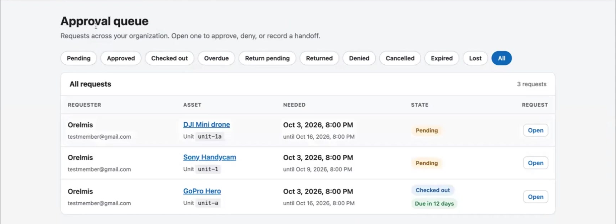
What Iteration 2 Actually Ships
Alex
19
48
8
15
25
screens
API routes
collections
state transitions
audit actions
16 → 19
29 → 48
7 → 8 (UserGroup)
10 → 15
13 → 25
The same structure, more of it
Groups got their own layer top to bottom: model, repository, service, routes and two screens.
New request states surface everywhere at once: the queue filters, the dashboard and the history timeline.
Review feedback applied: InviteForm and ResetPasswordForm now live in src/components.
Counted from the code at commit 5c4bcc8 against the Iteration1 tag. Screens are page components; routes are entries in the route table.
Notes:
ALEX:
Thanks, Alexa. Here's what that looks like in the code.
We went from 16 to 19 screens and from 29 to 48 API routes. There's one new collection, UserGroup. The request lifecycle grew from 10 transitions to 15, and we now record 25 kinds of audit event, up from 13.
The structure didn't change. Groups got the same model, repository, service and route layers as everything else. We also acted on last iteration's code feedback: the two forms that were built inside the Members page now live in their own component files.
[Next slide.]

Slide 6
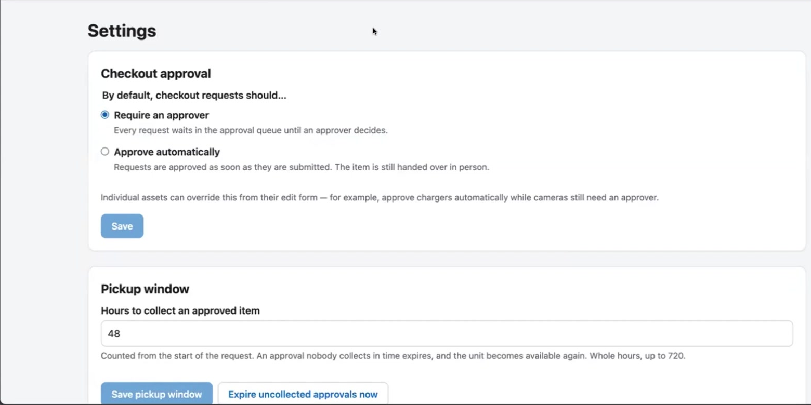
Approval Is a Policy, Not a Rewrite
Alex
Member submits a request
Asset's approval mode?
Required / Auto
Inherit
Use the asset's mode
Use the organization default
Resolved mode
Whether a human decides is configurable. Who may decide is not.
Auto-approval has its own audit action, so the log never shows an approval with no approver behind it.
Changing the default is audited with before and after values.
REQUIRED
AUTO
PENDING in the approval queue. The approver may not be the requester.
APPROVED at once, unit HELD, audited as REQUEST_AUTO_APPROVED.
Missing or unknown mode → REQUIRED. The rule fails closed.
SDD §8.5 Strategy pattern. The Iteration 1 policy interface let SCRUM-148 add a policy without changing approveRequest.
Notes:
ALEX:
In Iteration 1 we put the approval rule behind a policy interface, the Strategy pattern in our SDD, because we knew this iteration would need it. That paid off: adding configurable approvals meant adding a new policy, not rewriting the approval code.
Here's how it decides. When a member submits a request, we look at the asset. If the asset says required or auto, that's the answer. If it says inherit, we use the organization's default.
Required means the request waits in the approval queue, and the approver still can't be the person who asked. Auto means it's approved immediately.
If the mode is missing or unrecognized, we treat it as required, so the rule fails closed. And auto-approvals get their own audit action, so the log never shows an approval with no approver behind it.
[Next slide.]

Slide 7
The Lifecycle Grew, Still One Table
Alex
What changed and why
Pending
Approved
Checked out
Return pending
Returned
Return pending. The unit stays out and the borrower stays responsible until someone else confirms.
Sole confirmer. If the borrower is the only approver, they may close it, and the audit entry says so.
Expired. Approvals not collected in the pickup window (48 h default) release the unit.
return rejected
Denied · Cancelled
Expired
Overdue
Lost
New state
Pending and approved requests can also be cancelled. Checked-out units can be marked lost.
New transition
checkout.service.js TRANSITIONS. Every handler goes through assertTransition; each transition commits with its audit entry in one transaction.
Notes:
ALEX:
The lifecycle grew too, and it's still one transition table that every handler goes through. The new pieces are in amber.
Return pending: the borrower says the item is back, but the unit stays checked out to them until someone else confirms. If the return is rejected, it goes back to checked out. If the borrower happens to be the only approver in the organization, they're allowed to confirm it themselves, and the audit entry records that.
Expired: if an approved item isn't picked up within the pickup window, 48 hours by default, the approval expires and the unit is released.
[HAND-OFF: "Amber, over to you."]

Slide 8
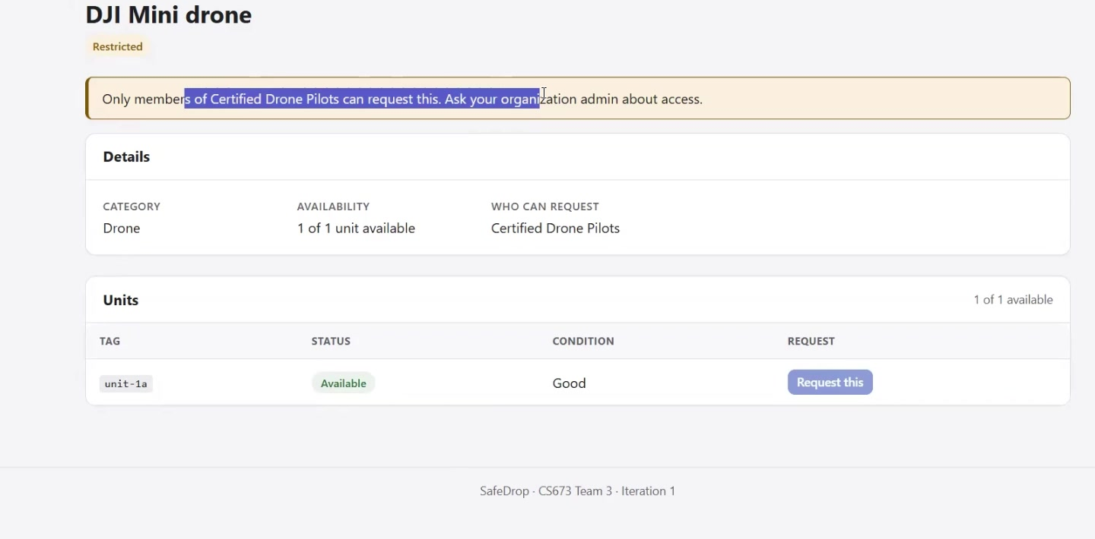
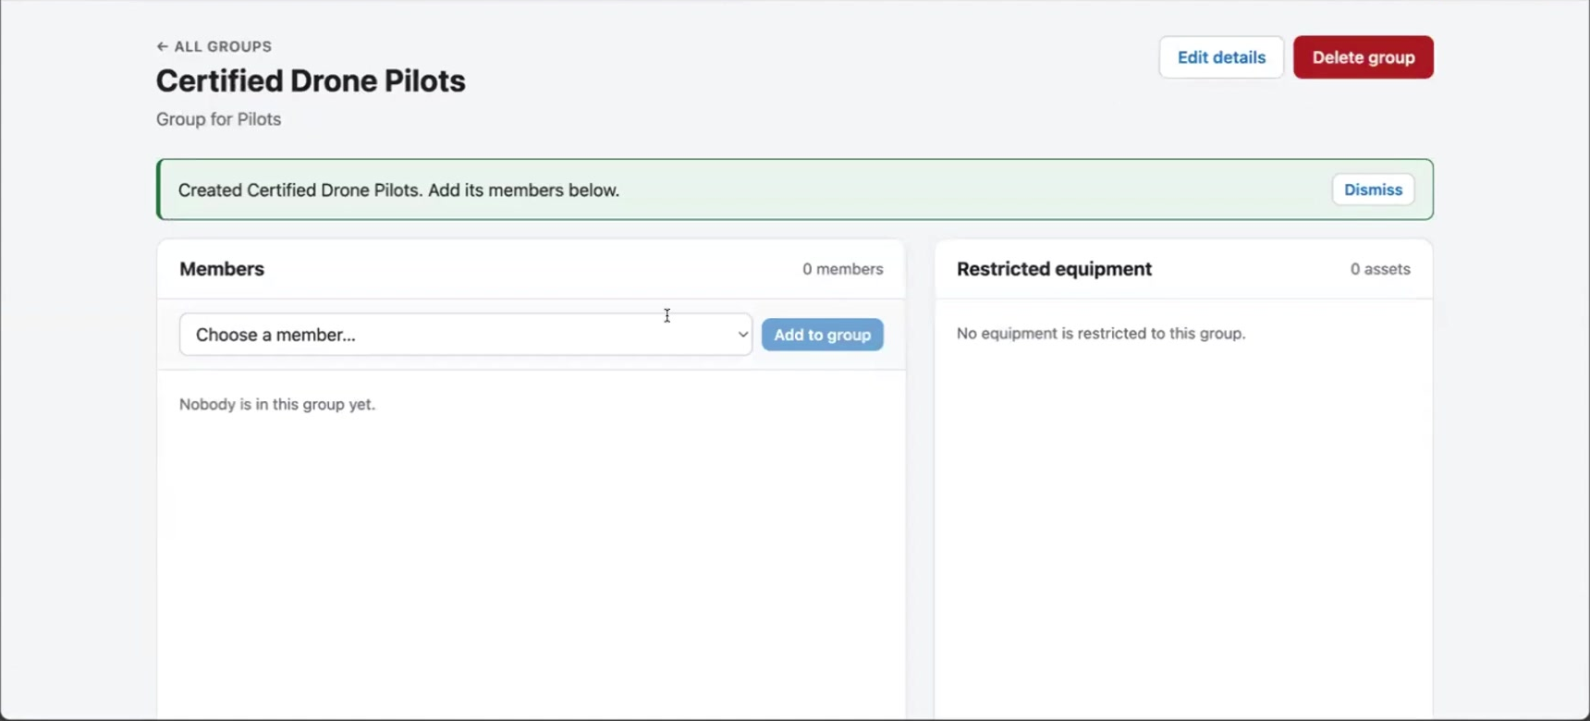
Who May Borrow Is Now Configurable
Amber
Enforced on the server, twice
Checked on submit and on approval. An approver cannot approve a member who is not eligible, even through a direct API call.
Restricted assets stay visible. Members see a Restricted badge and who can borrow it, so they know whom to ask.
Every group change is audited. Five new actions, from group created to member removed.
Tenant isolation extended. Another organization's group ids return 404, as everywhere else.
Deactivated members get the same 401 at sign-in as a wrong password, so the response reveals nothing.
SCRUM-149 and SCRUM-150. Manual tests MT-26, MT-27 and MT-34; automated suites groups.test.js (41), group.test.js (13), allowedGroupIds.test.js (5).
Notes:
AMBER:
Thanks, Alex. Groups let an organization decide who may borrow restricted equipment. In the demo, the drone is restricted to a group called Certified Drone Pilots.
The server checks eligibility twice: when the member submits the request, and again when an approver approves it. So an approver can't approve someone who isn't eligible, even through a direct API call.
Restricted items stay visible in the catalogue with a badge, so members know the item exists and whom to ask. Every group change is audited, and another organization's group IDs return 404, like every other resource.
And a deactivated member gets the same error at sign-in as a wrong password, so the response doesn't reveal anything.
[Next slide.]

Slide 9
AI-Assisted Search: The Model Only Ranks
Amber
1
2
3
4
5
Member types
API checks
Backend picks
Model ranks
Results
Debounced search bar, up to 200 characters
assets:read; organization comes from the token only
Up to 100 candidates from this organization, retired assets excluded
Microsoft Foundry orders the candidates; any other id it returns is dropped
Ranked matches, each with a short reason
Every failure is a fallback
Built to be safe with member data
Reused for "Similar items"
Foundry off, slow (10 s timeout) or answering off-contract returns the same candidates in plain order. Search never breaks because the model did.
The model never connects to MongoDB. Logs keep a prompt hash, latency and status, never the query or the answer.
SCRUM-151 runs the same pipeline and applies group eligibility before the model sees a candidate.
SCRUM-147, semantic retrieval with vector search. Candidates are still chosen by text match. Now in the Iteration 3 sprint.
NOT SHIPPED
SCRUM-103, 145, 146, 200, 201 and 151. The model is mocked in every automated test; Foundry is off by default (FOUNDRY_ENABLED=false).
Notes:
AMBER:
My story this iteration was AI-assisted search, and the design rule is simple: the model only ranks.
A member types in the search bar. The API takes the organization from the login token, never from the request. The backend then picks up to 100 candidate assets from that organization only, leaving out retired items.
Only those candidates go to Microsoft Foundry, and the model's job is to put them in order. If it returns an ID that wasn't in the list, we drop it. That means a prompt-injection attempt can't pull in another organization's data.
If the model is off, slow or gives a bad answer, we fall back to plain search, so search never breaks because the model did. We log a hash of the prompt, never what the member typed. Mateus reused this pipeline for "Similar items available now."
What didn't ship is the semantic part: choosing candidates by meaning with vector search. That's SCRUM-147, and it's now in our Iteration 3 sprint.
[Next slide.]

Slide 10
Security, Reported Honestly
Amber
HELD THIS ITERATION
STILL OPEN
Separation of duties reaches returns. Nobody confirms their own return unless they are the only approver, and then the log says so.
New rules fail closed. An unknown approval mode means an approver is required.
A new attack surface, bounded. Search text reaches a model, but the model can only reorder ids we chose for this organization.
Tests for the new pages. Tenant isolation was re-run on groups, alternatives and search (MT-34).
Audit immutability at the database layer
SCRUM-125 · SR-8 partially satisfied
The insert-only role and its test have been merged since Iteration 1. Applying it on Atlas is still blocked on console access.
Until then, anything that bypasses Mongoose could change audit rows. The application layer is tested and holds.
Our board was wrong: Jira shows SCRUM-125 Done. The STD is right. We are reopening the ticket.
SR-8 is in the risk register with an owner. We would rather present it as open than claim a layer that is not switched on.
Notes:
AMBER:
On security overall, here's what held. Separation of duties now covers returns as well as approvals. New rules fail closed. AI search adds a new input path, but the model can only reorder IDs we already chose for that organization. And we re-ran our tenant-isolation tests on the new pages.
One item is still open, and it's the same one as last time: SR-8. The insert-only database role for the audit log is written and tested, but it hasn't been applied on Atlas, because we're still blocked on console access. Until it is, audit immutability depends on the application layer, which is tested and holds.
We'd rather report it as open than claim a protection that isn't switched on.
Now let's go to the demo, recorded by Orelmis and Mateus on our staging site.
[Next slide, then start the video.]

Slide 11
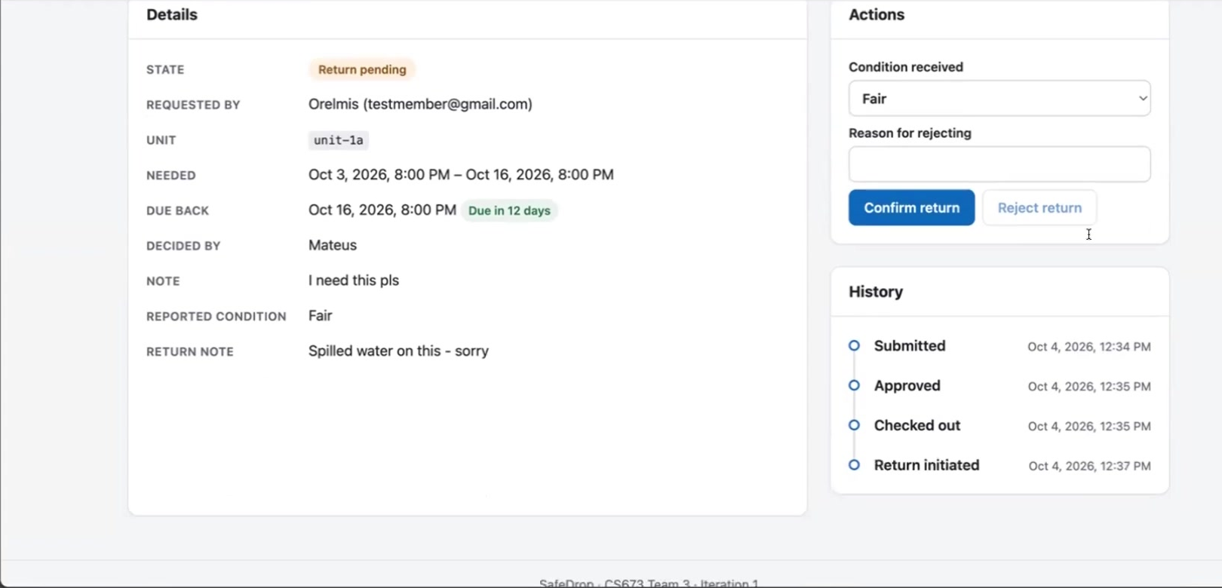
Demo: One Organization, End to End
LIVE ON STAGING
Recorded by Orelmis Toribio (member) and Mateus Silva (organization admin) at safe-drop-five.vercel.app
0:00
Create an organization
5:24
Auto-approved request, own pickup
1:18
Approval default, pickup window
6:00
"Similar items available now"
1:36
Invite a member
6:36
Restricted drone: refused, then granted
2:06
Create a group
7:54
Approval queue and handoff
2:24
Add assets: per-asset approval, restriction
8:42
Two-step return
4:42
Member's first sign-in
10:36
Audit log and dashboard
Notes:
VIDEO:
(No one speaks. Play Demo.mp4 in full: 11 minutes 31 seconds. The chapter times on the slide match the recording.)
[When the video ends, Alex picks up on slide 12.]

Slide 12
Quality Assurance and Testing
Alex
1,508
95.2%
97.8%
0
test cases passing
backend line coverage
frontend line coverage
npm audit findings
+587 since Iteration 1
gate fails below 80%
gate fails below 80%
at high or above
Built test-first
Manual tests, now recorded
Most stories committed each acceptance criterion as a failing test before the code. The history shows the red and green commits in pairs.
MT-19 to MT-35 each have steps and an expected result, run against the seeded stack. 15 pass, 2 partial:
PARTIAL
MT-19: the dashboard's Available count lags after a unit leaves maintenance.
custodyConfirmation
51
groups
41
approvalSettings
30
PARTIAL
MT-21: request dates shift between input, storage and display (time zones).
SCRUM-151 alternatives
29
One defect fixed in-iteration: PR #64, "Unknown user" rows in the approval queue, with 9 regression cases.
overdue
23
CI run on main at commit 5c4bcc8, 4 October 2026, which passed every job. STD v0.3 §1.2, §2.5 and §4.2.
Notes:
ALEX:
Welcome back. On testing: 1,508 automated tests pass, 587 more than in Iteration 1. Line coverage rose to 95.2 percent on the backend and 97.8 percent on the frontend, and there are no high-severity dependency findings.
Most stories were built test-first: each acceptance criterion was committed as a failing test before the code that makes it pass.
Last time you asked us to record our manual tests properly. MT-19 through MT-35 now each have steps and an expected result. Fifteen passed and two were partial: the dashboard's available count lags after maintenance, and request dates shift between time zones. Both are logged for Iteration 3.
[Next slide.]

Slide 13
Configuration and Delivery
Alex
16
0
100
6
pull requests merged
direct commits to main
commits since Iteration1
CI jobs on every push
What held
Still open from last review's pipeline notes
Every change reached main through a pull request with CI green, including the Lab 3 work.
Local, CI and staging still run the same Docker images, and staging deployed every merge.
The demo was recorded against staging, not a local build.
Release tags (Iteration*) still don't trigger the ZAP scan or production job, which key on v*.
The frontend production build (vite build) is not yet a CI step.
The stray safedrop-code: file:.. dependency is still in both package.json files.
The README still says Node 20; the engines field needs 22.12.
Pipeline items checked in the repository at commit 5c4bcc8. Staging: safe-drop-five.vercel.app and safedrop-ony6.onrender.com.
Notes:
ALEX:
On delivery: 16 pull requests merged this iteration, and nothing was committed straight to main. Every merge deployed to staging, and the demo you just watched ran there.
A few items from last review's pipeline notes are still open. Release tags don't trigger the security scan yet. The frontend production build isn't a CI step. There's a stray dependency in both package files, and the README lists the wrong Node version. They're all small fixes.
[HAND-OFF: "Amber?"]

Slide 14
Iteration 1 Feedback: What We Did
Amber
Show the app running in the demo
11-minute demo recorded live on staging
DONE
Add a product vision slide
Slide 2
DONE
Record manual test steps and results
MT-19 to MT-35 with steps and expected results
DONE
Move the Members page forms to src/components
InviteForm and ResetPasswordForm extracted
DONE
Approval on every PR; nothing straight to main
16 PRs, 0 direct commits to main
IMPROVED
Point every story; close finished subtasks
Iteration 2 stories pointed; tasks and Lab 3 stories not
PARTIAL
Risk register in release, NFR-5 number, "Verified by"
"Verified by" filled (SPPP v1.2); NFR-5 still TBD; register not updated
PARTIAL
Fix progress report hours and re-export
Iteration 2 summary row not yet filled
OPEN
The eight "Before Iteration 2" items from our Iteration 1 feedback, status as of this recording.
Notes:
AMBER:
Last review gave us eight action items. Four are done: the app runs live in the demo, we opened with the vision, manual tests are recorded properly, and the Members page forms moved into their own components.
Reviews improved: every change went through a pull request.
Story points and the SPPP items are partial, and the progress report row for this iteration is still open.
[HAND-OFF: "Alexa, back to you."]

Slide 15
How the Iteration Ran
Alexa
30 / 48
6 of 8
4
17
new story points shipped
desirable stories done
Lab 3 features merged
manual test cases run
The board drifted from the code
What we change
Found while preparing this review:
A story is Done only when its PR is merged, and the PR is linked on the ticket.
Before every review, someone checks the board against main, not from memory.
Tasks get points at planning, so Iteration 3 velocity covers all the work.
Keep the Lab 3 habit: red and green commits for every acceptance test.
Fixed: SCRUM-147 was Done but not in main. Reopened, moved to Iteration 3.
Fixed: SCRUM-200 and 201 sat In Review though merged. Closed.
Open: SCRUM-125 shows Done while SR-8 is open.
Open: Iteration 1 stories carried into the Iteration 2 sprint.
Sprint "Iteration 2" in Jira, 1–6 October, after the Lab 3 work from 22 September. Points are Jira story point estimates.
Notes:
ALEXA:
Here's how the iteration ran. We shipped 30 of 48 new story points and six of eight desirable stories, plus four Lab 3 features.
Our main lesson is that the board drifted from the code. SCRUM-147 was marked Done but wasn't in main, and two merged search tasks were still sitting in review. We fixed those for this review. SCRUM-125 still shows Done while SR-8 is open, and some Iteration 1 stories were carried into this sprint.
From now on, a story is Done only when its pull request is merged and linked on the ticket, and someone checks the board against main before every review.
[Next slide.]

Slide 16
What we take into the final iteration
NEXT: ITERATION 3
Finish SR-8
Semantic search
Optional AI features
Close the loose ends
Apply the insert-only audit role on Atlas and turn the skipped test on
SCRUM-147 vector retrieval, plus SCRUM-206 telemetry without query text
Borrower reliability from audit history, as planned in the SPPP
Release-tag triggers, frontend build in CI, the two partial manual tests
Repository
Staging
github.com/BUMETCS673/CS673OLF26P3
safe-drop-five.vercel.app
Thank you — questions welcome in the discussion thread.
Notes:
ALEXA:
For the final iteration, we'll finish SR-8, ship semantic search and its telemetry, take on the optional AI features from our SPPP, starting with borrower reliability, and close the loose ends from today.
Thank you for watching. We're happy to take questions in the discussion thread.
[End.]

