Slide 2
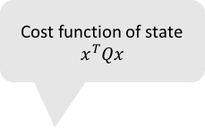

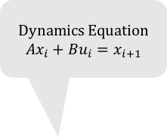



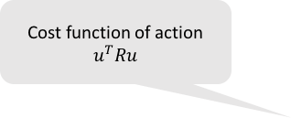

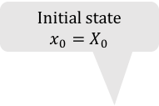
Cost function of state
$$x^{T}Qx$$
Initial state
$$x_{0}=X_{0}$$
Dynamics Equation
$$Ax_{i}+Bu_{i}=x_{i+1}$$
$$x_{0}$$
$$x_{1}$$
$$x_{2}$$
$$u_{0}$$
$$u_{1}$$
Cost function of action
$$u^{T}Ru$$

Slide 3



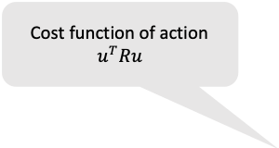
Cost function of state
$$x^{T}Qx$$
Dynamics Equation
$$Ax_{i}+Bu_{i}=x_{i+1}$$
$$x_{0}$$
$$x_{1}$$
$$x_{2}$$
Cost function of action
$$u^{T}Ru$$
$$u_{0}$$
$$u_{1}$$

Slide 4


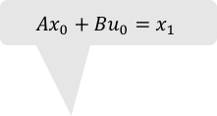



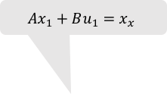



$$x_{0}^{T}Qx_{0}$$
$$x_{1}^{T}Qx_{1}$$
$$x_{2}^{T}Qx_{2}$$
$$Ax_{0}+Bu_{0}=x_{1}$$
$$Ax_{1}+Bu_{1}=x_{x}$$
$$x_{0}$$
$$x_{1}$$
$$x_{2}$$
$$u_{0}$$
$$u_{1}$$
$$u_{0}^{T}Ru_{0}$$
$$u_{1}^{T}Ru_{1}$$

Slide 5
$$x_{0}^{T}Qx_{0}$$
$$x_{1}^{T}Qx_{1}$$
$$x_{2}^{T}Qx_{2}$$
$$Ax_{0}+Bu_{0}=x_{1}$$
$$Ax_{1}+Bu_{1}=x_{x}$$
$$x_{0}$$
$$x_{1}$$
$$x_{2}$$
$$u_{0}$$
$$u_{1}$$
$$u_{0}^{T}Ru_{0}$$
$$u_{1}^{T}Ru_{1}$$

Slide 6
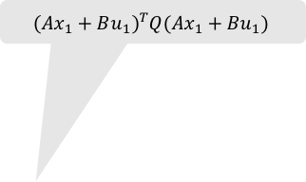
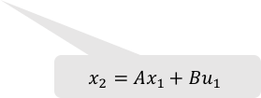
$$x_{0}^{T}Qx_{0}$$
$$x_{1}^{T}Qx_{1}$$
$${\left(Ax_{1}+Bu_{1}\right)}^{T}Q(Ax_{1}+Bu_{1})$$
$$Ax_{0}+Bu_{0}=x_{1}$$
$$x_{0}$$
$$x_{1}$$
$$x_{2}$$
$$x_{2}=Ax_{1}+Bu_{1}$$
$$u_{0}$$
$$u_{1}$$
$$u_{0}^{T}Ru_{0}$$
$$u_{1}^{T}Ru_{1}$$

Slide 7
$$x_{0}^{T}Qx_{0}$$
$$x_{1}^{T}Qx_{1}$$
$${\left(Ax_{1}+Bu_{1}\right)}^{T}Q(Ax_{1}+Bu_{1})$$
$$Ax_{0}+Bu_{0}=x_{1}$$
$$x_{0}$$
$$x_{1}$$
$$x_{2}$$
$$x_{2}=Ax_{1}+Bu_{1}$$
$$u_{0}$$
$$u_{1}$$
$$u_{0}^{T}Ru_{0}$$
$$u_{1}^{T}Ru_{1}$$

Slide 8



$$x_{0}^{T}Qx_{0}$$
$$x_{1}^{T}Qx_{1}$$
$$x_{1}^{T}(A^{T}QA−A^{T}QBK_{1})x_{1}$$
$$Ax_{0}+Bu_{0}=x_{1}$$
$$x_{0}$$
$$x_{1}$$
$$x_{2}$$
$$x_{2}=Ax_{1}+Bu_{1}$$
$$u_{0}$$
$$u_{1}$$
$$u_{0}^{T}Ru_{0}$$
$$u_{1}=K_{1}x_{1}$$

Slide 9

$$x_{0}^{T}Qx_{0}$$
$$x_{1}^{T}Qx_{1}$$
$$x_{1}^{T}(A^{T}QA−A^{T}QBK_{1})x_{1}$$
$$Ax_{0}+Bu_{0}=x_{1}$$
$$x_{0}$$
$$x_{1}$$
$$x_{2}$$
$$x_{2}=Ax_{1}+Bu_{1}$$
$$u_{0}$$
$$u_{1}$$
$$u_{0}^{T}Ru_{0}$$
$$u_{1}=K_{1}x_{1}$$

Slide 10

$$x_{0}^{T}Qx_{0}$$
$$x_{1}^{T}Qx_{1}$$
$$x_{1}^{T}(A^{T}QA−A^{T}QBK_{1})x_{1}$$
$$Ax_{0}+Bu_{0}=x_{1}$$
$$x_{0}$$
$$x_{1}$$
$$x_{2}$$
$$x_{2}=Ax_{1}+Bu_{1}$$
$$u_{0}$$
$$u_{1}$$
$$u_{0}^{T}Ru_{0}$$
$$u_{1}=K_{1}x_{1}$$

Slide 11

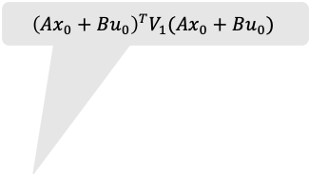
$$x_{0}^{T}Qx_{0}$$
$${\left(Ax_{0}+Bu_{0}\right)}^{T}V_{1}(Ax_{0}+Bu_{0})$$
$$x_{1}=Ax_{0}+Bu_{0}$$
$$x_{0}$$
$$x_{1}$$
$$x_{2}$$
$$x_{2}=Ax_{1}+Bu_{1}$$
$$u_{0}$$
$$u_{1}$$
$$u_{0}^{T}Ru_{0}$$
$$u_{1}=K_{1}x_{1}$$

Slide 12
$$x_{0}^{T}Qx_{0}$$
$${\left(Ax_{0}+Bu_{0}\right)}^{T}V_{1}(Ax_{0}+Bu_{0})$$
$$x_{1}=Ax_{0}+Bu_{0}$$
$$x_{0}$$
$$x_{1}$$
$$x_{2}$$
$$x_{2}=Ax_{1}+Bu_{1}$$
$$u_{0}$$
$$u_{1}$$
$$u_{0}^{T}Ru_{0}$$
$$u_{1}=K_{1}x_{1}$$

Slide 13




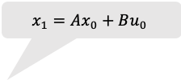
$$x_{0}^{T}Qx_{0}$$
$$x_{1}^{T}(A^{T}V_{1}A−A^{T}V_{1}BK_{2})x_{1}$$
$$x_{1}=Ax_{0}+Bu_{0}$$
$$x_{2}=Ax_{1}+Bu_{1}$$
$$x_{0}$$
$$x_{1}$$
$$x_{2}$$
$$u_{0}$$
$$u_{1}$$
$$u_{0}=K_{0}x_{0}$$
$$u_{1}=K_{1}x_{1}$$

Slide 14

$$x_{0}^{T}V_{0}x_{0}$$
$$x_{1}=Ax_{0}+Bu_{0}$$
$$x_{2}=Ax_{1}+Bu_{1}$$
$$x_{0}$$
$$x_{1}$$
$$x_{2}$$
$$u_{0}$$
$$u_{1}$$
$$u_{0}=K_{0}x_{0}$$
$$u_{1}=K_{1}x_{1}$$

Slide 15





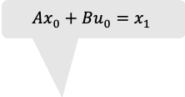


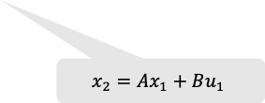









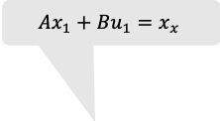
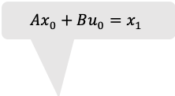



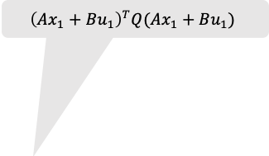
$$x_{0}^{T}Qx_{0}$$
$$x_{1}^{T}Qx_{1}$$
$$x_{2}^{T}Qx_{2}$$
$$Ax_{0}+Bu_{0}=x_{1}$$
$$Ax_{1}+Bu_{1}=x_{x}$$
$$x_{0}$$
$$x_{1}$$
$$x_{2}$$
$$u_{0}$$
$$u_{1}$$
$$u_{0}^{T}Ru_{0}$$
$$u_{1}^{T}Ru_{1}$$
$$x_{0}^{T}Qx_{0}$$
$$x_{1}^{T}Qx_{1}$$
$${\left(Ax_{1}+Bu_{1}\right)}^{T}Q(Ax_{1}+Bu_{1})$$
$$Ax_{0}+Bu_{0}=x_{1}$$
$$x_{0}$$
$$x_{1}$$
$$x_{2}$$
$$x_{2}=Ax_{1}+Bu_{1}$$
$$u_{0}$$
$$u_{1}$$
$$u_{0}^{T}Ru_{0}$$
$$u_{1}^{T}Ru_{1}$$

Slide 16

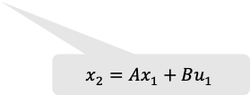



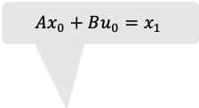











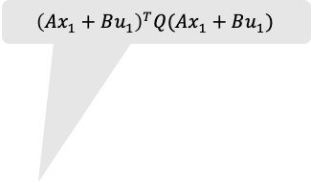
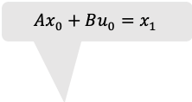



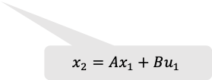
$$x_{0}^{T}Qx_{0}$$
$$x_{1}^{T}Qx_{1}$$
$${\left(Ax_{1}+Bu_{1}\right)}^{T}Q(Ax_{1}+Bu_{1})$$
$$Ax_{0}+Bu_{0}=x_{1}$$
$$x_{0}$$
$$x_{1}$$
$$x_{2}$$
$$x_{2}=Ax_{1}+Bu_{1}$$
$$u_{0}$$
$$u_{1}$$
$$u_{0}^{T}Ru_{0}$$
$$u_{1}^{T}Ru_{1}$$
$$x_{0}^{T}Qx_{0}$$
$$x_{1}^{T}V_{1}x_{1}$$
$$Ax_{0}+Bu_{0}=x_{1}$$
$$x_{0}$$
$$x_{1}$$
$$x_{2}$$
$$x_{2}=Ax_{1}+Bu_{1}$$
$$u_{0}$$
$$u_{1}$$
$$u_{0}^{T}Ru_{0}$$
$$u_{1}=K_{1}x_{1}$$

Slide 17
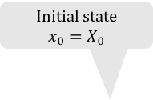
$$x_{0}^{T}Qx_{0}$$
$$x_{1}^{T}Qx_{1}$$
$$x_{2}^{T}Qx_{2}$$
Initial state
$$x_{0}=X_{0}$$
$$Ax_{0}+Bu_{0}=x_{1}$$
$$Ax_{1}+Bu_{1}=x_{x}$$
$$x_{0}$$
$$x_{1}$$
$$x_{2}$$
$$u_{0}$$
$$u_{1}$$
$$u_{0}^{T}Ru_{0}$$
$$u_{1}^{T}Ru_{1}$$

Slide 18
$$x_{0}^{T}Qx_{0}$$
$$x_{1}^{T}Qx_{1}$$
Initial state
$$x_{0}=X_{0}$$
$${\left(Ax_{1}+Bu_{1}\right)}^{T}Q(Ax_{1}+Bu_{1})$$
$$Ax_{0}+Bu_{0}=x_{1}$$
$$x_{0}$$
$$x_{1}$$
$$x_{2}$$
$$x_{2}=Ax_{1}+Bu_{1}$$
$$u_{0}$$
$$u_{1}$$
$$u_{0}^{T}Ru_{0}$$
$$u_{1}^{T}Ru_{1}$$

Slide 19

$$x_{0}^{T}Qx_{0}$$
$$x_{1}^{T}V_{1}x_{1}$$
Initial state
$$x_{0}=X_{0}$$
$$Ax_{0}+Bu_{0}=x_{1}$$
$$x_{0}$$
$$x_{1}$$
$$x_{2}$$
$$x_{2}=Ax_{1}+Bu_{1}$$
$$u_{0}$$
$$u_{1}$$
$$u_{0}^{T}Ru_{0}$$
$$u_{1}=K_{1}x_{1}$$

Slide 20
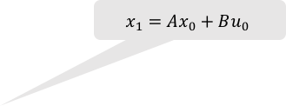

$$x_{0}^{T}Qx_{0}$$
Initial state
$$x_{0}=X_{0}$$
$$x_{1}=Ax_{0}+Bu_{0}$$
$${\left(Ax_{1}+Bu_{1}\right)}^{T}V_{1}(Ax_{1}+Bu_{1})$$
$$x_{0}$$
$$x_{1}$$
$$x_{2}$$
$$x_{2}=Ax_{1}+Bu_{1}$$
$$u_{0}$$
$$u_{1}$$
$$u_{0}^{T}Ru_{0}$$
$$u_{1}=K_{1}x_{1}$$

Slide 21
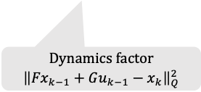

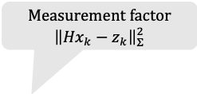



Measurement factor
$${\left\|{Hx}_{k}−z_{k}\right\|}_{Σ}^{2}$$
$$x_{1}$$
$$x_{2}$$
$$x_{3}$$
…….
$$x_{n}$$
Dynamics factor
$${\left\|{Fx}_{k−1}+Gu_{k−1}−x_{k}\right\|}_{Q}^{2}$$

Slide 22








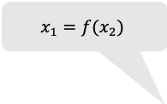




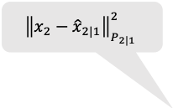


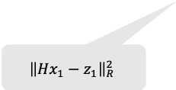
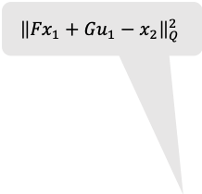
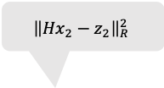

$${\left\|{Fx}_{1}+Gu_{1}−x_{2}\right\|}_{Q}^{2}$$
$${\left\|{Hx}_{2}−z_{2}\right\|}_{R}^{2}$$
$${\left\|{Hx}_{1}−z_{1}\right\|}_{R}^{2}$$
$$x_{1}$$
$$x_{2}$$
$$x_{3}$$
…….
$$x_{n}$$
$${\left\|x_{2}−{\hat{x}}_{2|1}\right\|}_{P_{2|1}}^{2}$$
$${\left\|{Hx}_{2}−z_{2}\right\|}_{R}^{2}$$
$$x_{1}=f(x_{2})$$
$$x_{1}$$
$$x_{2}$$
$$x_{3}$$
…….
$$x_{n}$$
$${\left\|x_{2}−{\hat{x}}_{2}\right\|}_{P_{2}}^{2}$$
$$x_{1}=f(x_{2})$$
$$x_{1}$$
$$x_{2}$$
$$x_{3}$$
…….
$$x_{n}$$

Slide 23










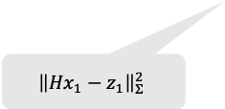
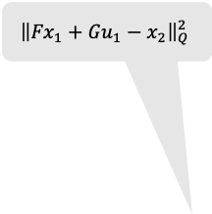

$${\left\|{Fx}_{1}+Gu_{1}−x_{2}\right\|}_{Q}^{2}$$
$${\left\|{Hx}_{2}−z_{2}\right\|}_{Σ}^{2}$$
$${\left\|{Hx}_{1}−z_{1}\right\|}_{Σ}^{2}$$
$$x_{1}$$
$$x_{2}$$
$$x_{3}$$
…….
$$x_{n}$$
$${\left\|x_{2}−{\hat{x}}_{2}\right\|}_{P_{2}}^{2}$$
$$x_{1}=Ax_{2}+b$$
$$x_{1}$$
$$x_{2}$$
$$x_{3}$$
…….
$$x_{n}$$

Slide 24
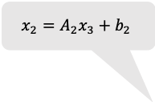



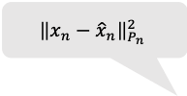


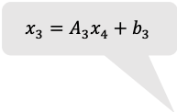
$${\left\|x_{n}−{\hat{x}}_{n}\right\|}_{P_{n}}^{2}$$
$$x_{1}=A_{1}x_{2}+b_{1}$$
$$x_{2}=A_{2}x_{3}+b_{2}$$
$$x_{3}=A_{3}x_{4}+b_{3}$$
$$x_{2}$$
$$x_{3}$$
…….
$$x_{1}$$
$$x_{n}$$

