Slide 1



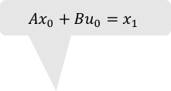



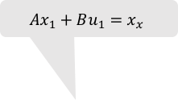




$$x_{0}^{T}Qx_{0}$$
$$x_{1}^{T}Qx_{1}$$
$$x_{2}^{T}Qx_{2}$$
$$Ax_{0}+Bu_{0}=x_{1}$$
$$Ax_{1}+Bu_{1}=x_{x}$$
$$x_{0}$$
$$x_{1}$$
$$x_{2}$$
$$u_{0}$$
$$u_{1}$$
$$u_{0}^{T}Ru_{0}$$
$$u_{1}^{T}Ru_{1}$$

Slide 2
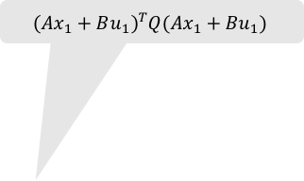
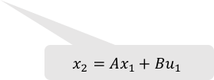
$$x_{0}^{T}Qx_{0}$$
$$x_{1}^{T}Qx_{1}$$
$${\left(Ax_{1}+Bu_{1}\right)}^{T}Q(Ax_{1}+Bu_{1})$$
$$Ax_{0}+Bu_{0}=x_{1}$$
$$x_{0}$$
$$x_{1}$$
$$x_{2}$$
$$x_{2}=Ax_{1}+Bu_{1}$$
$$u_{0}$$
$$u_{1}$$
$$u_{0}^{T}Ru_{0}$$
$$u_{1}^{T}Ru_{1}$$

Slide 3
$$x_{0}^{T}Qx_{0}$$
$$x_{1}^{T}Qx_{1}$$
$${\left(Ax_{1}+Bu_{1}\right)}^{T}Q(Ax_{1}+Bu_{1})$$
$$Ax_{0}+Bu_{0}=x_{1}$$
$$x_{0}$$
$$x_{1}$$
$$x_{2}$$
$$x_{2}=Ax_{1}+Bu_{1}$$
$$u_{0}$$
$$u_{1}$$
$$u_{0}^{T}Ru_{0}$$
$$u_{1}^{T}Ru_{1}$$

Slide 4



$$x_{0}^{T}Qx_{0}$$
$$x_{1}^{T}Qx_{1}$$
$$x_{1}^{T}(A^{T}QA−{K_{1}}^{T}B^{T}QA)x_{1}$$
$$Ax_{0}+Bu_{0}=x_{1}$$
$$x_{0}$$
$$x_{1}$$
$$x_{2}$$
$$x_{2}=Ax_{1}+Bu_{1}$$
$$u_{0}$$
$$u_{1}$$
$$u_{0}^{T}Ru_{0}$$
$$u_{1}=K_{1}x_{1}$$

Slide 5


$$x_{1}^{T}P_{1}x_{1}$$
$$x_{0}^{T}Qx_{0}$$
$$x_{1}^{T}Qx_{1}$$
$$Ax_{0}+Bu_{0}=x_{1}$$
$$x_{0}$$
$$x_{1}$$
$$x_{2}$$
$$x_{2}=Ax_{1}+Bu_{1}$$
$$u_{0}$$
$$u_{1}$$
$$u_{0}^{T}Ru_{0}$$
$$u_{1}=K_{1}x_{1}$$

Slide 6
$$x_{1}^{T}P_{1}x_{1}$$
$$x_{0}^{T}Qx_{0}$$
$$x_{1}^{T}Qx_{1}$$
$$Ax_{0}+Bu_{0}=x_{1}$$
$$x_{0}$$
$$x_{1}$$
$$x_{2}$$
$$x_{2}=Ax_{1}+Bu_{1}$$
$$u_{0}$$
$$u_{1}$$
$$u_{0}^{T}Ru_{0}$$
$$u_{1}=K_{1}x_{1}$$

Slide 7

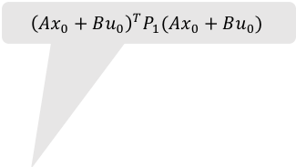
$$x_{0}^{T}Qx_{0}$$
$${\left(Ax_{0}+Bu_{0}\right)}^{T}P_{1}(Ax_{0}+Bu_{0})$$
$$x_{1}=Ax_{0}+Bu_{0}$$
$$x_{0}$$
$$x_{1}$$
$$x_{2}$$
$$x_{2}=Ax_{1}+Bu_{1}$$
$$u_{0}$$
$$u_{1}$$
$$u_{0}^{T}Ru_{0}$$
$$u_{1}=K_{1}x_{1}$$

Slide 8


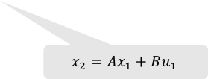

$$x_{0}^{T}Qx_{0}$$
$${\left(Ax_{0}+Bu_{0}\right)}^{T}P_{1}(Ax_{0}+Bu_{0})$$
$$x_{1}=Ax_{0}+Bu_{0}$$
$$x_{0}$$
$$x_{1}$$
$$x_{2}$$
$$x_{2}=Ax_{1}+Bu_{1}$$
$$u_{0}$$
$$u_{1}$$
$$u_{0}^{T}Ru_{0}$$
$$u_{1}=K_{1}x_{1}$$

Slide 9


$$x_{0}^{T}Qx_{0}$$
$$x_{1}^{T}\left(A^{T}P_{1}A−{K_{1}}^{T}B^{T}P_{1}A\right)x_{1}$$
$$x_{1}=Ax_{0}+Bu_{0}$$
$$x_{0}$$
$$x_{1}$$
$$x_{2}$$
$$x_{2}=Ax_{1}+Bu_{1}$$
$$u_{0}$$
$$u_{1}$$
$$u_{0}^{T}Ru_{0}$$
$$u_{1}=K_{1}x_{1}$$

Slide 10


$$x_{0}^{T}P_{0}x_{0}$$
$$x_{0}^{T}V_{0}x_{0}$$
$$x_{1}=Ax_{0}+Bu_{0}$$
$$x_{0}$$
$$x_{1}$$
$$x_{2}$$
$$x_{2}=Ax_{1}+Bu_{1}$$
$$u_{0}$$
$$u_{1}$$
$$u_{0}^{T}Ru_{0}$$
$$u_{1}=K_{1}x_{1}$$

Slide 11



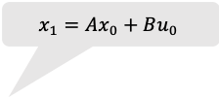
$$x_{0}^{T}P_{0}x_{0}$$
$$x_{1}=Ax_{0}+Bu_{0}$$
$$x_{2}=Ax_{1}+Bu_{1}$$
$$x_{0}$$
$$x_{1}$$
$$x_{2}$$
$$u_{0}$$
$$u_{1}$$
$$u_{0}=K_{0}x_{0}$$
$$u_{1}=K_{1}x_{1}$$

Slide 12
$$x_{0}^{T}Qx_{0}$$
$$x_{1}^{T}Qx_{1}$$
$$x_{2}^{T}Qx_{2}$$
$$Ax_{0}+Bu_{0}=x_{1}$$
$$Ax_{1}+Bu_{1}=x_{x}$$
$$x_{0}$$
$$x_{1}$$
$$x_{2}$$
$$u_{0}$$
$$u_{1}$$
$$u_{0}^{T}Ru_{0}$$
$$u_{1}^{T}Ru_{1}$$

