Slide 1
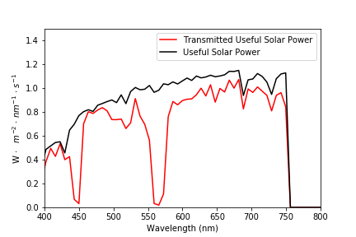
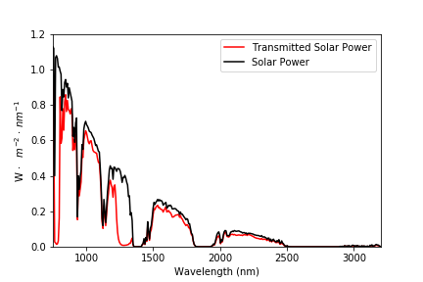
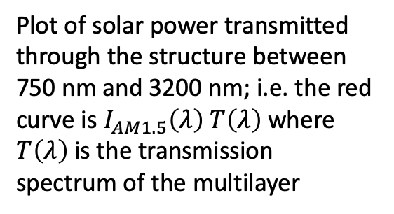
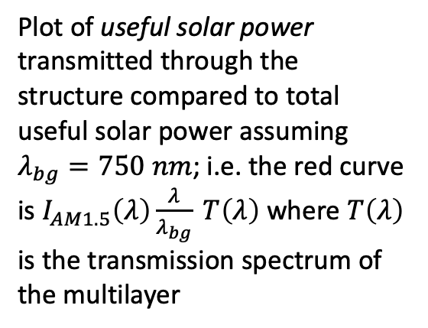
SiO2, d = 815 nm
Ta2O5, d = 458 nm
SiO2, d = 663 nm
Ta2O5, d = 457 nm
SiO2, d = 673 nm
Ta2O5, d = 457 nm
Plot of useful solar power transmitted through the structure compared to total useful solar power assuming $λ_{bg}=750 nm$; i.e. the red curve is $I_{AM1.5}\left(λ\right)\frac{λ}{λ_{bg}} T\left(λ\right)$ where $T\left(λ\right)$ is the transmission spectrum of the multilayer
SiO2, d = 668 nm
Plot of solar power transmitted through the structure between 750 nm and 3200 nm; i.e. the red curve is $I_{AM1.5}\left(λ\right) T\left(λ\right)$ where $T\left(λ\right)$ is the transmission spectrum of the multilayer
Ta2O5, d = 460 nm
SiO2, d = 669 nm
Ta2O5, d = 455 nm
SiO2, d = 669 nm
Ta2O5, d = 465 nm
SiO2, d = 670 nm
Ta2O5, d = 460 nm
SiO2, d = 532 nm

Slide 2
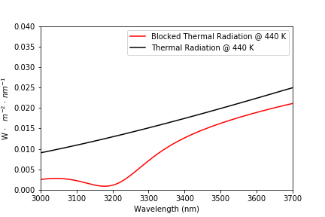
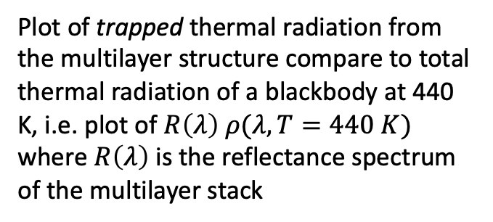
Plot of trapped thermal radiation from the multilayer structure compare to total thermal radiation of a blackbody at 440 K, i.e. plot of $R\left(λ\right) ρ(λ, T=440 K)$ where $R\left(λ\right)$ is the reflectance spectrum of the multilayer stack
Optimized Multilayer
SiO2, d = 815 nm
Ta2O5, d = 458 nm
SiO2, d = 663 nm
Ta2O5, d = 457 nm
SiO2, d = 673 nm
Ta2O5, d = 457 nm
SiO2, d = 668 nm
Ta2O5, d = 460 nm
SiO2, d = 669 nm
Ta2O5, d = 455 nm
SiO2, d = 669 nm
Ta2O5, d = 465 nm
SiO2, d = 670 nm
Ta2O5, d = 460 nm
SiO2, d = 532 nm

