Slide 1
User
Materials Geometries
Temperature Uses
Figures of merit, spectra, and images
multilayer (class)
Optical Properties
and Thermal Emission
stpvlib
Optical
Properties
Refractive
Indices (RIs)
Geometries,
RIs
Materials
lightlib
tmm
datalib
coolinglib
colorlib

Slide 2
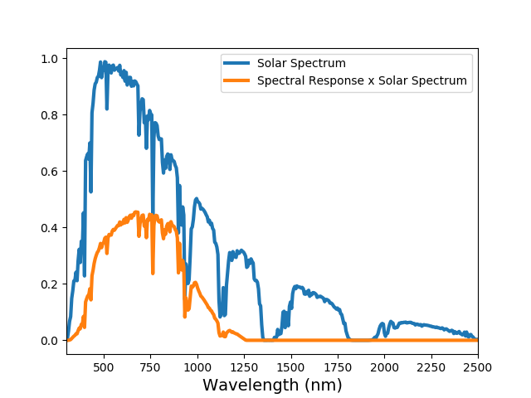
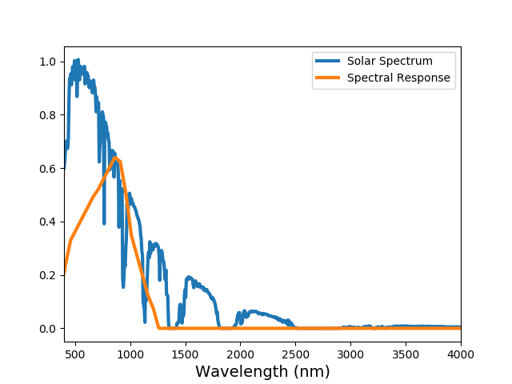

Slide 3
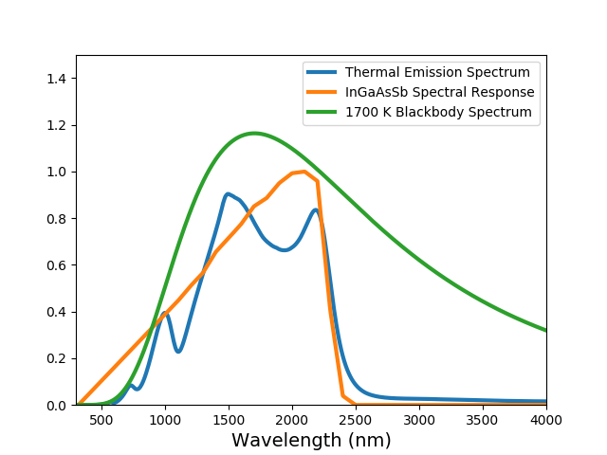
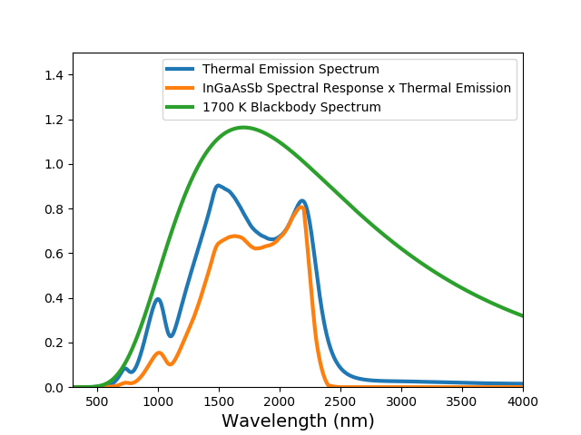
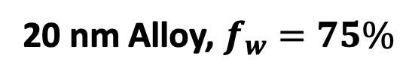
(a)
(b)
(c)
Optically-thick W
10 nm Al₂O₃
255 nm SiO₂
150 nm TiO₂
Arbitrary Units
255 nm SiO₂
20 nm Alloy, $f_{w}=75\%$

Slide 4
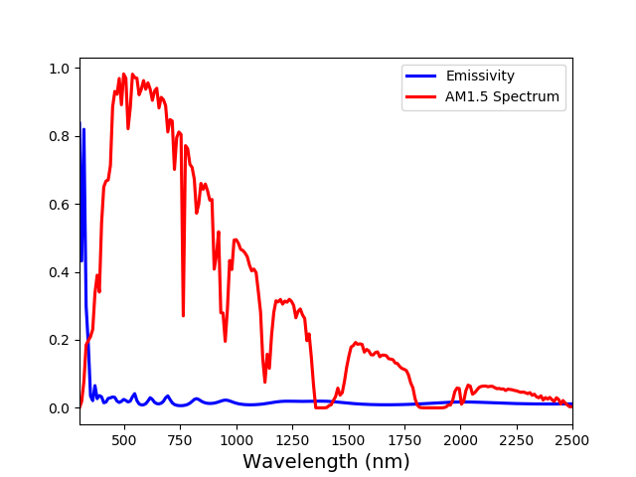
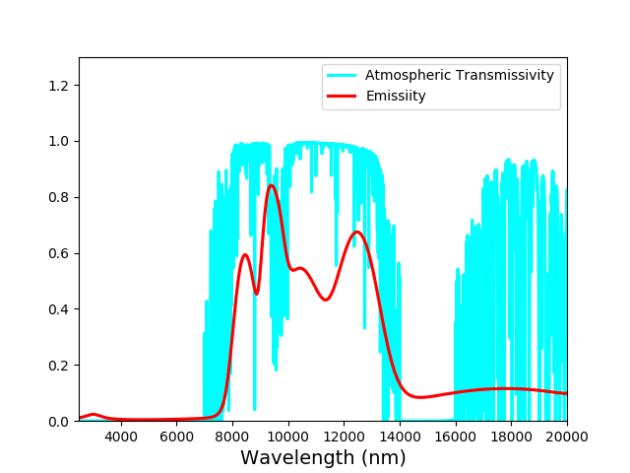
(a)
(b)

