Slide 1
Digital Speech Processing Homework #1
Discrete hidden markov model implementation
Date: 3/29 2017
Revised by 李致緯

Slide 2
Outline
HMM in Speech Recognition
Problems of HMM
Training
Testing
File Format
Submit Requirement

Slide 3
HMM in Speech Recognition

Slide 4
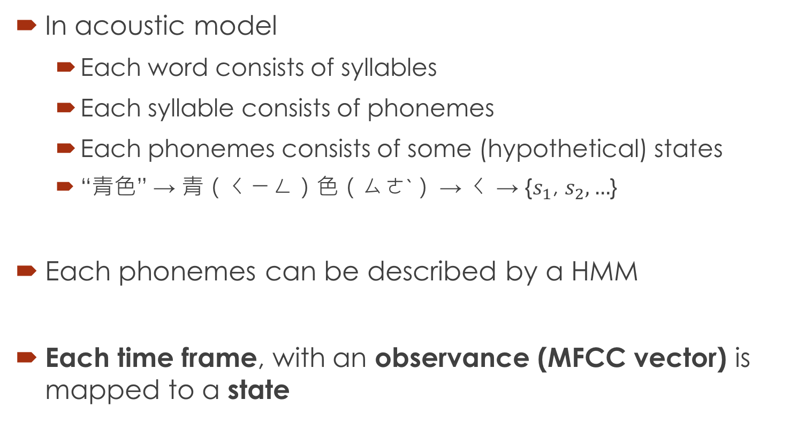
Speech Recognition
In acoustic model
Each word consists of syllables
Each syllable consists of phonemes
Each phonemes consists of some (hypothetical) states
“青色” → 青（ㄑㄧㄥ）色（ㄙㄜˋ） → ㄑ → {$s_{1}$, $s_{2},…$}
Each phonemes can be described by a HMM
Each time frame, with an observance (MFCC vector) is mapped to a state

Slide 5
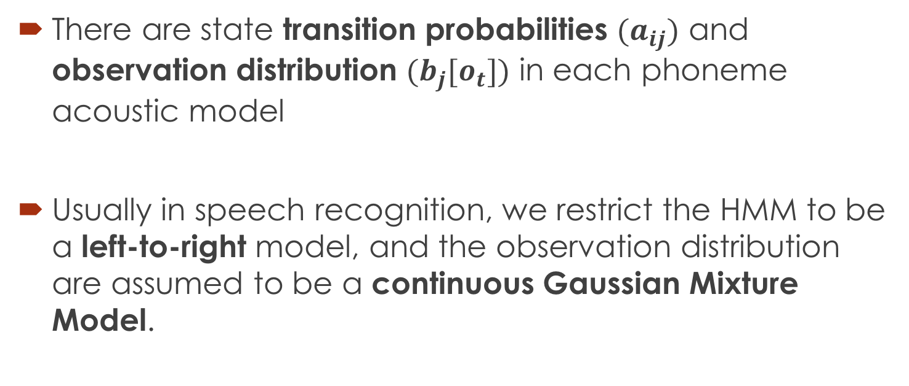
Speech Recognition
There are state transition probabilities ${(a}_{ij})$ and observation distribution ${(b}_{j}[o_{t}])$ in each phoneme acoustic model
Usually in speech recognition, we restrict the HMM to be a left-to-right model, and the observation distribution are assumed to be a continuous Gaussian Mixture Model.

Slide 6
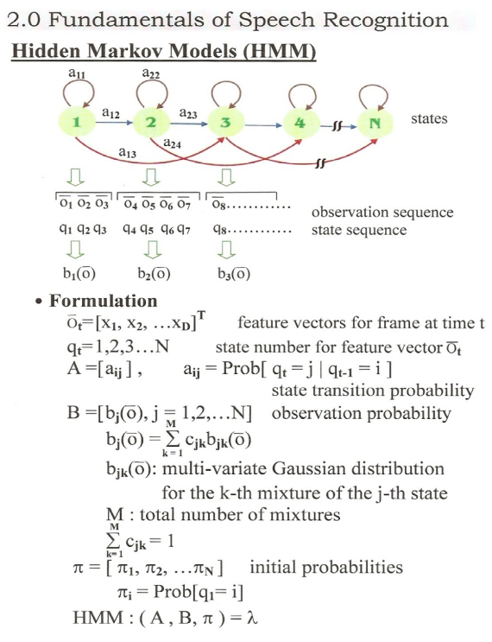
Review
Left-to-right
Observation distribution are a continuous GMM

Slide 7
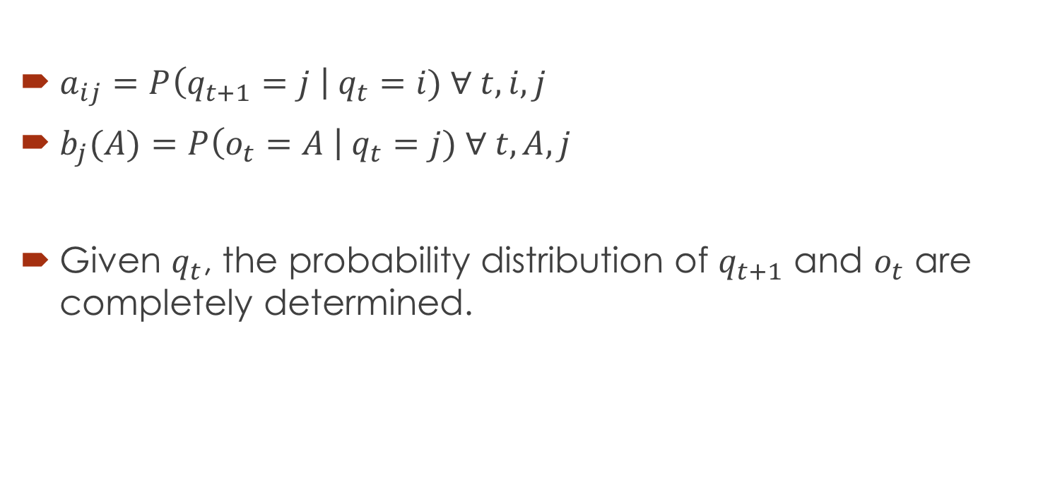
General Discrete HMM
$a_{ij}=P\left(q_{t+1}=j \right| q_{t}=i) ∀ t,i,j$
$b_{j}(A)=P\left(o_{t}=A \right| q_{t}=j) ∀ t,A,j$
Given $q_{t}$, the probability distribution of $q_{t+1}$ and $o_{t}$ are completely determined.

Slide 8
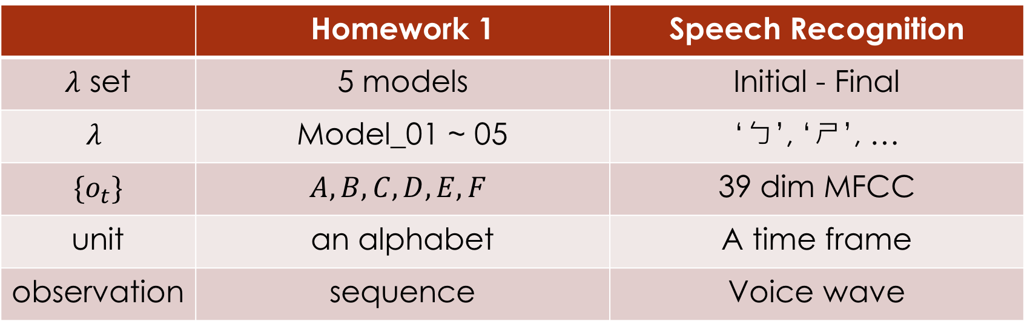
HW1 v.s. Speech Recognition
 | Homework 1 | Speech Recognition
$λ$ set | 5 models | Initial - Final
$$λ$$ | Model_01 ~ 05 | ‘ㄅ’, ‘ㄕ’, …
$$\{o_{t}\}$$ | $$A, B, C, D, E, F$$ | 39 dim MFCC
unit | an alphabet | A time frame
observation | sequence | Voice wave

Slide 9
Homework of HMM

Slide 10
Flowchart
testing_answer.txt
seq_model_01.txt
model_01.txt
Test
Train
ERROR
seq_model_05.txt
model_05.txt
model_init.txt
testing_data.txt

Slide 11
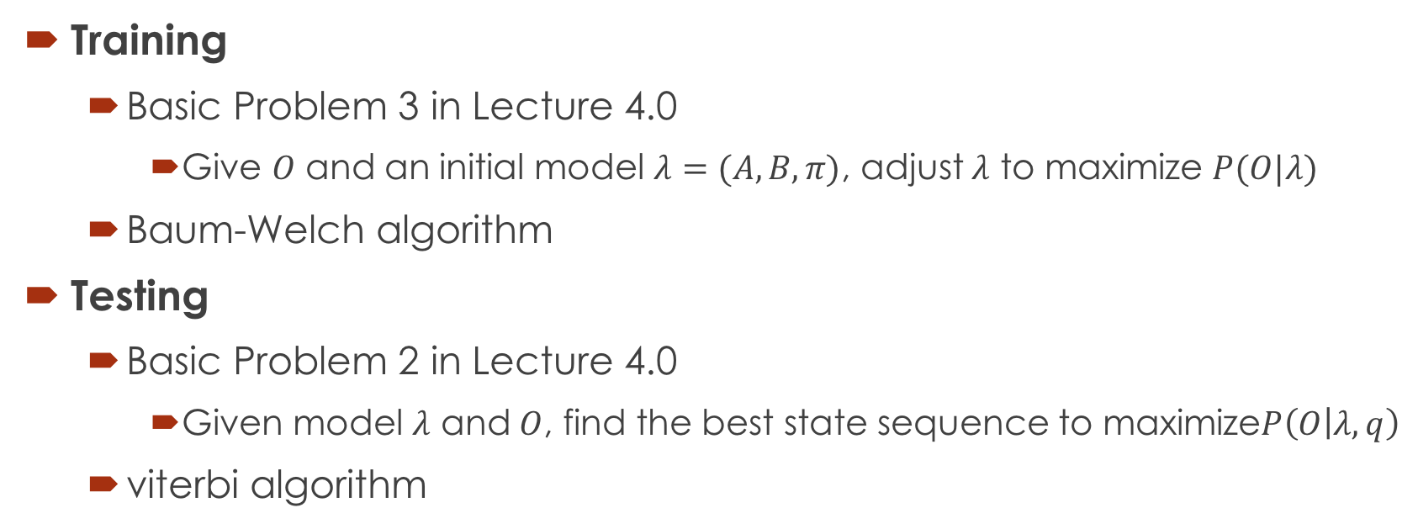
Problems of HMM
Training
Basic Problem 3 in Lecture 4.0
Give $O$ and an initial model $λ=(A, B, π)$, adjust $λ$ to maximize $P(O|λ)$
Baum-Welch algorithm
Testing
Basic Problem 2 in Lecture 4.0
Given model $λ$ and $O$, find the best state sequence to maximize$P\left(O | λ,q\right)$
viterbi algorithm

Slide 12
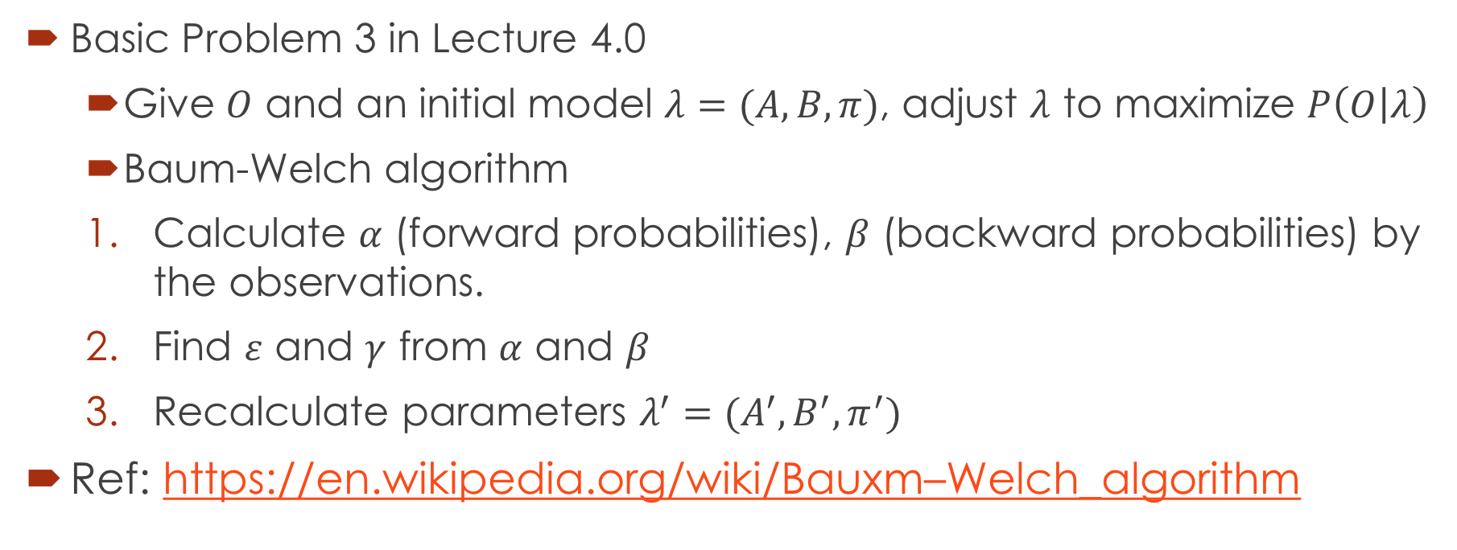
Training
Basic Problem 3 in Lecture 4.0
Give $O$ and an initial model $λ=(A, B, π)$, adjust $λ$ to maximize $P\left(O | λ\right)$
Baum-Welch algorithm
Calculate $α$ (forward probabilities), $β$ (backward probabilities) by the observations.
Find $ε$ and $γ$ from $α$ and $β$
Recalculate parameters $λ^{′}=(A^{′},B^{′},π^{′})$
Ref: https://en.wikipedia.org/wiki/Bauxm–Welch_algorithm

Slide 13
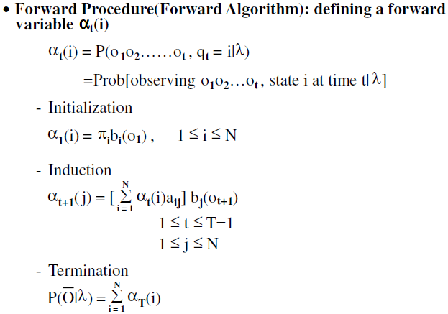
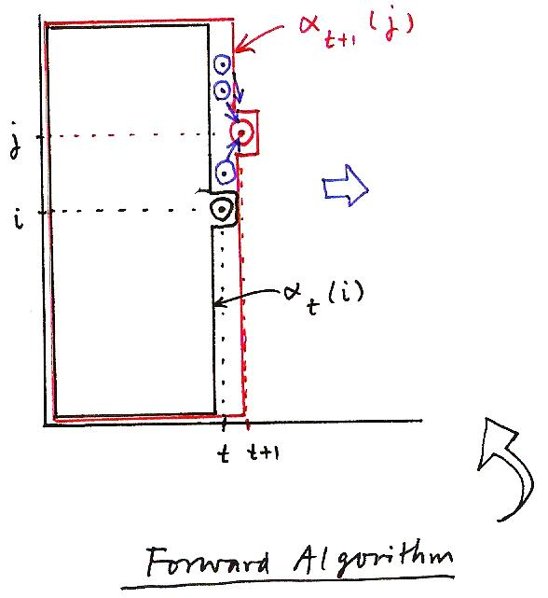

Forward Procedure
Calculate $α$ by forward algorithm
α_{t+1}(j)
j
i
α_{t}(i)
t
t+1
Forward Algorithm

Slide 14
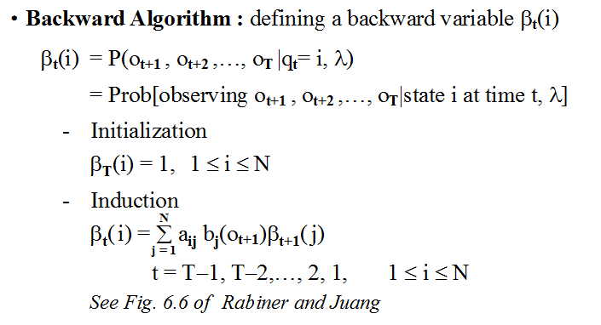

Backward Procedure
Calculate $β$ by backward algorithm

Slide 15
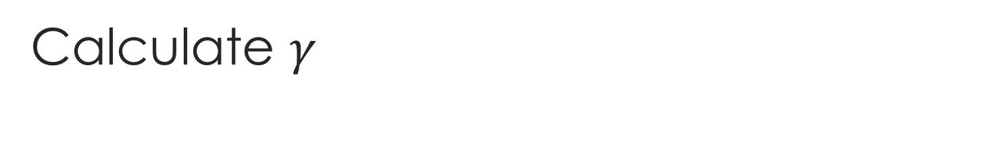
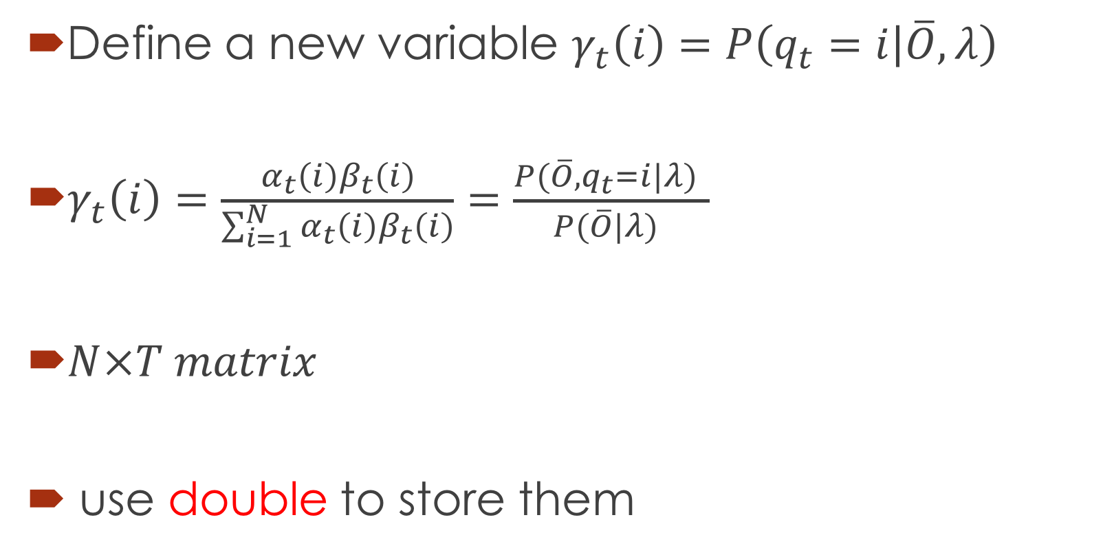
Calculate $γ$
Define a new variable $γ_{t}\left(i\right)=P\left(q_{t}=i | \overline{O},λ\right)$
$γ_{t}\left(i\right)=\frac{α_{t}\left(i\right)β_{t}\left(i\right)}{\sum_{i=1}^{N}{α_{t}\left(i\right)β_{t}\left(i\right)}}=\frac{P(\overline{O}, q_{t}=i|λ) }{P(\overline{O}|λ) }$
$N×T matrix$
use double to store them

Slide 16
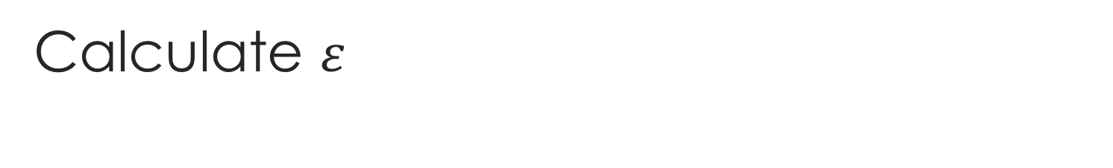
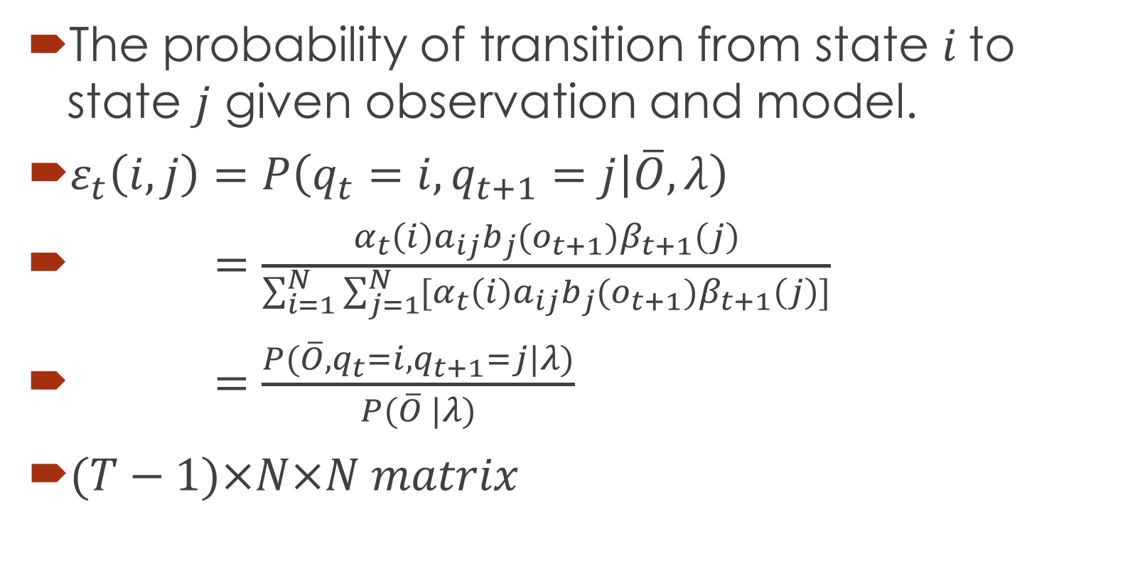
Calculate $ε$
The probability of transition from state $i$ to state $j$ given observation and model.
$ε_{t}\left(i,j\right)=P\left(q_{t}=i,q_{t+1}=j | \overline{O},λ\right)$
$=\frac{α_{t}\left(i\right)a_{ij}b_{j}(o_{t+1})β_{t+1}\left(j\right)}{\sum_{i=1}^{N}{\sum_{j=1}^{N}{[α_{t}\left(i\right)a_{ij}b_{j}(o_{t+1})β_{t+1}\left(j\right)]}}}$
$=\frac{P(\overline{O},q_{t}=i,q_{t+1}=j|λ)}{P(\overline{O} |λ)}$
$(T−1)×N×N matrix$

Slide 17
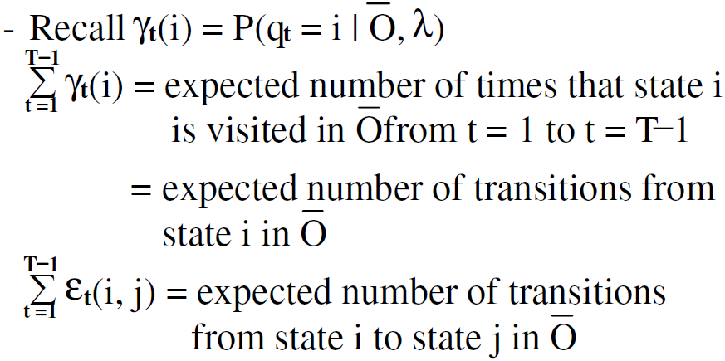

Accumulate $ε$ and $γ$

Slide 18





Re-estimate model parameters
$λ^{′}=(A′, B′, π′)$
Accumulate ε and γ through all samples!!
Not just all observations in one sample!! (refer to FAQ)

Slide 19
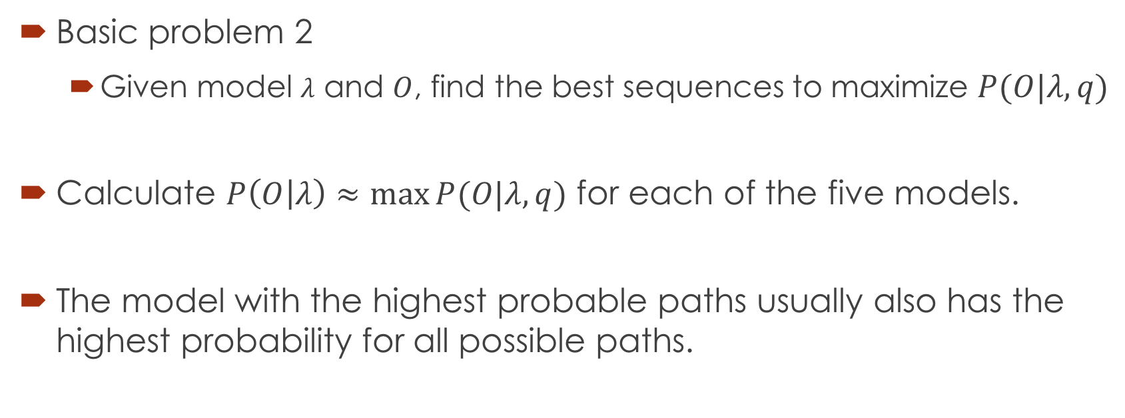
Testing
Basic problem 2
Given model $λ$ and $O$, find the best sequences to maximize $P(O|λ, q)$
Calculate $P\left(O | λ\right)≈\max{P(O|λ, q)}$ for each of the five models.
The model with the highest probable paths usually also has the highest probability for all possible paths.

Slide 20
File Format

Slide 21
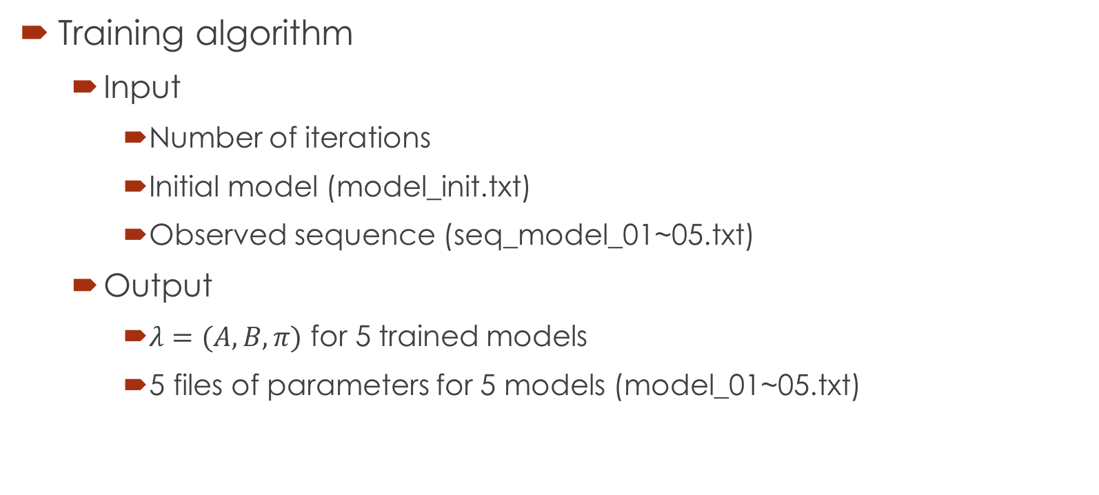
Input and output
Training algorithm
Input
Number of iterations
Initial model (model_init.txt)
Observed sequence (seq_model_01~05.txt)
Output
$λ=(A,B,π)$ for 5 trained models
5 files of parameters for 5 models (model_01~05.txt)

Slide 22
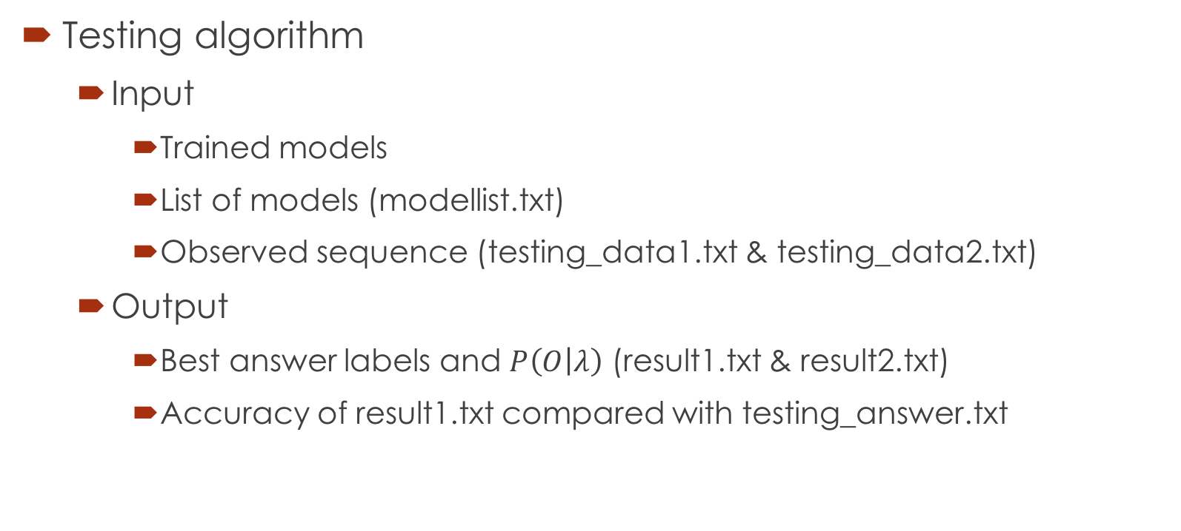
Input and output
Testing algorithm
Input
Trained models
List of models (modellist.txt)
Observed sequence (testing_data1.txt & testing_data2.txt)
Output
Best answer labels and $P\left(O | λ\right)$ (result1.txt & result2.txt)
Accuracy of result1.txt compared with testing_answer.txt

Slide 23
Program Format Example
Training Program
./train iteration model_init.txt seq_model_01.txt model_01.txt
Execute 5 times (seq_model_01~05.txt)
Testing Program
./test modellist.txt testing_data.txt result.txt

Slide 24
Files Contained in Homework #1
dsp_hw1/
c_cpp
modellist.txt //list of models to be trained
model_init.txt //HMM initial models
seq_model_01~05.txt //training data observation
testing_data1,2.txt //testing data observation
testing_answer.txt //answer for testing_data1.txt

Slide 25
hmm.h format
Some useful function here:
Read model
Write model
You can add or modify functions in hmm.h
Please explain the functions you add or modify in report

Slide 26
Observation Sequence Format
seq_model_01~05.txt / testing_data1,2.txt
ACCDDDDFFCCCCBCFFFCCCCCEDADCCAEFCCCACDDFFCCDDFFCCD
CABACCAFCCFFCCCDFFCCCCCDFFCDDDDFCDDCCFCCCEFFCCCCBC
ABACCCDDCCCDDDDFBCCCCCDDAACFBCCBCCCCCCCFFFCCCCCDBF
AAABBBCCFFBDCDDFFACDCDFCDDFFFFFCDFFFCCCDCFFFFCCCCD
AACCDCCCCCCCDCEDCBFFFCDCDCDAFBCDCFFCCDCCCEACDBAFFF
……

Slide 27
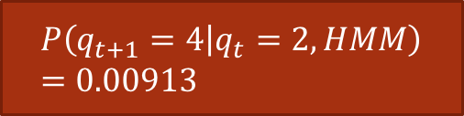
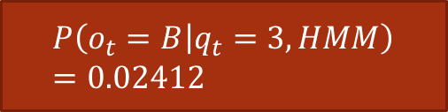
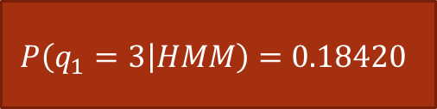
Model Format
model_init.txt / model_01~05.txt
$$P\left(q_{1}=3 | HMM\right)=0.18420$$
0 1 2 3 4 5
initial: 6
0.22805 0.02915 0.12379 0.18420 0.00000 0.43481
transition: 6
0.36670 0.51269 0.08114 0.00217 0.02003 0.01727
0.17125 0.53161 0.26536 0.02538 0.00068 0.00572
0.31537 0.08201 0.06787 0.49395 0.00913 0.03167
0.24777 0.06364 0.06607 0.48348 0.01540 0.12364
0.09149 0.05842 0.00141 0.00303 0.59082 0.25483
0.29564 0.06203 0.00153 0.00017 0.38311 0.25753
observation: 6
0.34292 0.55389 0.18097 0.06694 0.01863 0.09414
0.08053 0.16186 0.42137 0.02412 0.09857 0.06969
0.13727 0.10949 0.28189 0.15020 0.12050 0.37143
0.45833 0.19536 0.01585 0.01016 0.07078 0.36145
0.00147 0.00072 0.12113 0.76911 0.02559 0.07438
0.00002 0.00000 0.00001 0.00001 0.68433 0.04579
0
1
2
3
4
5
$$P\left(q_{t+1}=4 | q_{t}=2, HMM\right)=0.00913$$
$$P\left(o_{t}=B | q_{t}=3, HMM\right)=0.02412$$
A
B
C
D
E
F

Slide 28
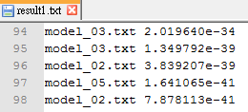
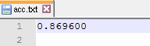
What Your Outputs Should Look Like
result.txt
Hypothesis and likelihood
acc.txt
Calculate the classification accuracy
The highest accuracy
NOTE: only number

Slide 29
Submit Requirement
Upload to CEIBA
Your program
train.c/cpp, test.c/cpp, Makefile
5 models after training
model_01~05.txt
Testing result and accuracy
result1,2.txt (according to testing_data1,2.txt)
acc.txt (acc. between testing_data1.txt and testing_answer.txt)
Report (pdf file) (NO MORE THAN 2 PAGES)
Name, student ID, environment, summary of your results
How to execute

Slide 30
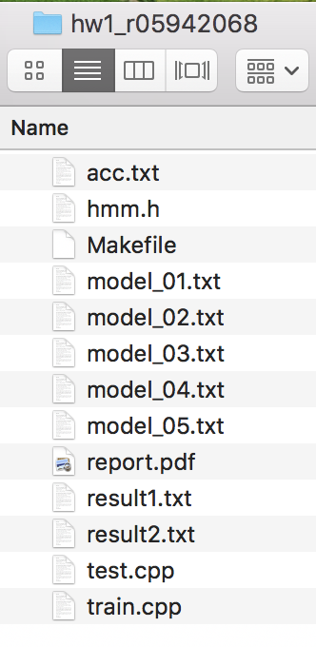


Submit Requirement (very important!)
Compress hw1_[ID] into hw1_[ID].zip zip zip zip zip
hw1_[ID].zip → hw1_[ID]
hw1_[ID]
train.c/cpp
test.c/cpp
acc.txt
hmm.h
makefile
model_01~05.txt
report.pdf
result1,2.txt

Slide 31
TA’s Environment
g++/gcc version 6.2.0 20160901
Makefile
Type ‘make’ to compile (not execute) all programs (train/test)
Type ’make clean’ to delete all compiled programs

Slide 32
Grading Policy
Accuracy 30%
Program 35%
Makefile 5% (do not execute program, just compile them)
Command line 10%
Report 10 + 5%
Advanced analysis in report will get extra 5% bonus
File Format 25%
zip & fold name 10%
result1,2.txt 5%
model_01~05.txt 5%
acc.txt 5%

Slide 33
Do Not Cheat
Any form of cheating will not be tolerated.
We’ll compare your code with other’s including students who has been enrolled in this course.

Slide 34
Contact TA
ntudigitalspeechprocessingta@gmail.com 李致緯
Office hour: Tuesday 13:30 ~ 14:30 @ EE2 531
Your question might be in FAQ, please read FAQ first.
Please inform me that you’ll come in advance, thanks!

