Slide 1
Internet
Workshop

Slide 2
The first “inter-net”
https://www.youtube.com/watch?v=L4bJIGuQX40

Slide 3
Internet
IP and ARPANET are very similar. The big change with IP is the openness and decentralization. Unlike ARPANET, anyone can join the internet (☭). The entire specification of IP is free and public. If you wanted, you can just read the document and create your own products that use IP https://www.rfc-editor.org/rfc/rfc791

Slide 4
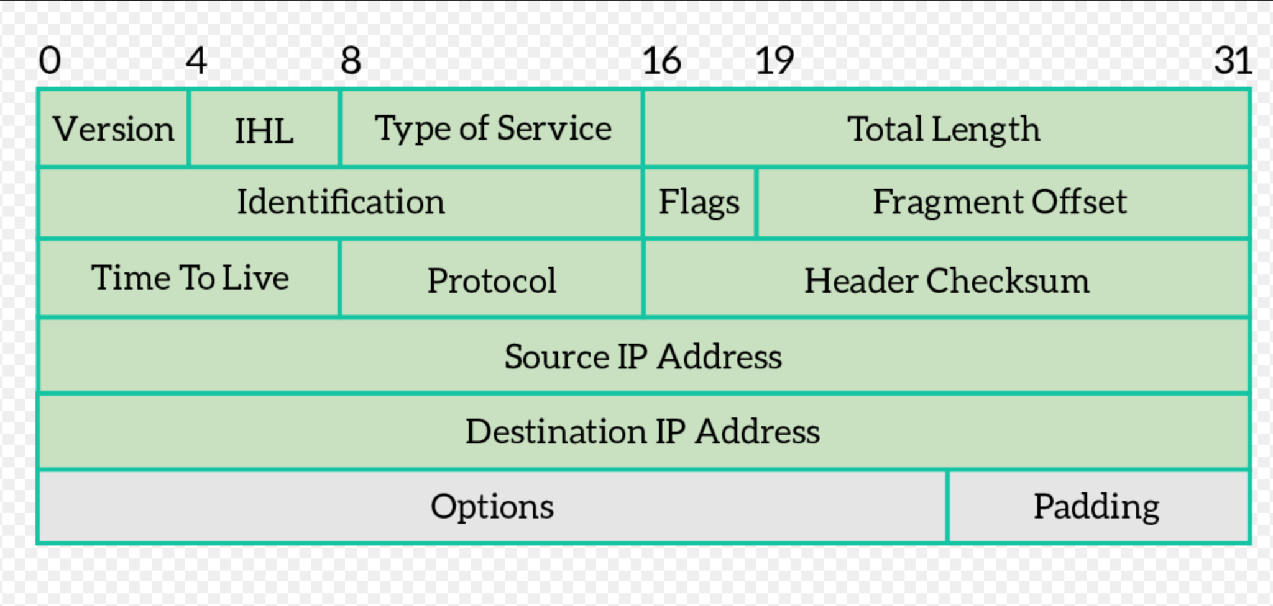
IP Packets

Slide 5
Headers
Total Length - How many bytes are in your message
Time to Live (TTL) - At each hop, this number decreases by 1, when it reaches 0 you get a "time exceeded" message
Then Source IP Address and Destination IP Address says where the packet is coming from and where it is going to.

Slide 6
IP Addresses
IP Addresses are 32 bit wide. Written as 4 blocks of decimal numbers between 0-255. 45.79.189.214 is “mahoney.best.”
There's only around 4 billion IP addresses. This made a lot of sense in the 70s with mainframes. Today, we're almost out of IP addresses.

Slide 7
IP exhaustion
The first solution to this problem is called Network Address Translation (NAT). It allows entire networks the share a single ip address. The second solution is to make IP addresses bigger. This is what IPv6 does, replacing 32 bit addresses with 128 bit addresses. > Every star in the observable universe can have around 100,000 IPv4 addresses spaces worth of IPv6 addresses.

Slide 8
Routing
The way IP works is that every "router" on the internet keeps track of a map of all networks on the internet. When the router receives a packet, it sends it down a path that will bring it closer to its destination. Check you this group who makes visualizations of the internet. Every core router on the internet has this map in memory. https://www.opte.org/the-internet/

Slide 9
Private Networks
IP was designed to be network agnostic. Any organization can choose to run it’s internal network however they want. However, IP is designed so well that people still choose to use it within private networks. To facilitate this the IP designers left some space for private use. The most important of the private spaces are:
10.0.0.0/8 | 10.*
192.168.0.0/16 | 192.168.*
172.16.0.0/12 | 172.16.* through 172.31.*

Slide 10
TRACERT
The tracert (“trace route”) command uses a trick to “map” your connection to servers on the internet. By sending IP packets with increasing TTLs (1, 2, 3, …) we’re able to see how far our packet gets along the internet before dying. This workshop requires using a command prompt and running commands. Test to see if you have a working command prompt by running: ping mahoney.best

Slide 11
TRACERT
The tracert command with no arguments is slow. In order to speed it up add the -d option to remove DNS resolution (~5-10x faster). Some places on the internet are very far away, so you may need to increase the numbers of allowed hops using the -h N option. For example: tracert -d -h 100 45.79.189.214

Slide 12
Activity
Choose one of the following ip addresses to tracert A - 163.22.17.70 B - 45.155.125.8 C - 169.229.200.70 D - 128.8.207.141 E - 102.130.127.69

Slide 13
Lookup approximately where each router is
https://trace.mahoney.best For each IP address in your traceroute: - Record if the address is public or private - If it’s public plug it into my website and write down its (approximate) location PUT ALL INFORMATION IN A GOOGLE DOC (each hop and location) Once you’ve finished share out the country we sent you to.

Slide 14
Questions:
How accurate do you think this “geo-ip lookup” is? How safe is it to share your ip address with strangers?
If you run the same tracert again do you get the same route? Why or why not?

Slide 15
Learn More:
How Traceroute Works (Building a Movie Scene 'Trace' Map) - Computerphile

