Slide 1
Node.js
Module 09

Slide 2
What is full-stack web development?

Slide 3
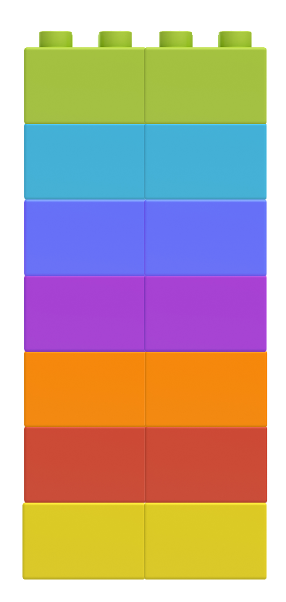
Full-Stack Web Development
HTML
Full-stack web development encompasses the suite of tools required to build both the front and back ends of a web application.
CSS
JavaScript
API
Node.JS
Express.JS
MySQL

Slide 4
How much of the stack do we know?

Slide 5
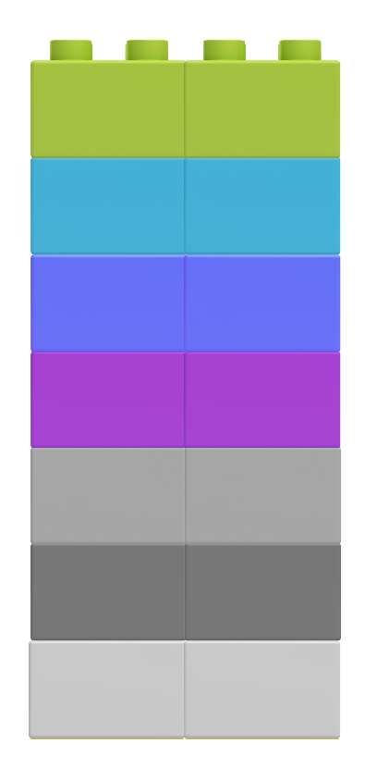
Client-Side
HTML
So far, we have learned about client-side development. The three primary components of client-side code are HTML, CSS, and JavaScript. We can also fetch data from an API for use in the client.
CSS
JavaScript
API
Node.JS
Express.JS
MySQL

Slide 6
What is a client?

Slide 7
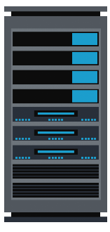

Client
A client is a piece of computer hardware or software that makes requests to a server. It can be a desktop computer, laptop, mobile device, and beyond!
Further reading.
http://website.com
Request
Response
Client
Server

Slide 8
What Is GitHub Pages doing?

Slide 9
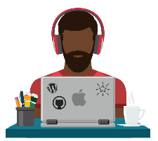
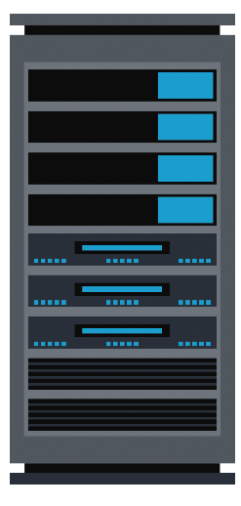




Deploying Projects to GitHub Pages
GitHub Pages is serving content to clients.
https://pages.github.com/
Request
Response
Client
https://pages.github.com/
Request
Response
GitHub Pages Server
Client

Slide 10
What is a server?

Slide 11

Server Definition
Depending on the context, a server is both the physical hardware and the software that hears requests from users and returns something, like an HTML or image file, or completes a process.
var http = require("http");
var PORT = 8080;
​
function handleRequest(request, response) {
response.end("It Works!! Path Hit: " + request.url);
}
​
var server = http.createServer(handleRequest);
server.listen(PORT, function() {
console.log("Server listening on: http://localhost:" + PORT);
});
Server

Slide 12
What is the client-server model?

Slide 13
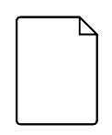
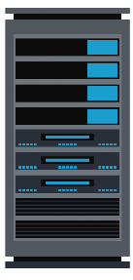
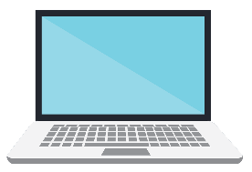

The Client-Server Model
In modern web applications, there is constant back-and-forth communication between the visuals displayed on the user’s browser (the front end) and the data and logic stored on the server (the back end). Clients make requests, and servers respond.
The client's request contains the name and address
(the URL) of what the client is looking for.
HTML
</>
Client Request
The server typically has lots of content that it can return to clients. That content can be web pages, JPEGs, and other resources.
HTML
HTML
</>
</>
</>
Response
</>
The server's response contains the actual
document that the client requested (or an
error code if the request could not be processed).
Web Browser (Client)
Server

Slide 14

Key Question:
So what is NodeJS ?

Slide 15
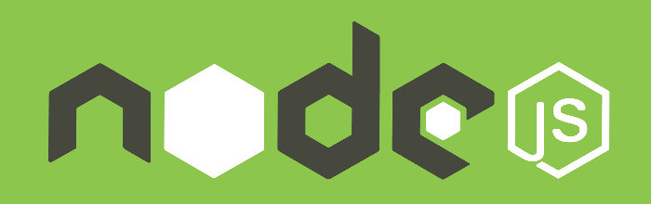
Definition of NodeJS
Node.js is an open source, cross-platform JavaScript runtime environment designed to be run outside of the browser.
It is a general utility that can be used for a variety of purposes including asset compilation, scripting, monitoring, and most notably as the basis for web servers.

Slide 16
Mini-Project

