Slide 1
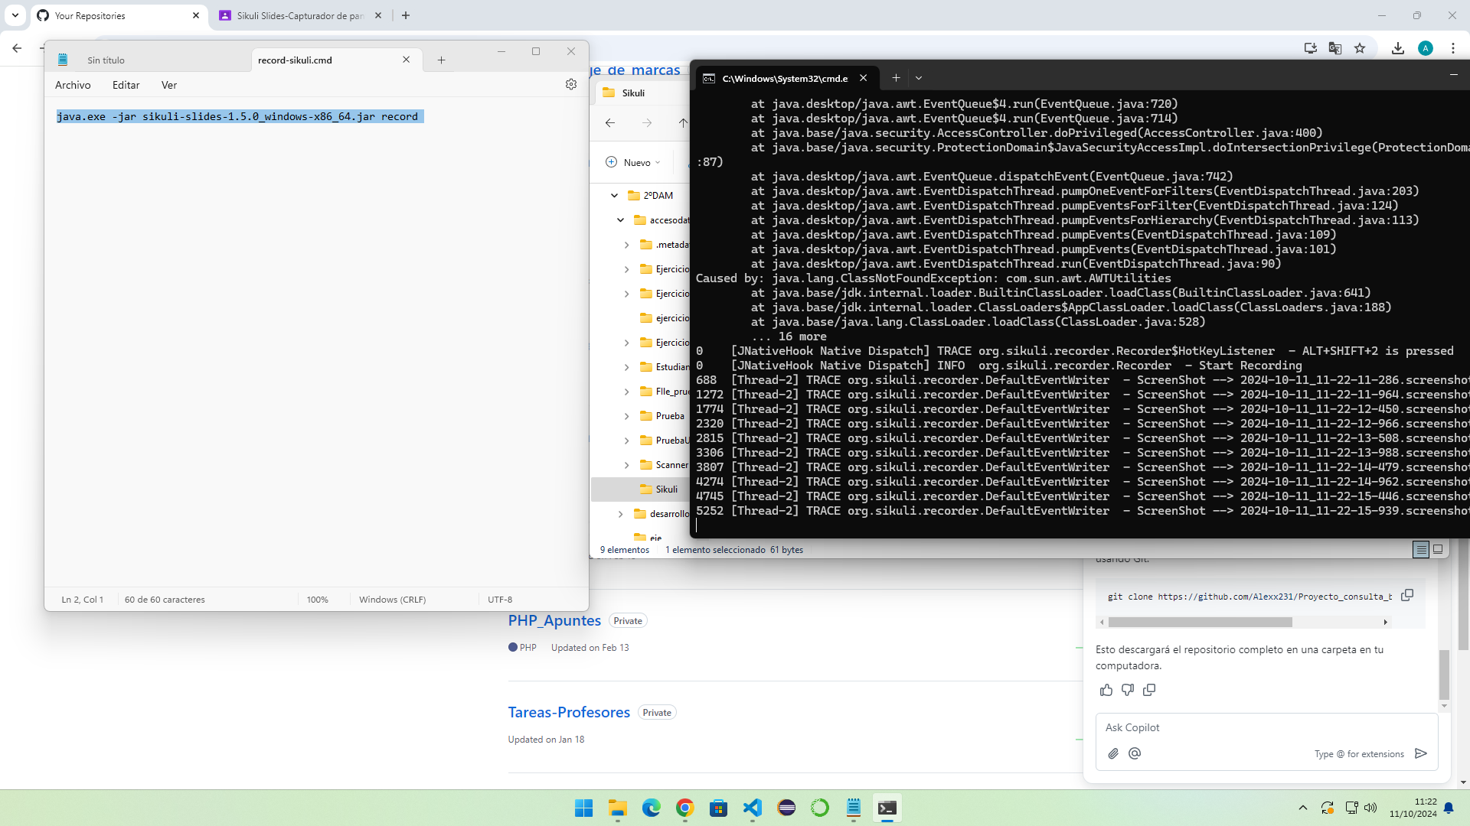
Click

Slide 2
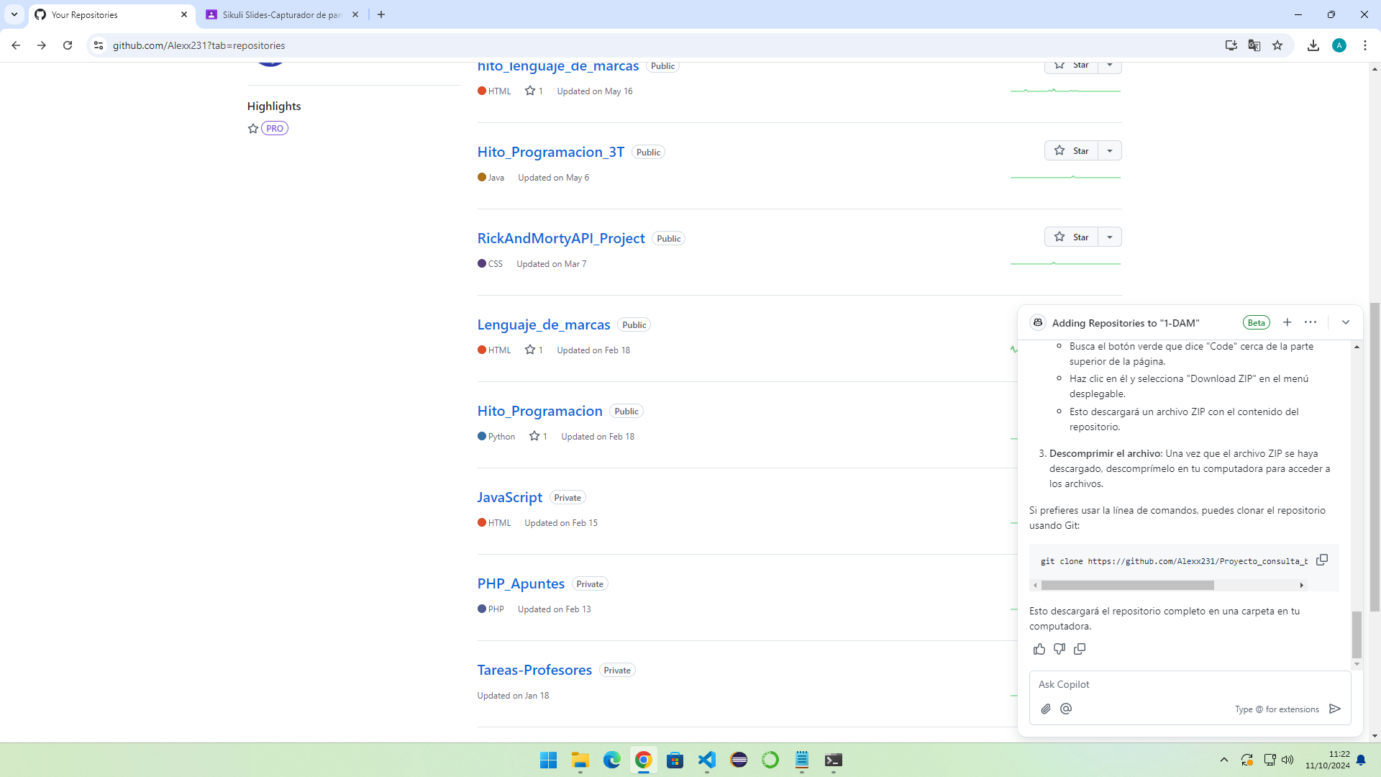
Click

Slide 3
Click

Slide 4
Click

Slide 5

Click

Slide 6
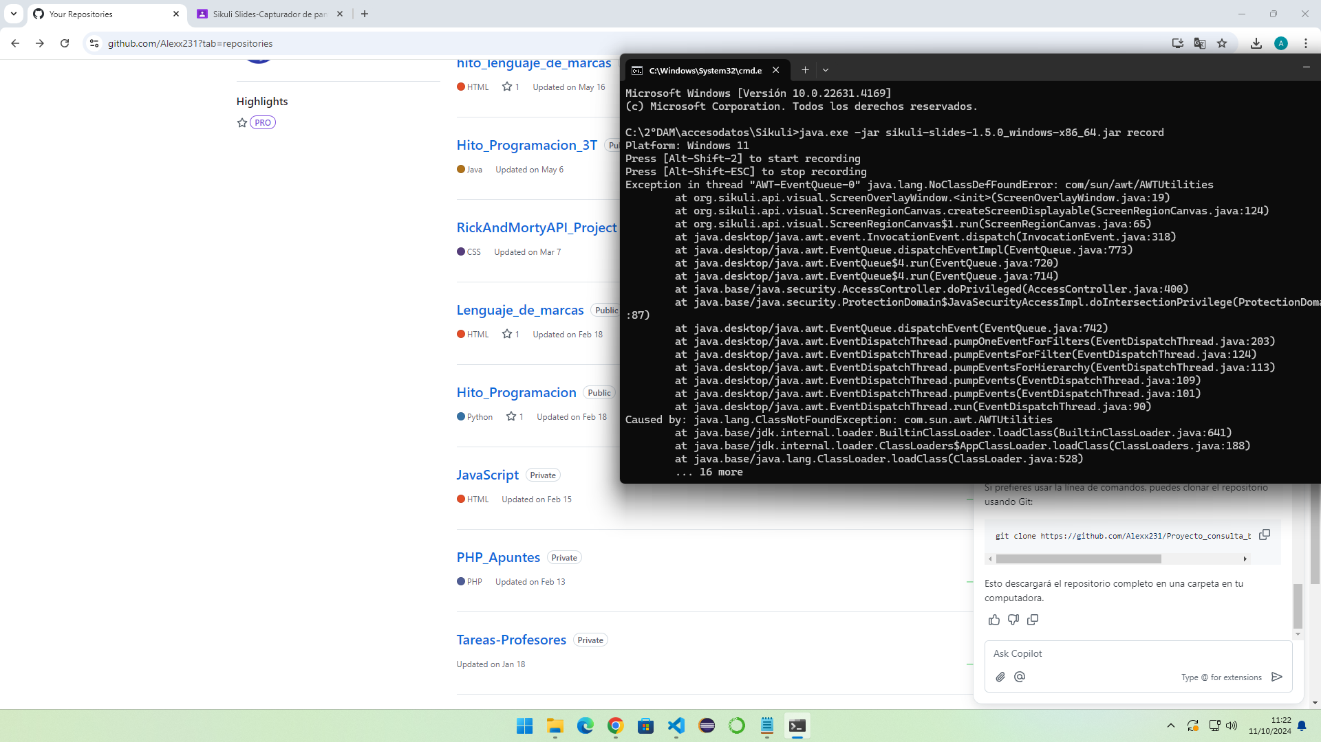
Click

Slide 7

Click

Slide 8
Double Click

Slide 9
Click

Slide 10
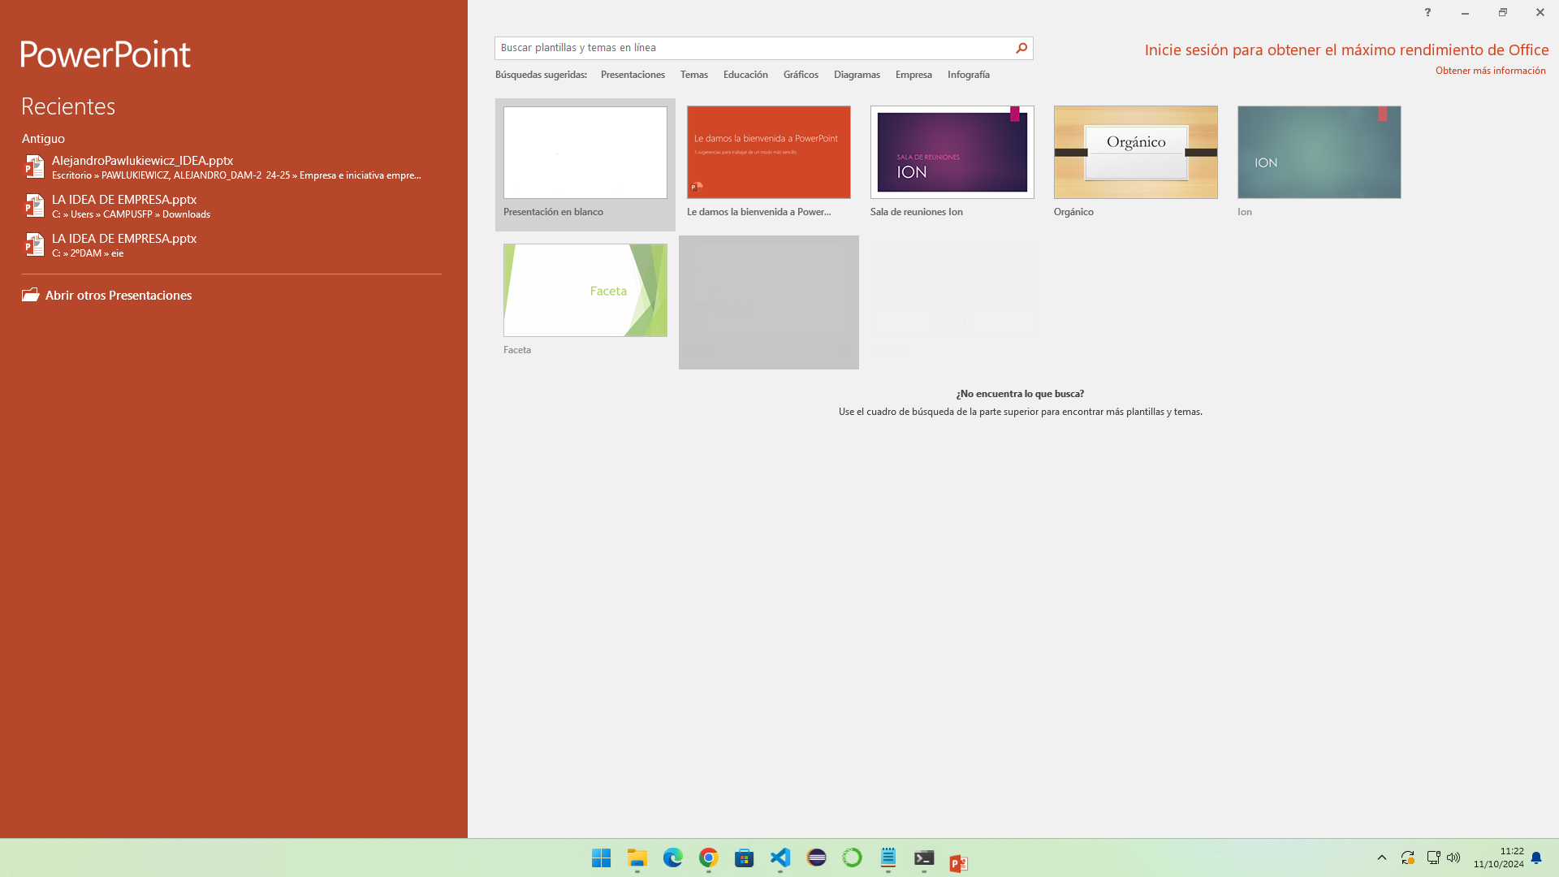
Click

Slide 11
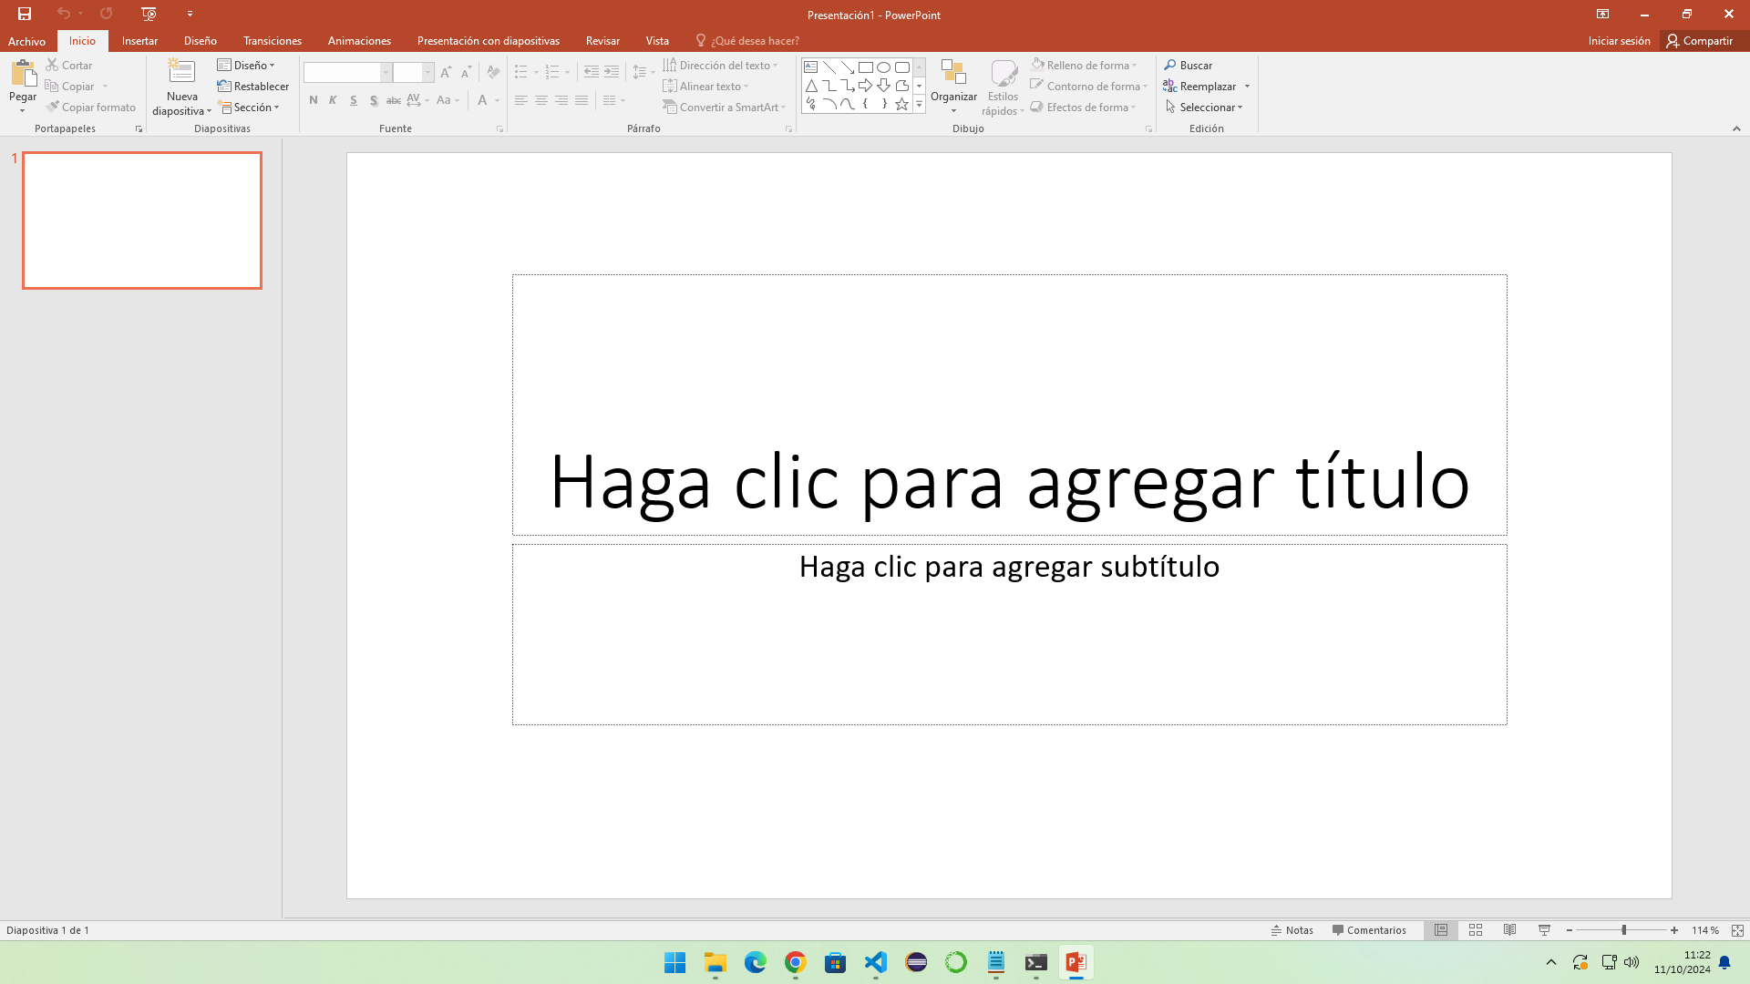
Click

Slide 12
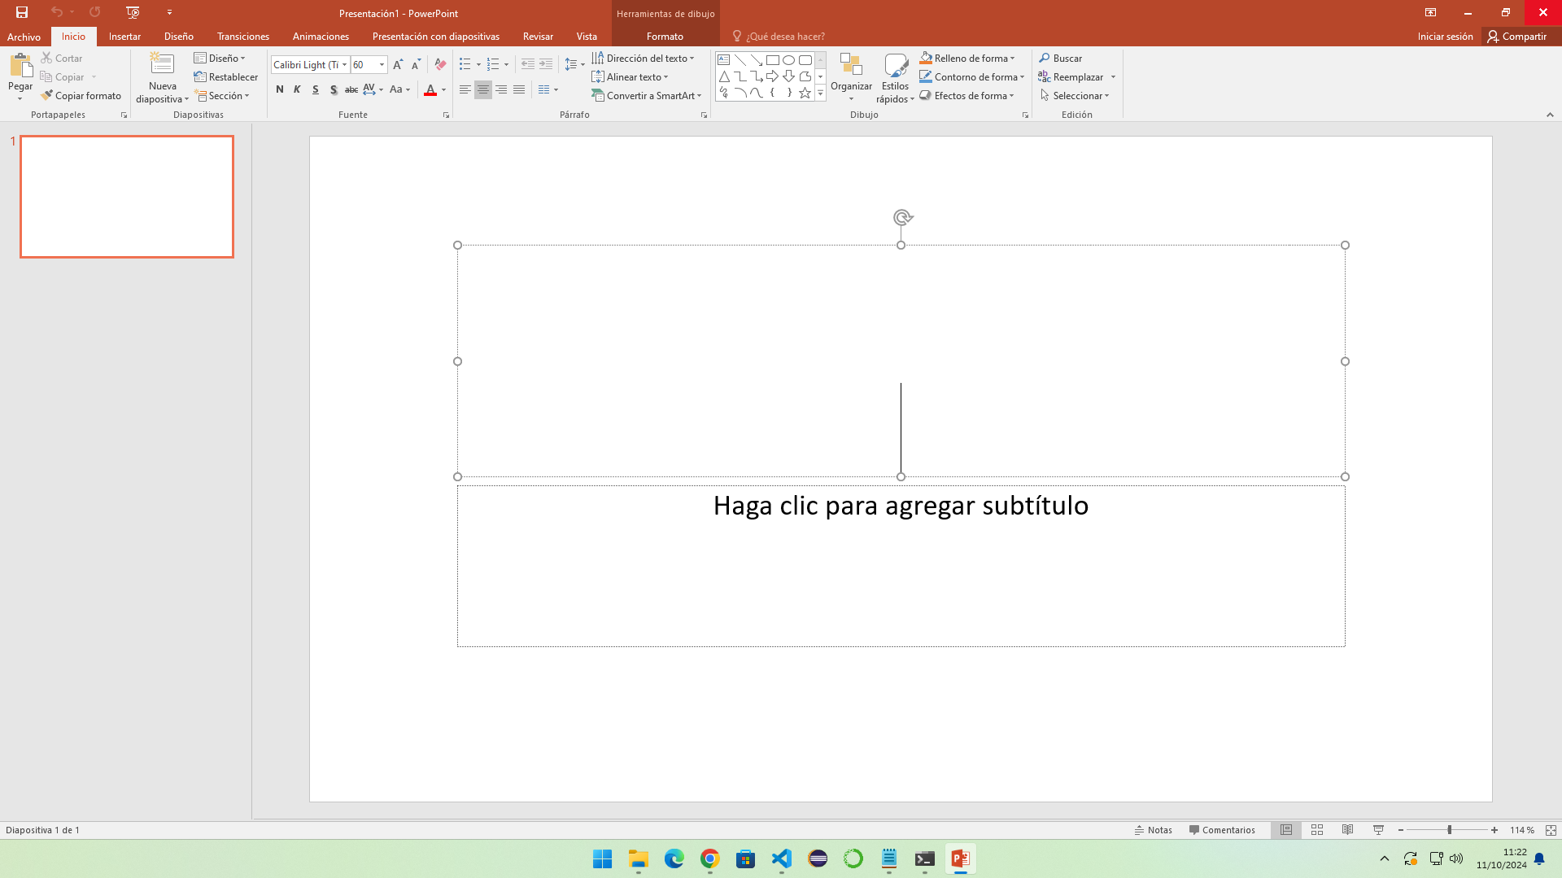
Click

Slide 13
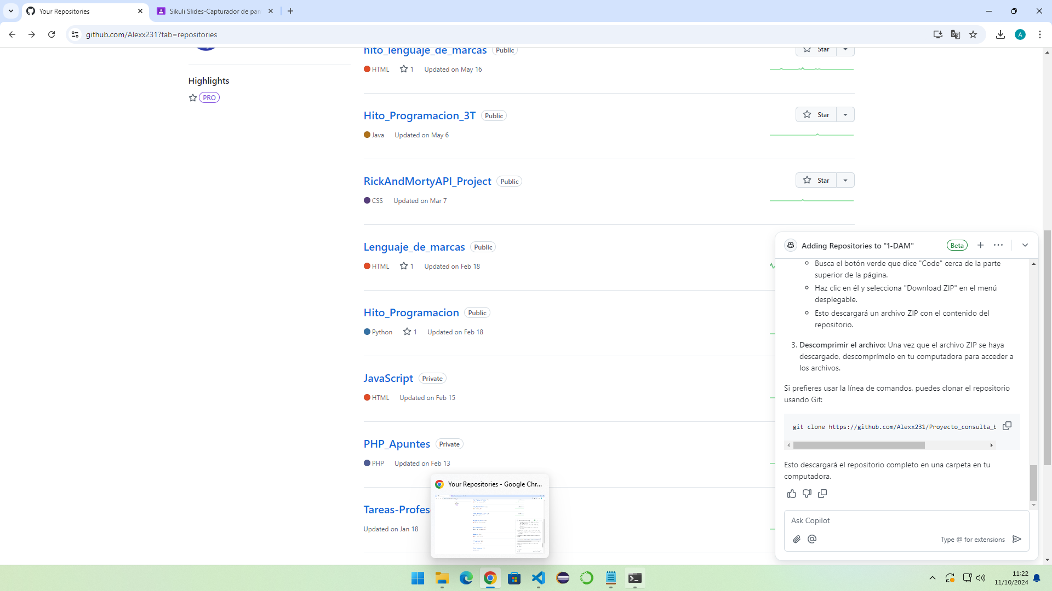
Click

