Slide 1
Assignment 3
623.915 (20S) Content Search with Deep Learning
Alexander Lercher, 01560095

Slide 2
Dataset
Three videos with approx. 10 minutes in total per class
Similar resolutions
Downloaded with 360p
Small differences due to aspect ratio
Uniformly sampled every second to ensure similar number of keyframes
90% used as training data per class

Slide 3
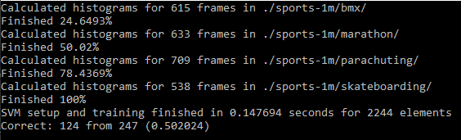
Results
Around 50% accuracy (depending on actual training set distribution)
Sample output:

Slide 4
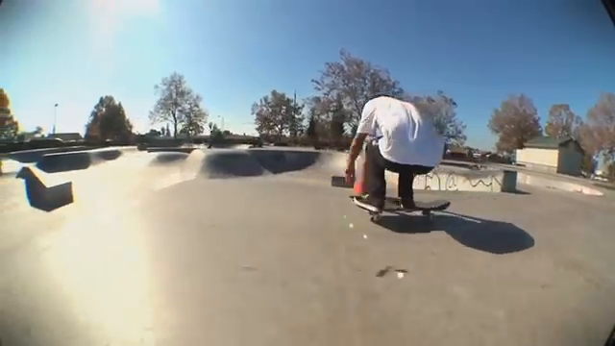
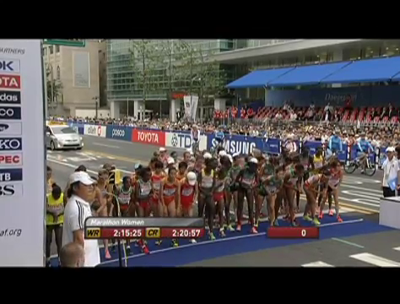
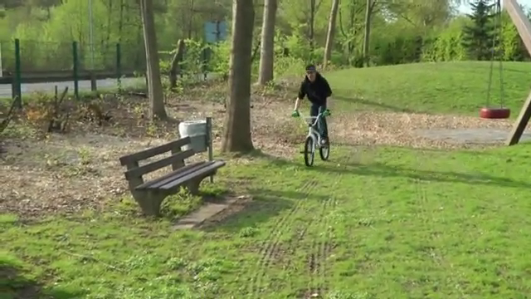
Correctly Classified Results

Slide 5
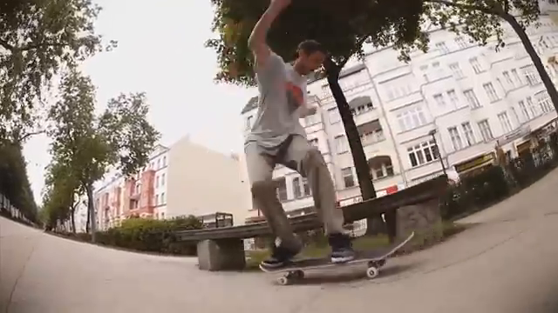
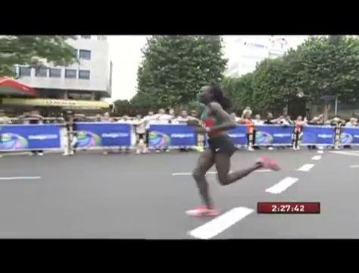
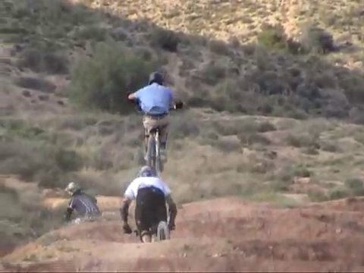
Incorrectly Classified Results
Classified as parachuting
Classified as bmx
Classified as marathon

Slide 6
Conclusions
Fast training but only moderate results
Suboptimal training and test data
Raw keyframes uniformly sampled
No black intro removal, duplicates removal, normalization, ...
Results improve for more detailed histograms
47.37% for 64 bins
53.44% for 256 bins
For same shuffling seed

