Slide 1
This deck contains videos for the RTVS documentation.

Slide 2
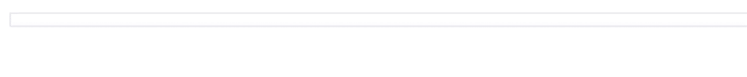
read.csv code snippet video

Slide 3
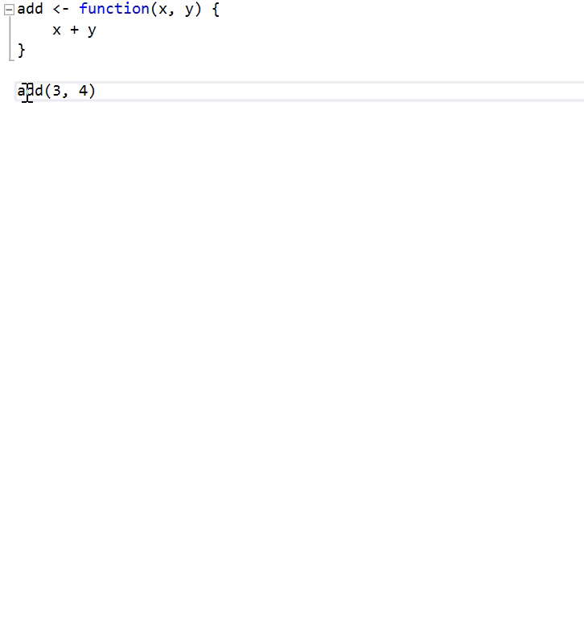
goto definition

Slide 4
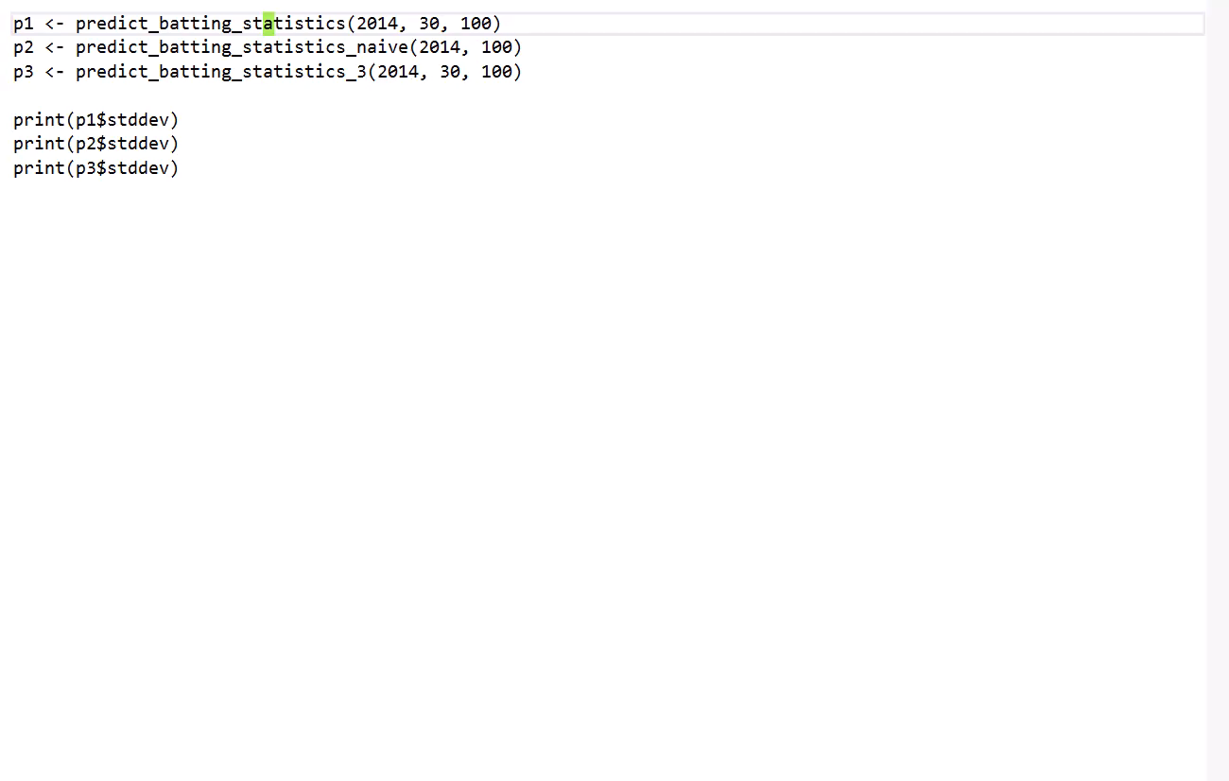
peek definition

