Slide 1
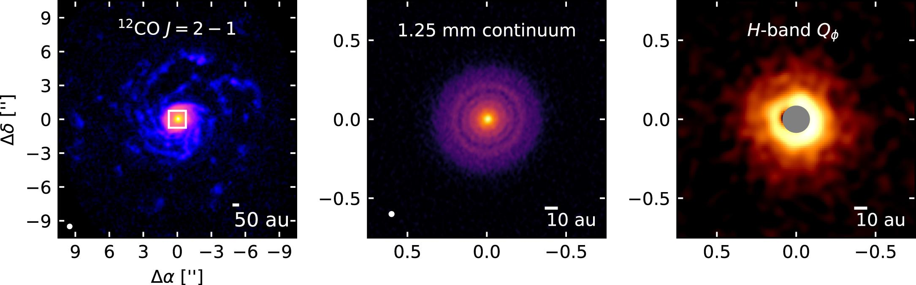
Figure 9. from Large-scale CO Spiral Arms and Complex Kinematics Associated with the T Tauri Star RU Lup
null 2020 APJ 898 140 doi:10.3847/1538-4357/aba1e1
http://dx.doi.org/10.3847/1538-4357/aba1e1
© 2020. The American Astronomical Society. All rights reserved.
Information:
Thank you for downloading this PowerPoint slide from The Astrophysical Journal. This slide was designed to be edited; you can:
- Remove components (including this text box!)
- Resize components
- Apply a style or theme
- Please remember to include the original article citation information.

