Slide 1

Profitable
All-in-one platform for the professional speculators

Slide 2
Agenda
The Problem
The Solution
Current Development State
System Design Diagram – Current Development State
The Future of The Platform

Slide 3
The Problem
Too many platforms are used – tough and costly to manage
Some are not narrowly oriented to the speculator profession
Valuable functionalities are missing
There is no existing anti-disinformation platform

Slide 4
The Solution
All-in-one platform – one profile accessing all functionalities needed
Web application accessible through browsers, desktop and mobile
Developing Footprint charts, statistical tools, AI assistants, chat organizations, calculators, news panel, economic data panel and more
Bilateral secured communication between the regulators and the platform through REST APIs

Slide 5
Current Development State
It is Prototype version
Monolithic, three-layered architecture
Backend is a Web API, Frontend is a Single-page application
Basic charts, news panel, economic data panel, profile management and chat rooms
JWT token authentication
Advanced password hashing algorithm, XSS, XSRF, SQL injection, parameter tampering
Web browser access only

Slide 6
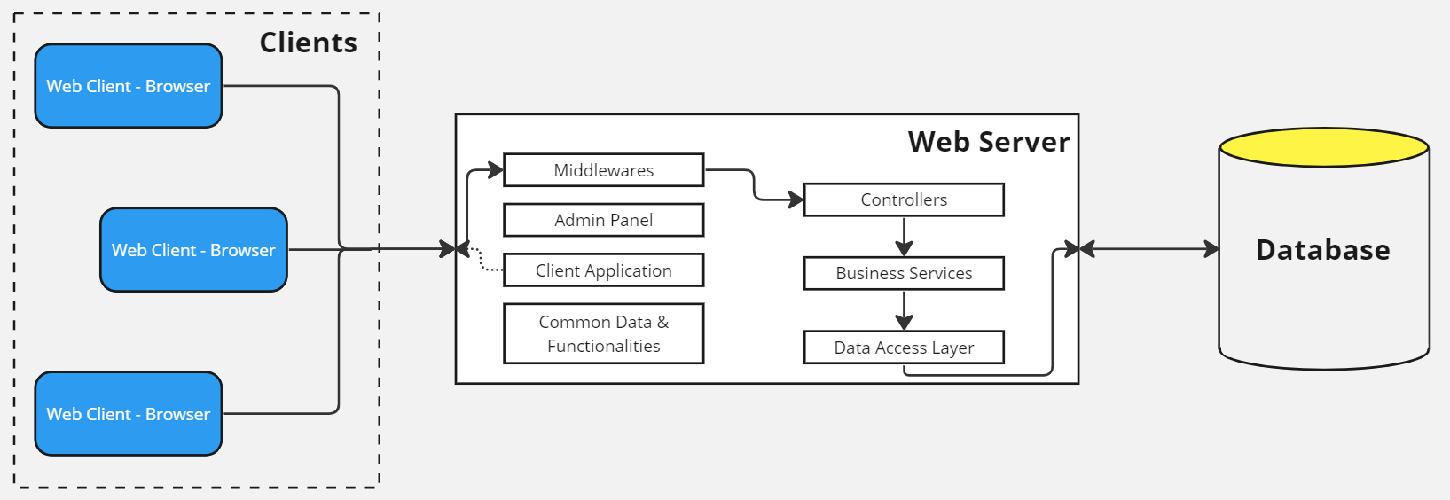
System Design Diagram – Current Development State
Monolithic architecture
Single web server
Single database – relational database

Slide 7

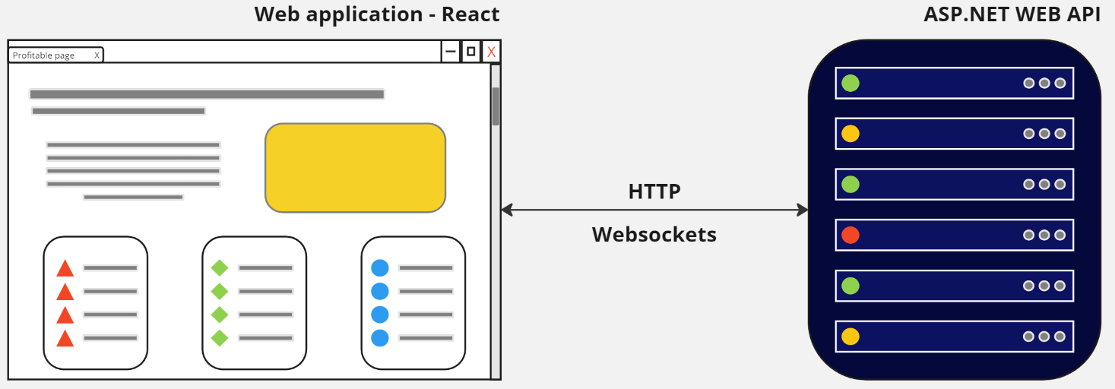
System Design Diagram – Current Development State
Frontend application – React – React components
Backend application – ASP.NET WEB API
Communication – HTTP or Websocket protocol

Slide 8
The Future of The Platform
Divided into microservices
Based on Three-Tier architecture and Clean architecture principles
Training and deploying AI assistant model
Implementing API calls or messaging queues for communication with regulators’ systems
Developing complex charts, based on footprint, and statistical tools like Gaussian Curves
Mobile and desktop applications - cross-platform

Slide 9
Thank you for your attention!

