Slide 1

An Analyzation Of Attrition Contributors And Other Trends
Created By Alexy Morris

Slide 2
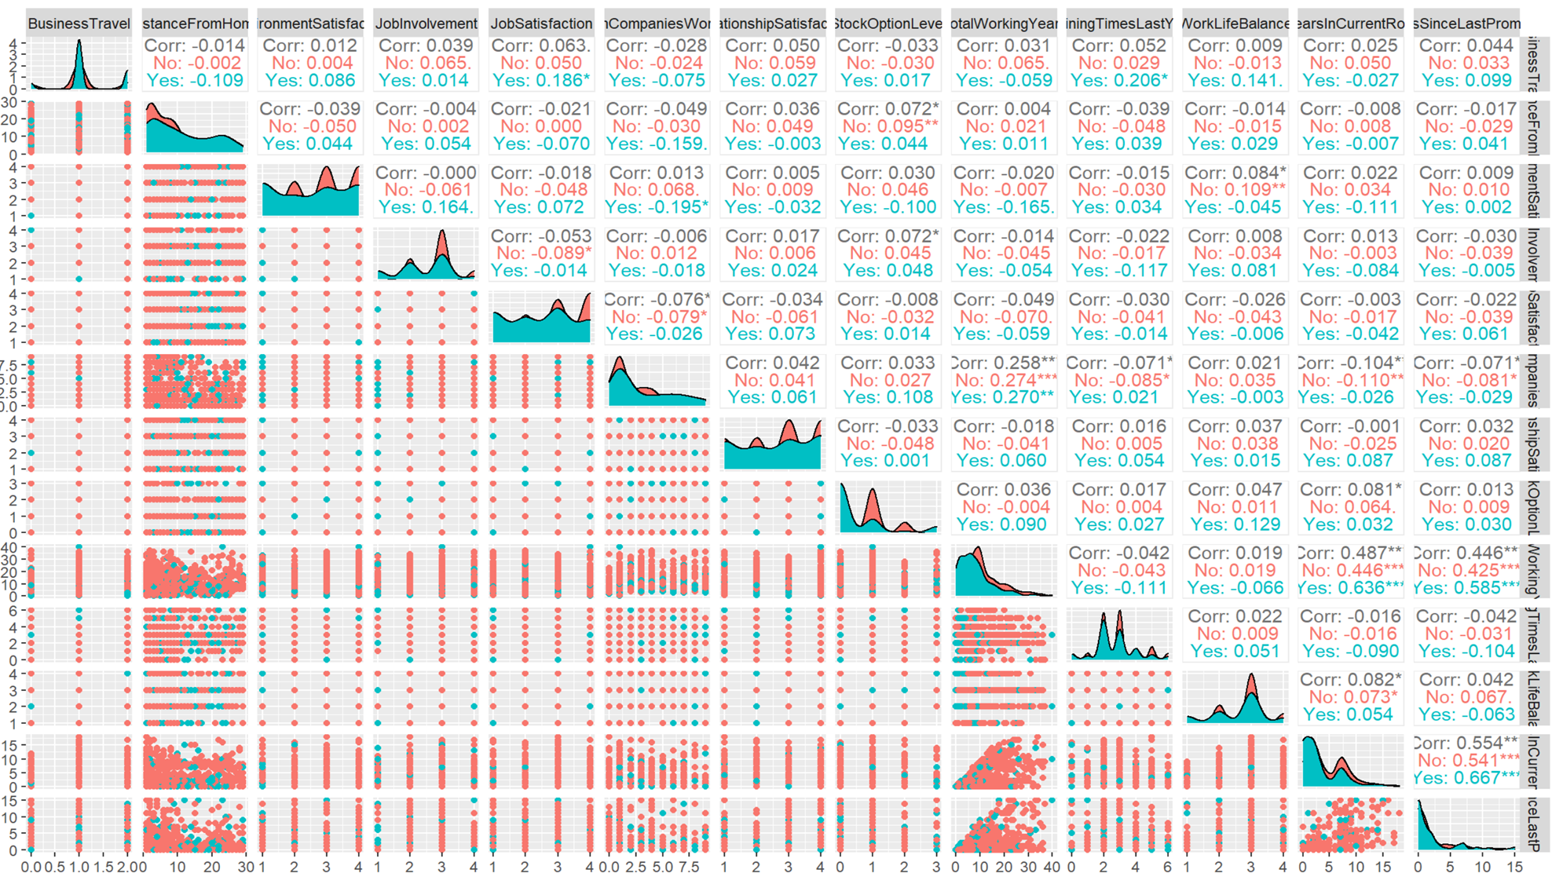

Slide 3

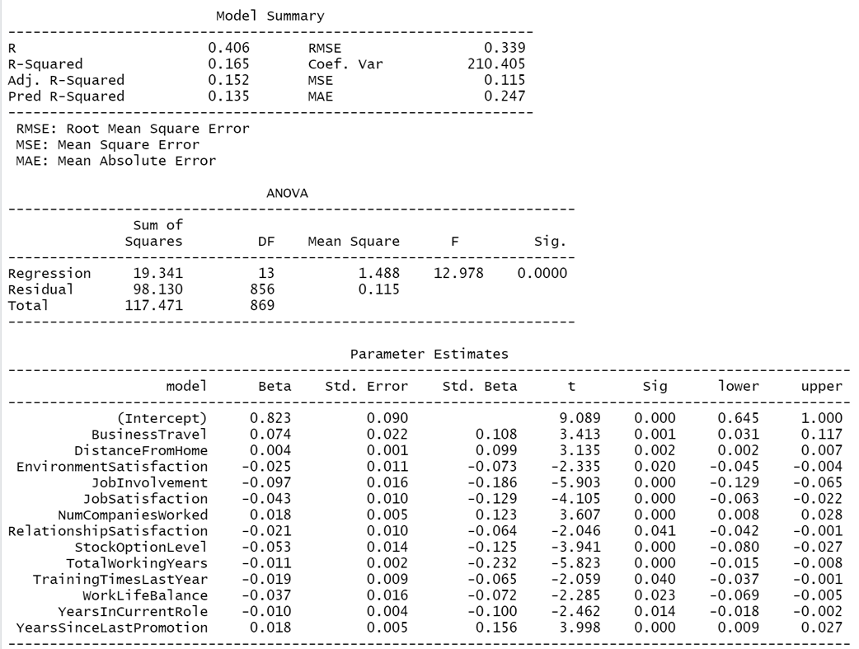
Attrition Model
Our linear regression created with Backwards Selection and a slightly cut down version of the dataset.

Slide 4
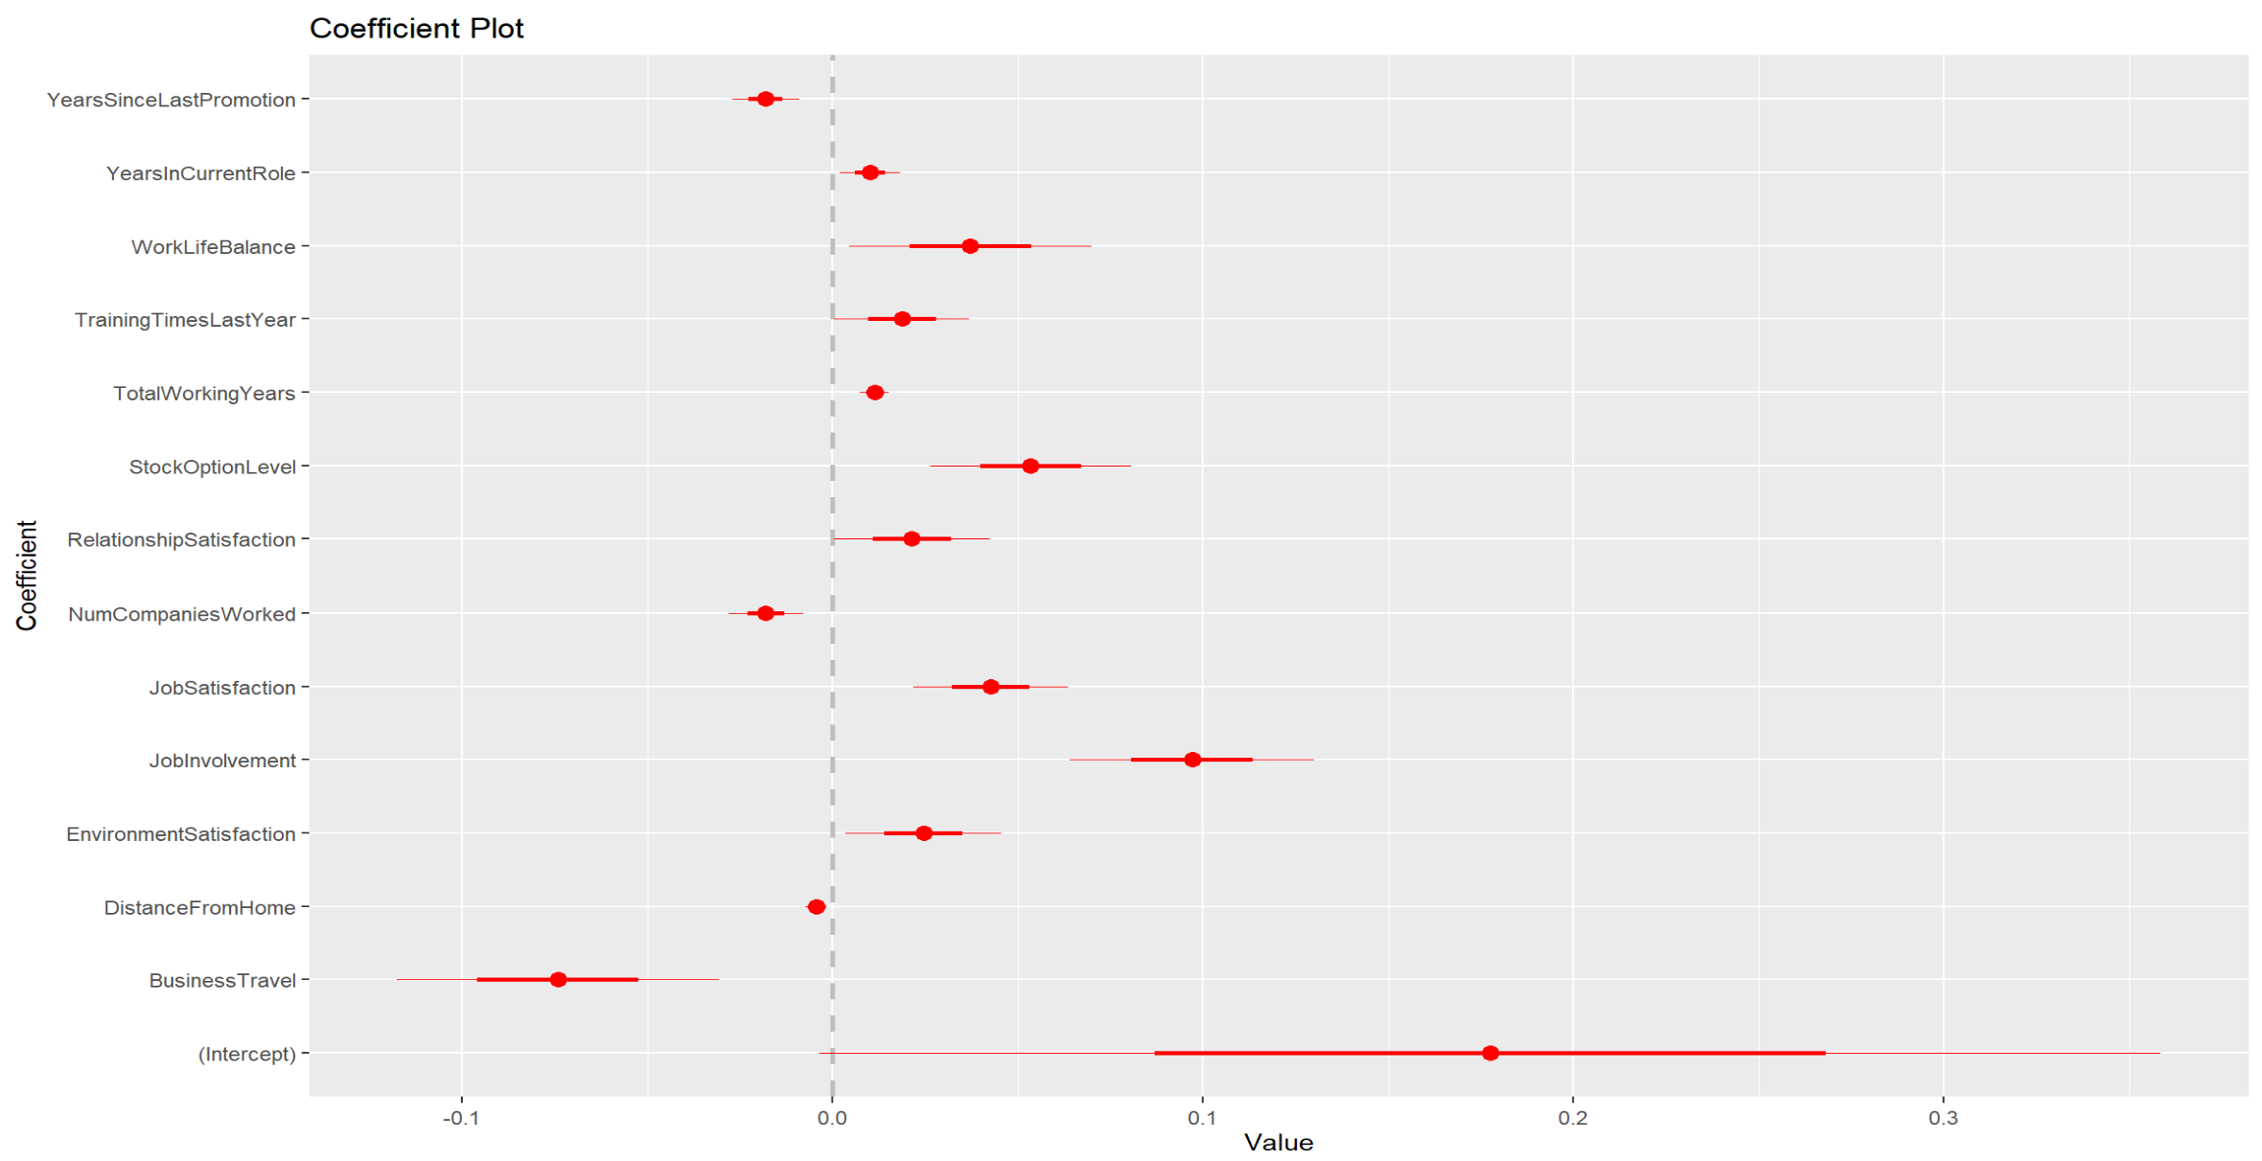
Attrition Model
The influence of each variable along with a 95% confidence interval.

Slide 5
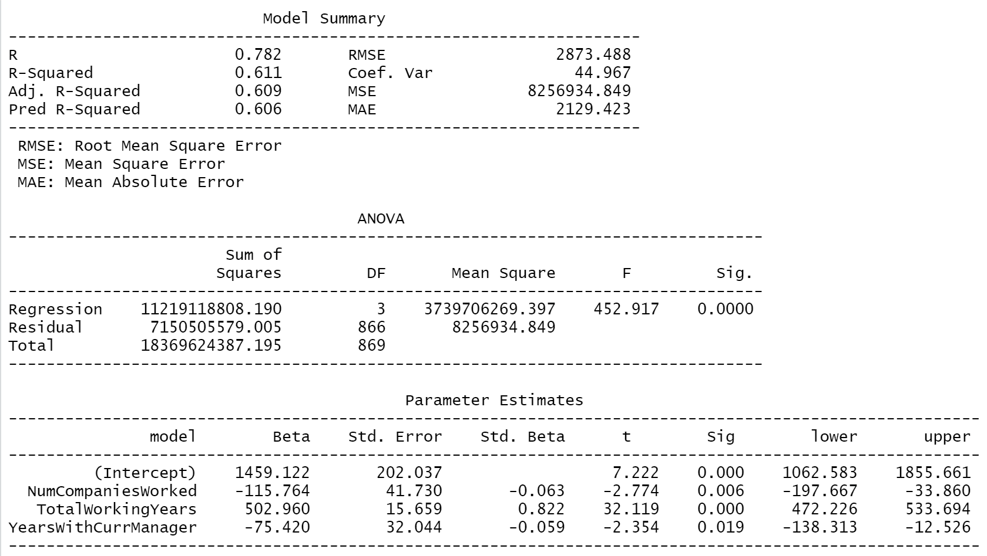
Salary Model
Linear model of salary in regards to the variables selected from backwards selection.

Slide 6
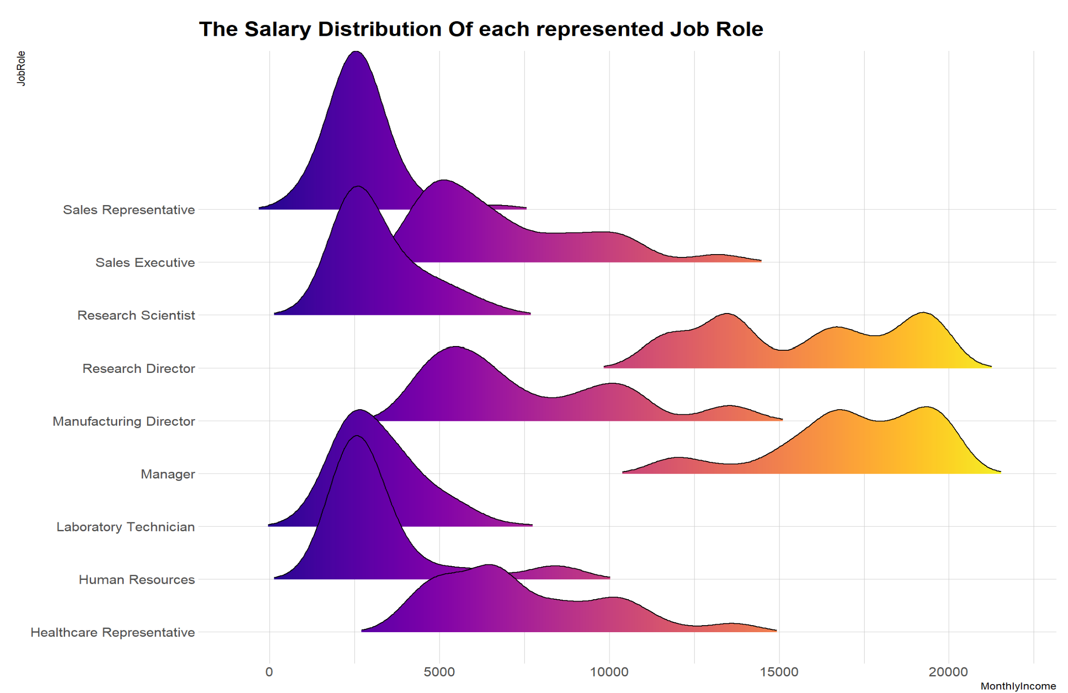
Salary Distribution
A look at the wide variety of salaries per job role.

Slide 7
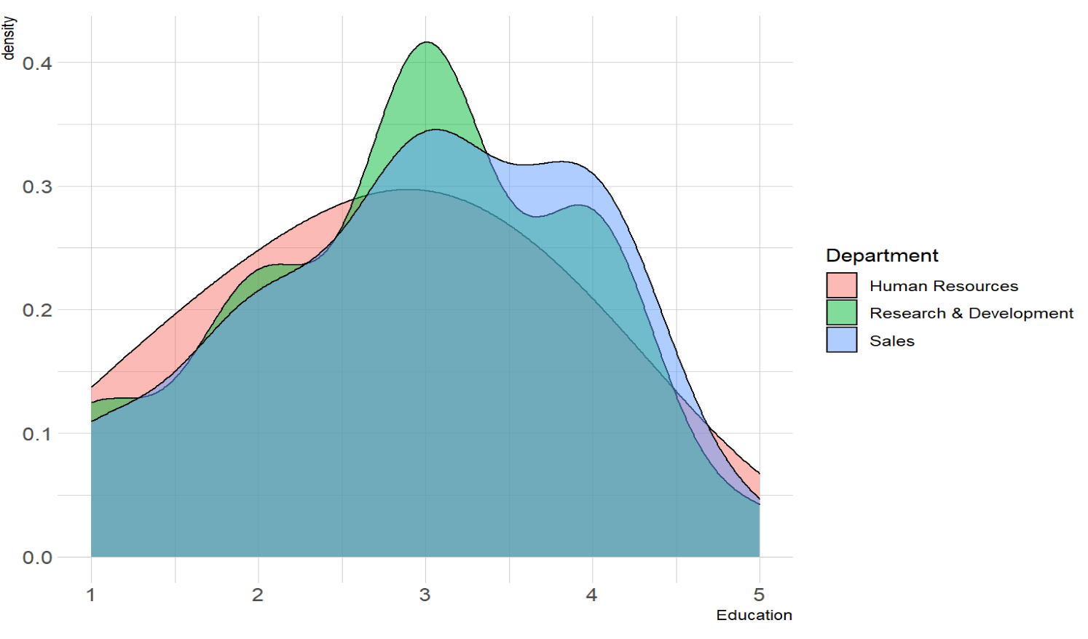
Education Levels by Department
A group of non normal distributions with an interesting trend near the end.

Slide 8
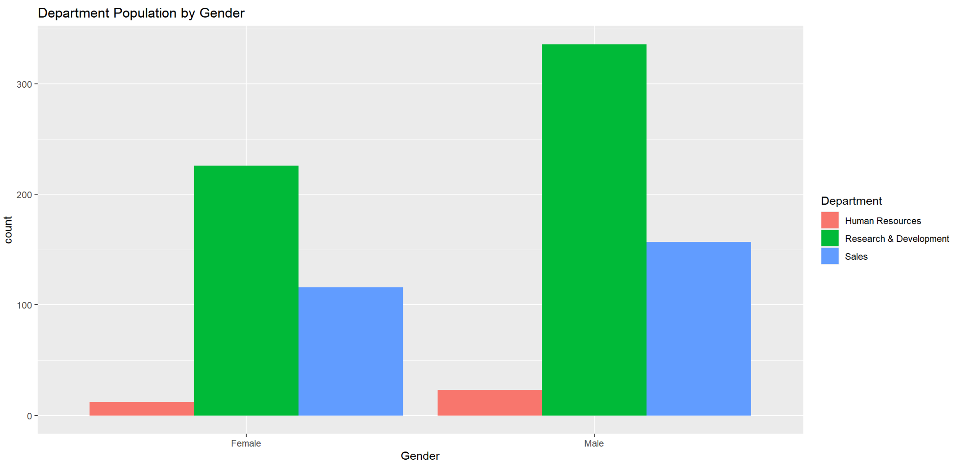
Surveyed Population
A look at the surveyed population split by gender.

Slide 9
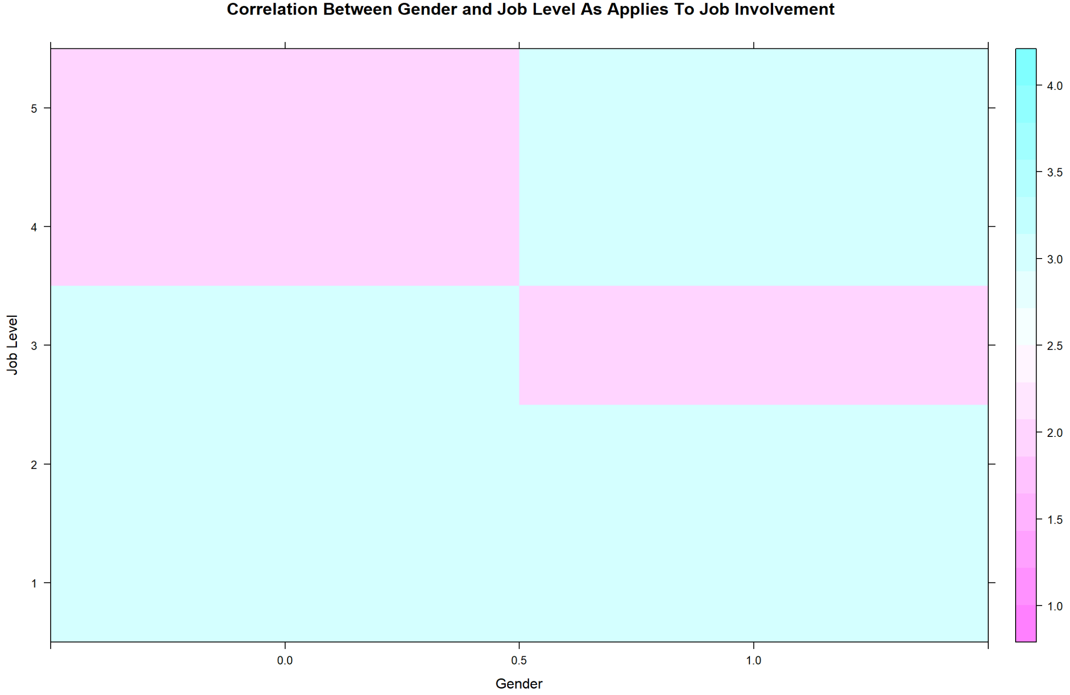
Job Involvement Correlation

