Slide 1
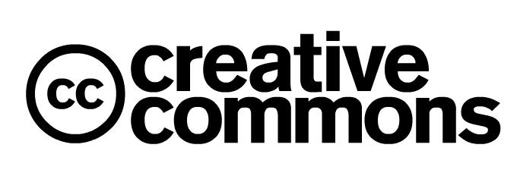

Slide 2
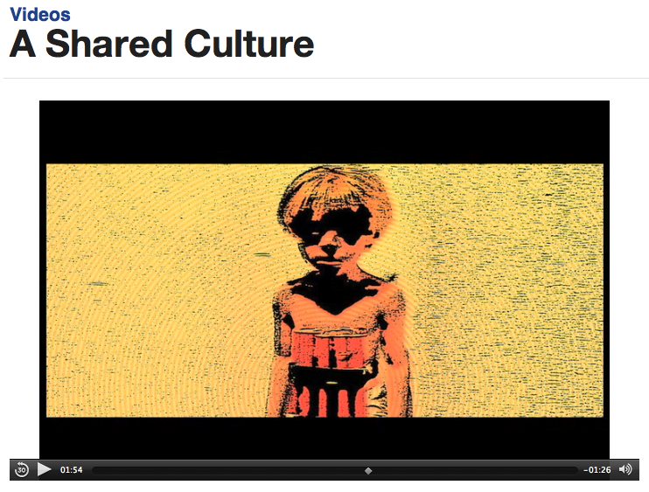
http://creativecommons.org/videos/a-shared-culture
Notes:
Video explains why Creative Commons licenses were developed.

Slide 3
The Copyright Setting
  Copyright
  happens automatically when a work is created in a tangible form
  does not require registration or notice
  lasts for the life of the author plus 70 years at least, and more in some cases
  Copyright is a bundle of rights:
  you can sign them away exclusively
  you can grant non-exclusive licenses that give multiple people permission to use a work for different purposes
Notes:
“All rights reserved” is the default. Changes in copyright law has now created a climate where it’s difficult to do what copyright law was supposed to enable-promote the progress of science and the useful arts. Key elements of the copyright setting within which we all work but this is NOT a class on copyright so look for the Know Your Copy Rights sessions at DCAL or ask for one for your group!

Slide 4
What is a Creative Common License?
  Creative Commons Licenses:
  apply to works that are subject to copyright (NOT to works already in the public domain)
  offer an option for the creator to define permitted uses explicitly
  do NOT affect Fair Use
  are NOT exclusive
  allow copying, distribution, display, public performance, & reformatting
  do NOT contradict copyright
Notes:
“Some rights reserved” is an option made available by CC licenses. Fair Use is intrinsic to copyright law and is the most useful set of restrictions on the exclusive rights of copyright owners. See handout

Slide 5
Why use Creative Commons Licenses?
  Although everything is copyrighted automatically, creators may not want or need to hold all those rights exclusively
  Perfectly acceptable uses are often restricted due to the automatic assignment of copyrights
  Permissions handling is often unnecessary but costly in time, money and effort

Slide 6

What are the conditions?
Attribution
Author must be acknowledged on all copies and adaptations of the work, including a link to the original version of the work

Slide 7

What are the conditions?
Non-commercial
The work can only be used for non-commercial purposes

Slide 8

What are the conditions?
No Derivatives
The work can only be distributed in its original form; no adaptations or translations can be made

Slide 9






What are the six licences?

Slide 10
What does adaptation mean?
Changes made to the work itself
Some examples
  Re-use in educational material
  Sampling your voice to use in electronic music
  Incorporating still or moving images into a Youtube video
Re-use must avoid ‘derogatory treatment’ meaning adaptation that risks having a detrimental effect on your reputation
Syncing music to video represents an adaptation of both

Slide 11
How do I attribute?
The author may have specified precisely how they wish to be attributed – always check
Otherwise…
Keep intact all copyright notices for the Work and give the original author 'credit reasonable to the medium'
Convey the title of the work if supplied
Include an URL for the work as long as the version of the work at the URL includes ownership and licensing information
In an adaptation explain the use made of the work and credit the original author as prominently as the adapter
Credit may be implemented 'in any reasonable manner'

Slide 12
How do I publish?
http://www.creativecommons.org provides a web-based tool for applying CC licences to web resources
Make sure the material is actually yours to publish
Be wary of using logos that might be trademarks (except in attribution contexts)

