Slide 1


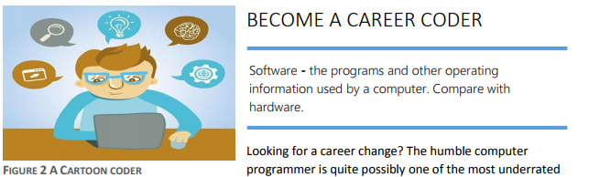

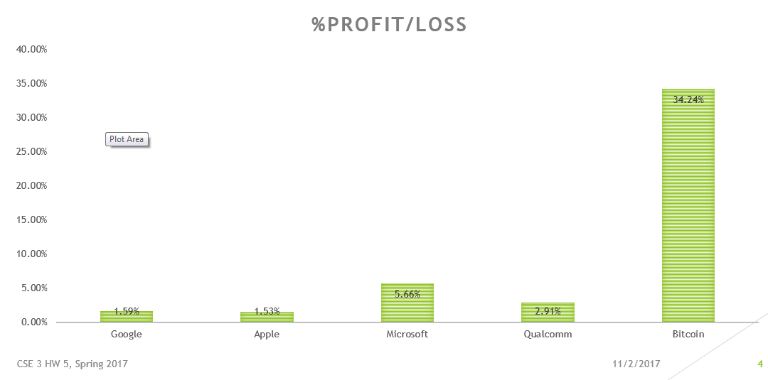
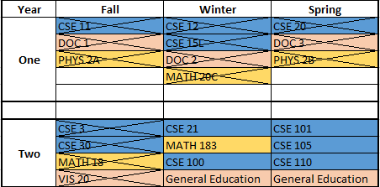
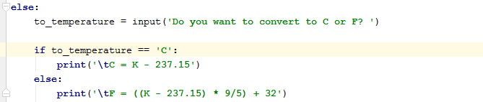


Computational Training
Making Information Available to the World with HTML and Web Pages
Desktop Publishing with MS Word
The Internet is older than one would think, holding roots back to ENIAC from 1946. Computers have come a long way from the enormous prototype that would dim the lights of the city when it was turned on. Transistors revolutionized the computer and soon, the personal computer become less of a pipe dream and more of a concept to work towards. But with great power comes great responsibility, as the internet has now become one of the most powerful tools in the world for information sharing, and as a result, a place for those who steal information to thrive. Computers cannot think for themselves just yet, but with human ingenuity, they can push the bounds of technology far beyond what it would’ve been without them.
In this section of the course, I learned to create my own functioning websites and share information through various pictures, links, and clever usage of fonts. HTML will become a useful tool for me in the future and I gladly add the ability to create functioning and aesthetically pleasing websites to my tool belt for the future. In a world of information, this know-how can be crucial.
What better way to present information than through colorful yet professional text? During this section of the course I learned how to format word documents to my advantage and use them to captivate my readers without compromising the professionality of my word document.
Presentation of Information with MS PowerPoint
Data Analysis and Visualization with MS Excel
IDE (Integrated Development Environment) Programming with Python
What you’re looking at even now is none other than the power of the PowerPoint application. Through this section of the course I was able to learn to harness the efficiency of this application to make my own visually stunning and attention capturing presentations.
In this part of the course, I learned how to filter data to show what was most important through the power of MS Excel. I am now able to visualize basic trends, show meaning behind otherwise abstract numbers, and use formulas to effortlessly conquer otherwise difficult problems like balancing a budget.
During this course, I learned how to begin creating my own code rather than relying on Excel’s pre-built formulas. After this course my coding literacy grew, as I learned how to utilize computer decisions with if/else statements, loops, and user input and output to create cohesive code that dynamically interprets what the user puts in.
Experiences with Computational Thinking
Dynamic Webpage Programming with JavaScript
The culmination of this course! With this, I was able to build on my HTML design and coding literacy to create my own dynamic webpages that respond intelligently to user interaction. With this, I now have the knowledge to start stepping into the world of website creation with an arsenal of tools and know-how to help me.
By Alexander Zhou

