Slide 1
Connection to a Social Media Api’s
InstagramApi
Time boxed: 1week
Boldisor Alexandru-Sebastian
Information Type: Working Standard, Disclosure Range: , Information Owner: alexandru.boldisor, NTT DATA Romania

Slide 2
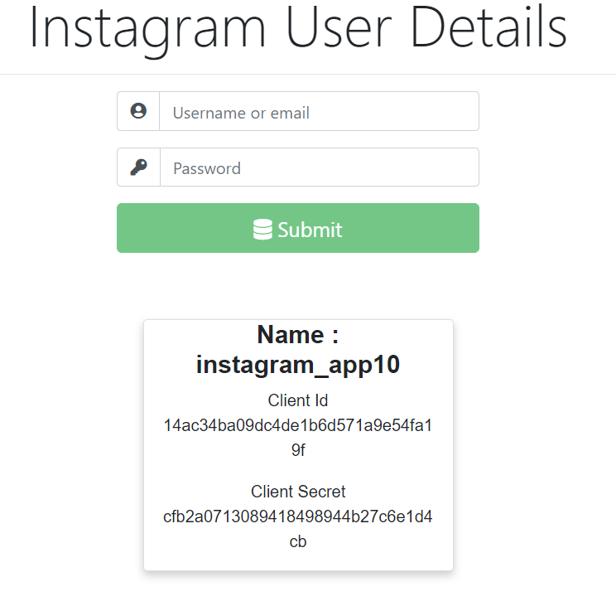
Project description
Building an application that connects with a chosen Social Media App.
Provides information regarding the account and public content.
Used a client develop in Angular that send request to the Asp.net core server and displays the received data.

Slide 3
Technologies involved
1. Integrated development environment
Visual Studio 2019 ( Back-end )
Visual Studio Code (Front-end)
Microsoft SQL Server Management Studio 2018 (Database)
2. Languages
HTML 5 & CSS 3
JavaScript & Typescript
C#
3. Software frameworks
Entity framework (code first)
Bootstrap
Angular cli 7.3 & ASP.NET Core 3.0
4. Database
SQL Server 2017
Postman (Rest service test)

Slide 4
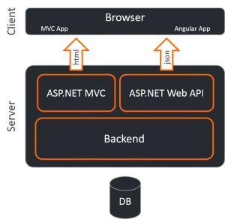
Architecture

Slide 5
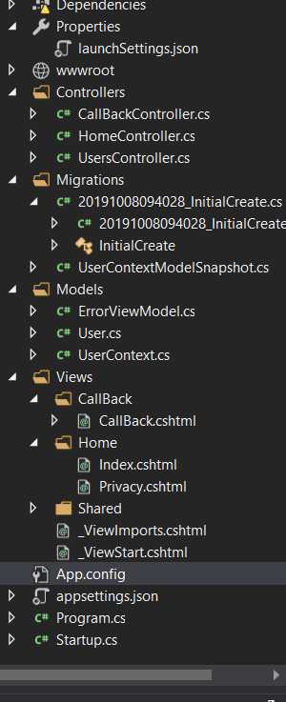
Project structure Asp.net core 3.0 MVC Server
Models folder provides only the User class and an Instance of the database for more flexibility and numerous of methods regarding the User.
View has only the first page created automatically.
Controllers offers all the Rest Services regarding a User and also settings for the connection to the Instagram App.

Slide 6
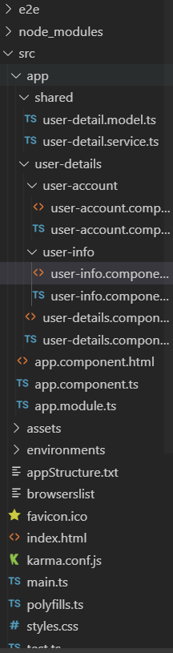
Project structure Angular 7 Client
User-details offers the login method and information about the user account.
In the shared folder I have the model of the User and the typescript service that provides the connection between rest services from server and angular UI.

Slide 7
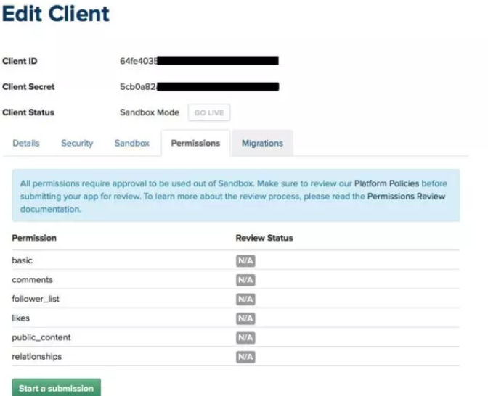
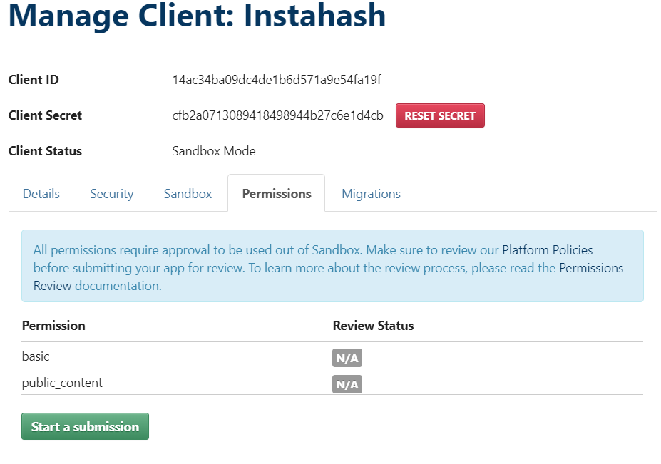
Bad choise ?

Slide 8
Manage Client Instagram 2016 vs Manage Client Instagram 2019’
Instagram has lowered permissiveness regarding the public content that someone get access through the Instagram App.
You have to come up with strong arguments and clear goals in order to have access to more services and public content.
Sandbox mode vs “live” mode. Practically you Sandbox mode is someone alone on an island. Only chance to get know about someone else is to invite them on your island so on your sandbox mode.
So connecting with an Instagram account to an app is not very benefit as proof as many have a connection with Facebook or email.

Slide 9
Information that I could access
Full name
Picture URL
Client Id
Client Secret
User Id
Access token
Bio
Is Business

Slide 10
Where I got stuck & What I did
#askafriend #askgoogle
#stackoverflow
New technology, new framework, new language. So first day I just read about all stuff who should be involved in project and understand basically for what they are used and where.
First time that I access app that doesn’t belong to me. I searched for many articles and repos on how to access Instagram, to configure settings and what data can I receive.
No experience in industry. So many times the complexity in programming was not so high and low technologies were involved: Client-Server side, a sync function, multiple projects configuration. When neither google nor I were able to solve the problem I discussed with a colleague that helped me from the beginning I was hired in NTT Data. (Oana Moldovan)

Slide 11

Positive Feedback
The requirement can be evaluated as a simple task but at the same time very challenging due to the technologies used.
Another aspect was the short time that we had getting used to technologies and understanding the compatibility and connection quick.
The stage of configuration of the back-end and front-end projects, connection between them, I consider to be the most important as well as the structure in a project and the role of each component.
It was a great advantage to work and learn two of the powerful technologies which helps to develop a strong web application: Angular & ASP.NET Core

Slide 12
