Slide 1
River Sites
As used in the Miller et al. 2021 paper.

Slide 2
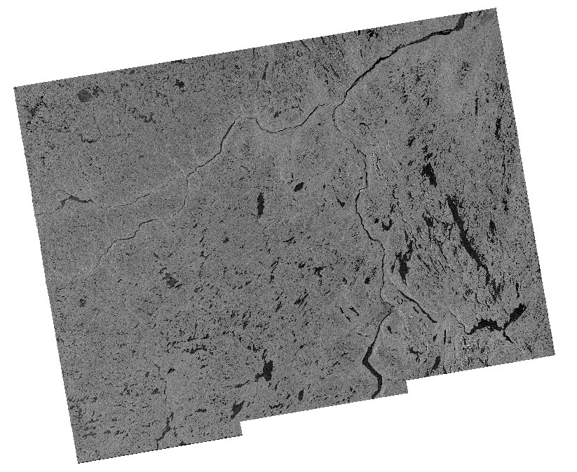
Western Australia

Slide 3
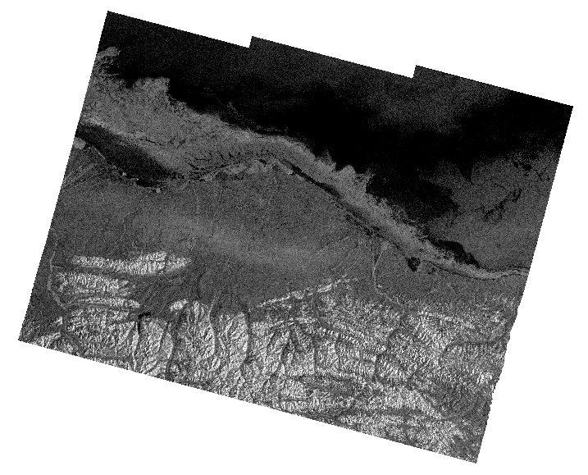
North Slope Alaska

Slide 4
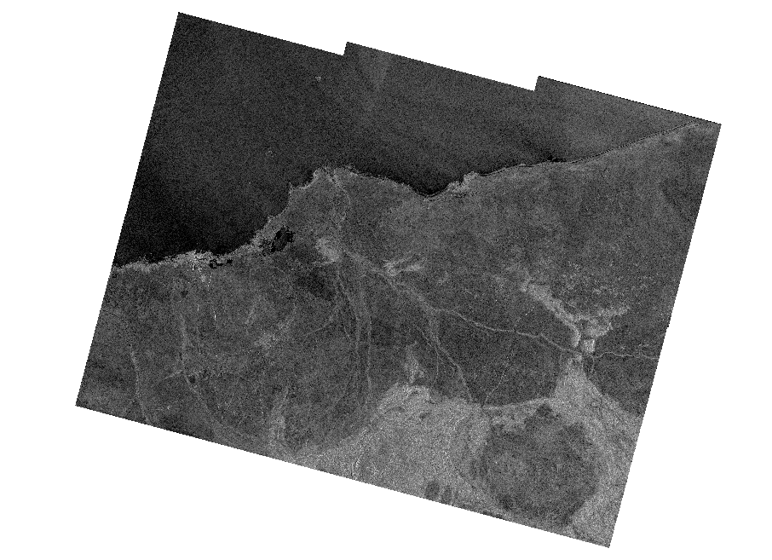
Northern_Quebec

Slide 5
Random Sites

Slide 6
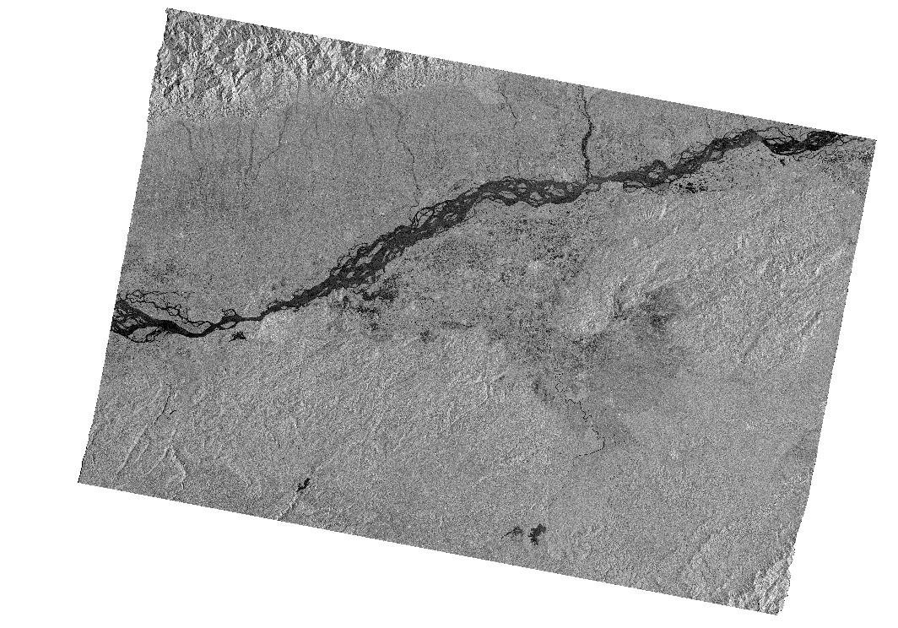
Buttan River

Slide 7
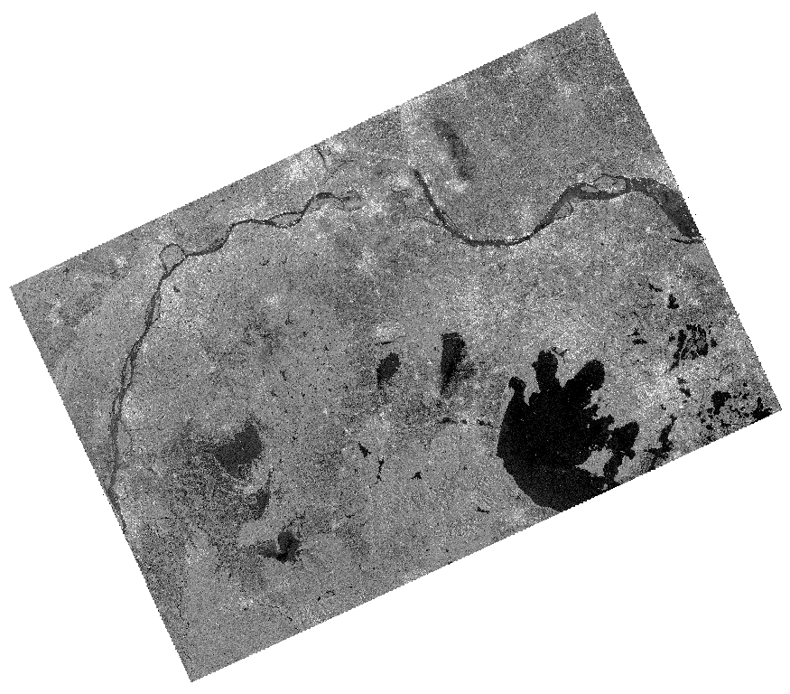
Yagntze River, China

Slide 8
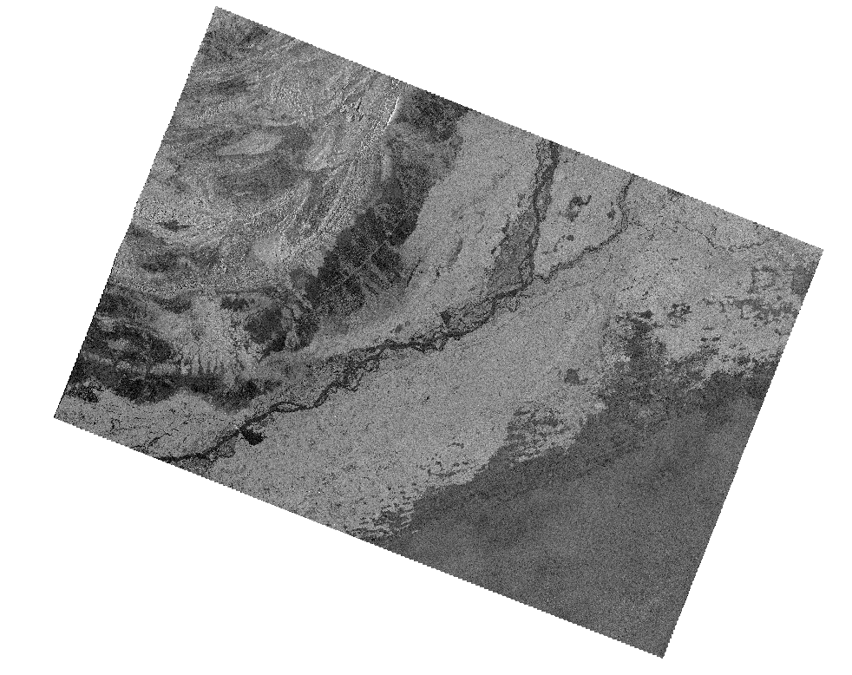
Indus River, Pakistan

Slide 9
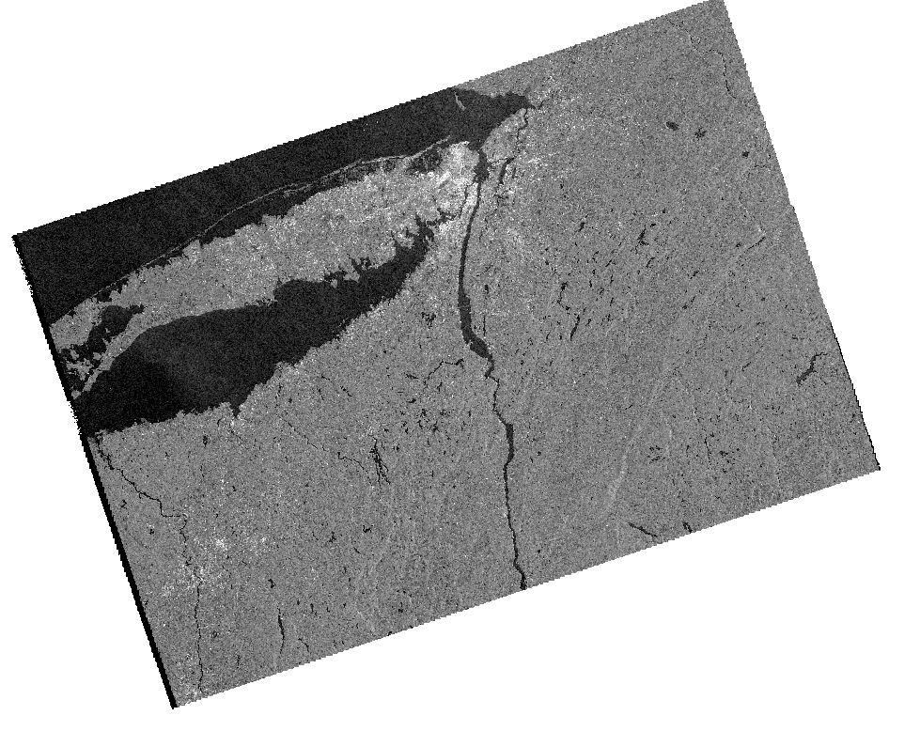
Hudson River, New York

