Slide 1
FitPulse TV Description
Your Company Name

Slide 2
Revision History
Version | Date | Description | Author
1.0 | March 19, 2026 | Initial Samsung TV Seller Office UI description for FitPulse TV. | Your Company Name

Slide 3
Contents
UI Structure
Usage Scenario
Menu & Function Description
Key Policy
Additional Notes

Slide 4
UI Structure
Whole UI Structure
FitPulse TV is a Samsung TV fitness application for browsing workouts,
opening guided training plans, and starting remote-friendly workout sessions.
Only currently available user flows are described in this document.
Primary user flow:
Welcome -> Profile Ready -> Home
Home -> Classic -> Plan Calendar -> Day Detail -> Workout Player
Home / Me -> History
Main screens in the current release:
- Home dashboard
- Library by body part
- Classic programs
- Plan calendar and day detail
- Workout player and completion summary

Slide 5
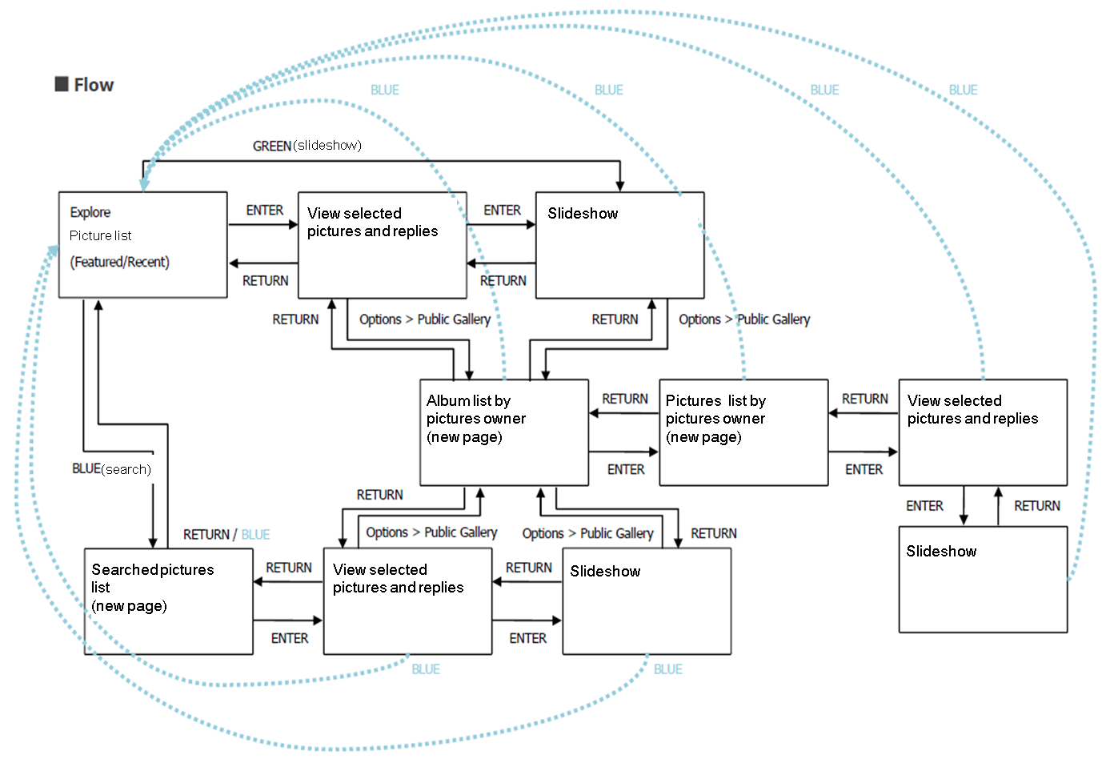
UI Structure - Flow Graph
Welcome
->
Home
->
Library
v
Classic Programs
v
Plan Calendar
v
Day Detail
->
Workout Player

Slide 6
UI Structure - Depth Navigation
Depth 1 : Welcome, Profile Ready, Home, Library, Classic, Me
Depth 2 : History, Plan Calendar, Day Detail
Depth 3 : Get Ready, Workout Player, Rest, Workout Complete
Global UI elements:
- Sidebar navigation on main browsing screens
- Directional focus highlight
Contextual UI elements:
- Workout plan cards
- Day grid in the plan calendar
- Start button on day detail page
- Timer and action button in workout flow

Slide 7
Usage Scenario
Use Case 1: Browse a workout plan and start a guided session.
1. Launch the app and go to the Home screen.
2. Open Library or Classic Programs with the remote.
3. Select a workout plan from Classic Programs.
4. Choose an available day from the plan calendar.
5. Review the workout summary on the Day Detail screen.
6. Start the workout and continue through the workout player flow.
7. Return to previous screens with the Back key.
No account sign-in, activation, or purchase is required in the current release.

Slide 8
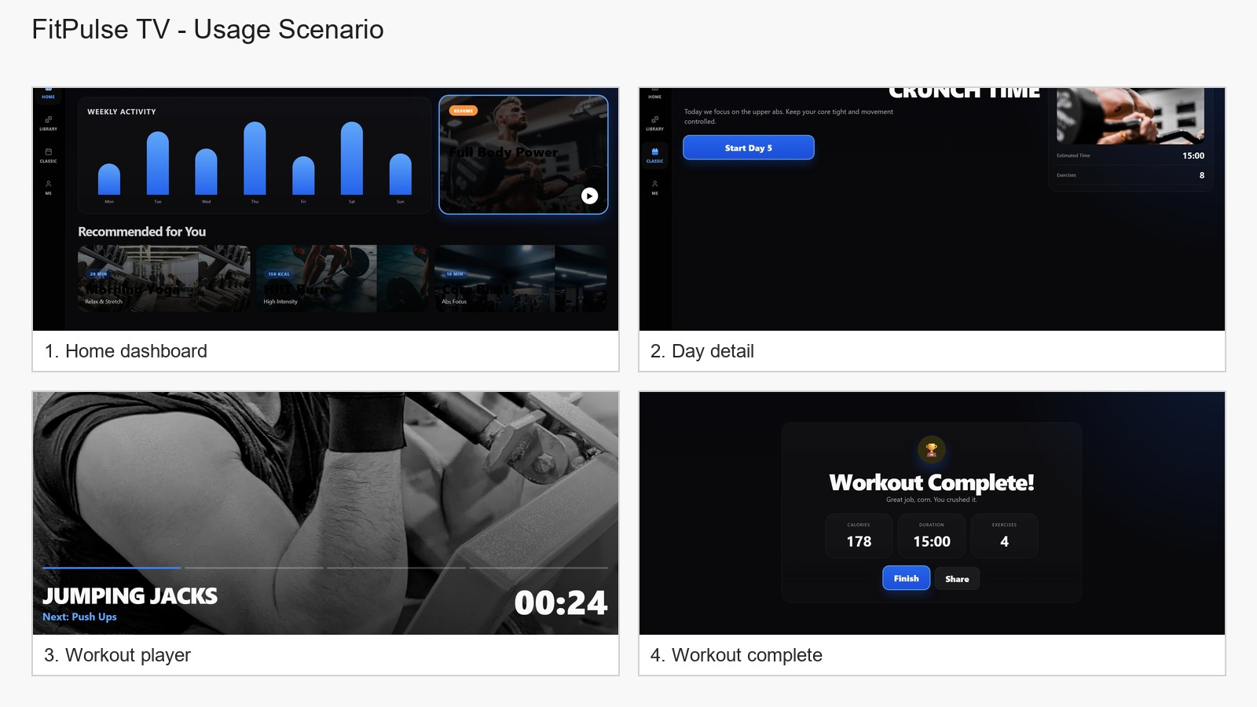
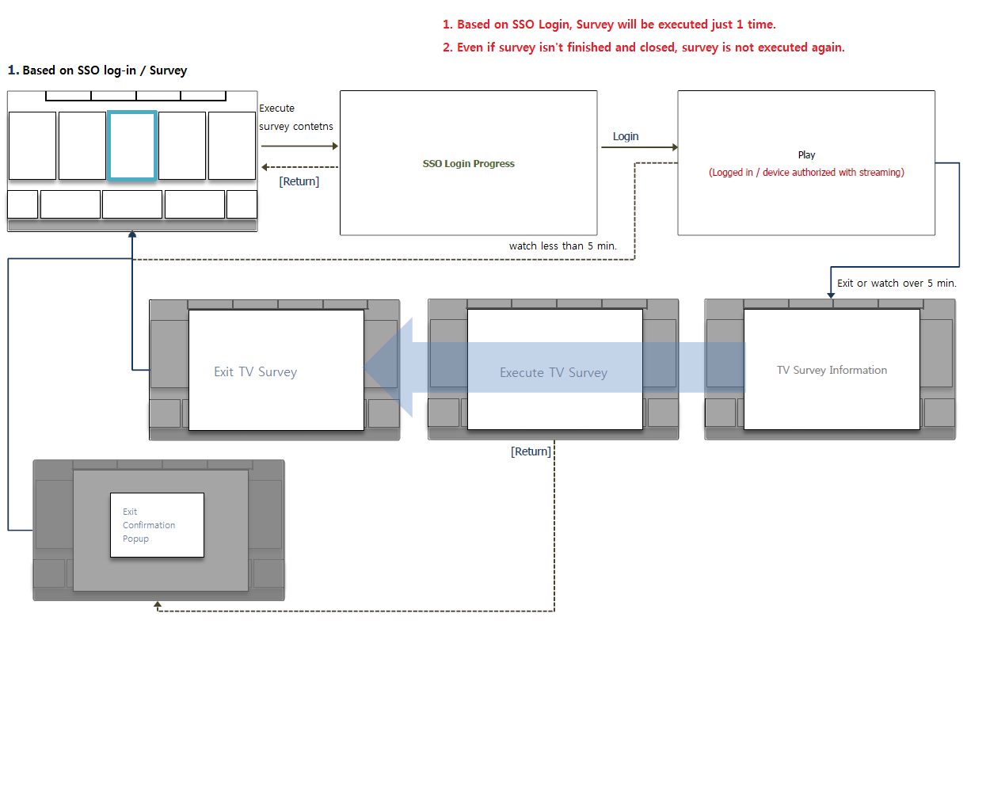
Usage Scenario
Use Case Title: Browse and start a workout session
Path: Home -> Classic -> Plan Calendar -> Day Detail -> Workout Player
Supporting notes:
- Users can also browse workouts from Library.
- The TV remote is used for directional focus navigation.
- The completion summary appears after the guided workout flow.
No account login is required.
No in-app purchase is required.

Slide 9
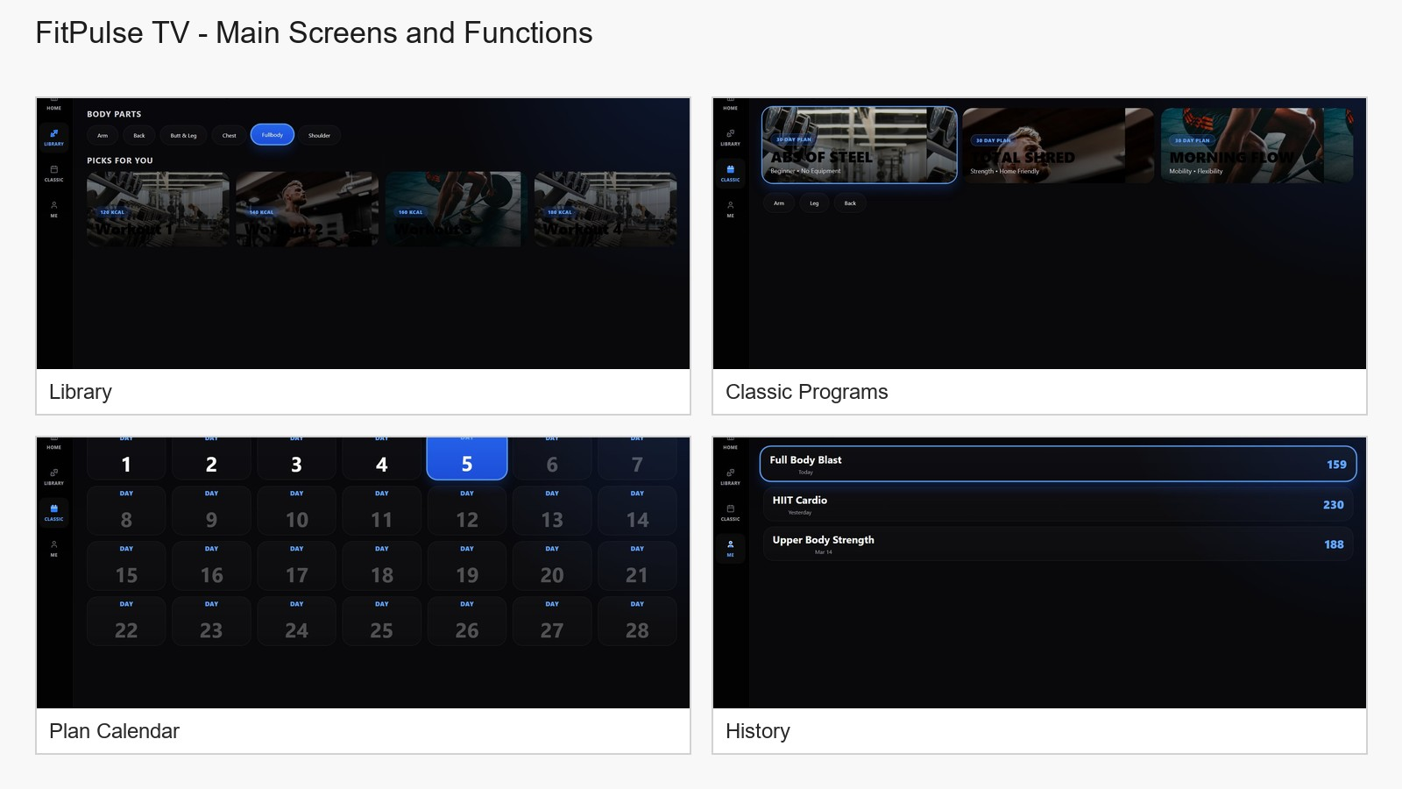
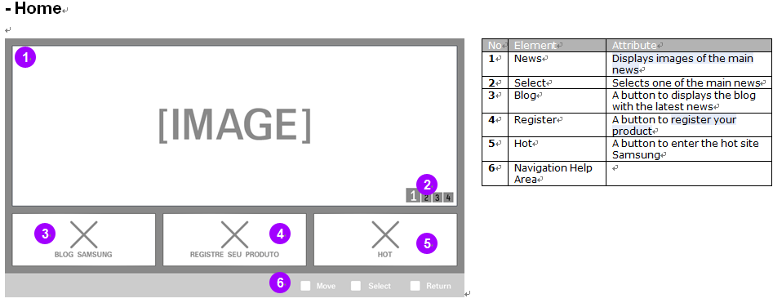
Menu & Function Description
Screen descriptions in the current release:
Home: weekly activity, resume card, and recommended workouts.
Library: body-part filter chips and workout cards.
Classic Programs: structured plan cards for long-form training.
Plan Calendar: day selection for a multi-day workout plan.
History: previous completed sessions.
Only currently implemented screens and functions are described in this document.

Slide 10
Key Policy
Standard Samsung TV navigation behavior is used in the current release.
The app focuses on directional focus movement and Back key behavior.
Button | Action | Remarks
ENTER | Select the focused card, button, or action | Standard selection behavior
UP / DOWN | Move focus vertically | Stops at the screen edge
LEFT / RIGHT | Move focus horizontally | Stops at the screen edge
BACK / RETURN | Go to the previous screen | Standard Samsung TV behavior
PLAY / PAUSE | Control timer-based workout flow when applicable | Current workout flow only
EXIT | Close the application | Standard Samsung TV behavior
COLOR KEYS | N/R | No custom key mapping
CHANNEL / NUMBER KEYS | N/R | No custom key mapping
FAST FORWARD / REWIND | N/R | No custom key mapping

Slide 11
Additional Notes
Language support
This version supports English only. No in-app language change menu is provided.
Seller / Support
Seller: Your Company Name
Support E-mail: your-support@example.com
Support URL: https://your-domain.example
Seller Address: Your Address
Additional notes
This app is a Samsung TV web application package (.wgt).
The current release focuses on workout browsing, plan selection, and guided remote-based workout flow.

