Slide 1
MoneTV Description
MATICONE LTD

Slide 2
Revision History
Version | Date | Description | Author
1.0 | March 19, 2026 | Initial Samsung TV Seller Office UI description for MoneTV. | db
1.0.1 | March 24, 2026 | Updated return key policy scenarios and screenshots for Samsung review. | db

Slide 3
Contents
UI Structure
Usage Scenario
Menu & Function Description
Key Policy
How to Change Languages

Slide 4
UI Structure
Whole UI Structure
MoneTV is a Samsung TV video application for browsing short-drama content
and playing selected episodes.
Only currently available user flows are described in this document.
Primary user flow:
Home -> Detail -> Player
Discover -> Detail -> Player
Main screens in the current release:
- Home: featured banner and content rows
- Discover: trending, genre, and new-this-week sections
- Detail: title information, episode list, and recommendation area
- Player: video playback and episode list

Slide 5
UI Structure - Flow Graph
Home
<->
Discover
v
Detail
v
Player

Slide 6
UI Structure - Depth Navigation
Depth 1 : Home, Discover
Depth 2 : Selected drama detail page
Depth 3 : Episode playback page
Global UI elements:
- Header navigation bar
- Focus highlight for remote-control navigation
Contextual UI elements:
- Episode list on Detail page
- Video area and episode list on Player page

Slide 7
Usage Scenario
Use Case 1: Browse content and play an episode.
1. Move focus on the Home or Discover screen with the directional keys.
2. Select a drama card with the Enter key.
3. Review the title information and episode list on the Detail screen.
4. Select Play Episode 1 or choose an available episode card.
5. The Player screen opens and video playback starts.
6. Select another episode from the episode list if needed.
7. Press Return on Discover / Detail / Player to go to the previous screen.
No account sign-in, activation, or purchase is required in the current release.

Slide 8
Usage Scenario
Use Case Title: Return key policy scenarios
Path 1: Home -> Return -> Exit confirmation popup
Path 2: Exit popup open -> Return -> Popup closes and Home remains active
Path 3: Discover / Detail / Player -> Return -> Previous page
Supporting notes:
- The app follows Samsung TV Return key policy in the current release.
- The Home page does not exit immediately on Return.
- The dedicated EXIT key is left to the Samsung TV platform default behavior.
No account login is required.
No in-app purchase is required.

Slide 9
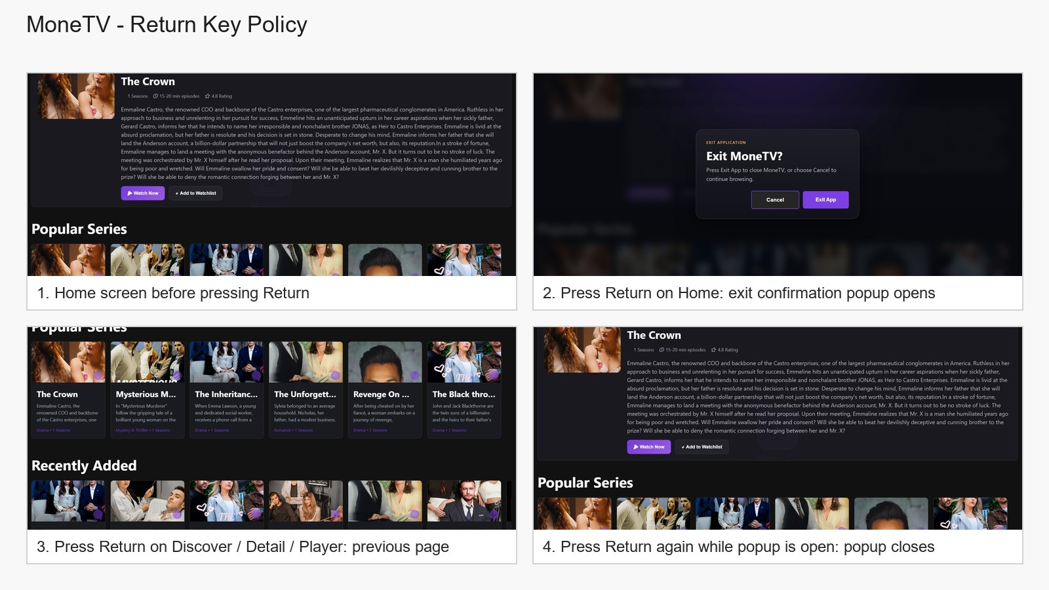

Slide 10
Menu & Function Description
Screen descriptions in the current release:
Home: displays a featured banner and drama rows for browsing.
Discover: displays trending content, genre browsing blocks, and new content sections.
Detail: displays title metadata, synopsis, episode list, and recommendation area.
Player: displays the selected video and the episode list for switching episodes.
Only currently implemented screens and functions are described in this document.

Slide 11
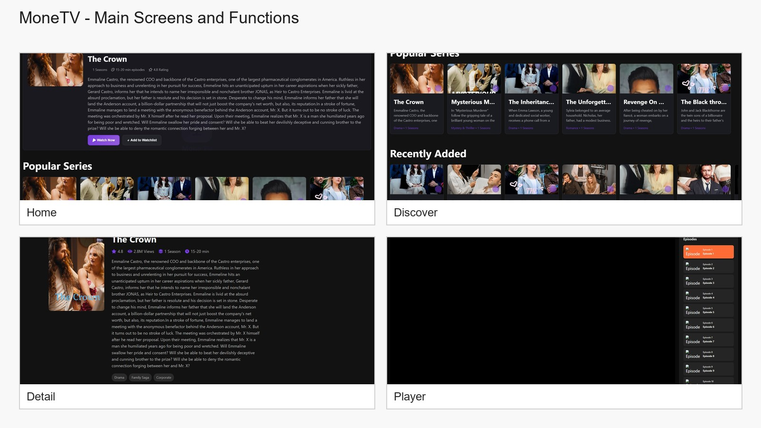

Slide 12
Key Policy
The current release follows Samsung TV Return key policy.
Home page: Return opens the exit confirmation popup.
Exit popup open: Return closes the popup first.
Discover / Detail / Player pages: Return navigates to the previous page.
The dedicated EXIT key uses the Samsung TV platform default behavior.
Button | Action | Remarks
ENTER | Select the focused card, button, or episode | Standard selection behavior
UP / DOWN | Move focus vertically | Standard directional navigation
LEFT / RIGHT | Move focus horizontally | Standard directional navigation
RETURN on Home | Open the exit confirmation popup | Required by Samsung TV Return key policy
RETURN on popup | Close the exit confirmation popup | The app stays on the Home page
RETURN on Discover / Detail / Player | Go to the previous screen | Navigates back within the app flow
EXIT | Close the application | Platform default Samsung TV behavior
PLAY / PAUSE / FF / RW | N/R | No custom key mapping in current release
COLOR / CHANNEL / NUMBER KEYS | N/R | No custom key mapping in current release

Slide 13
How to Change Languages
Items | Contents
Language support | This version supports English only. No in-app language change menu is provided.

