Slide 1
MoneTV Description
MATICONE LTD

Slide 2
Revision History
Version | Date | Description | Author
1.0 | March 19, 2026 | Initial Samsung TV Seller Office UI description for GoMaxShort. | bd

Slide 3
Contents
UI Structure
Usage Scenario
Menu & Function Description
Key Policy
How to Change Languages

Slide 4
UI Structure
Whole UI Structure
GoMaxShort is a TV-oriented short-drama application.
The main review flow is:
Home -> Detail -> Player
Discover -> Detail -> Player
Core screens in the current release:
- Home page for featured and browsable drama rows
- Discover page for trending, genre, and new content sections
- Detail page for title information and episode selection
- Player page for episode playback and switching episodes

Slide 5
UI Structure - Flow Graph
Launch
->
Home
<->
Discover
v
Detail
v
Player

Slide 6
UI Structure - Depth Navigation
Depth 1 : Home, Discover
Depth 2 : Selected drama detail page
Depth 3 : Episode playback page
Global UI elements:
- Header navigation
- Search field visual element
- Focus-based card navigation for remote control
Contextual UI elements:
- Episode list on Detail page
- Episode sidebar and playback controls on Player page

Slide 7
Usage Scenario
All steps for using the app are described below.
1. Launch the app. The Home page is displayed.
2. Move focus with the remote directional keys.
3. Select a drama card from Home or Discover.
4. Open the Detail page and review title information.
5. Press Play Episode 1 or select an episode card.
6. The Player page opens and playback starts.
7. Use playback keys such as Play/Pause, Rewind, Fast Forward, and Back.
The current release does not require login, activation, or payment.

Slide 8
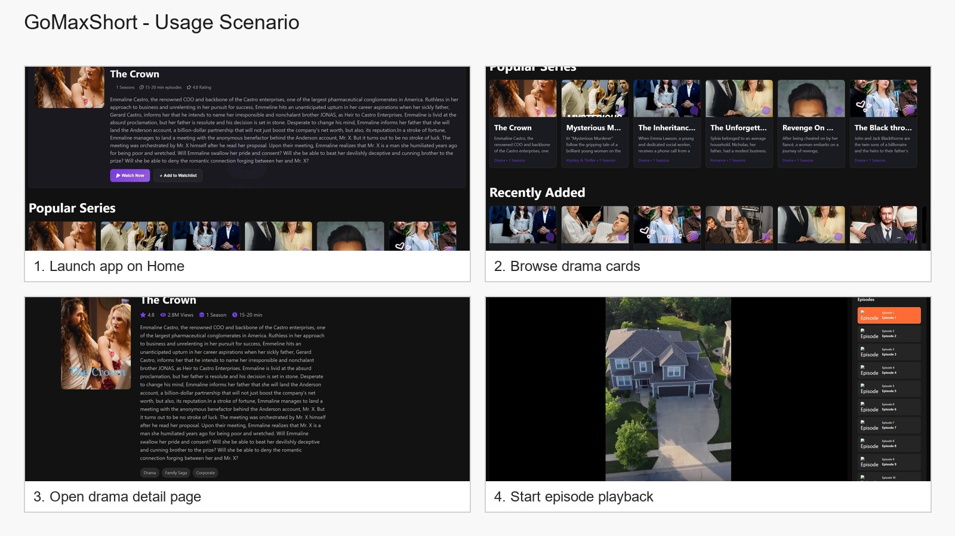
Usage Scenario
Review flow used for this submission:
1. Launch on Home
2. Browse drama content
3. Open a drama detail page
4. Start playback in the player page
No account login is required.
No in-app purchase is required.

Slide 9
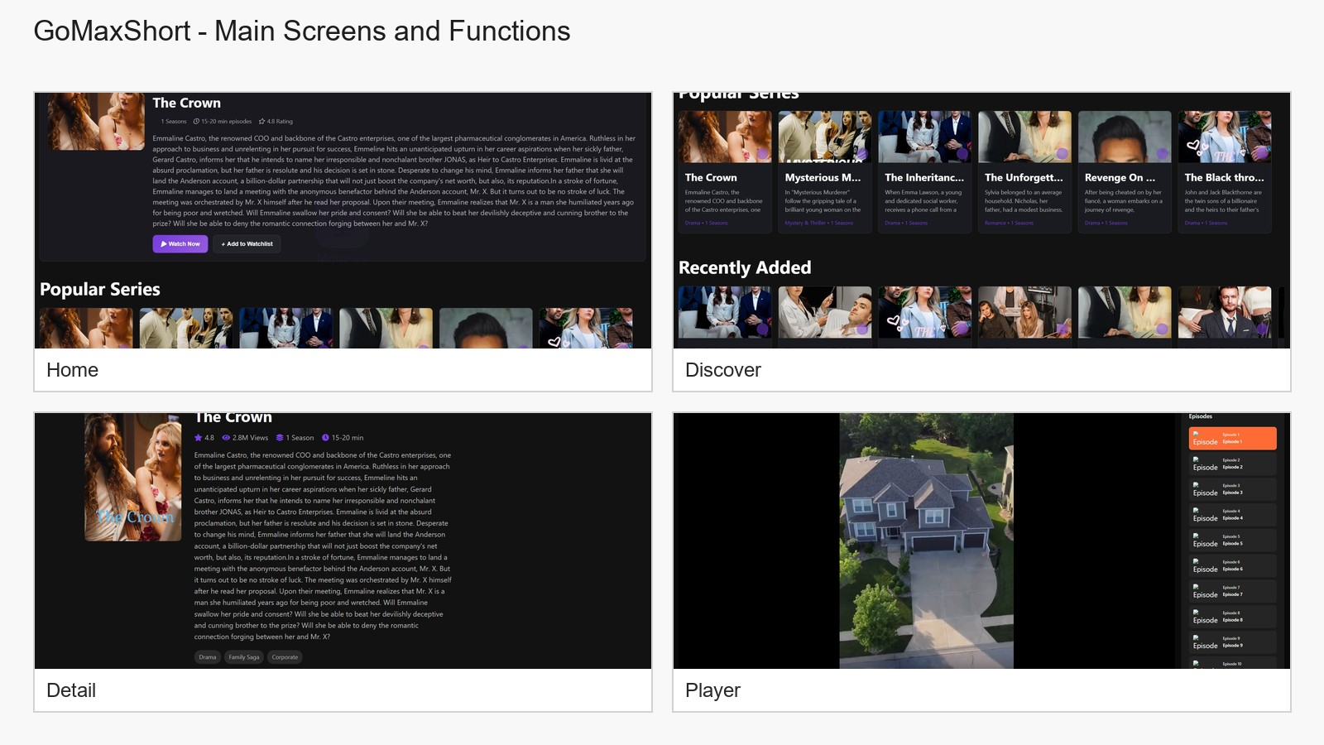
Menu & Function Description
Main menus and functions in the current release:
Home : shows featured content and browsable drama rows.
Discover : shows trending, genre, and new-this-week sections.
Detail : shows title metadata, description, episode list, and related content.
Player : plays the selected episode and allows episode switching.
The app is optimized for Samsung TV remote-control navigation.

Slide 10
Key Policy
Supported remote-key behavior in the current release.
Button | Action | Remarks
ENTER | Select focused item / open page / start playback | Used across Home, Discover, Detail, and Player
UP / DOWN | Move focus vertically | Focus-based navigation
LEFT / RIGHT | Move focus horizontally | Focus-based navigation
BACK | Return to previous screen | Mapped to Samsung remote back key
PLAY / PAUSE | Control playback | Used on Player page
FAST FORWARD | Seek forward 10 seconds | Used on Player page
REWIND | Seek backward 10 seconds | Used on Player page
EXIT | Exit application | Handled by Samsung TV environment
CH. UP / DOWN / COLOR KEYS | N/R | No dedicated function in current release

Slide 11
How to Change Languages
Items | Contents
Language support | The current release provides English UI only. There is no in-app language switch in this version.

