Slide 1
Covid-19 Infodemic and Misinformation in the Social Media
Aleyna ESER
17030411052

Slide 2
INTRODUCTION
Besides all useful information about Covid-19, there are also a new mix of misinformation in the social media. For example, when we have spent time online in the past few months, we probably all feel the difficulty of determining what information about the coronavirus vaccine is reliable and what is not.
As a result of that, in early February 2020, The World Health Organization defined this situation as the over-abundance of information with the term "Infodemic" and Covid-19 was recorded as the first global infodemic.
In this study, my problem is to make general evaluations about misinformation that is also known as Infodemic in the social media during Covid-19.
The main purpose of the study is to inform users or clients who use social media to follow Covid-19 news and provide suggestions about this problem for users.
In this story, the problem is formed around 3 main topics. These are general situation of Turkey, the world and people attitudes to this problem.
Analyzes and visualization of data was done to support the story through Visme tool. These are general situation of Covid-19 Infodemic, Covid-19 misinformation types and topics, through which social media channels and people's attitude to this situation in the social media.
The time period are divided to collect data such as the first time in 2020 when the disease started to spread, 2021 and May.

Slide 3
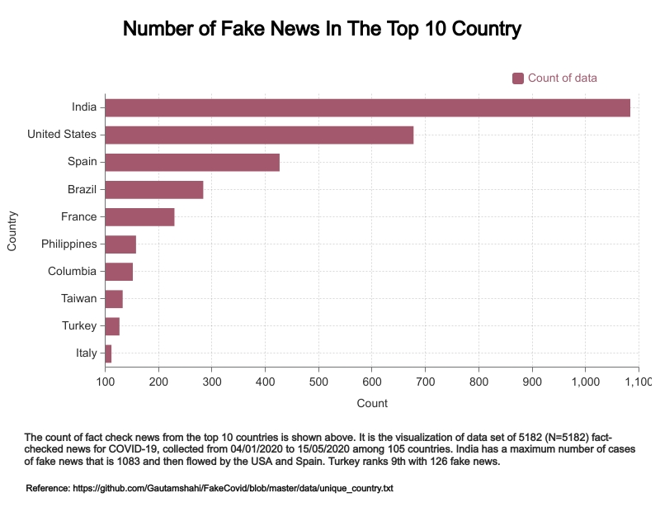

Slide 4
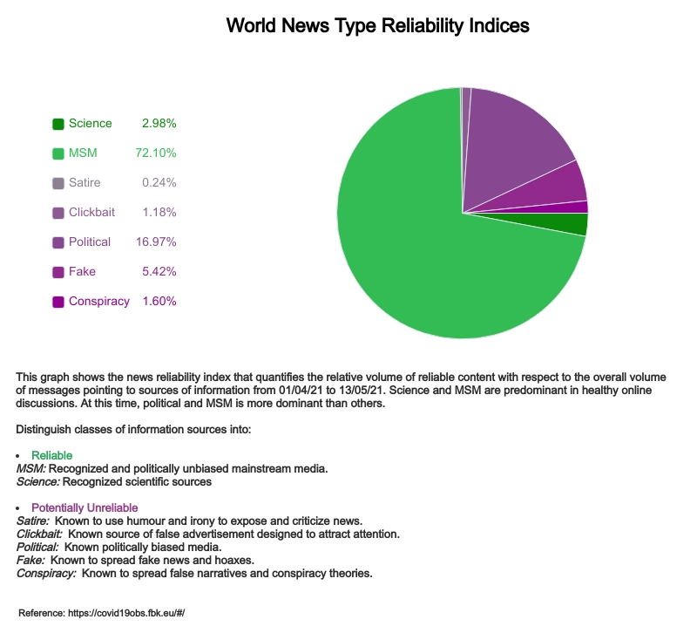

Slide 5
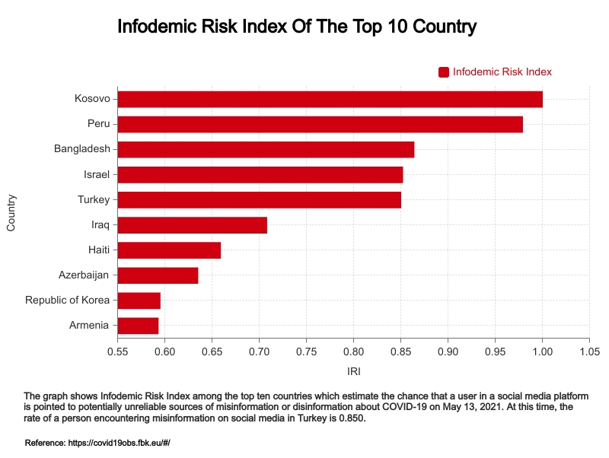

Slide 6
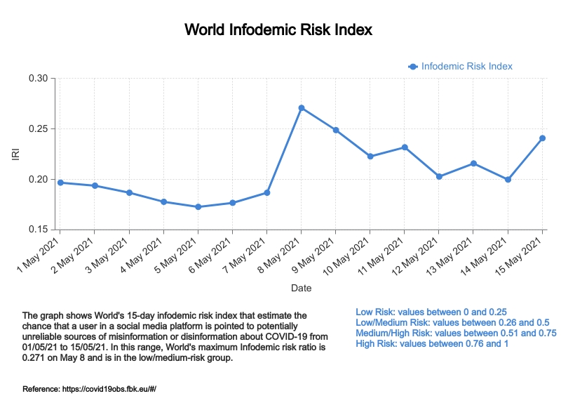

Slide 7
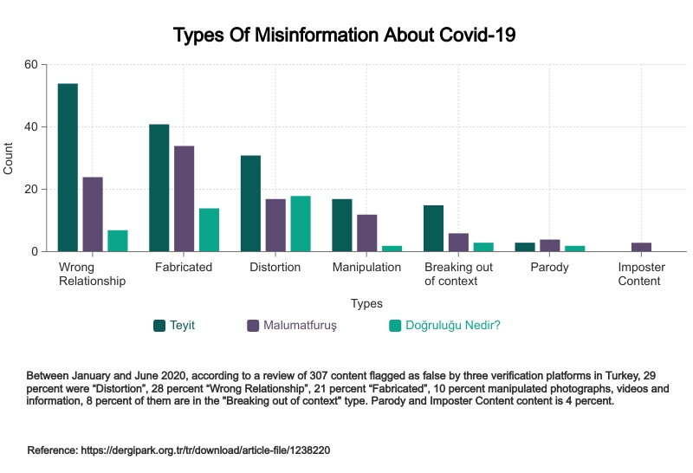
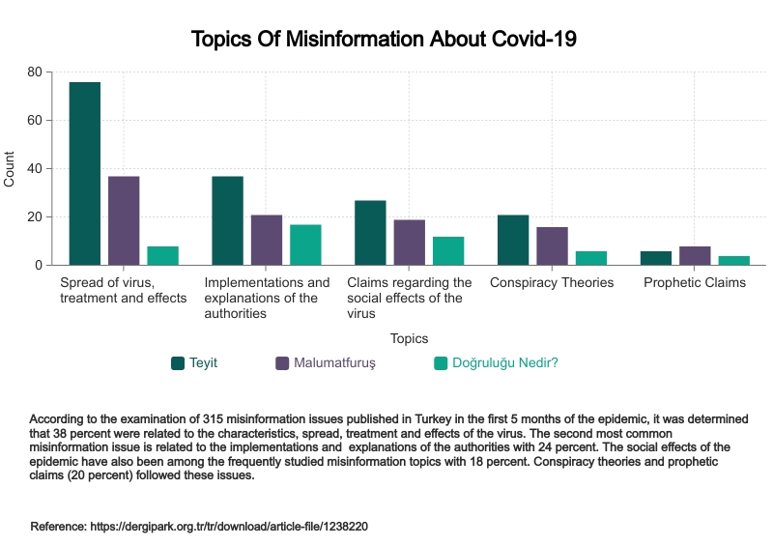
Between January and June 2020, according to a review of 307 content flagged as false by three verification platforms in Turkey, 29 percent were “Distortion”, 28 percent “Wrong Relationship”, 21 percent “Fabricated”, 10 percent manipulated photographs, videos and information, 8 percent of them are in the "Breaking out of context" type. Parody and Imposter Content is 4 percent.
According to the examination of 315 misinformation issues published in Turkey in the first 5 months of the pandemic, it was determined that 38 percent were related to the characteristics, spread, treatment and effects of the virus. The second most common misinformation issue is related to the implementations and explanations of the authorities with 24 percent. The social effects of the epidemic have also been among the frequently studied misinformation topics with 18 percent. Conspiracy theories and prophetic claims (20 percent) followed these issues.
Reference: https://dergipark.org.tr/tr/download/article-file/1238220

Slide 8
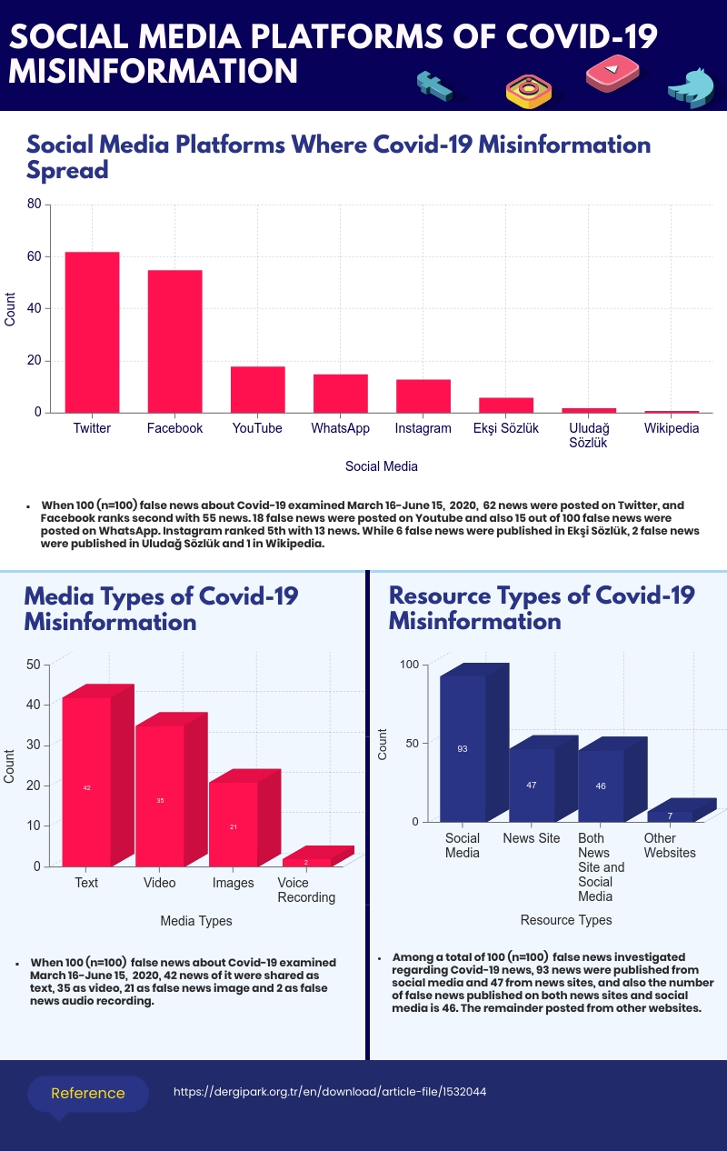

Slide 9
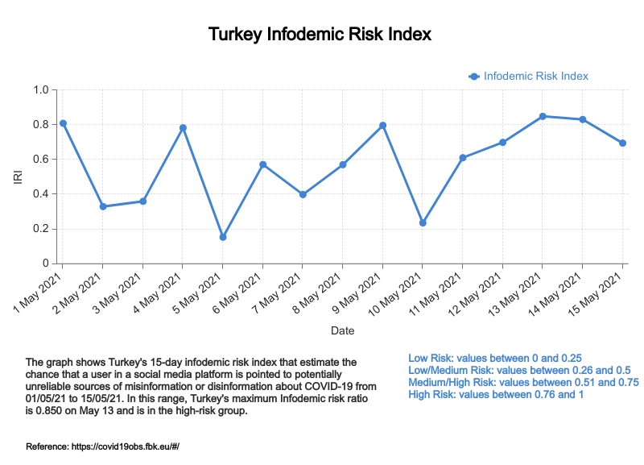

Slide 10
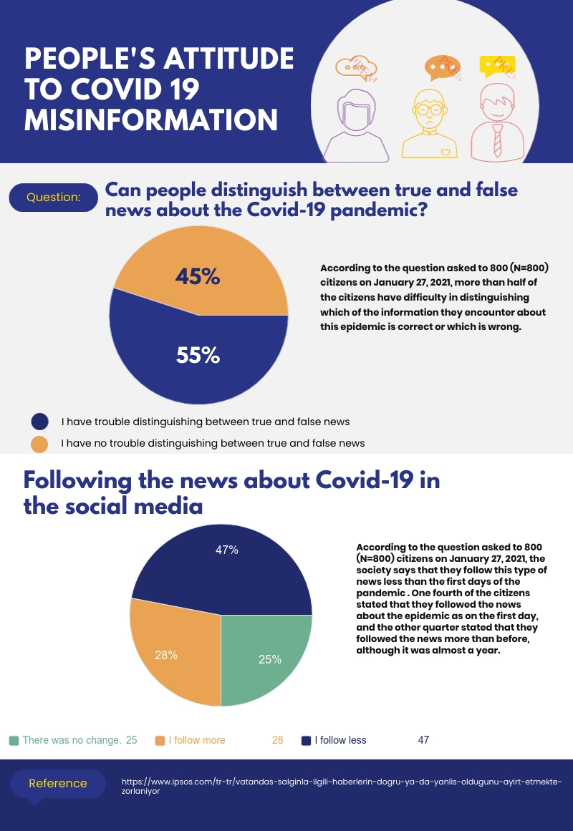

Slide 11
RESULT
As a result of my investigations, the main reasons of this problem are the social panic, the uncertainty of the disease and people's anxiety and panic triggered by Covid 19 in digital environment.
I can give some advice for users to fight this problem.
The first advice is that fake news spreads faster than real news, so social media users should avoid from publishing Covid-19 related news if they are unsure of its accuracy.
The users must build resistance to misinformation and verify its accuracy using verification platforms.
Also, the users should follow the news published by official institutions or by social media platforms under the name of Covid-19.
As a result of this study, to the audience who use social media platforms for Covid19 news, I gave general information about Covid19 Infodemic and misinformation, I supported these by visualized data and also informed about the reasons and the advices to be taken.

