Slide 1
A4 - Concept Video
Team 2: JAI DED
Ecem “AJ” Yilmazhaliloglu
Alexander Yue
Diego Valdez Duran
Evan Hsu

Slide 2
01
Project Name & Value Proposition

Slide 3

Solution from A2
Our solution will provide students with pre-planned and convenient study group sessions using preferences, schedules, and learning styles

Slide 4

Introducing:
Note: Landed on the name based on word play, cultural connotations and its association with focus!
Effortless, personalized study groups tailored to your schedule, preferences, and learning styles

Slide 5
02
Problem & Solution

Slide 6

Primary User and their problem
Our interviews revealed that many us undergraduate students use collaboration as a study tool for academic success, but often find the formation, scheduling, and planning of such groups quite difficult.

Slide 7
How does work?
We collect information from students in classes and use AI enhanced tools paired with research on effective collaboration practices to automatically plan recurring study sessions
Notes:
HMW’s Generated: 1. HMW... make opening up to other students less confrontational?
2. HMW... encourage collaboration amongst students with similar academic goals?
3. HMW... make connecting with other students fun, welcoming and productive?
4. HMW make resources easier to share/create a culture of sharing?
5. HMW eliminate the fear of reaching out to other students and sharing resources?
6. HMW... help students how to navigate their applications more effectively?
7. HMW create a more welcoming space for high school students working on college applications?
8. HMW create a more transparent system to show students what college admissions officers look for in students?
9. HMW... gameify application processes so they are more rewarding?
10. HMW ensure students are equipped with the best college app resources without the need for peer interaction?

Slide 8
03
Market Research

Slide 9

Comparison #1
Discord
Mission statement
Discord is about give people the power to create space to find belonging in their lives.
What works from our problem domain?
What doesn’t work?
Discord allows users to create communities and a sense of belonging
Flexibility in managing different channels for topics or groups based on what the users want
Real-time communication for individual or group help via direct messages or in public channels
Potential distractions from other channels, DMs, or groups from the same server. Would have to separate personal from educational to limit distractions
Difficult to manage large groups or communities if there isn’t clear guidelines or moderation
Often has many channels, it’s busy and can be overwhelming
Free-for all type of environment
Notes:
HMW’s Generated: 1. HMW... make opening up to other students less confrontational?
2. HMW... encourage collaboration amongst students with similar academic goals?
3. HMW... make connecting with other students fun, welcoming and productive?
4. HMW make resources easier to share/create a culture of sharing?
5. HMW eliminate the fear of reaching out to other students and sharing resources?
6. HMW... help students how to navigate their applications more effectively?
7. HMW create a more welcoming space for high school students working on college applications?
8. HMW create a more transparent system to show students what college admissions officers look for in students?
9. HMW... gameify application processes so they are more rewarding?
10. HMW ensure students are equipped with the best college app resources without the need for peer interaction?

Slide 10
Comparison #1
Discord
Mission statement
Discord is about give people the power to create space to find belonging in their lives.
Main Takeaways
Unlike Discord, which is very general and unspecialized, our solution specifically targets academic collaboration by matching students based on detailed profiles and other academic goals
Instead of a free-for-all environment, we tailor matches and people that would increase the likelihood of working together with the same goals
Our solution focuses on continuous partnerships between people and groups
Notes:
HMW’s Generated: 1. HMW... make opening up to other students less confrontational?
2. HMW... encourage collaboration amongst students with similar academic goals?
3. HMW... make connecting with other students fun, welcoming and productive?
4. HMW make resources easier to share/create a culture of sharing?
5. HMW eliminate the fear of reaching out to other students and sharing resources?
6. HMW... help students how to navigate their applications more effectively?
7. HMW create a more welcoming space for high school students working on college applications?
8. HMW create a more transparent system to show students what college admissions officers look for in students?
9. HMW... gameify application processes so they are more rewarding?
10. HMW ensure students are equipped with the best college app resources without the need for peer interaction?

Slide 11

Comparison #2
Marriage Pact
Mission statement: Matches students looking for romantic/platonic partners within the same university/ college based on a personality questionnaire filled individually.
What works from our problem domain?
What doesn’t work?
Matches can be heavily influenced by background or protected traits
Difficult to ensure students will follow up on the pairing- a high percentage of pairs hesitate to reach out
No encouragement to make the first move and no platform that supports interaction between pairs- matches need to stalk and DM on another
All-around feelings of awkwardness- especially if the match is a friend/ someone disliked
Marriage Pact allows users to match users with similar values, interests and personalities, increasing the chance they will get along
Questionnaire format allows a personalized, tailored experience
Artificial-Intelligence for optimal pairings of student profiles
Users motivated by the possibility of matching with new, promising people as well as already existing crushes
Gamified, multi-step match announcement created a big hype on campus
Notes:
HMW’s Generated: 1. HMW... make opening up to other students less confrontational?
2. HMW... encourage collaboration amongst students with similar academic goals?
3. HMW... make connecting with other students fun, welcoming and productive?
4. HMW make resources easier to share/create a culture of sharing?
5. HMW eliminate the fear of reaching out to other students and sharing resources?
6. HMW... help students how to navigate their applications more effectively?
7. HMW create a more welcoming space for high school students working on college applications?
8. HMW create a more transparent system to show students what college admissions officers look for in students?
9. HMW... gameify application processes so they are more rewarding?
10. HMW ensure students are equipped with the best college app resources without the need for peer interaction?

Slide 12
Comparison #2
Marriage Pact
Mission statement: Matches students looking for romantic/platonic partners within the same university/ college based on a personality questionnaire filled individually.
Main Takeaways
Unlike Marriage Pact, which is geared towards matching couples based on romantic preferences and personality, our solutions targets more practical and less personal aspects that are specific to academic collaboration
Our solution provides a platform where study pairs are connected, and put into contact as soon as the matches become available, removing the hesitancy of reaching out or the anxiety of being the first one to make a move
Our solution minimizes the feelings of awkwardness by focusing on the tasks and academic achievement, aiming for continuous collaboration
Unlike Marriage Pact, we give our users the option to state those they would not like to be paired with
Notes:
HMW’s Generated: 1. HMW... make opening up to other students less confrontational?
2. HMW... encourage collaboration amongst students with similar academic goals?
3. HMW... make connecting with other students fun, welcoming and productive?
4. HMW make resources easier to share/create a culture of sharing?
5. HMW eliminate the fear of reaching out to other students and sharing resources?
6. HMW... help students how to navigate their applications more effectively?
7. HMW create a more welcoming space for high school students working on college applications?
8. HMW create a more transparent system to show students what college admissions officers look for in students?
9. HMW... gameify application processes so they are more rewarding?
10. HMW ensure students are equipped with the best college app resources without the need for peer interaction?

Slide 13

Comparison #3
Slack
Mission statement
Slack’s goal is to make work and collaboration simpler, more productive, and more connected through intuitive communication tools
What works from our problem domain?
What doesn’t work?
Slack allows communication between students in a shared workspace
Slack offers peer-to-peer interaction through the creation of group chats and channels
The platform is efficient, as messages are sent in real time and recipients are immediately notified
Slack’s workspace easily gets overcrowded with channels, making it difficult to locate proper channels.
Depending on the classes that use Slack, the channels are not named to be class-specific, causing confusion in channel organization
There is no way to know about other classmates, such as their study schedules or habits, making it difficult to meet other study partners
Notes:
HMW’s Generated: 1. HMW... make opening up to other students less confrontational?
2. HMW... encourage collaboration amongst students with similar academic goals?
3. HMW... make connecting with other students fun, welcoming and productive?
4. HMW make resources easier to share/create a culture of sharing?
5. HMW eliminate the fear of reaching out to other students and sharing resources?
6. HMW... help students how to navigate their applications more effectively?
7. HMW create a more welcoming space for high school students working on college applications?
8. HMW create a more transparent system to show students what college admissions officers look for in students?
9. HMW... gameify application processes so they are more rewarding?
10. HMW ensure students are equipped with the best college app resources without the need for peer interaction?

Slide 14
Comparison #3
Slack
Mission statement
Slack’s goal is to make work and collaboration simpler, more productive, and more connected through intuitive communication tools
Main Takeaways
Unlike Slack, which does not offer any matching process between students based on availability or habits, our solution allows users to create a personalized profile and the matching of similar profiles
Our platform will not use channels, which causes overcrowding. Instead, we will have a direct message feature for individuals and groups as well as a centralized space to announce study sessions.
Our solution focuses on connecting students optimally and efficiently, and also maintaining those connections.
Notes:
HMW’s Generated: 1. HMW... make opening up to other students less confrontational?
2. HMW... encourage collaboration amongst students with similar academic goals?
3. HMW... make connecting with other students fun, welcoming and productive?
4. HMW make resources easier to share/create a culture of sharing?
5. HMW eliminate the fear of reaching out to other students and sharing resources?
6. HMW... help students how to navigate their applications more effectively?
7. HMW create a more welcoming space for high school students working on college applications?
8. HMW create a more transparent system to show students what college admissions officers look for in students?
9. HMW... gameify application processes so they are more rewarding?
10. HMW ensure students are equipped with the best college app resources without the need for peer interaction?

Slide 15

Comparison #4
Ed Discussion
Mission statement
Ed Discussion helps scale class communication by making questions visible to everyone
What works from our problem domain?
What doesn’t work?
Students cannot get help in a class if they cannot formulate a question to ask
There is no way for students to connect with each other outside of the platform
Getting study help is a one time thing, process must be repeated for each request
It is quick and easy for students to get answers to specific questions they have
Anonymity decrease the activation effort to reach out for help
Having professors control access to the group ensures that no bad actors can enter the community
Notes:
HMW’s Generated: 1. HMW... make opening up to other students less confrontational?
2. HMW... encourage collaboration amongst students with similar academic goals?
3. HMW... make connecting with other students fun, welcoming and productive?
4. HMW make resources easier to share/create a culture of sharing?
5. HMW eliminate the fear of reaching out to other students and sharing resources?
6. HMW... help students how to navigate their applications more effectively?
7. HMW create a more welcoming space for high school students working on college applications?
8. HMW create a more transparent system to show students what college admissions officers look for in students?
9. HMW... gameify application processes so they are more rewarding?
10. HMW ensure students are equipped with the best college app resources without the need for peer interaction?

Slide 16
Comparison #4
Ed Discussion
Mission statement
Ed Discussion helps scale class communication by making questions visible to everyone
Main Takeaways
Compared to Edstem, where students can connect with teachers and TAs in the class for one-time questions, our solution is tailored to connecting students with each other to learn together over multiple study sessions.
We need a way to verify class enrollment within our study groups to prevent infiltration by bad actors
It would be game changing if students could receive more involved study help without high user activation energy
Notes:
HMW’s Generated: 1. HMW... make opening up to other students less confrontational?
2. HMW... encourage collaboration amongst students with similar academic goals?
3. HMW... make connecting with other students fun, welcoming and productive?
4. HMW make resources easier to share/create a culture of sharing?
5. HMW eliminate the fear of reaching out to other students and sharing resources?
6. HMW... help students how to navigate their applications more effectively?
7. HMW create a more welcoming space for high school students working on college applications?
8. HMW create a more transparent system to show students what college admissions officers look for in students?
9. HMW... gameify application processes so they are more rewarding?
10. HMW ensure students are equipped with the best college app resources without the need for peer interaction?

Slide 17


Competitor comparison matrix
communities
profile based matching
education focus
communication variety ie. DMs, public…
mobile app

Slide 18
04
Values in Design

Slide 19
Stakeholders and Ethical Implications
Direct Stakeholders
Indirect Stakeholders
Undergraduate students
Educational Institutions
Teachers/Professors
Parents
TA’s or other staff
Academic Advisors
Tutors
Ethical Implications - Tarot Cards of Tech
The Big Bad Wolf
Implication: academic exploitation. For example, one person in a study group may rely on the other members to do a majority of the work. This could lead to an imbalance of learning and academic integrity issues, such as plagiarism
Reflection: we could have a peer review system, where a feedback mechanism can help detect unfair behavior early on
The Scandal
Implication: algorithmic bias. Matching could be biased against specific groups of people, have to be careful to test and see how matching behaves on user inputs
Reflection: be transparent on how the matching algorithm would work, what types of things are considered, but keep weights secret so people can’t game the system

Slide 20
05
Tasks

Slide 21
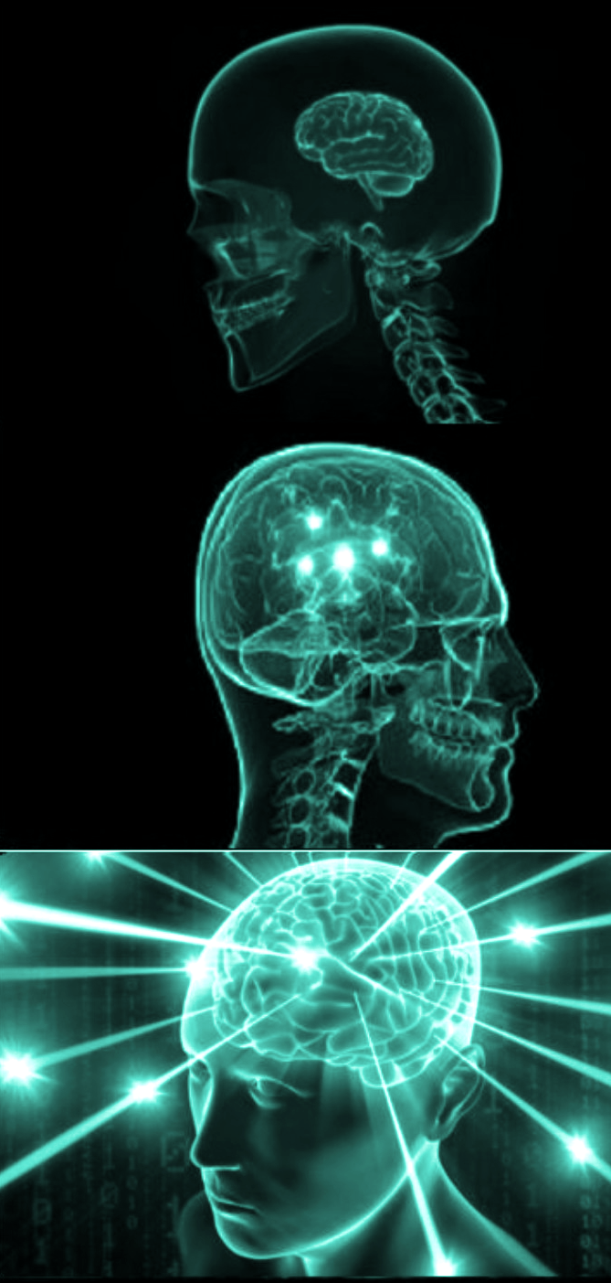
simple
the user can discover public open study sessions for a class
moderate
the user can create a study profile and get matched with recurring partners/study groups
complex
the user can plan and host public/private study sessions for a class or group

Slide 22
06
Storyboarding

Slide 23
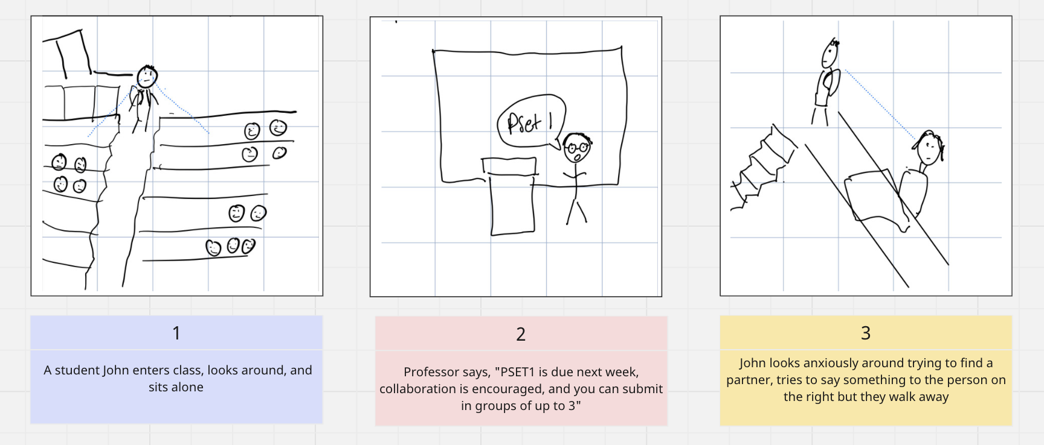
[mood change]
→ discouraged
[setting]
classroom → lack of community

Slide 24
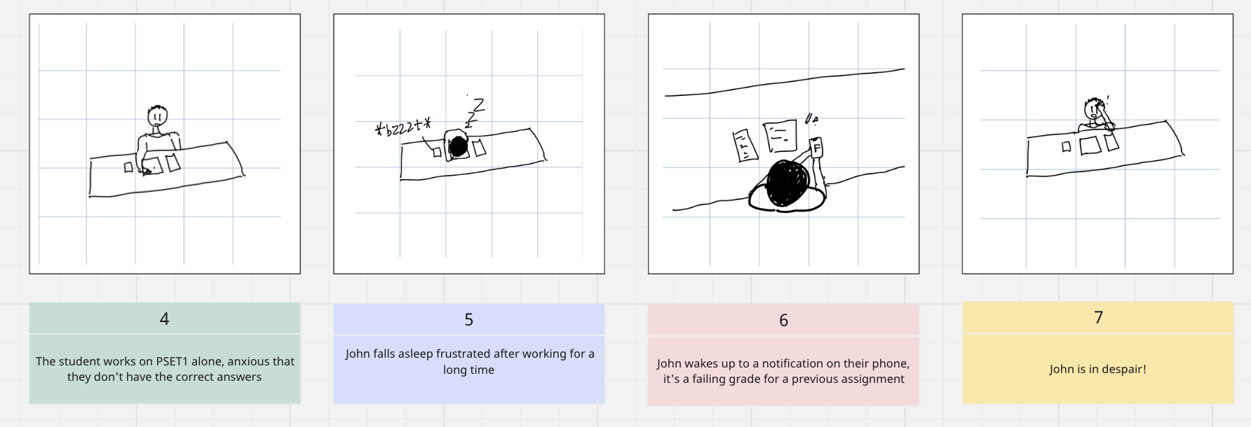
[setting]
studying alone, working on PSET
[mood change]
discouraged → isolated + despair

Slide 25
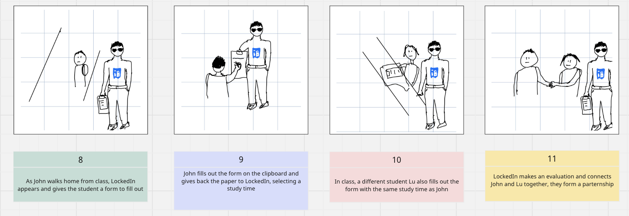
[task 1]
discover public open study sessions for a class
[task 2]
create a study profile and get matched with a recurring study group
[mood change]
despair → partnership

Slide 26
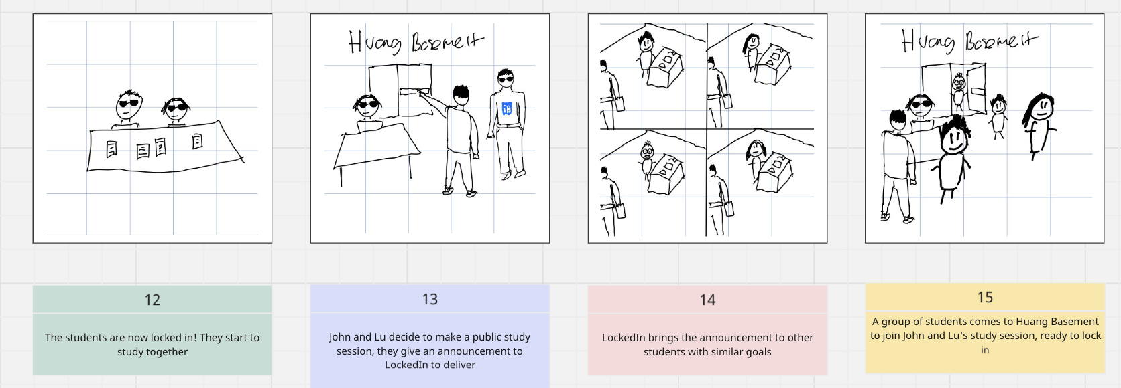
[mood change]
partnership → commendatory
[task 3]
plan and host the public open study sessions for a class

Slide 27
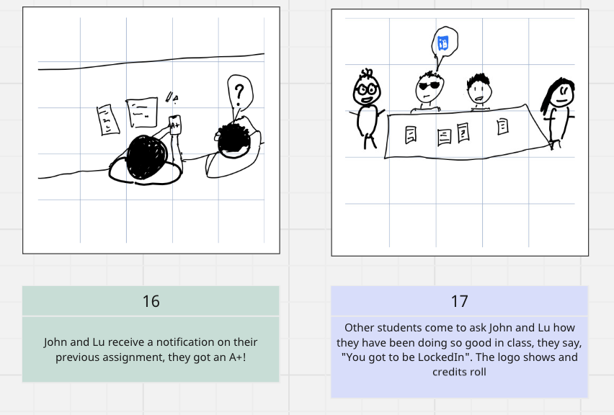
[resolution]
academic success & lasting partnerships

Slide 28
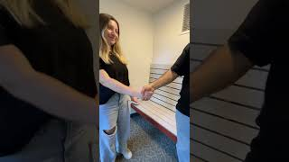
Concept Video

Slide 29

07
APPENDIX

