Slide 1
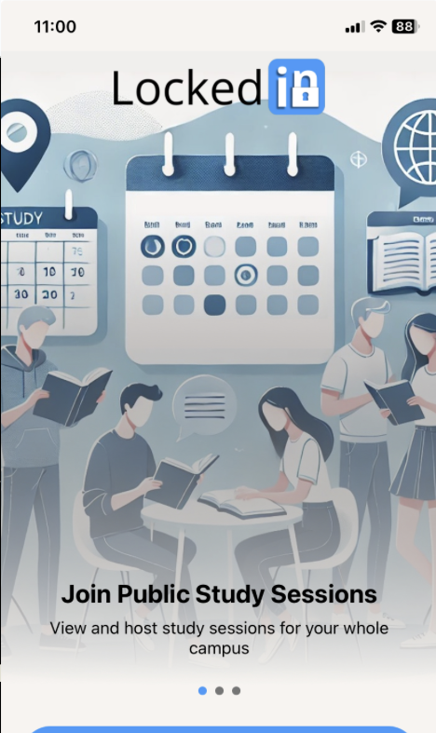

In a classroom full of students you don't know…
is your
best friend.

