Slide 1


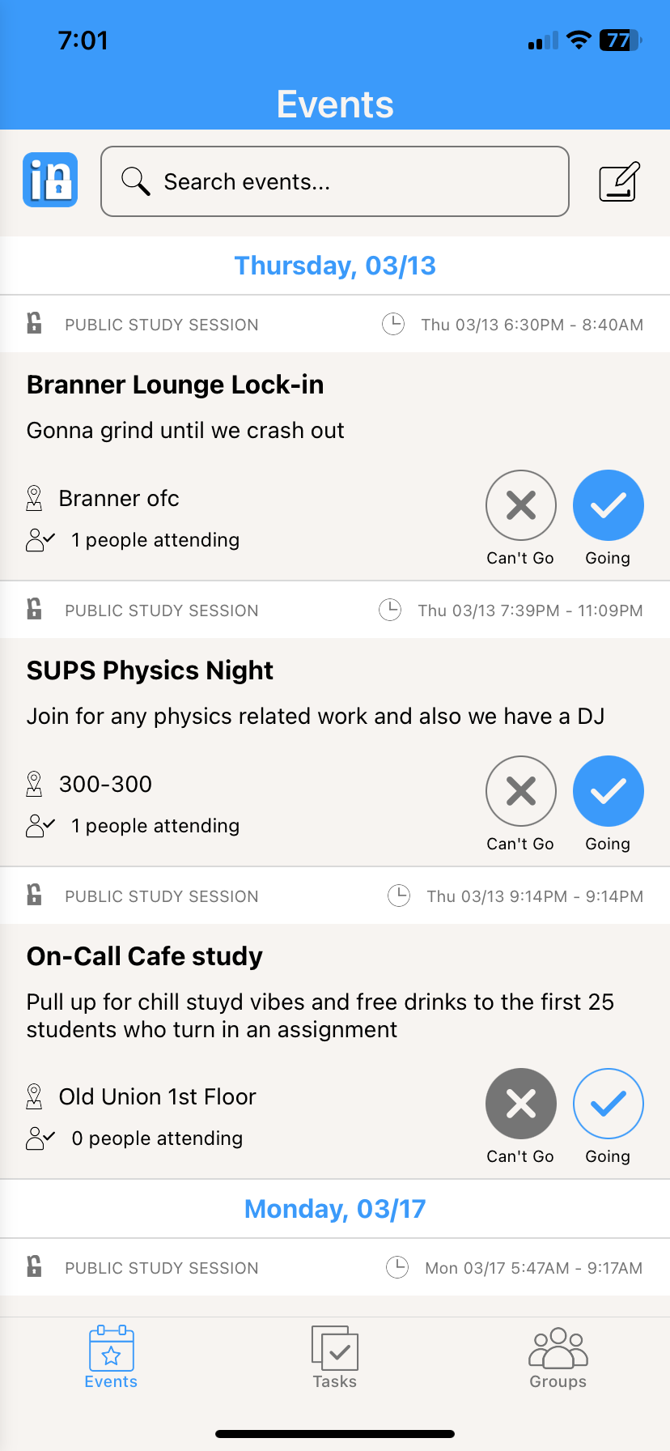
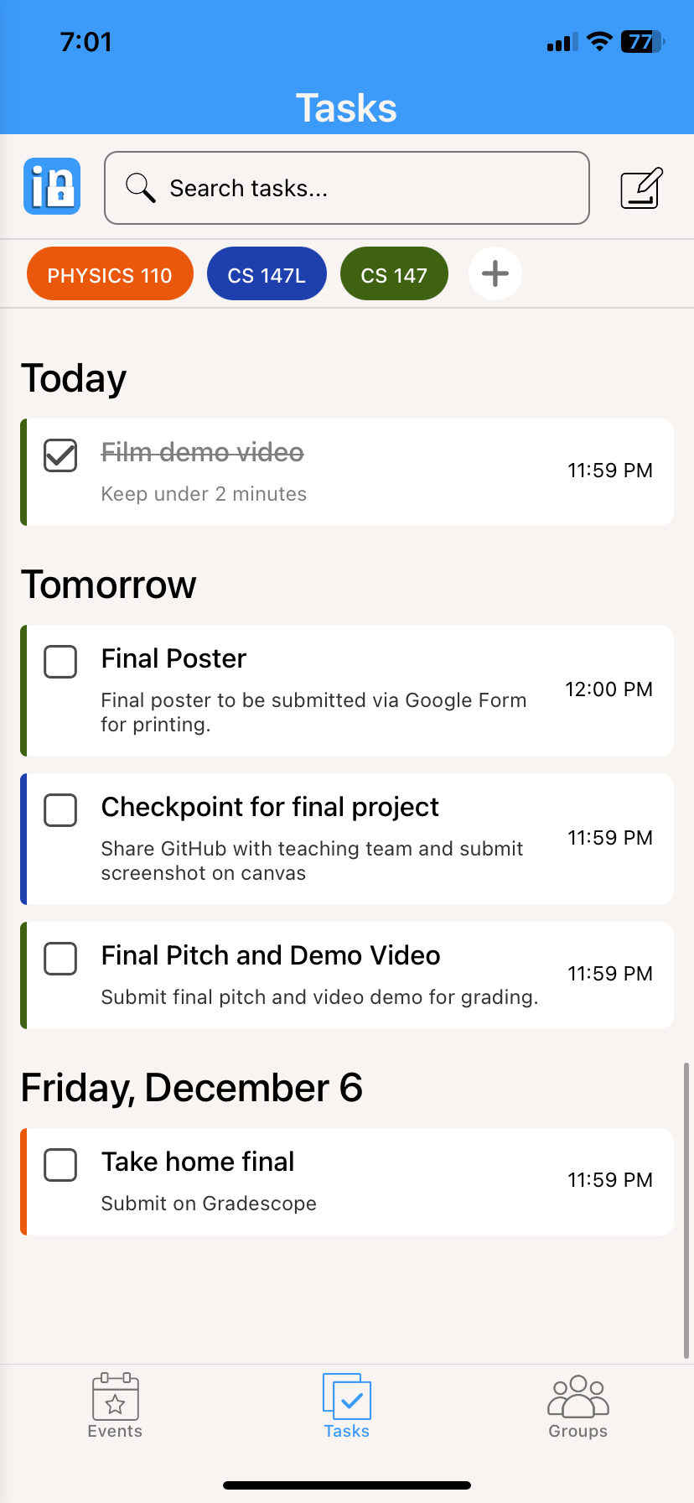
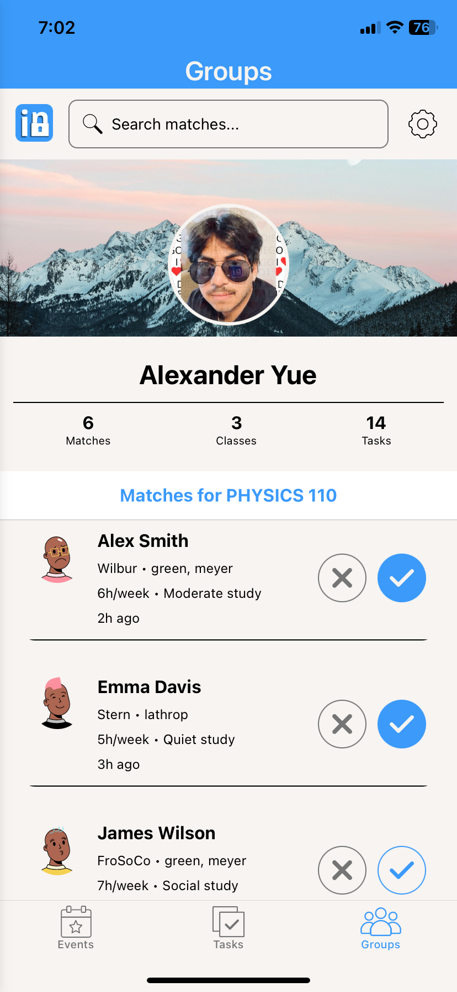
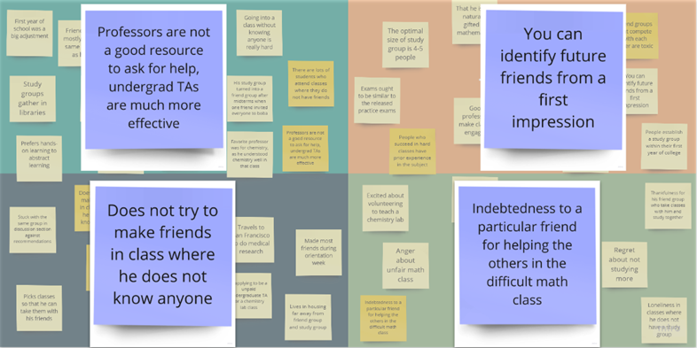
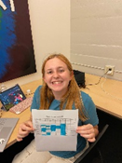
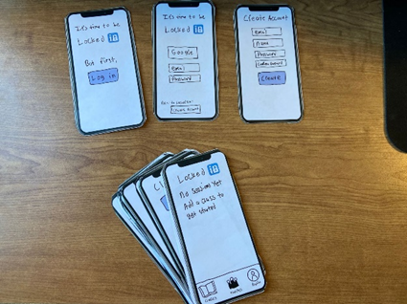
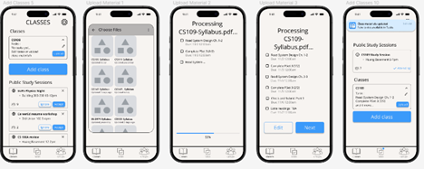
The Problem
Our Solution
Many undergrads value collaboration, but find it hard to make a study group
A platform to foster academic partnerships and plan study groups by schedule and learning style
Key Features
We help college students study together
3
1
2
Create a profile and get matched with recurring partners and study groups
Discover and create study sessions for a class
Upload syllabi and assignments to get AI powered study plans
1
View Events
2
Create Tasks
3
Find Matches
Design Process
Needfinding
Testing
Lo-Fi Prototype
Med-Fi Prototype
Alexander Y. Evan H. Diego V. Ecem Y. | CS147 Autumn 2024 | https://hci..stanford.edu/courses/cs147/2024/au/projects/AI-in-Classroom/LockedIn/

