Slide 1


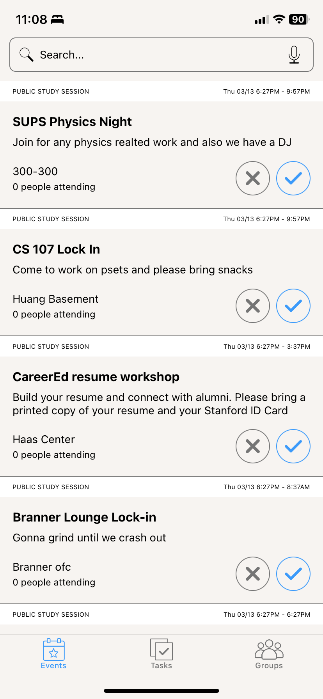
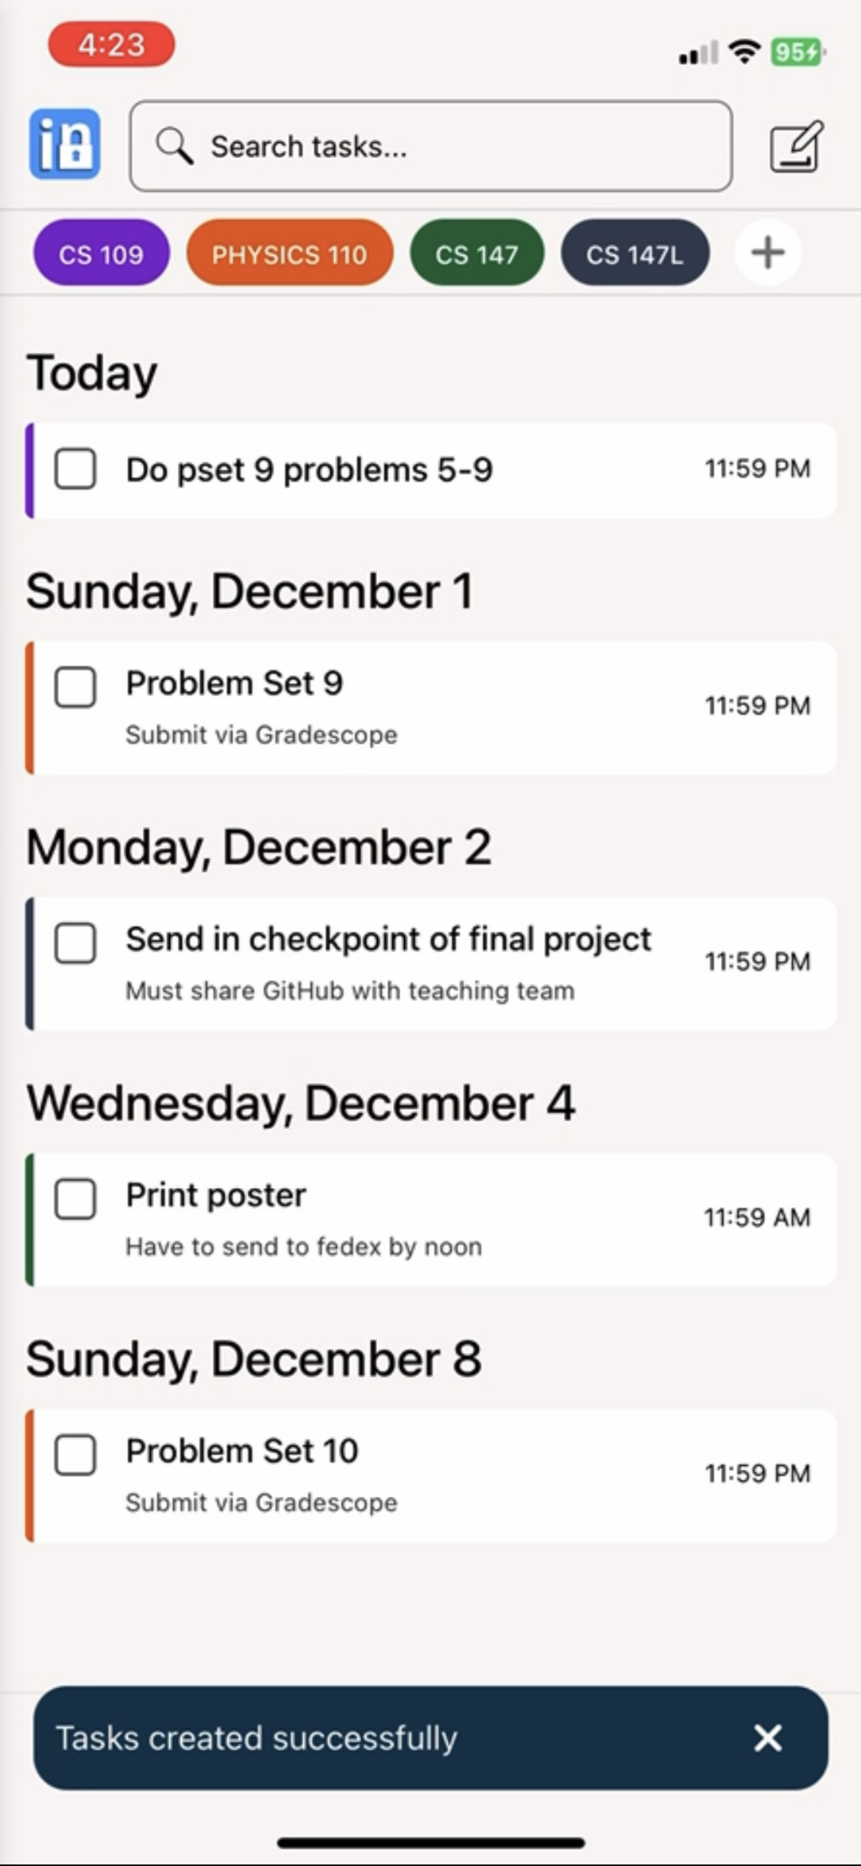
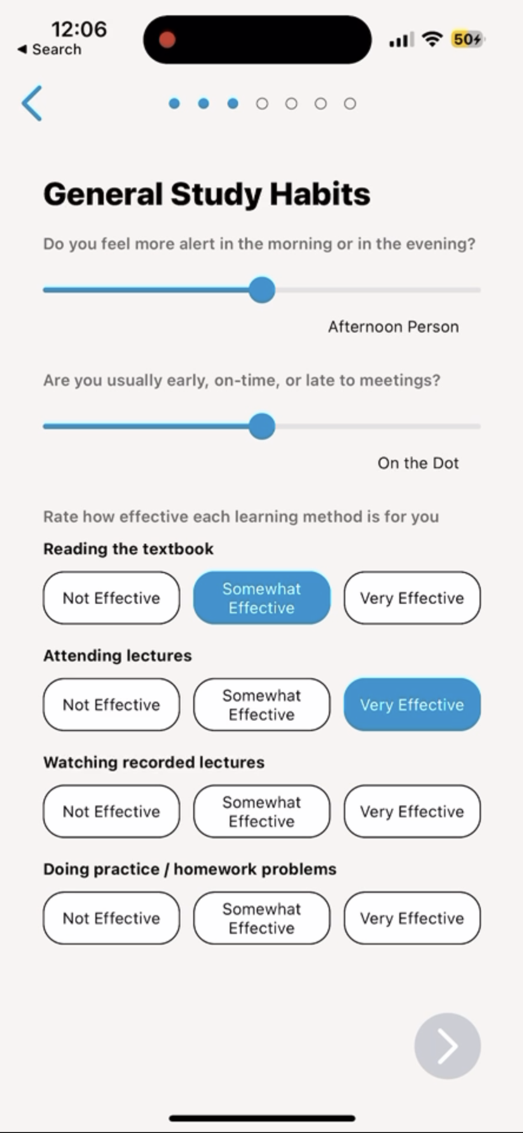
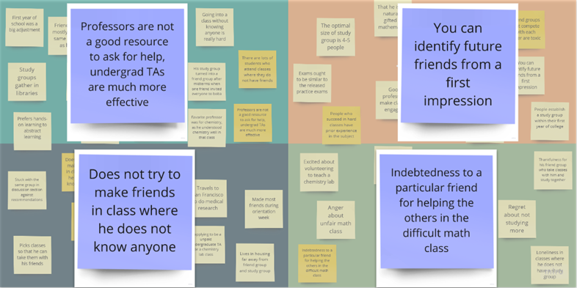
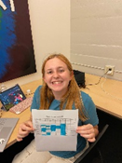
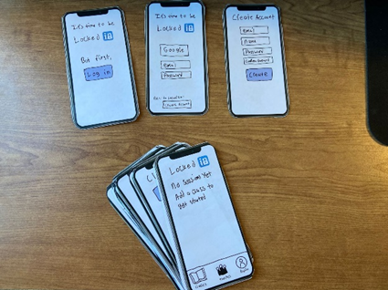
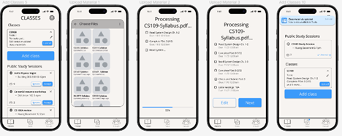
The Problem
Our Solution
Many U.S. undergraduate students use collaboration as a study tool for academic success, but often find the formation, scheduling, and planning of such groups quite difficult
A centralized platform to foster academic partnerships with pre-planned and convenient study group sessions using preferences, schedules, and learning styles
We help college students study together
Key Features
1
2
3
3
1
2
Create a study profile and get matched with recurring partners and study groups
Discover and create study sessions for a class
Upload class syllabi and assignments to get AI powered study plans
Design Process
Needfinding
User Testing
Lo-Fi Prototype
Med-Fi Prototype
Alexander Yue, Evan Hsu, Diego Valdez, Ecem Yilmazhaliloglu | CS147 Autumn 2024 | https://web.stanford.edu/class/cs147/projects/AI-in-Classroom/LockedIn/

