Slide 1
Request:
Request ID
Address of Target ECU
Parameter Number
Padding
ID: 0x000FFFFE Data: CD 7A A6 12 9D 01 00 00
DLC (0xC8 + Number of Significant Bytes)
Requested Number of Responses
Read Current Data by Identifier
Response:
Response ID
Address of Responding ECU
Parameter Number
Padding
ID 0x00400021 Data: CD 7A E6 12 9D 95 00 00
DLC (0xC8 + Number of Significant Bytes)
Requested Data
A6 + 0x40 to Denote Response

Slide 2
Dashboard Brightness and Light Sensor:
Light Sensor
8 Bit Value: 0 X X X X X X X
I only care about this bit
Padding (also don’t care)
Message ID
ID: 0x0100082C Data: 0F 40 BE 07 05 90 00 00
Dashboard Brightness
8 Bit Value: X X X X 1 1 1 1
Data I Don’t Care About
I only care about the last 4 bits (lower nibble)

Slide 3
Ignition Status:
Ignition Status
8 Bit Value: X 1 X X X X X X
I only care about this bit
Padding (also don’t care)
Message ID
ID: 0x19E00006 Data: 10 00 18 CA 81 9B 40 00
Data I Don’t Care About

Slide 4
Cruise Control Buttons:
Cruise Control Buttons
8 Bit Value: X X 0 X X X X X
Other Steering Wheel Buttons
Cruise Control Cancel Button
Message ID
ID: 0x19000026 Data: 00 FF 01 40 38 11 8C 00
Data I Don’t Care About

Slide 5
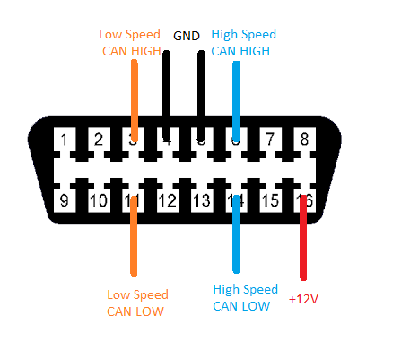
Network Layout:
Instrument Cluster
ABS Module
CEM
(Central Electronics Module)
High Speed (500 kbps)
Low Speed (125 kbps)
To Other Modules
To Other Modules
ECM (Engine Control Module)
Radio
Door Locks
To OBD2 Port
To OBD2 Port

Slide 6
Wiring Diagram:
+12v and GND
Macchina M2
LCD Display
+5v and GND
To OBD Port
Low Speed CAN (CAN0)
LCD Reset Line
High Speed CAN (CAN1)
Asynchronous Serial

