Slide 1
Quantifying Reef Fish Color Patterns
An Introduction to pavo • Lab 5 • Week 6
EEB 187 — Ecology & Evolution of Color • Rosamari + Michael
Notes:
Welcome students. Today's lab is the first time we'll use a real R package to
extract numbers from photographs. We'll work with 3 reef fish from 3 families,
predict their pattern statistics, and then verify our predictions with pavo.
After that, you'll run your own assigned fish through the same pipeline.
Pacing target: this deck is ~35 slides; allow ~35 min, then 30 min of student
hands-on, then 15 min wrap.

Slide 2
The big question
Given a fish photo, can we put numbers on its pattern?
We can describe color patterns in words — "barred," "spotted," "reticulate." But to compare species, test hypotheses, or build phylogenetic models, we need numbers we can compute and replicate.
That is what pavo's adjacency framework gives us.
Notes:
Set up the motivation. This is the first time we are doing computational
analysis of color in the course. Ground students in the answer to "why are
we doing this?" — words don't scale; numbers do.

Slide 3
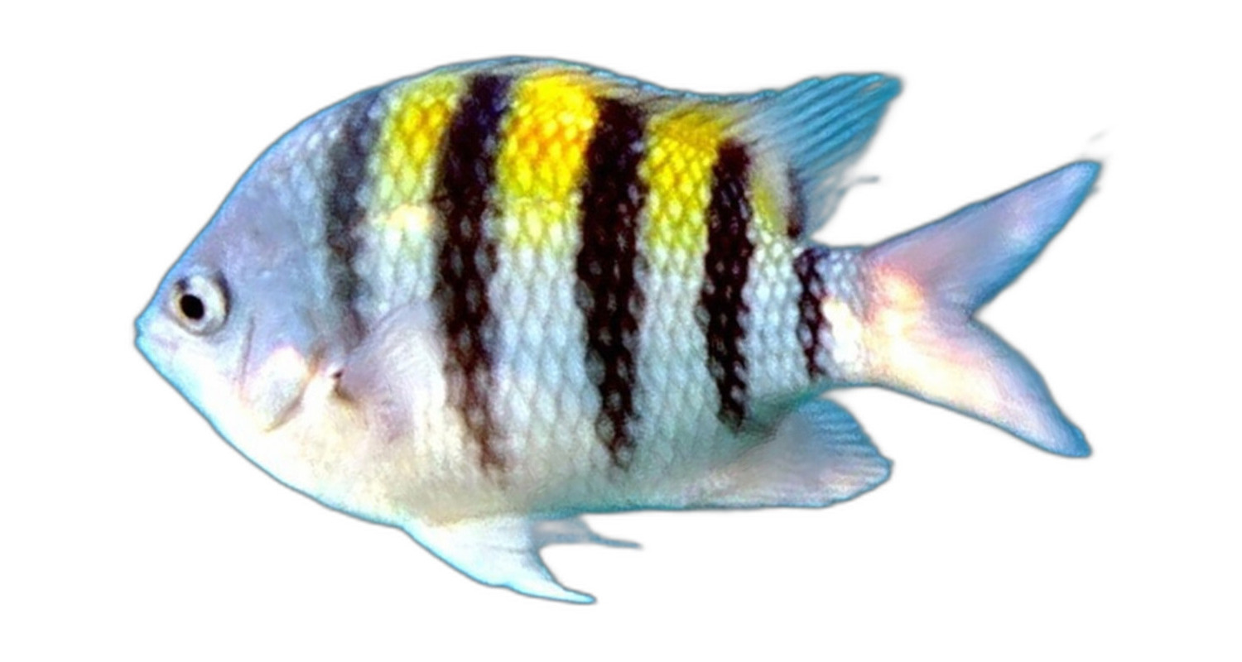
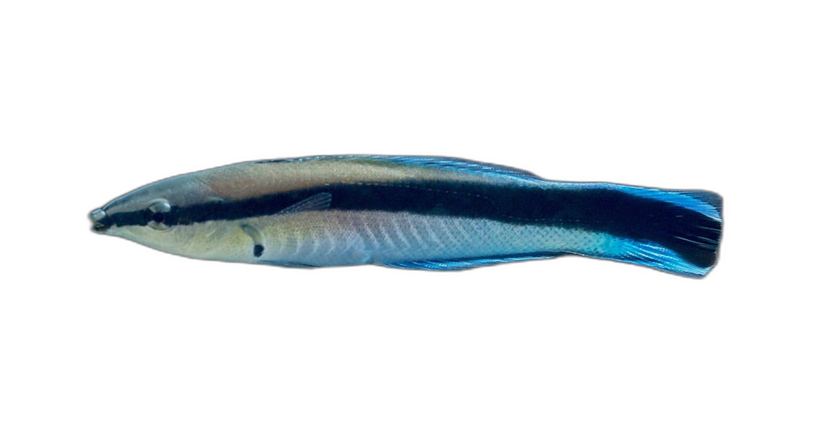
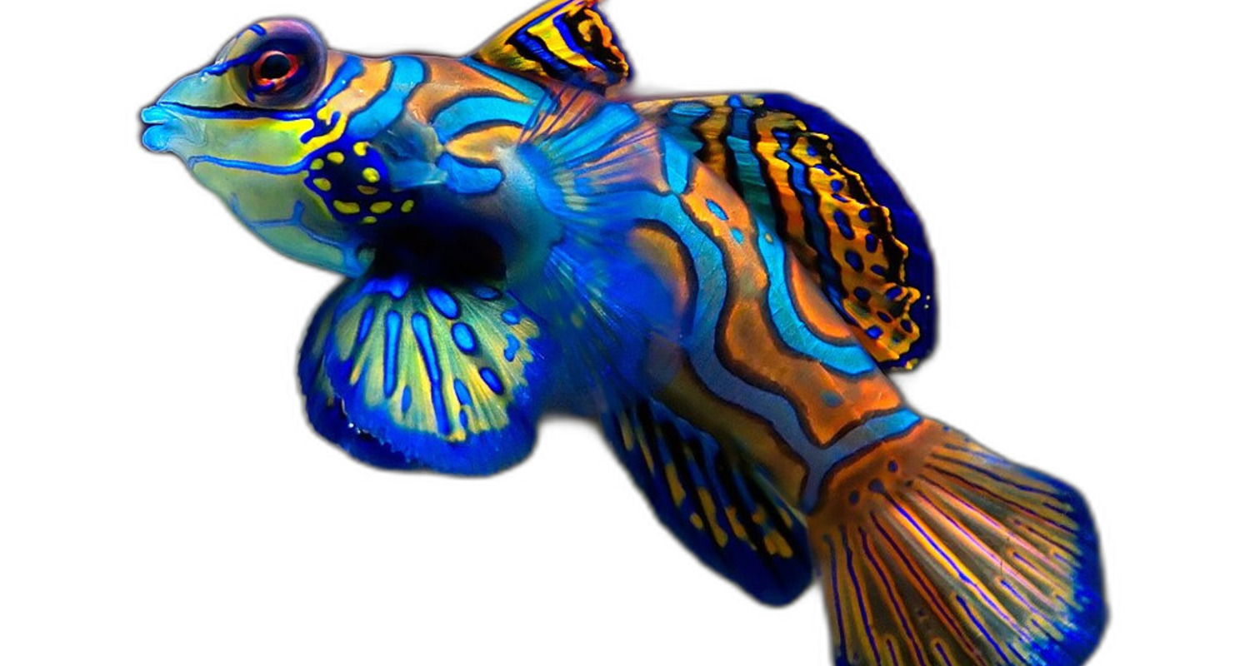
Today's three demo fish — three patterns, three families
Sergeant major
Cleaner wrasse
Mandarin fish
Pomacentridae
Labridae
Callionymidae
vertical bars
horizontal stripe
reticulate maze
Three fish that look different — let's see if pavo can SEE that difference in numbers.
Notes:
Walk through each fish briefly. Don't read the family names; just let
students see the visual difference. Set up the question: can numbers
distinguish these patterns? Spoiler — yes, beautifully, and the metric
that does it is the aspect ratio A.

Slide 4
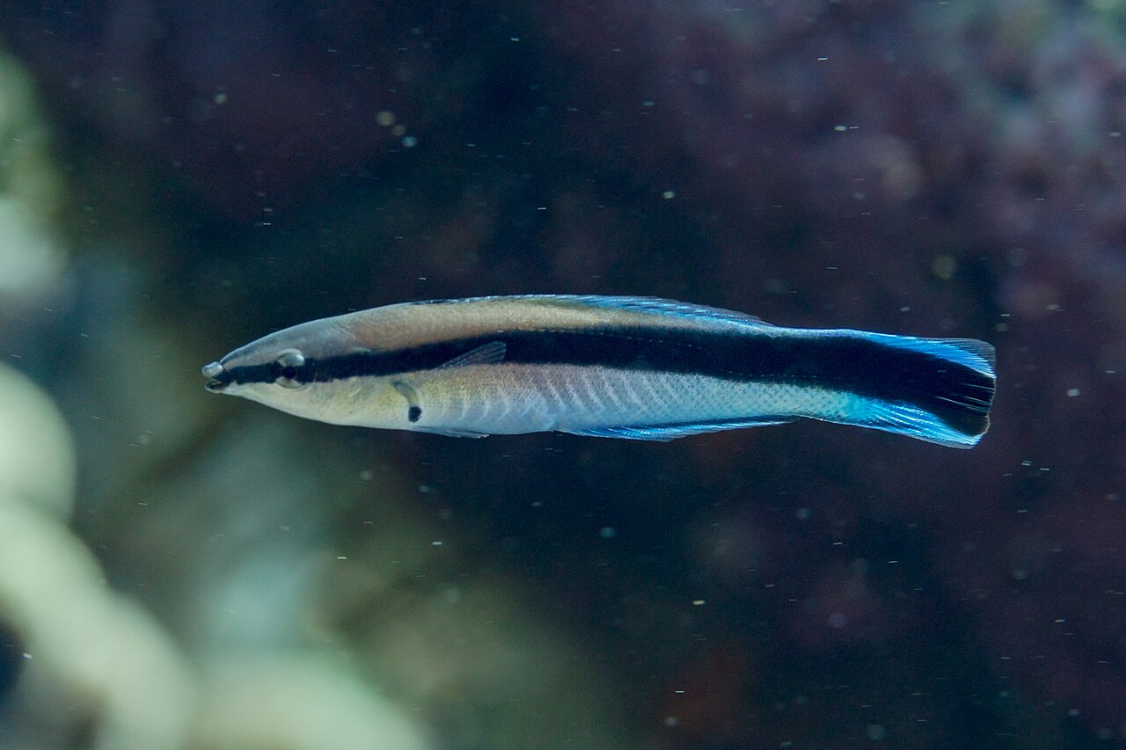
Step 0 — Segment the fish from its background
Raw photo
Segmented (background removed)
segment_fish() uses rembg to isolate the animal so pavo never classifies background pixels as a color class.
Without this step, k-means would find "reef-blue" or "sand" as one of your fish's color classes — and your pattern statistics would describe the photo, not the animal.
Notes:
Make this concrete: hold up the raw cleaner wrasse — water and rock and
diver bubbles all visible — and ask "if I asked pavo for the dominant
colors here, what would it find?" Answer: it would find a lot of blue
and white BACKGROUND, and the actual fish pattern would be diluted. The
segmentation step (rembg, run before pavo touches the image) is what
keeps the analysis fish-only. Demoed once on the cleaner wrasse so
students see exactly what segment_fish() does.

Slide 5
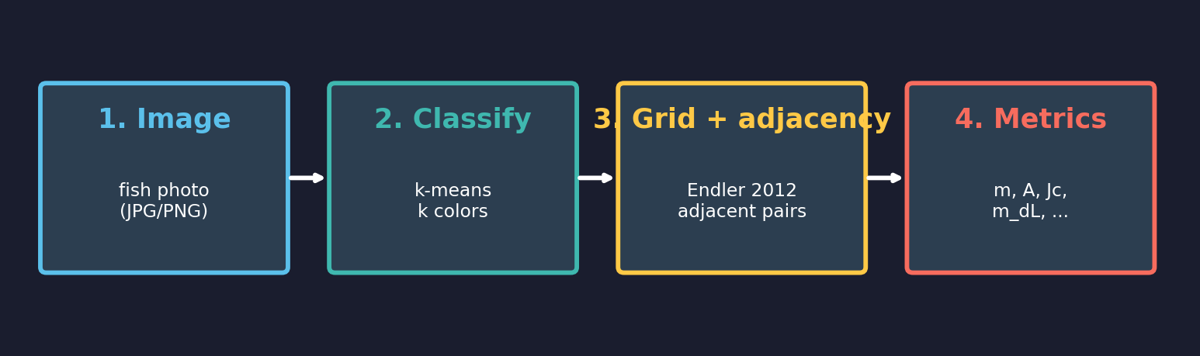
The pavo pipeline — four steps
We're going to walk through each box in detail. The whole point is to demystify what's happening at each step.
Notes:
Roadmap slide. Tell students that this is the sequence we'll cover, and that
each step will get its own treatment. Stress that "adjacency" — step 3 — is
the unique conceptual content; the rest is plumbing.

Slide 6
Step 1 — Load the image
getimg() reads JPG / PNG into a 3D array

Slide 7
What does pavo see when it loads an image?
An image is a 3D array of numbers: width × height × {R, G, B}.
A 1280 × 720 photo holds 1280 × 720 × 3 ≈ 2.8 million numbers.
R code
What you see
library(pavo) fish <- getimg("cleaner-wrasse.jpg") plot(fish)
Notes:
This slide does three things at once: introduces getimg, makes the array
representation explicit, and shows what the loaded image looks like. Don't
spend more than a minute here — students grok this fast.

Slide 8
Step 2 — Classify the colors
k-means reduces millions of unique RGB values to k color classes

Slide 9
Why classify? — The 16-million color problem
• An RGB image has up to 256³ = 16.7 million possible colors per pixel.
• Within one fish photo, there might be 50,000 unique RGB values.
• But biologically, there are only a handful of distinct color regions — maybe 3 (yellow, black, white) or 5 (multi-band angelfish).
• We need to collapse the continuous color cloud to a small, discrete palette.
• That palette is the input to all the pattern statistics.
Notes:
Frame the problem. The continuous-to-discrete reduction is what makes the
adjacency analysis tractable. Students should hear that "classifying" is a
decision the analyst makes — not something that comes from God.

Slide 10
k-means in one paragraph
Pick k. Drop k random points into RGB space. For each pixel: snap to the nearest of the k points. Then move each of the k points to the centroid of the pixels assigned to it. Repeat until nothing moves. The k final points are your color classes.
That's what classify(img, kcols = k) does inside pavo.
fish_k3 <- classify(fish, kcols = 3) plot(fish_k3)
Notes:
Don't get into Lloyd's algorithm in detail. The single paragraph above is
enough. The key takeaway is: pick k, then the algorithm assigns every pixel
to one of k color classes.

Slide 11
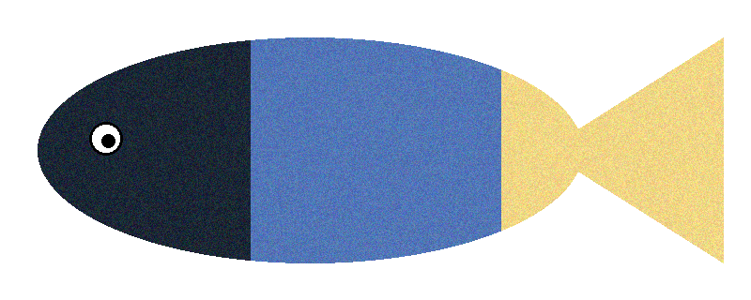

classify() — before and after, k = 3
Before — natural variation
After — classified to k = 3
Every pixel is now ONE of 3 color labels. The continuous color cloud has become a categorical map.
Notes:
Pause here. Let students see the discretization. Make the point that this
is what enables the adjacency analysis — you can't count "how often
RGB(127,53,89) is next to RGB(126,52,91)" because every pixel is unique.
You CAN count "how often dark is next to light." That's why classify is
the gateway step.

Slide 12

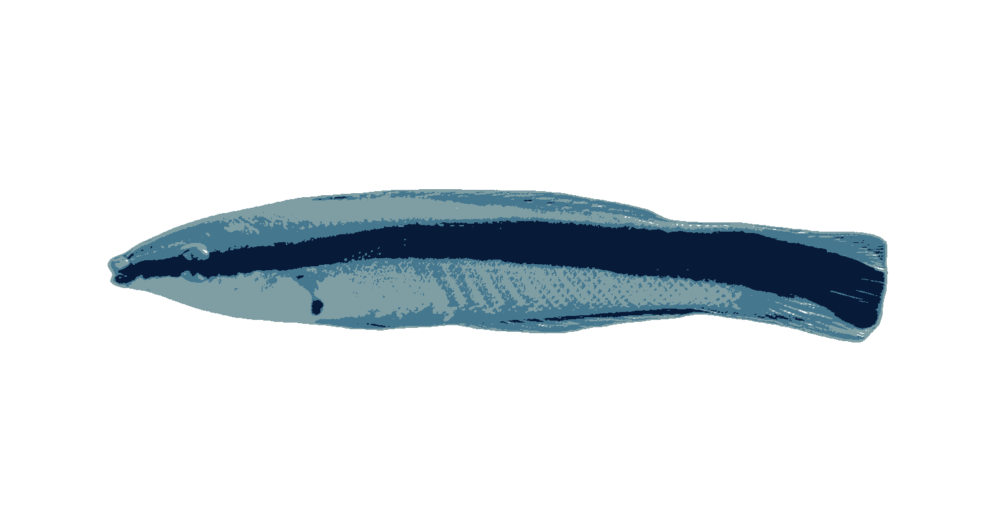
classify() on a real fish — cleaner wrasse, k = 4
Before — full color photograph
After — classified to k = 4
Same idea on a real fish. Every pixel collapses to one of 4 color labels — black mask, blue back, white belly, white background.
Notes:
Show the toy version first, then this — students get the cartoon, then see
that pavo really does this same operation on the photo. The fourth class
in this k=4 run is the white background; that's a feature, not a bug, and
it sets up the bkgID conversation on the next slide.

Slide 13
How do you choose k?
• Eyeball it: how many distinct color regions does the fish have?
• Try k = 3, 4, 5; plot each; pick the one that looks like the biology.
• There's no single right answer — pavo respects what the analyst decides.
• For a 2-color animal (yellow tang, all-black drum), k = 2 is fine.
• For multi-band angelfish or pufferfish, you may need k = 6.
• Today: sergeant major k = 3, cleaner wrasse k = 3, mandarin k = 5.
Notes:
This is where students will ask the inevitable "what's the right k?"
question. Pre-empt it. The answer is "there isn't one; gestalt + biology;
this is a JUDGMENT call and we own it." Show that pavo also has an
interactive mode (interactive = TRUE) for picking class colors by hand.

Slide 14
Step 3 — Lay down a grid
The Endler 2012 idea: sample the pattern at regular points, ask what colors are adjacent at each point.

Slide 15
Why a grid?
• We want to summarize the pattern statistically — not pixel-by-pixel.
• Endler (2012) proposed a regular grid of sampling points across the patch.
• At each grid point, compare the focal pixel to its cardinal neighbors.
• Tally how often color A is next to color B → a transition matrix.
• Every metric pavo reports is a function of that transition matrix.
• Same algorithm works on a fish, a frog, a flower, a feather. Generalizable.
Notes:
This is the conceptual heart of the lab. Take your time. Make the point that
the grid is not analyzing the whole image — it's SAMPLING the image at
regular points, and inferring pattern statistics from those samples.

Slide 16
Frame 0 — Start with the classified fish
Three color classes: dark, mid, light. No grid yet.
Notes:
Anchor the audience on what the input looks like AFTER classification but
BEFORE the grid is laid down.

Slide 17
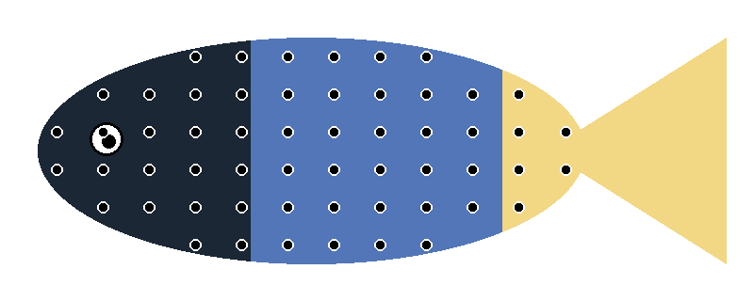
Frame 1 — Drop a regular grid of points
Grid is laid down on the FISH only. Background points are excluded (see next slide).
Notes:
Grid spacing is a parameter you set (xpts) — sparse grids are fast/noisy,
dense grids are slow/well-resolved. pavo's default xpts = 200 places ~200
points along the longest axis. Note this slide only shows the on-fish
points; the next slide explains why.

Slide 18

How pavo handles the background — and edge points
bkgID — flag the background class
After classify(), one of the k color classes is the white padding around the fish. Pass that class number to adjacent(bkgID = X). pavo then drops every transition that touches the bkg class — both the focal pixel and any of its neighbors that fall on background.
Points with < 4 neighbors
Edge / contour points may only have 2 or 3 valid neighbors (the others fall off the body or on bkg). pavo simply tallies whatever transitions ARE valid — the matrix is then normalized to proportions, so a point with 2 neighbors contributes ½ as much weight as one with 4. No extrapolation, no padding, no fudge.
Hollow grey rings = grid points pavo DROPS (they fall on the white background)
Notes:
This slide answers the two most common confused-student questions:
Q1: "What about the white space around the fish?"
A1: bkgID. Show how to find the right class number — after classify(),
run summary(fish_classified) and look for the class that's
~white (e.g. R/G/B values all > 240). Pass that integer to
adjacent(bkgID = N). pavo also accepts a vector if more than one
class is background-like.
Q2: "What about pixels at the edge of the fish?"
A2: The grid only sees pixels that are NOT background (after bkgID
filtering). Edge points contribute fewer transitions, but pavo
normalizes the transition matrix by total counts, so the metrics
are weighted correctly. No edge artifact.
Optional aside: pavo also supports procimg(outline = TRUE) for clicking
a manual fish outline — cleaner than bkgID for fish on busy backgrounds,
but more work. We use bkgID throughout this lab because rembg already
gave us a clean white background.

Slide 19
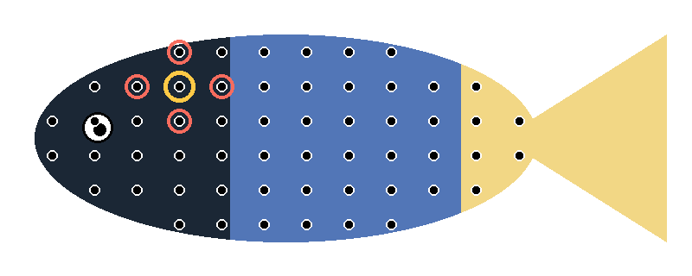
Frame 2 — Pick ONE point. Look at its 4 cardinal neighbors.
Focal point — gold ring. N, S, E, W neighbors — coral rings.
We are going to count: what color is the focal pixel? What color is each neighbor?
Notes:
Slow down here. This is the single most important conceptual idea in the
lab. Make sure students see the focal/neighbor distinction. Optionally
ask the room: what is the color of the focal? What color is each neighbor?

Slide 20
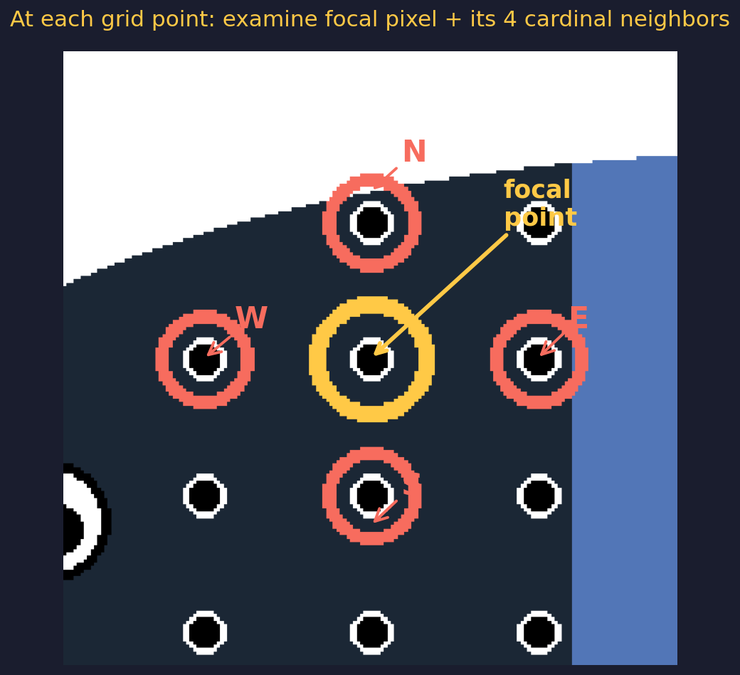
Frame 3 — Zoom in on the focal point
One focal pixel + 4 neighbors = 4 adjacency tests.
Notes:
The 4 cardinal neighbors are the standard pavo default. Some implementations
use 8 neighbors (including diagonals); pavo uses 4. Each neighbor gives one
adjacency test → one entry in the transition matrix.

Slide 21
Frame 4 — Count the four adjacencies at THIS point
Focal color → Neighbor color
E neighbor: mid → mid (same)
W neighbor: mid → dark (transition)
N neighbor: mid → mid (same)
S neighbor: mid → mid (same)
Result: 1 transition (mid → dark) and 3 same-color pairs.
Notes:
Walk through each adjacency by name. Make sure students understand: each
adjacency contributes to ONE cell of the transition matrix. Three same-
color hits go to the diagonal (mid→mid). One off-diagonal hit goes to
mid→dark. That's the bookkeeping the algorithm does.

Slide 22
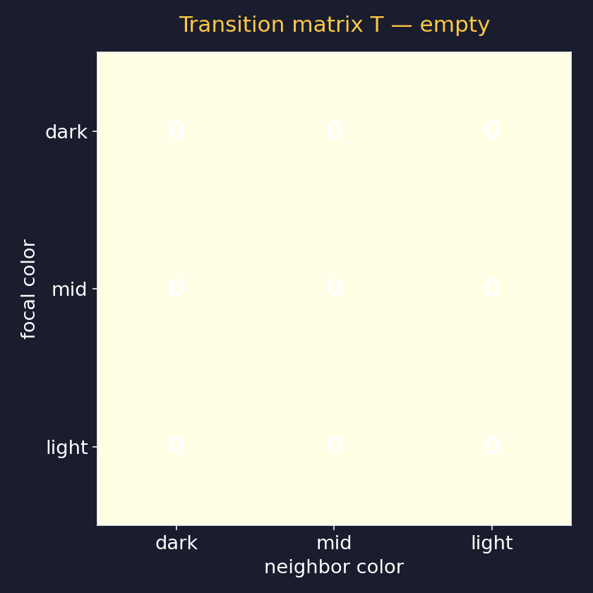
Frame 5 — These tallies fill in a transition matrix T
• Rows = focal color class.
• Columns = neighbor color class.
• Cell T[i, j] = number of times focal color i was adjacent to neighbor color j.
• Diagonal cells (T[i, i]) = same-color adjacencies (= big blobs).
• Off-diagonal cells = color transitions (= edges).
Notes:
Diagonal vs off-diagonal is the conceptual hinge. Big blobs of one color =
lots of diagonal mass. Lots of pattern complexity = mass distributed off
the diagonal. This is the cleanest way to talk about pattern.

Slide 23
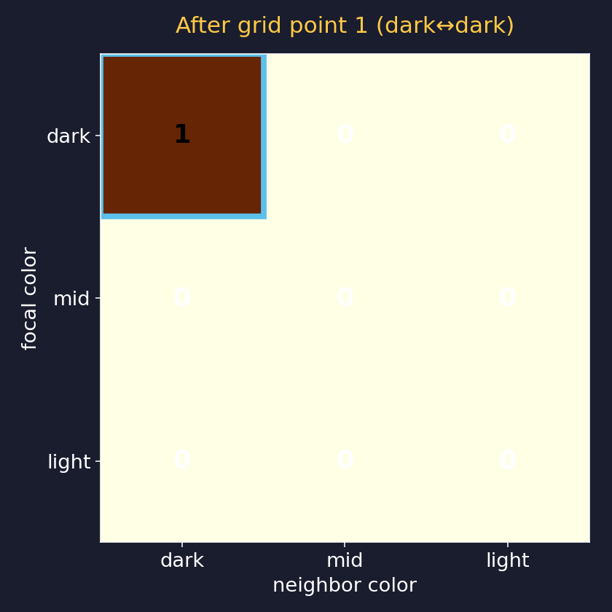
Frame 6 — Increment cell T[mid, dark] for the one transition
We're not actually incrementing T[mid, dark] = 1 yet — but conceptually, every adjacency we counted at this grid point contributes to ONE cell of T.
Notes:
The matrix in this slide has one cell highlighted to show the principle.
The actual matrix-fill happens after we visit ALL grid points. Be clear
about this distinction.

Slide 24
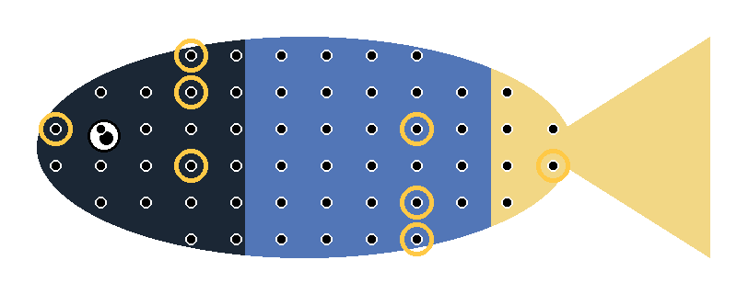
Frame 7 — Now do this at every grid point
8 example focal points marked in gold. Same procedure at each: focal vs 4 neighbors, contribute 4 tallies to T.
Notes:
Drive home the repetition: pavo doesn't analyze just one point — it
visits all 72 (or 200, or however many) grid points, contributing 4
adjacency tallies from each. So one fish image generates ~280+ adjacency
tallies, all going into the same matrix T.

Slide 25
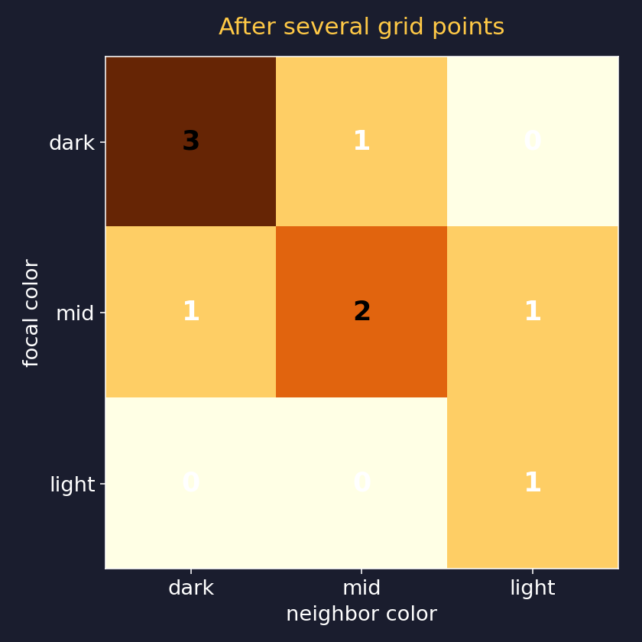
Frame 8 — After several grid points, T fills in
Partial T after ~10 grid points. Diagonals are accumulating (same-color adjacencies). Off-diagonals starting to populate (color transitions).
Notes:
You can see the shape of T already: most mass on diagonal (most adjacent
pixels are the same color, because pattern regions are bigger than the
grid spacing). Off-diagonal mass tells us about edges.

Slide 26
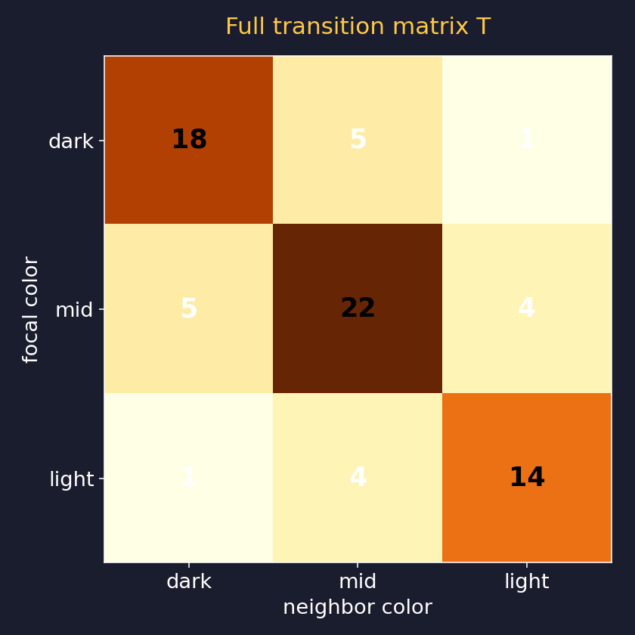
Frame 9 — Full transition matrix T after all grid points
All 72 grid points × 4 neighbors = 288 adjacency tallies. The matrix is now complete.
All pattern metrics derive from THIS matrix.
Notes:
This is the punchline of the grid section. Every metric we're about to
introduce is just a different way of summarizing T. Same matrix, multiple
descriptions of the pattern.

Slide 27
All of that — in one pavo function call
fish_adj <- adjacent(fish_k3, xpts = 200, xscale = 5)
Output: a data frame of pattern statistics, computed from T.
xpts = number of grid points along the longest axis xscale = pixel-to-real-world scale (cm) — used for distance metrics
Notes:
This is where the abstraction lands: everything we just walked through —
9 frames of grid + matrix mechanics — is one function call in R. That's
the value of pavo.

Slide 28
Step 4 — The metrics
Six numbers that describe a pattern, each derived from T

Slide 29
The six metrics we'll focus on today
• m — transition density (off-diagonal mass / total)
• A — aspect ratio (vertical transitions vs horizontal)
• Jc — color heterogeneity (Simpson diversity of colors)
• Jt — transition heterogeneity (diversity of transition types)
• m_dS — chromatic boundary strength (saturation step at edges)
• m_dL — achromatic boundary strength (luminance step at edges)
Each one is a single number computed from T.
Notes:
We're focusing on these six because they're the ones in the worksheet.
pavo's adjacent() actually returns ~30 columns; the other ones are
variants and breakdowns of these core ideas.

Slide 30
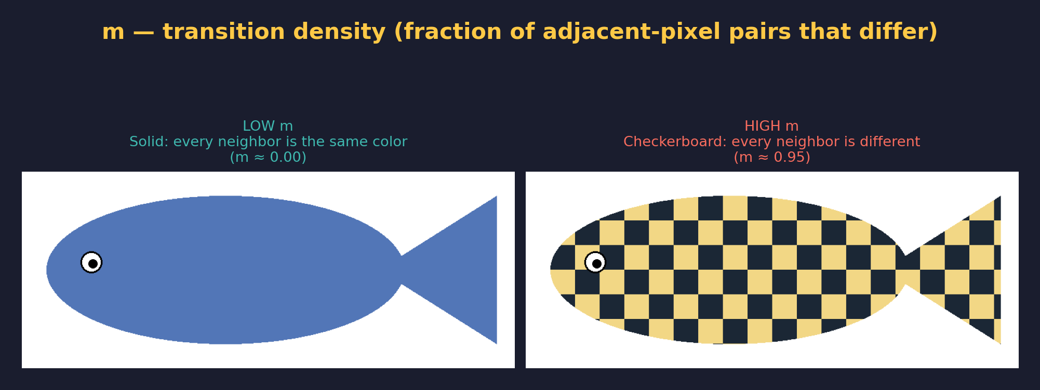
m — transition density
Low m = mostly same-color neighbors → big blobs. High m = lots of color changes → busy pattern.
Notes:
m — transition density — show students the two toy fish side by side. The visual
difference is dramatic. Have them tell YOU which is high and which is
low before you confirm the answer. Then connect back to: this is exactly
what we'll measure on the real reef fish.

Slide 31
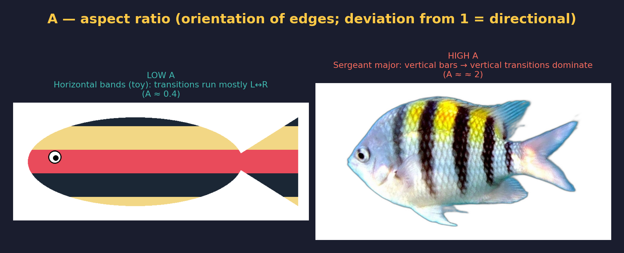
A — aspect ratio
Pavo's A = (vertical transitions) / (horizontal transitions). Toy horizontal bands → A < 1 (low). The real sergeant major has vertical bars → A > 1 (high). Reticulate / spotted patterns sit near A ≈ 1.
Notes:
A — aspect ratio — show students the two toy fish side by side. The visual
difference is dramatic. Have them tell YOU which is high and which is
low before you confirm the answer. Then connect back to: this is exactly
what we'll measure on the real reef fish.

Slide 32
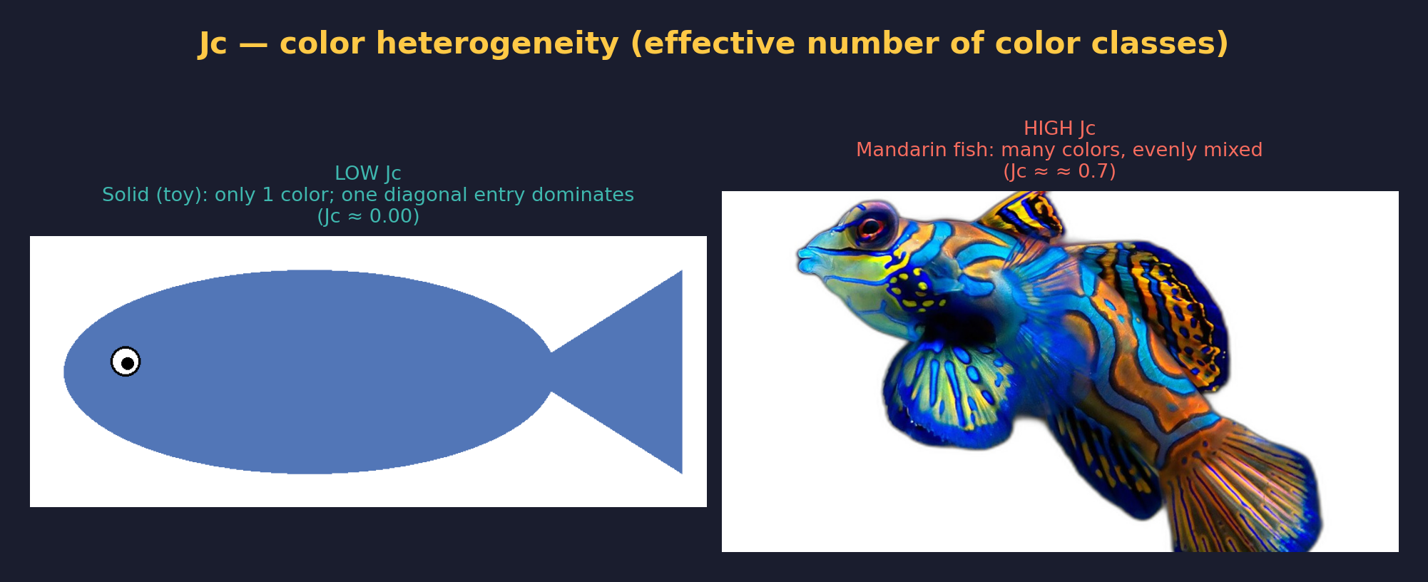
Jc — color heterogeneity
Jc tracks how many color classes show up and how evenly they're used. Toy solid fish → low Jc. The real mandarin fish has many colors mixed evenly → high Jc.
Notes:
Jc — color heterogeneity — show students the two toy fish side by side. The visual
difference is dramatic. Have them tell YOU which is high and which is
low before you confirm the answer. Then connect back to: this is exactly
what we'll measure on the real reef fish.

Slide 33
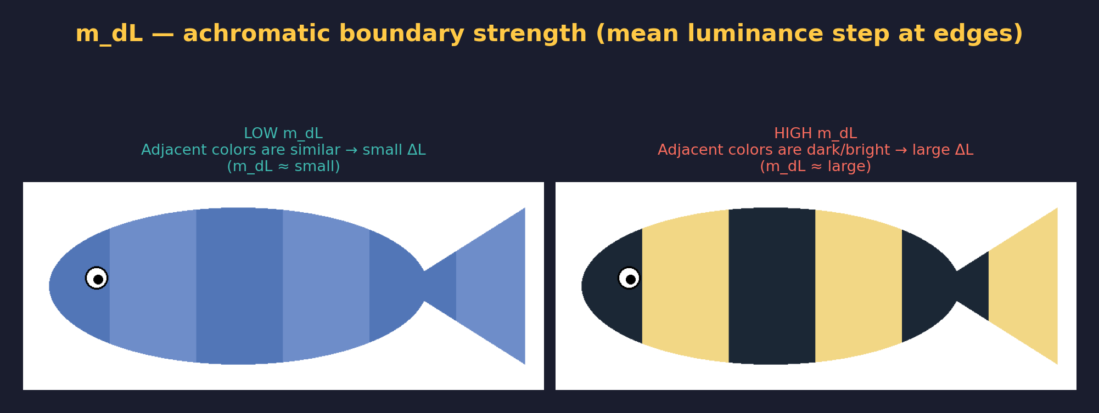
m_dL — luminance boundary
How bright is the contrast across edges? Black-on-white = strong achromatic boundary. Two similar greens = weak.
Notes:
m_dL — luminance boundary — show students the two toy fish side by side. The visual
difference is dramatic. Have them tell YOU which is high and which is
low before you confirm the answer. Then connect back to: this is exactly
what we'll measure on the real reef fish.

Slide 34
Predict, then measure
Before running pavo on the three demo fish — what would you expect each metric to look like?

Slide 35
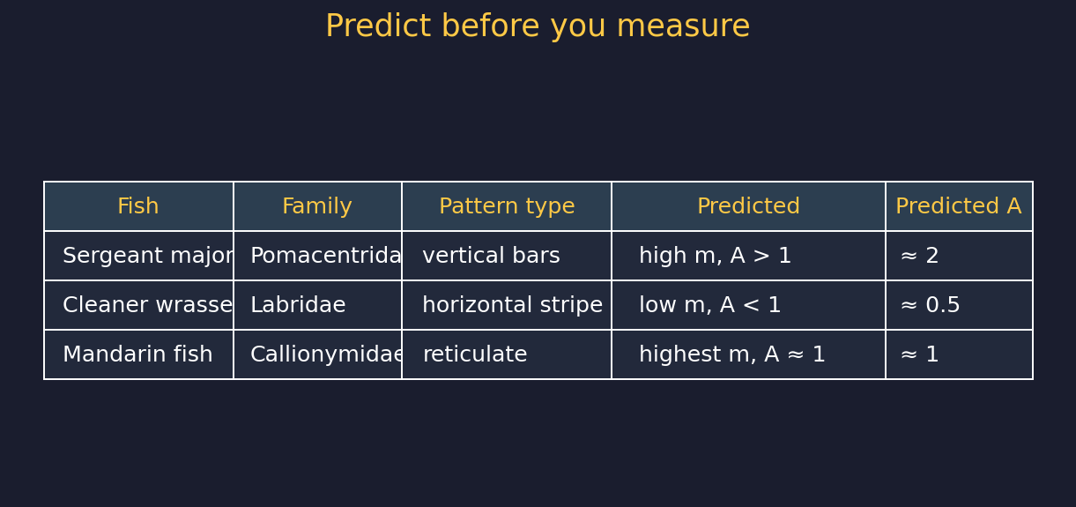
Predict — one minute, with your neighbor
Take 60 seconds. Discuss with your neighbor: do you agree with these predictions? Where might they be wrong?
Notes:
60-second think-pair. Don't lecture during this. Wait. Then call on
1-2 students to defend or challenge predictions. The mandarin is the
trickiest — students may guess A != 1 because it has obvious lines, but
those lines run in BOTH directions, so A should land near 1.

Slide 36
Now run the live demo
Switch to RStudio.
scripts/walkthrough.R
We'll process all three fish, build a comparison table, and check our predictions.
Notes:
Cue to switch out of slides into R. Run walkthrough.R end-to-end. The
script is annotated; students should be following along on their laptops.
Take 15 minutes. Project the output table at the end.

Slide 37
Now — your turn
Pick THREE fish from your assigned lineage — three DIFFERENT pattern types. Run all three. Compare to the demo fish.

Slide 38
Your assignment for today
• Your group has an assigned reef fish lineage (typically a family).
• Pick THREE species from your lineage that look as different from each other as you can find:
• one with vertical bars (you predict A > 1)
• one with horizontal stripes or bands (you predict A < 1)
• one with spotty / reticulate / solid pattern (you predict A ≈ 1)
• Run the full pipeline on each: getimg → classify → adjacent → summary.
• Compare your three A values to the demo fish you just saw.
Did pavo's A statistic classify your fish the same way it classified the demos?
Notes:
30 minutes of student hands-on work. Rosamari + Michael circulate. Common
struggles: choosing k (just go with their first guess and see), forgetting
to load pavo (library(pavo)), wrong file path. Keep groups loose; they
should help each other. The 3-fish design means students who finish their
first fish quickly should immediately move to the next; tell them this.

Slide 39
How to pick your three fish
• Use whatever image source your group has been working with — FishView, FishBase, your own field photos, or the pre-loaded library at images/student-fish/<your-lineage>/, or images/student-images/ for fish you upload yourself.
• Look at the photos before you classify. Pick three that span the widest pattern range your lineage offers.
• If your lineage doesn't have all three pattern types (e.g., all surgeonfishes are vaguely solid-colored), don't force it — just pick the three with the most different patterns you can find.
• REGISTER each image to LEFT-LATERAL view (head on left). If a fish is facing the wrong way, flip it horizontally with flip_to_left_lateral() or magick -flop.
• Talk to your group; aim for different choices across the four members so you have more data to compare in the wrap-up.
Notes:
Address the question of "what if my lineage is too uniform" head-on. Some
families (Acanthuridae) are pretty pattern-uniform; some (Pomacanthidae)
are wildly varied. The lab works either way — the latter just gives more
striking comparisons.

Slide 40
What you'll fill in
Three metric tables, plus a comparison to the demo fish.
Example: your worksheet's results table
Metric Fish 1 (bars) Fish 2 (stripe) Fish 3 (reticulate)
k 3 3 5
m 0.13 0.07 0.28
A 2.4 0.45 1.05
Jc 0.62 0.48 0.78
m_dL 0.55 0.30 0.40
Then ONE comparison question (do your fish track the demo pattern?) and ONE biological interpretation (selection hypothesis for one fish).
Notes:
This is the visual scaffold for what the deliverable looks like. The
example numbers shown are roughly what we'd expect from a Pomacanthidae
or Chaetodontidae trio — barred angelfish, banded butterflyfish, spotted
something. Don't dwell on exact values; the point is that there are 3
columns and a comparison.

Slide 41
Wrap-up — 5 min
Compare results across groups. Predict for next session.

Slide 42
What we did today
• Loaded reef fish photos with getimg().
• Reduced millions of RGB values to k color classes with classify().
• Sampled the pattern with a regular grid (Endler 2012).
• Counted color transitions in a transition matrix T.
• Derived 6 pattern metrics from T with adjacent().
• Predicted, measured, and compared three demo fish.
• Each of you ran your own assigned fish through the same pipeline.
Notes:
Recap. Then preview the next pavo session: comparative analysis across
multiple species in your assigned family.

Slide 43
Next time
• We will run pavo on multiple species per family.
• Compute a metric MATRIX — species × metric.
• Cluster species by pattern. Compare to phylogeny.
• Ask: do related fish share patterns? Or has selection pushed lineages to different parts of pattern space?
Today was the toolkit. Next time we use it to do biology.
Notes:
Set up the second pavo lab. Don't promise specifics — we may use FishView
or a curated dataset.

Slide 44
Questions?
Submit your worksheet to BruinLearn by end of day.
Files: images/ • scripts/walkthrough.R • scripts/helpers.R • lab-05-pavo-intro.qmd • student-guide.qmd

