Slide 1
Introduction

Slide 2
BASIC CONCEPTS OF NEURAL NETWORKS
Neural Networks, which are simplified models of the biological neuron system,
is a massively parallel distributed processing system
made up of highly interconnected neural computing elements
that have the ability to learn and thereby acquire knowledge
make it available for use.
The structural constituents of a human brain termed neurons are the entities, which perform computations such as cognition, logical inference, pattern recognition and so on.
Hence the technology, which has been built on a simplified imitation of computing by neurons of a brain, has been termed Artificial Neural Systems (ANS) technology or Artificial Neural Networks (ANN) or simply Neural Networks.

Slide 3
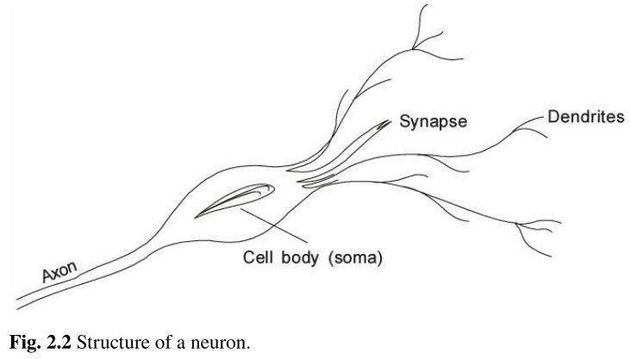
Human Brain
Brain contains about 1010 basic units called neurons.
Each neuron in turn, is connected to about 104 other neurons.
A neuron is a small cell that receives electro-chemical signals from its various sources and in turn responds by transmitting electrical impulses to other neurons.
A neuron is composed of a nucleus—a cell body known as soma.
Attached to the soma are long irregularly shaped filaments called dendrites.
The dendrites behave as input channels, (i.e.) all inputs from other neurons arrive through the dendrites.
Another type of link attached to the soma is the Axon.
Unlike the Dendritic links, the axon is electrically active and serves as an output channel.
Axons, which mainly appear on output cells are non-linear threshold devices which
produce a voltage pulse called Action Potential or Spike that lasts for about a millisecond.
The axon terminates in a specialized contact called synapse or synaptic junction
that connects the axon with the dendritic links of another neuron.
. It is this fluid which is responsible for accelerating or retarding the electric charges to the soma.

Slide 4
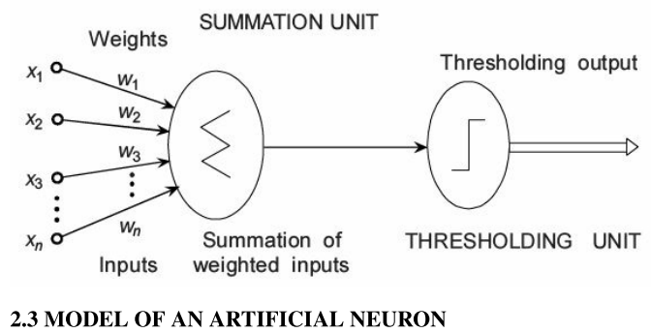
An Artificial Neuron
The behavior of a neuron can be captured by a simple model as shown in Fig. 2.3.
Every component of the model bears a direct analogy to the actual constituents of a biological neuron and hence is termed as artificial neuron.
It is this model which forms the basis of Artificial Neural Networks.
Here, x1, x2, x3, ..., xn are the n inputs to the artificial neuron. w1, w2, ... , wn are the weights attached to the input links.

Slide 5
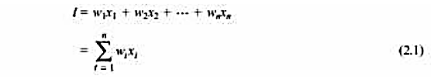
An Artificial Neuron
In biological neuron, the input signals are passed on to the cell body through the synapse which may accelerate or retard an arriving signal.
It is this acceleration or retardation of the input signals that is modelled by the weights.
An effective synapse which transmits a stronger signal will have a correspondingly larger weight while a weak synapse will have smaller weights.
Thus, weights here are multiplicative factors of the inputs to account for the strength of the synapse.
Hence, the total input I received by the soma of the artificial neuron is

Slide 6
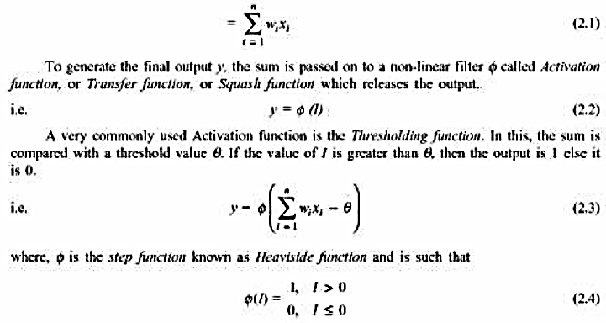
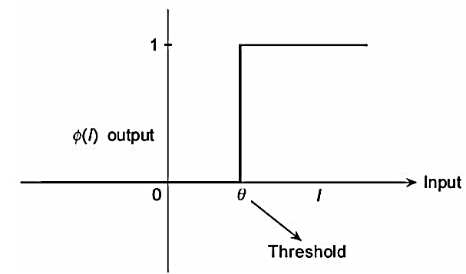
An Artificial Neuron
Figure 2.4 illustrates the Thresholding function. This is convenient in the sense that the output signal is either 1 or 0 resulting in the neuron being on or off.
Fig. 2.4 Thresholding function.

