Slide 1
Chapter 6 Image Restoration
Md. Mahadi Hassan
Associate professor, CSE

Slide 2
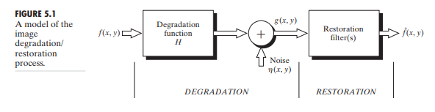
Restoration/Degradation modeling
■
■

Slide 3
Noise modeling
An image gets corrupted by noise, which may arise in the process of acquiring the image or during its transmission, or even during reproduction of the image
Removal of noise from an image is one of the most important tasks in image processing
Depending on the nature of the noise, such as additive or multiplicative type of noise, there are several approaches towards removing noise from an image
■
■
■

Slide 4
Noise modeling
Mathematically the imaging procedure including corruption by noise can be represented by
v(x, y) = g[u(x, y)+η(x, y)]
■
■
Here u (x, y) represents the original image, and v (x, y) is the observed image, g() is generally nonlinear function and η(x, y) represent the additive noise

Slide 5
Additive noise: Sometime the noises generated from sensors are white Gaussian, which is essentially additive and signal independent, i.e.
g(x, y) = f (x, y) +η(x, y)
Types of noise in an image and their Characteristics
■
■
Where g (x, y) is the result of the original image function f (x, y) corrupted by the additive Gaussian noise η(x, y)

Slide 6
Cont.
■
Multiplicative noise: The graininess from photographic plates essentially multiplicative in nature. The speckle noise from the imaging system as in coherent, ultra sound imaging etc are also multiplicative
g(x, y) = f (x, y)*η(x, y)
where η(x, y) is the multiplicative noise
■

Slide 7
Cont.
Impulse noise: Quite often the noisy sensors generate impulse noise
Sometimes the noise generated from digital image transmission system is impulsive in nature, which can be model as
■
■
g(x, y) = (1− p) f (x, y) + p.i(x, y)
Where i (x, y) is the impulsive noise and p is a binary parameter that assumes the values of either 0 or 1.
■

Slide 8
Cont.
■
The impulsive noise may be easily detected from the noisy image because of the contrast anomalies.
Once the noise impulses are detected, these are replaced by the signal samples
■

Slide 9
Image Restoration
■
Improving the quality of images acquired by optical, electro-optical or electronic means is one of the basic tasks in digital image processing. Images may be degraded due to several reasons,
Imperfection of the imaging system Imperfection in the transmission channel Degradation due to atmospheric condition
Degradation due to relative motion between the object and the camera
■
■
■

Slide 10
Cont.
The original scene is usually blurred due to convolution of the degrading mechanism as maintain before
A random noise is usually added to the degraded data. The random noise may originate from the image formation process, trans mission medium, recording process etc.
■
■

Slide 11
Cont.
A typical cause of degradation may be defocusing of the camera lens system, sudden jerking motion of the imaging system. The additive Gaussian noise results in the degraded
■
image
g(x, y) = H [ f (x, y)]+η(x, y)
■
where f (x, y) is the pixel value of the original image at the point (x, y), H is the degradation model, and g (x, y) is the degraded image;
η(x, y) is the additive noise

Slide 12
Cont.
■
A simple degradation model may be achieved by
convolving a 3× 3 window with the original image. Thus g (x, y) becomes
g(x, y) = ∑ H (k, l) f (x − k, y − l )+η(x, y)
k ,l∈w
■
Here w represent the convolving window.

Slide 13
There are conventional methods like inverse filtering, winner filtering, kalman filtering, etc., to restore the original image.
■
■
In all these cases we assume that the blurring function H is known.
If H is known, then obviously we can get back or restore original image by simply by convolving the degraded image with the inverse of the blurring function.
To remove the noise, it is important that the noise statistics should be known prior
■
■

Slide 14
Image restoration of impulse noise Embedded images

Slide 15
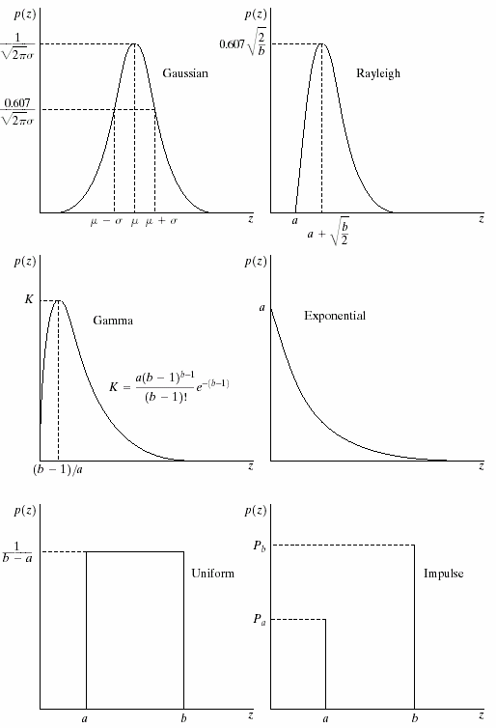
Noise Models
■
Most types of noise are modeled as known probability density functions
Noise model is decided based on understanding of the physics of the sources of noise.
■
■
Gaussian: poor illumination Rayleigh: range image Gamma, exp: laser imaging
Impulse: faulty switch during imaging,
■
■
■
■
Uniform is least used.
■
Parameters can be estimated based on histogram on small flat area of an image

Slide 16
Noise Removal Restoration Method
■
Mean filters Adaptive filters
■
■
Arithmetic mean filter Geometric mean filter Harmonic mean filter
Contra-harmonic mean filter
■
Adaptive local noise reduction filter
Adaptive median filter
■
■
■
■
■
Order statistics filters
■
Median filter
Max and min filters Mid-point filter
alpha-trimmed filters
■
■
■

Slide 17
Inverse Filtering
■
Inverse filtering approach toward image restoration assumes that the degradation of the image is caused by a degradation function h (i, j)
The additive noise is assumed to be independent of the image signal
Thus the degradation can be expressed in the Fourier domain as
G(u, v) = F (u, v)H (u, v)+ N (u, v)
Where F (u, v) is the Fourier transform of the uncorrupted image, G (u, v) is the Fourier transform of the degradation image, H (u, v) is the Fourier transform of the degradation process h (i, j).
■
■
■

Slide 18
Cont.
■
Therefore from the above equation we can write
F (u, v) = ^{G(u, v)}
H (u, v)
N(u, v)
H(u, v)
■
From the above equation it is evident that the original image cannot be restored in case the nature of the random noise function is unknown
In case there is no additive noise N (u, v), the inverse filtering performs very well
If noise is present, then its influence becomes significant at higher frequency (u, v), where magnitude of H (u, v) becomes very low.
The effect of noise in such cases influences the result of restoration
■
■
■

Slide 20
Wiener Filter
■
The Wiener is a minimum mean-square estimator which theoretically minimizes average error
Wiener filter a method that restores an image in the presence of blur as well as noise
Here, both the image f (x, y) and noise η(x, y) are the zero mean
■
■
random processes and the objective is to obtain an estimate
f^{ˆ}(x, y)
of the original image f (x, y) such that the mean square error is
minimized. The resulting estimate is also MMSE estimate.
e² = E{[f (x, y)− f(x, y)]² }

Slide 21
Cont.
g(x, y) = h(x, y)∗ f (x, y)+ n(x, y) f(x, y) = w(x, y)∗ g(x, y)
Where w(x, y)is the wiener filter.
E[{f (x, y)− f(x, y)}² ]
= E[f (x, y)² ]+ E[f(x, y)² ]− 2.E[ f (x, y) f (x, y)]
.....................
Winner filter equation for an N × Nimage:
W (u, v) =
H ∗ (u, v)
H (u, v
₎2 ⎡ S_{n} (u, v)⎤
^{+ ⎢} S (u, v)⎥
⎣ I ⎦
Where :
H ∗ (u,v) = complex conjugate of H(u,v)
S_{n} (u, v) = N (u,v) = power spectrum of the noise
2
S_{I} (u,v) = I (u,v) = power spectrum of the orginal image
2

Slide 22
Cont.
■
The Wiener filter response is reduced at high frequencies compared to an inverse filter due to the
power spectrum ratio,
⎡S_{n} (u, v)⎤
⎢S (u, v)⎥
⎣ I ⎦
■
The practical wiener filter replaces the power spectrum ratio with an experimentally determine constant, because in real applications S_{I} (u, v) cannot be determined
H ∗ (u, v)
W (u, v) =
H (u, v) + k
2

