Slide 1
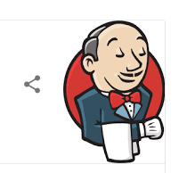



Operating system
Operating system
container
container
React JS
React JS
HTML
HTML
HTML
Build and test process
HTML
HTML
HTML
Web server (Node.js)
Web server (Node.js)
Source
Package
Server (dev)
Server (prod)
Local
Internet

Slide 2
Backlog
Feedback
Release Management/ Value Stream Management
Continuous Delivery Choreography
_
Source Control(GitHub)
Continuous Integration
Package/ Image Repo(s)
Pipeline as code(Jenkins Pipeline code)
Product code – Retail-Application
Release automation
Load service
Monitoring
Control plane
Choreography definition
Build management
Infrastructure definition
CI-based deployment
Upstream resources
Package or image-based deployments
Deployment and test results
Testing stages
Unit Testing and Analysis
Functional Testing
Integration Testing
Load Testing
User Acceptance
Testing
Production
Infrastructure provisioning
Build
Test
Integra-tion
Pre-prod
Stage
Prod
Environments
Infrastructure automation
Infrastructure Services (Cloud)

