Slide 1
SEIS 6XX IT Infrastructure
Jason Baker
Adjunct Instructor
Graduate Programs in Software
University of St. Thomas
St. Paul, MN

Slide 2
Readings
Distributed infrastructure (CSA Chapter 1)
Virtualization

Slide 3

How challenging was last week’s assignment?

Slide 4
Distributed infrastructure
Let’s look at where we’ve been
Mainframes presenting applications via direct terminals
Personal computers running desktop applications
Client-server applications (thick client <-> database)
Web applications (thin client <-> middleware+db)
Distributed applications (highly scaled in the cloud)
Distributed apps are broken into small components which can be individually scaled

Slide 5
Distributed infrastructure
Example: Single large webserver vs. many small webservers
Single large server | Multiple small servers
Easy to maintain | Difficult to maintain, need to sync content and handle performance differences
Finite amount of processing, memory & I/O | Unlimited* amount of processing, memory & I/O
Requires no special application support | Application needs to support distributed deployment architecture (stateless, ephemeral, etc.)
* Nothing is really unlimited ☺

Slide 6
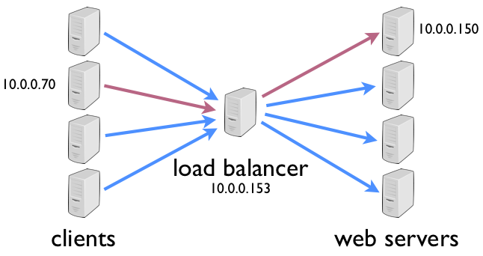
Distributed composition patterns
Load balancer with backend servers
LB coordinates communication between users and servers
LB watches the health of servers and dynamically re-routes requests to maintain high availability

Slide 7
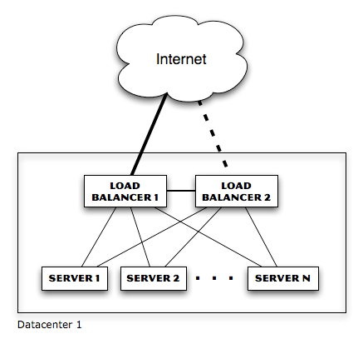
Distributed composition patterns
LB eliminates single-point-of-failure with servers, but what about LB itself?
Now we need redundant LB (and switches and firewalls and routers…)

Slide 8
Distributed composition patterns
LB can use a variety of algorithms to determine which server handles a request
Random: each incoming request is sent to a random server in the pool
Round-robin: each incoming request is sent to a different server in a predetermined order (sometimes referred to as spray-and-pray)

Slide 9
Distributed composition patterns
Least load: LB monitors load of each server and sends requests to least loaded system
Problem? What if least loaded system is actually malfunctioning in some way the LB cannot detect.
Least loaded system could be quickly overwhelmed because avg load metrics lag behind requests (solution = slow start)
Weighted round robin: servers are given specific weights so that higher-weighted servers receive a greater percentage of requests

Slide 10
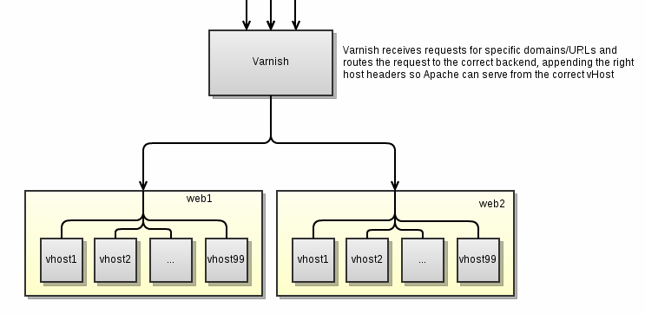
Distributed composition patterns
Server with multiple backends
Server partitions request into multiple queries to backend systems and then aggregates responses
Response impacted by highest latency
Fan-in I/O challenges

Slide 11
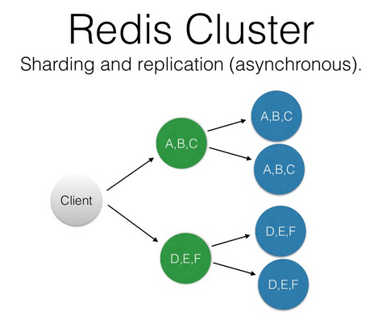
Distributed composition patterns
Server tree
Commonly used by distributed databases
Found in services like Active Directory and DNS
Main benefit is parallelization and reduced request latency

Slide 12
The distributed state challenge
Large distributed systems need to store state (data that changes)
Single database server will eventually run out of processing power
Solution: store data across multiple database servers
New problem: users reading old data from database servers that haven’t been updated yet (consistency problem)

Slide 13
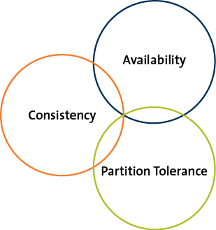
CAP Principle
Presented by Eric Brewer in 1999
It is not possible to build a distributed system that guarantees consistency, availability, and partition tolerance.
You can only pick
2 of the 3!

Slide 14
CAP Principle
Consistency
All nodes see the same data at the same time
Options:
Application waits until all server nodes are updated (slow)
Application reads data from an available server knowing data might be outdated (fast – eventual consistency)
Apps where transactions are significant, like banks, need strong consistency
Apps where speed is more important than data recency, like social media, leverage eventual consistency

Slide 15
CAP Principle
Availability
Means that the system is accessible when a user makes a request. It’s up!
We spread and replicate data on multiple servers to guarantee availability
Can an application on a single server be available? Sure, but a single server isn’t a distributed architecture. ☺

Slide 16
CAP Principle
Partition tolerance
The system continues to operate despite the failure of part of the system.
Classic failure scenario: network link is severed between groups in a pool of servers, creating a partition (split-brain scenario)
Can’t maintain consistency because writes to one partition cannot be communicated to other.

Slide 17
CAP Principle
Q: Why is understanding CAP important?
A: Because it informs our design decisions when building highly distributed systems
Consistency & Availability (Traditional RDMS)
Consistency & Partition Tolerance (MongoDB)
Availability & Partition Tolerance (Dynamo)

Slide 18
Distributed system coupling
You learned about the concept of coupling in the software engineering course
In general, loose coupling is desirable
Easier to maintain and replace components
Fewer bugs and hidden dependencies
More flexible
Loose coupling is highly desirable in distributed systems as well

Slide 19
Scaling distributed performance
The speed of small systems cannot easily be translated to large distributed systems
Network and disk I/O is orders of magnitude slower than cpu and memory access
Be very wary of these kinds of requests
Slow request latencies are magnified at scale

Slide 20
Designing for Operations

