Slide 1
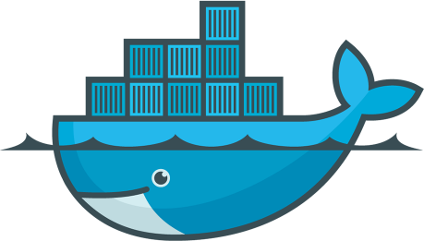
DevOps & Cloud Infrastructure SEIS 665 Week 11
Jason Baker
Adjunct Instructor
Graduate Programs in Software
University of St. Thomas
St. Paul, MN

Slide 2
Agenda
Containers
Dockers

Slide 3




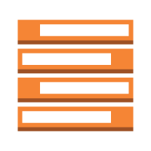


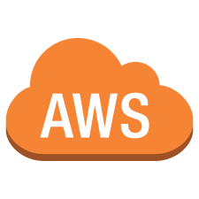
Fragile IT
Many different application
stacks
Analytics
Hadoop + pig + spark
Queue
Redis + redis-sentinel
Web API
Python + flask + celery + postgres
Static website
Nginx + bootstrap + jekyll
Many different hardware
environments
Production
servers
QA server
Developer
laptop
Development
Virtual machine
Public cloud

Slide 4
IT Service Matrix
Static website | ? | ? | ? | ? | ?
Queue | ? | ? | ? | ? | ?
Analytics | ? | ? | ? | ? | ?
Web API | ? | ? | ? | ? | ?
 | Development VM | QA Server | Public Cloud | Production servers | Developer laptop

Slide 5
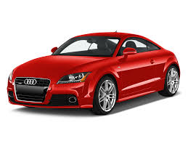
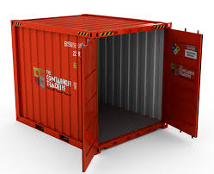
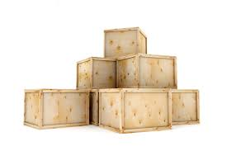
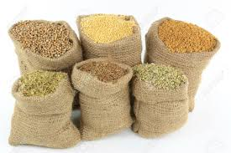
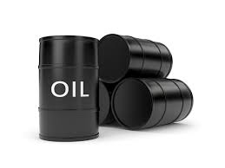
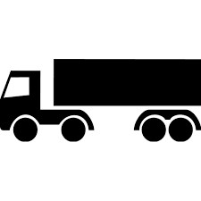
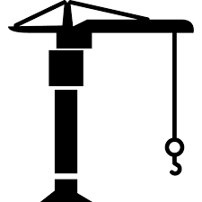
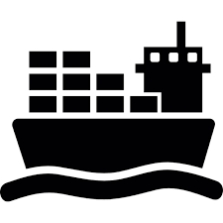
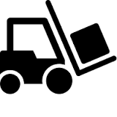

Transporting Cargo Pre-1960
Many different products
Many different transport
methods

Slide 6
Cargo Transport Matrix
 | ? | ? | ? | ? | ?
 | ? | ? | ? | ? | ?
 | ? | ? | ? | ? | ?
 | ? | ? | ? | ? | ?
 | ? | ? | ? | ? | ?

Slide 7

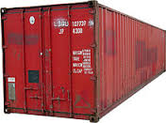
Intermodal Transport Solution
Intermodal shipping container
Shipping container sizes standardized
Can be loaded with almost any cargo
Supports wide variety of transport methods
Can ship cars next to beans
Don’t need to worry about transitioning from ship to truck

Slide 8
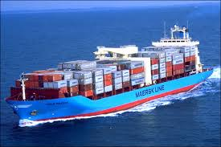
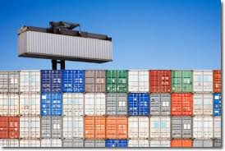
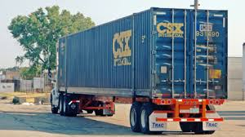
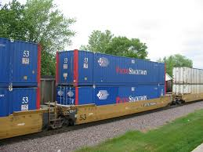
Intermodal Shipping Containers

Slide 9
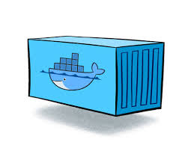
IT Transport Solution: Containers
Static website
Queue
Analytics
Web API
A container is the IT equivalent of a shipping container.
Encapsulates application stack in a lightweight and portable environment
Can be manually composed using simple operations
Runs on almost any hardware platform using a modern OS kernel
Development
Virtual machine
QA server
Production
servers
Developer
laptop
Public cloud

Slide 10
Developer Benefits
Build the application stack once and run it anywhere.
Eliminate concerns about compatibility on different hardware platforms
The application will in dev, testing, and at the customer site.
No worries about missing application dependencies like required packages
Each application runs in its own container to eliminate conflicts like different shared libraries
Easy to automate application testing and deployments using scripting
Much less performance penalty than virtual machines

Slide 11
IT Operations benefits
Configure the application once, run it anywhere.
Application lifecycle (develop/test/deploy) becomes much more repeatable
Eliminate inconsistencies between development, testing, and production environments
Simplifies continuous integration/deployment practices
Addresses performance and financial costs associated with virtual machines

Slide 12
Separation of Concerns
Developer
Focused on stuff inside the container
App code
Required libraries
Package management
Services
Data
Operations
Focused on stuff outside the container
Hardware/OS
Networking
Log management
Service monitoring
Developers can write awesome code and hand it off to operations in containers.
Operations doesn’t have to worry about the code, just the containers.

Slide 13
High Level Overview
A container feels like a lightweight VM
You can log into it and get a shell.
It has its own process space.
You can run commands within the container as root.
You can install packages in the container.
The container can run services.
You can modify network settings in the container.

Slide 14
Low Level Overview
But… it’s not quite like a virtual machine.
It uses the host kernel.
It can’t run a different OS than the host.
It can’t load its own kernel modules.
It can’t emulate devices like usb, storage, etc.
Network using port forwarding
It doesn’t need to run OS-type processes like syslogd and cron.
It’s like chroot on steroids.
chroot = process jail that prevents the process from accessing external files outside an “apparent root directory”

Slide 15
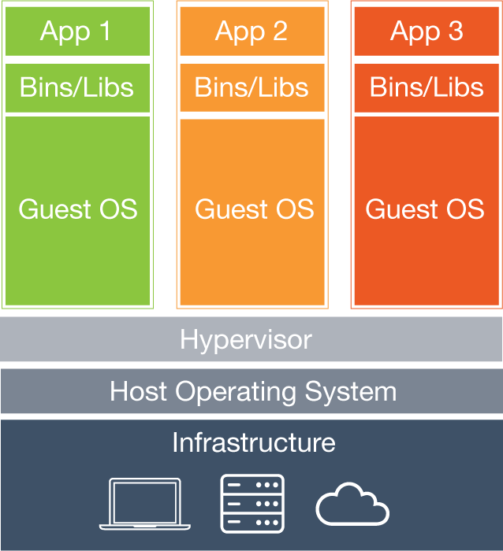
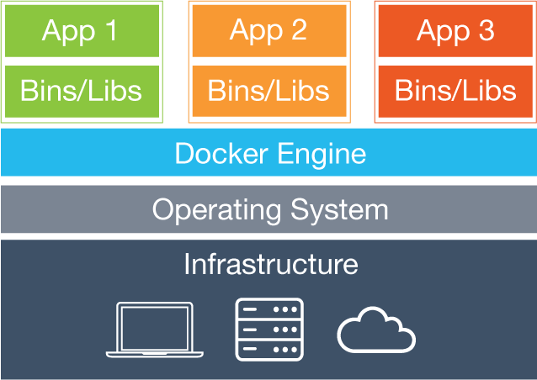
Virtual Machines vs. Containers
Key difference: Each virtual machine contains an OS whereas all containers share the same OS.

Slide 16
Container advantages over VMs
What can a container do that a VM cannot?
Really simple app deployment with a single command line
“Boot” in a fraction of a second compared to a minute for a VM
Enables very granular services (micro-service architecture)
Significantly reduce testing and development footprint
Imagine the resource savings when launching hundreds of containers vs VMs

Slide 17
Docker
An open-source Linux-based container implementation started by Solomon Hykes in France.
Initially released in 2013 and now in widespread use by cloud providers and enterprises.
It’s really an API and toolset that utilizes existing Linux facilities like cgroups and namespaces.
Docker wasn’t the first Linux-based container solution
Google developed cgroups 10 years earlier
OpenVZ

Slide 18
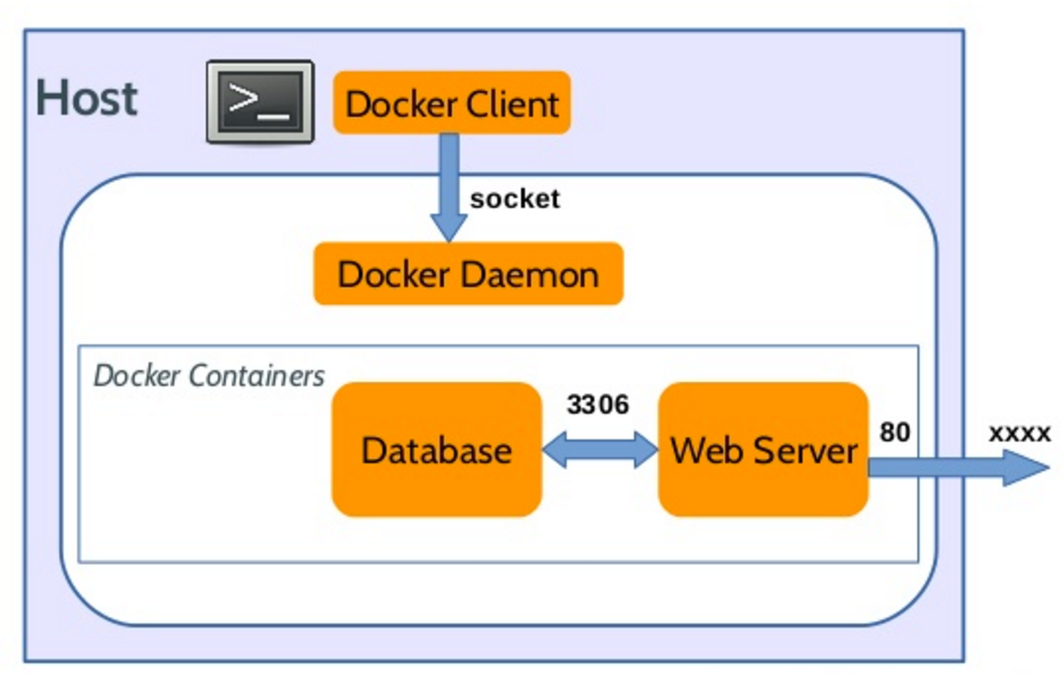
How Docker Works
Implemented as a client-server system
Docker daemon (engine) runs on a host
Daemon builds, runs, and manages containers.
Docker CLI is the client app
Takes user input and sends it to the daemon
CLI can run on the host or a different machine

Slide 19
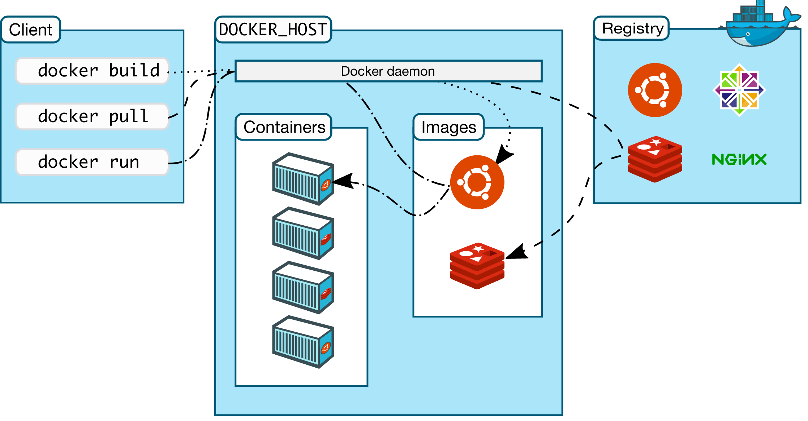
Start
Stop
Terminate

Slide 20
Docker Terms
Host: machine running containers
Image: a read only template containing files and meta-data used to create containers
Container: an isolated application platform containing everything needed to run an application
Registry: a repository of images
Volume: data storage outside the container
Dockerfile: a script for creating images

Slide 21
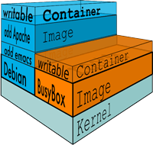
Docker Image

Slide 22
Other Container Technologies
Google Container Engine
Microsoft Containers
FreeBSD jails/ Solaris zones
Some vendors offer “containers” that are really slimmed down VMs (VMWare Integrated Containers).
Kubernetes: build and manage server clusters to quickly deploy containers
Rancher OS

Slide 23
Homework
Assignment 10
Read Web Operations Chapter 4 & 10
Read Practice of Cloud Systems Administration Chapter 8

