Slide 1

DevOps & Cloud Infrastructure SEIS 665 Week 6
Jason Baker
Adjunct Instructor
Graduate Programs in Software
University of St. Thomas
St. Paul, MN

Slide 2
Agenda
Web Operations readings
AWS
Cloud Watch
EC2 user data
EC2 Auto-scaling
ElastiCache
SNS
SQS
SES
Route 53
Elastic Beanstalk
AWS Security

Slide 3

Readings
Web Operations Chapter 1: The Career
Web Operations/ Site Reliability Engineer (SRE)
Modern-day system architect/admin/engineer
Requires multi-disciplinary technology background
Broad knowledge vs. deep
Knowledge vs. experience
Knowledge = studying of experiences of others (like this class!)
Experience = the process of making and surviving bad judgments

Slide 4
Readings
Web Operations Chapter 2: Lessons Learned
Provides an example of Piknik’s journey with AWS
Note that this story is 5+ years old
AWS reliability is better
Very high-end storage I/O options are now available (I2) as well as EFS (replacing NAS)
Lessons:
Danger of “infinite” storage is that it’s easy to waste it
I/O (network and/or disk) are typically the biggest performance constraints

Slide 5

CloudWatch
CloudWatch is a monitoring service for AWS resources and applications
Track performance metrics
Collect and monitor log files
Set alarms based on predefined thresholds
Supports EC2, RDS, DynamoDB, and other services
Basic monitoring is free, detailed costs extra
Increased interval from 5 min to 1 min
Monitor custom app metrics using an API

Slide 6
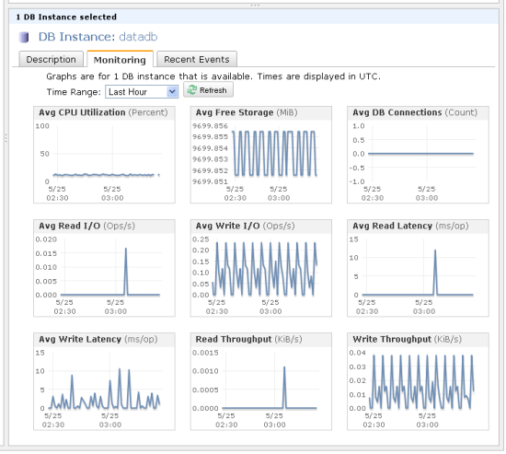
CloudWatch Instrumentation

Slide 7

CloudWatch Hands-on
View Metrics
EC2 instance CPU utilization
RDS database read IOPS
Create Alarm
S3ObjectCount: alarm when number of S3 objects in a bucket is over 1000

Slide 8
EC2 User Data
User Data is a set of shell script commands automatically executed by the instance during the initial launch
Commands are executed as root, so do not need sudo
Commands supplied via text entry or stored in a file
Benefit: automate installation and configuration of instance

Slide 9
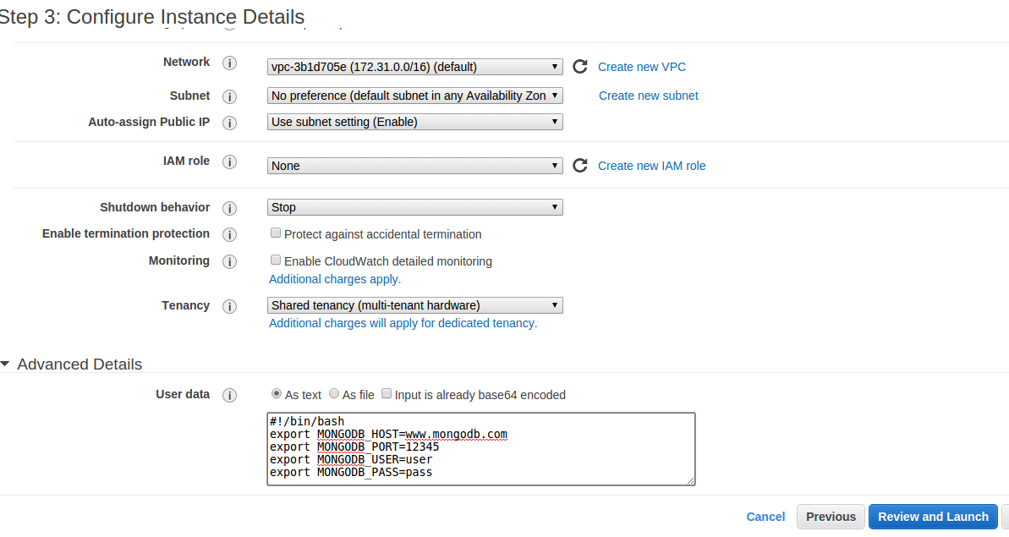
EC2 User Data

Slide 10
EC2 Auto Scaling
Auto scaling allows you to scale EC2 capacity up or down based on defined conditions
Ensure a certain number of instances are always running
Increase or decrease number of instances to support current demand and save costs
Only billed for instances created by Auto Scaling, not the service itself

Slide 11
EC2 Auto Scaling
Two components of auto scaling configuration:
Launch Configuration: specifies the type of EC2 instance created during the auto scaling process
Very similar to launching an EC2 instance, in this case just the configuration is created
Auto Scaling Group: defines a set of EC2 instances and the the conditions which determine the number of instances in the set

Slide 12
EC2 Auto Scaling
Auto Scaling Group configurations:
Maintain minimum number of instances: automatically launches new instances if a current instance becomes unhealthy
Manual scaling: user manually changes auto scaling group configuration and AWS adjust instance count to match new configuration
Dynamic scaling: instances launched or removed based on CloudWatch metrics and alarms

Slide 13
Auto Scaling Hands On
Create a launch group
Create an auto scaling group
Group size = 2
Keep group at its initial size
Watch AWS automatically launch EC2 instances
Manually fail one of the instances and watch automatic recovery

Slide 14
ElastiCache
ElastiCache is a distributed in-memory caching system
Huge performance improvement when reading from memory vs. disk
Main memory reference = 100 ns
Read 4k randomly from SSD = 150,000 ns
Benefits:
Cache frequent database queries
List of US states
Product listing
Store frequently-accessed data
Web sessions

Slide 15
ElastiCache
Supports two types of cache systems:
Memcached
Redis
Memcached
Very reliable key/value store
Simple to operate and use
Redis has more features today
Storing data in a variety of formats beyond key/value: list, array, sets, and sorted sets
More complex to operate
AWS supports master/slave replication and cross AZ redundancy

Slide 16
Memcached Example
telnet mycachecluster.eaogs8.0001.usw2.cache.amazonaws.com 11211
Trying 128.0.0.1...
Connected to mycachecluster.eaogs8.0001.usw2.cache.amazonaws.com.
Escape character is '^]'.
>
set a 0 0 5 // Set key "a" with no expiration and 5 byte value
hello // Set value as "hello"
STORED
get a // Get value for key "a"
VALUE a 0 5
hello
END
get b // Get value for key "b" results in miss
END
>

Slide 17

Simple Notification Service (SNS)
SNS makes it easy to publish messages from an application and deliver them to subscribers or other applications
Send messages via:
Email
SMS (text message)
Mobile push (Apple, Google, Fire OS, Windows)
SQS queues
HTTP endpoints

Slide 18
SNS
A topic is created as an access point to allow multiple recipients to receive a message
A single topic can support multiple endpoint types
Messages published to SNS are stored in multiple AZs for redundancy
Recipients must subscribe to a topic in order to receive published messages
Messages are pushed to topic recipients
Use-cases: event notifications (triggers, alerts, auto scaling notifications, etc.)

Slide 19
SNS Hands-on
Create a new topic
Add a recipient to the topic
Publish a message

Slide 20

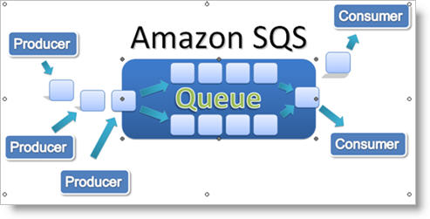
Simple Queue Service (SQS)
SQS is a distributed queue system that allows messages generated by one system component to be consumed by another
First web service launched by Amazon in 2005
Asynchronous application integration: message producers are decoupled from consumers

Slide 21
SQS
SQS use cases:
Create thumbnails from user uploaded images or apply watermarks
Video transcoding
Support payment process workflow for orders
Scale bursty applications that are trying to balance data consumption with backend data processing
Messages are added to a queue by an application, and then pulled from the queue by another application.
Consumer app must process message within a certain amount of time called the visibility timeout
Consumer app must delete the message from the queue when complete

Slide 22
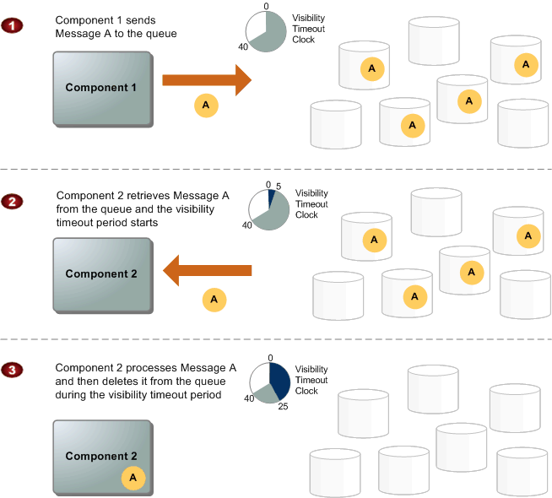

Slide 23
SQS
SQS guarantees that a message will be received at least once (but possibly more than once!)
Action taken on message should be idempotent (repeat action multiple times with same result)
Because messages are pulled, requests must be made every few seconds to see if anything in the queue
1 request every 5 sec = 12*60*24*7*4.3= 520,128/mo
4 backend workers > 2 million requests/mo
Wasteful if queue is empty at times
Long polling: keep message pull call open for up to 20 seconds, streaming in new messages as they arrive

Slide 24
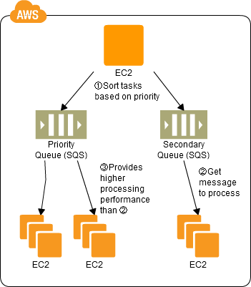
SQS Priority Queuing
SQS doesn’t support the concept of prioritization, but you can use multiple queues to accomplish the same thing.

Slide 25
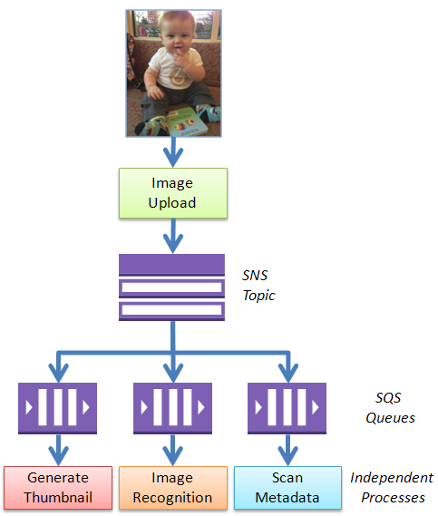
SQS Fan-out

Slide 26

Simple Email Service (SES)
SES is a scalable email service to support sending and receiving email from AWS
Building and maintaining a scalable email platform is challenging and expensive (personal experience)
Building a secure platform is tricky
Spam and virus filtering expensive
AWS customers must get approval to run mail servers (smtp) on EC2 instances
Service providers have to constantly combat abuse by spammers leveraging platform
Public IP addresses eventually get blacklisted by spam monitors eventually leading to blacklisting of entire networks

Slide 27
Simple Email Service (SES)
Messages sent via standard SMTP, received messages are stored in S3
SES provides greater message delivery assurance by supporting authentication mechanisms:
Sender Policy Framework (SPF)
DomainKeys Identified Mail (DKIM)
Both use DNS records to verify that SES is allowed to send email on behalf of the domain owner
Billing is based on number of messages sent and received per month (first 62k sent free)

Slide 28

Route 53
Scalable domain name hosting and registration service
Route 53 name based on famous Route 66 highway across America, 53 is DNS port number
Domain Name Services (DNS) are a critical part of Internet infrastructure
DNS translates domain names (domain.com) into IP addresses
Availability of DNS services directly impacts service availability
Service isn’t really “up” if nobody can find it

Slide 29
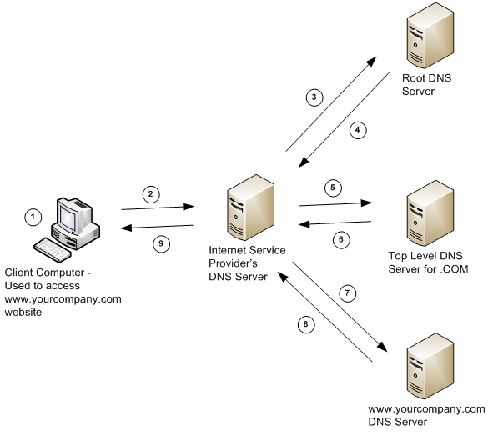
Route 53
How DNS Works

Slide 30
Route 53
AWS can serve as a domain registrar and name server
A name server provides all authoritative records for a domain name
Record types:
Start of authority (SOA): administrator name, version, and TTL information
Name Server (NS): used by top level servers to locate authoritative name server
Address (A): maps a hostname to an IP address
CNAME: maps a hostname to a fully qualified domain name
Alias: like a CNAME, but can use dynamic AWS targets
Example: Elastic load balancers use a dynamic endpoint, not an IP address

Slide 31
Route 53 Routing Policies
Routing policies are used to distribute traffic over multiple regions using dynamic DNS responses
Simple: default policy which maps a DNS response to a single region
Weighted: distribute traffic over multiple regions based on the weighting assigned to each region
Example: 85% us-east, 15% us-west)
May be useful for A/B testing

Slide 32
Route 53 Routing Policies
Latency: distribute traffic by directing user to the lowest latency region
Example: US customers directed to us-east and European customers direct to eu-west
Failover: monitor health of services and fail over to a secondary region if health check fails
Example: us-east is primary, us-west is secondary
Primarily used for disaster recovery purposes, protect against failure of an entire region
Geolocation: distribute traffic to a specific region based on physical location of user
Example: All queries from European users go to eu-west
Primarily used to meet regulatory and data privacy requirements

Slide 33
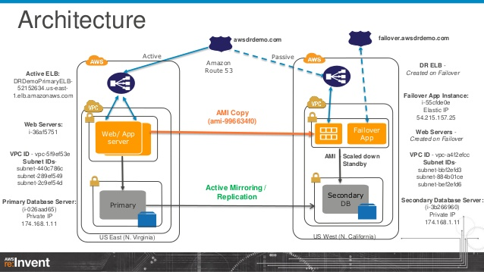
DR Architecture Using Route 53

Slide 34

Elastic Beanstalk
PaaS which automates the configuration and deployment of application stacks
Automatically provisions and scales EC2, load balancing, networking, storage, and RDS
Installs and manages application servers and frameworks
AWS user just focuses on loading custom application
Benefit: designed primarily for application developers that don’t want to deal with infrastructure

Slide 35
Elastic Beanstalk
Application support:
Java
PHP
Python
Ruby
IIS/.NET
Node.js
Docker
EB controls capacity of resources, but you can still access infrastructure

Slide 36
Elastic Beanstalk Deployment Policies
Deployment policies control how EB updates deployed application
All at once: deploy application to all instances simultaneously (short service disruption)
Rolling: deploy new app in batches, reducing service capacity but causing no disruption
Rolling with additional batch: launch new resources before batch updates so that service capacity isn’t reduced
Immutable: deploy new application to a fresh group of instances (blue-green deployment)

Slide 37
Elastic Beanstalk Hands On
Deploy auto-scaling PHP platform using sample application

Slide 38
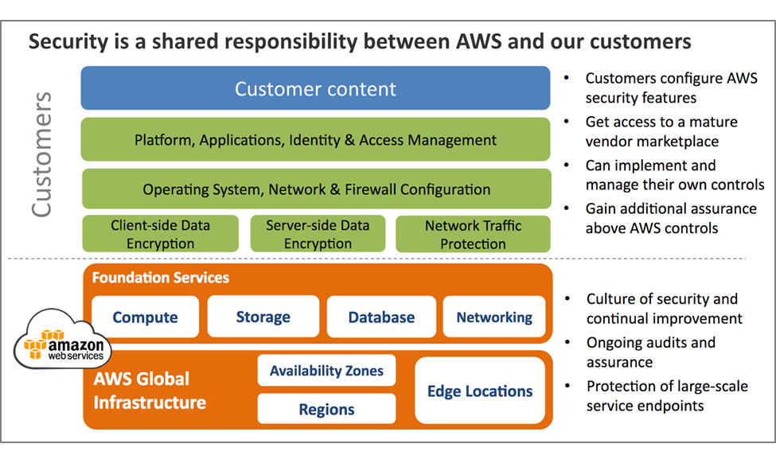
AWS Shared Security Model

Slide 39
AWS Network Security
AWS network and Amazon network use similar infrastructure, but are logically separated from one another
AWS prevents IP spoofing: instance sending data with an IP or MAC address that’s not it’s own
Network port scans must be approved by AWS in advance

Slide 40

AWS Trusted Advisor
Originally an internal tool used by AWS consultants to audit customer service configuration
Audits four aspects of deployed services:
Cost optimization
Performance
Security
Fault tolerance
Basic review available for free, advanced reports require a support plan

Slide 41
Resource Groups
Resource Groups are collections of AWS resources that share tags
Tags are user-definable metadata for resources
One or more tags may be used in a resource group
Benefit: easily view associated resources across the entire AWS platform
Tag and group resources by organization or project
Group resources by owner

Slide 42
Homework
Study for Midterm Exam
Due in Week 8 class:
Assignment 6
Read Practice of Cloud Systems Administration Chapters 2 & 4

